Slide 1
Finding the Hypotenuse
Finding a Shorter Side
Do Now
Do Now
$$y$$
$$4.1cm$$
$$7.3cm$$
$$d$$
$$5.3cm$$
$$2.04cm$$
Do Next
Do Next
Erica walks 10 miles west, then 5.2 miles North. What is the shortest distance from where she started to where she ended up.
Neil walks 11.2 miles Southeast, then 6 miles West. How many miles South from where Neil started is he now.
Notes:
Discuss that all previous learning has been separated into these two sections.
This lesson we will be working on recognising what we are looking for and applying to solve problems.

Slide 2
What are we learning in this lesson?
How to find missing lengths on any right-angled triangle without being told whether you are finding the hypotenuse or shorter side. Learning Outcomes: Recall how to find the missing hypotenuse and how to find a missing shorter side. Recognise which a question is looking for you to find. Apply this recognition to being able to find missing lengths and solve problems with a mix of hypotenuse and shorter sides.
Why are we learning about this?
We are now very confident with finding missing lengths on a right-angled triangle when we are told in the title that we are finding the hypotenuse or shorter side. However, in real life or in exams, we won’t have a title saying which one we are looking for.

Slide 3
Are we looking for the Hypotenuse, or a Shorter Side
Write Hypotenuse on one side of your mini whiteboard and shorter side on the other.

Slide 4
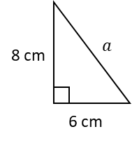
Are we looking for the Hypotenuse, or a Shorter Side

Slide 5
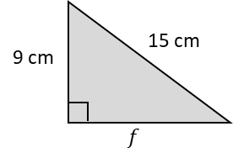
Are we looking for the Hypotenuse, or a Shorter Side

Slide 6
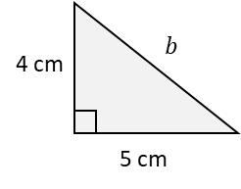
Are we looking for the Hypotenuse, or a Shorter Side

Slide 7
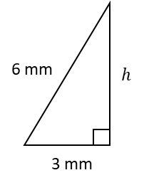
Are we looking for the Hypotenuse, or a Shorter Side

Slide 8
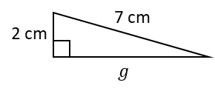
Are we looking for the Hypotenuse, or a Shorter Side

Slide 9
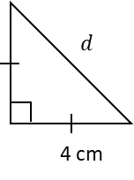
Are we looking for the Hypotenuse, or a Shorter Side

Slide 10
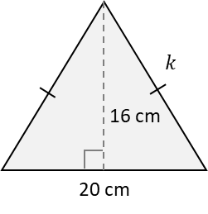
Are we looking for the Hypotenuse, or a Shorter Side

Slide 11
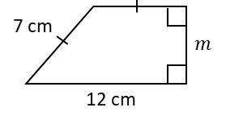
Are we looking for the Hypotenuse, or a Shorter Side

Slide 12
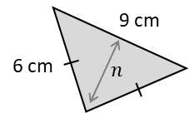
Are we looking for the Hypotenuse, or a Shorter Side

Slide 13
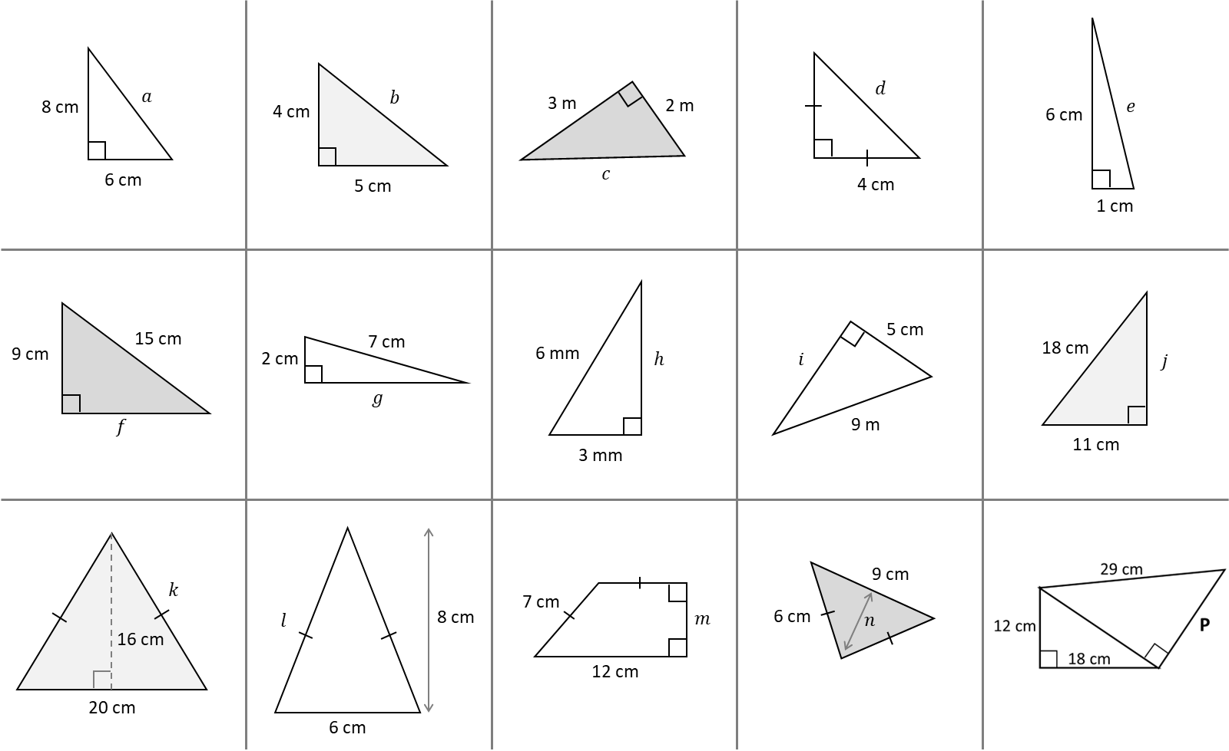
Your Do – Find the missing lengths correct to 1 decimal place.

Slide 14
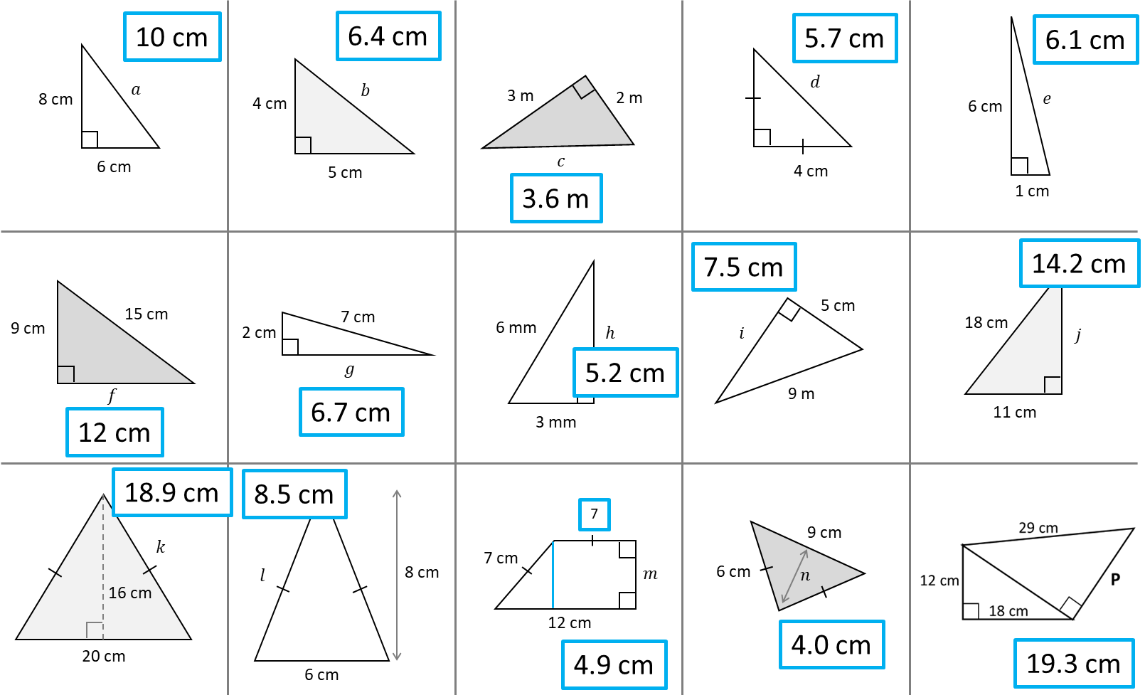

Slide 15
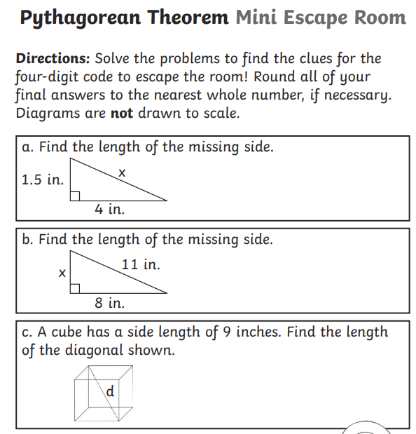
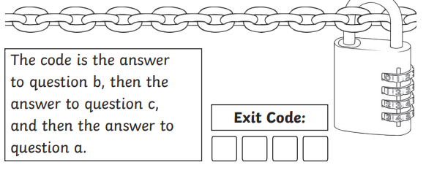
Notes:
BW Pythagorean Theorem Mini Escape Room.pdf

