Slide 1
Dual coding symbols:
Practise
Explain
Organise
Big Question
Reflect
Present
Compare
Evaluate
Activate
Discuss
Predict
Connect
Summarise
Recall
Vocabulary

Slide 2
Editable reading ruler
Every child in an Archway school will become a fluent reader
 | RETRIEVE the words or phrases you need from the text | DECODE the words or phrase to address a breakdown | CONNECT with words or phrases you know from the text or your memory | VISUALISE the images in as much detail as possible | SUMMARISE the main ideas of the text in a few words | INFER meanings that might be within the text | PREDICT what might happen next using details from the text | EXAMINE how the writer uses words to construct meaning
 | ASK THOUGHTFUL QUESTIONS TO HELP YOU UNDERSTAND THE TEXT

Slide 3
A
B

Slide 5
LESSON TITLE: Factors and Multiples

Slide 6
Key vocabulary:
Decode the word
Definition
.
Multiples
Examples
Non-examples

Slide 7
List as many multiples of 6 as you can in one minute
Notes:
Check using divisibility rule that the largest values are multiple of 2 and 3 so consequentlu multiples of 6

Slide 8
Key vocabulary:
Decode the word
Definition
.
Factor
Examples
Non-examples

Slide 9
A product is the result of two or more numbers multiplied together.
?
?
A multiple is the product of a number and an integer.
?
A numerical factor is an integer.
?

Slide 10
A numerical factor is an integer which exactly divides another integer.
Factors and multiples are inverse concepts.
Example
Example
20 ÷ 2 = 10
10 ✕ 2 = 20
No remainder, so 2 and 10 are factors of 20
20 is a multiple of 2 and 10

Slide 11
List all the factors of 24

Slide 12
Always true, sometimes true or never true?
1 is a factor of every integer

Slide 13
Always true, sometimes true or never true?
The product of two integers
is an integer

Slide 14
Always true, sometimes true or never true?
A multiple of a number is bigger than its largest factor

Slide 15
Always true, sometimes true or never true?
Given A, B and C are integers where
A x B = C
C is a multiple of A & B

Slide 16
Always true, sometimes true or never true?
Given A, B and C are integers where
A x B = C
A & B are factors of C

Slide 17
What number am I?
I am less than 100
I am greater than 50
I am a square number
I am a multiple of 9
Notes:
81

Slide 18
What number am I?
I am a factor of 24
I am a multiple of 2
I am a number less than 10
I am a square number
Notes:
4

Slide 19
What number am I?
I am a cube number
I am a square number
I am a factor of every number
Notes:
1

Slide 20
What number am I?
I am a cube number
The sum of my digits is 9
I am a multiple of 9
I am less than 100
Notes:
1

Slide 21
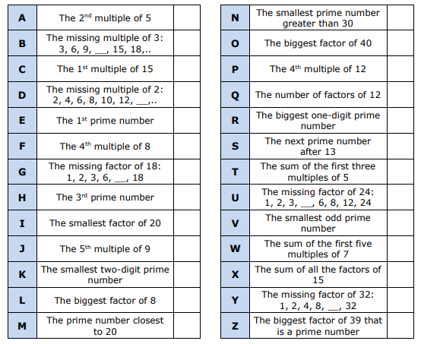
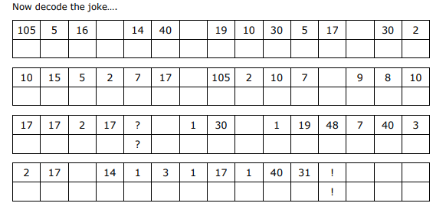
Decode the Joke
Notes:
7ac124_bcedb9a3f3ea4e62a02ebea9c019e2dd.pdf

Slide 22
What are the factors of $24x$?
Fill in the gaps in the table below.
$$1$$ | $×$ | $$24x$$ | $$=24x$$
$$2$$ | $$×$$ | $$12x$$ | $$=24x$$
$$3$$ | $×$ | $$8x$$ | $$=24x$$
$$4$$ | $$×$$ | $$6x$$ | $$=24x$$
$$6$$ | $×$ | $$4x$$ | $$=24x$$
$$8$$ | $$×$$ | $$3x$$ | $$=24x$$
$$12$$ | $×$ | $$2x$$ | $$=24x$$
$$24$$ | $$×$$ | $$x$$ | $$=24x$$
?
?
?
?
?
?
?
?
Therefore, the factors of $24x$ are:
$1, 2, 3, 4, 6, 8, 12, 24, x, 2x, 3x, 4x, 6x, 8x, 12x$ and $24x$
Notes:
Introducing students to the idea of algebraic factors. Use the same listing strategy as in the prerequisite knowledge check.

Slide 23
What are the factors of $6xy$?
Fill in the gaps in the table below.
$$1$$ | $×$ | $$6xy$$ | $$=6xy$$
$$2$$ | $$×$$ | $$3xy$$ | $$=6xy$$
$$3$$ | $×$ | $$2xy$$ | $$=6xy$$
$$6$$ | $$×$$ | $$xy$$ | $$=6xy$$
$$x$$ | $×$ | $$6y$$ | $$=6xy$$
$$2x$$ | $$×$$ | $$3y$$ | $$=6xy$$
$$3x$$ | $×$ | $$2y$$ | $$=6xy$$
$$6x$$ | $$×$$ | $$y$$ | $$=6xy$$
?
?
?
?
?
?
?
?
Therefore, the factors of $6xy$ are:
$$1, 2, 3, 6, x, 2x, 3x, 6x, y, 2y, 3y, 6y, xy, 2xy, 3xy, 6xy$$
Notes:
Introducing students to the idea of algebraic factors. Use the same listing strategy as in the prerequisite knowledge check.

Slide 24
a
List the factors of $18x$
b
List the factors of $6xy$
The factors of $6xy$ are:
$$1, 2, 3, 6,$$
$$x, 2x, 3x, 6x,$$
$$y, 2y, 3y, 6y,$$
$xy, 2xy, 3xy$ and $6xy$
?
?
The factors of $18x$ are:
$1, 2, 3, 6, 9, 18, x, 2x, 3x, 6x, 9x$ and $18x$
c
List the factors of $25y^{2}$
?
The factors of $25y^{2}$ are:
$$1, 5, 25,$$
$$y, 5y, 25y$$
$y^{2}, 5y^{2}$ and $25y^{2}$
Notes:
Three questions to test their understanding of listing factors of an algebraic term. Could be done on MWB.

Slide 25
By finding the full factorisation of $30x^{2}$, prove that $6x^{2}$ is a factor of $30x^{2}$.

Slide 26
By finding the full factorisation of $15ab$, prove that $8a$ is not a factor of $15ab$.

Slide 27
Show that 4(𝑥 + 3) + 𝑥 − 2 is always a multiple of 5

Slide 28
Show that (𝑥 + 8)(𝑥 + 1) − 𝑥(𝑥 + 5) is always a multiple of 4

Slide 29
Show that $3(7 + 2x) − 9$is always a multiple of 6

Slide 30
Show that $4(x + 7) + 2(1 − x)$ is always a multiple of 2

Slide 31
Show that $(x + 7)(x − 2) − x^{2} − 1$is always a multiple of 5

Slide 32
Prove algebraically that the sum of any four consecutive integers is not a multiple of 4.

Slide 33
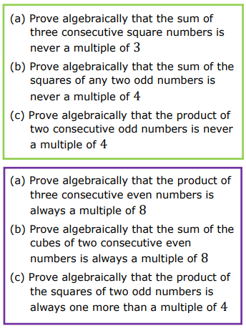

Slide 34
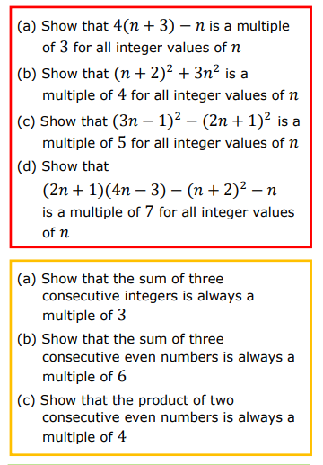
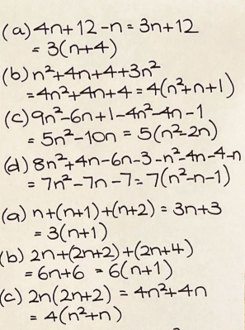

Slide 35
