Slide 1
LESSON TITLE: HCF & LCM from Prime Factorisation

Slide 2
LO: To use Venn diagrams to find the HCF and LCM
Key vocabulary:
Word | Definition
Prime | A number with exactly 2 factors
Factor | A number that goes into another number with no remainder
Decomposition | To break something down into smaller parts
Retrieve from memory without prompts or discussion. You must write something for each.
RETRIEVE
INSTRUCT
PRACTISE
SECURE

Slide 3
PRE REQUISITES:
8118 =
Is 33 a factor of 8118?
Is 8118 a multiple of 7?
Is 8118 a multiple of 18?
RETRIEVE
INSTRUCT
PRACTISE
SECURE

Slide 4
PRE REQUISITES:
18
48
Put the factors into the Venn Diagram below:
18
48
RETRIEVE
INSTRUCT
PRACTISE
SECURE

Slide 5
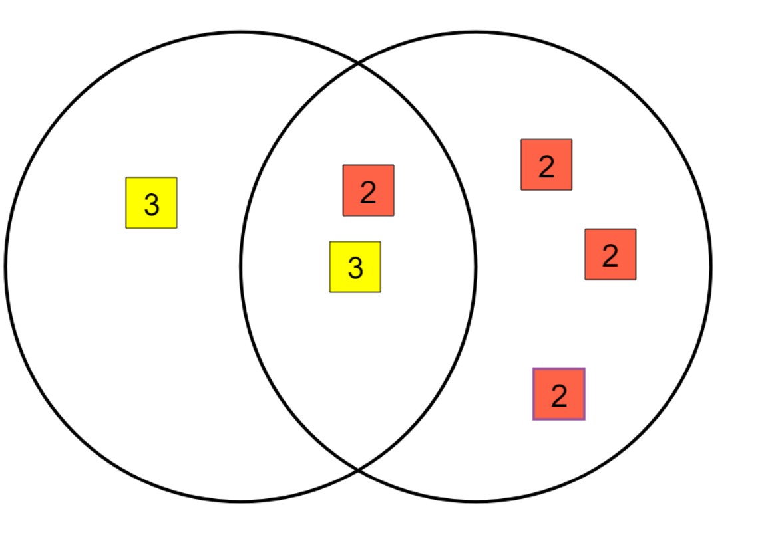
18
48
Because all of the factors that appear in both numbers have to go in the middle of your Venn diagram the HCF can be found by multiplying just the numbers in the middle together.
RETRIEVE
INSTRUCT
PRACTISE
SECURE

Slide 6
18
48
Because the Venn diagram gets rid of ‘duplicate’ prime factors by being able to put them in the middle if they appear in both numbers the Venn diagram also gives you the smallest number of prime factors needed to make both numbers – the LCM.
RETRIEVE
INSTRUCT
PRACTISE
SECURE

Slide 7
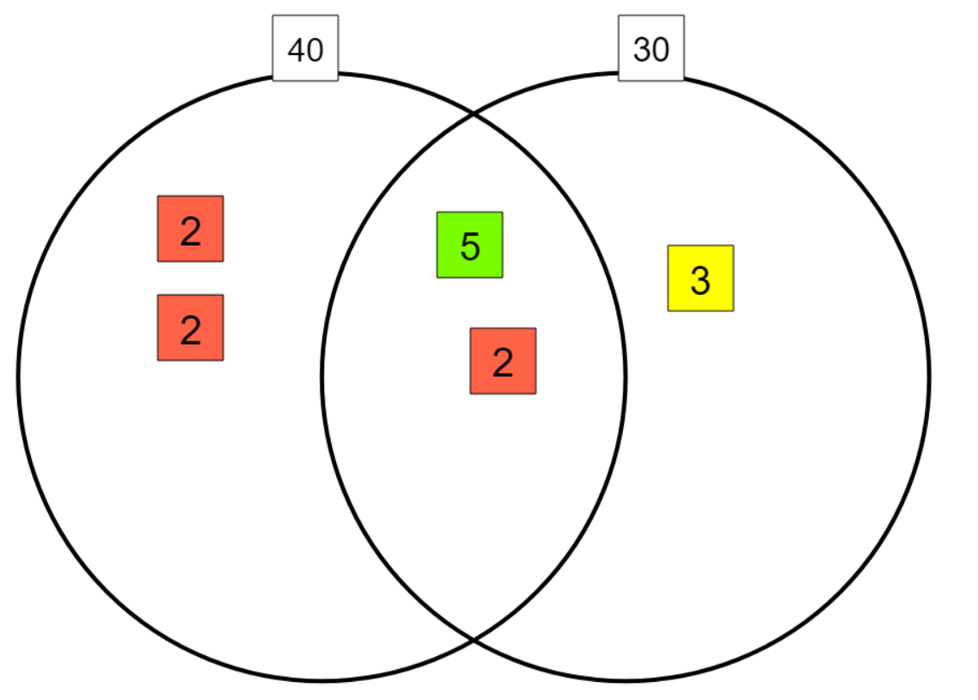
HCF = $5×2=10$
LCM = $2×2×5×2×3=120$
RETRIEVE
INSTRUCT
PRACTISE
SECURE

Slide 8
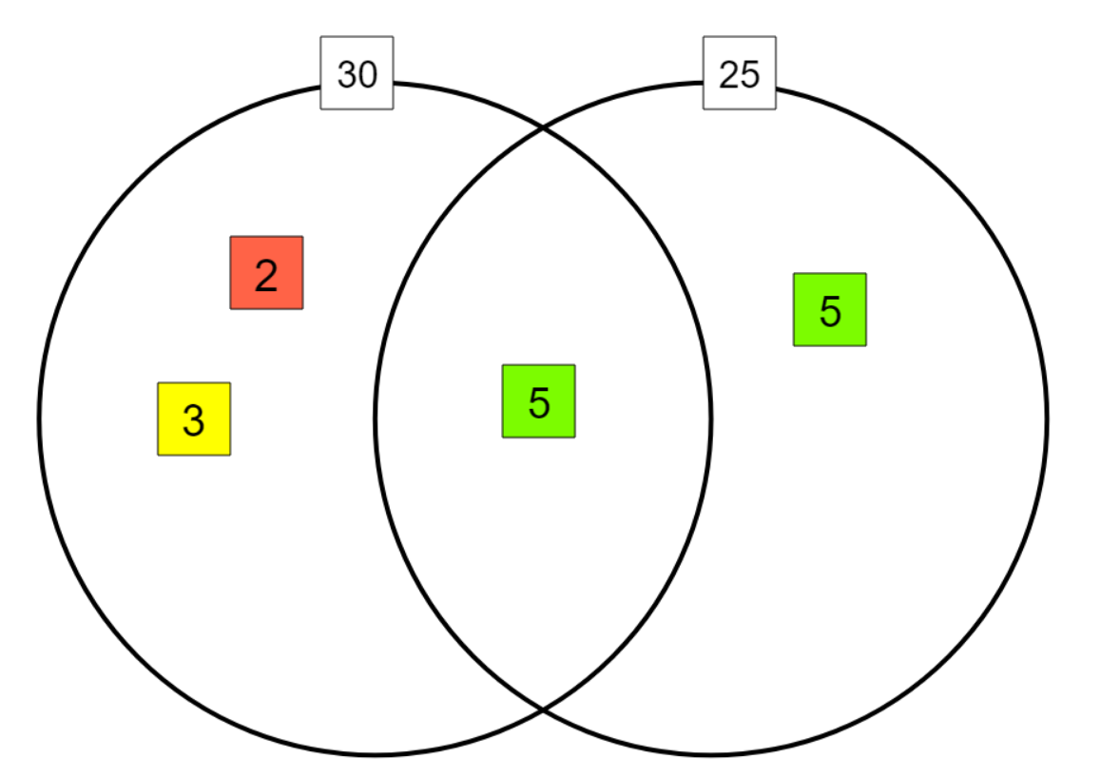
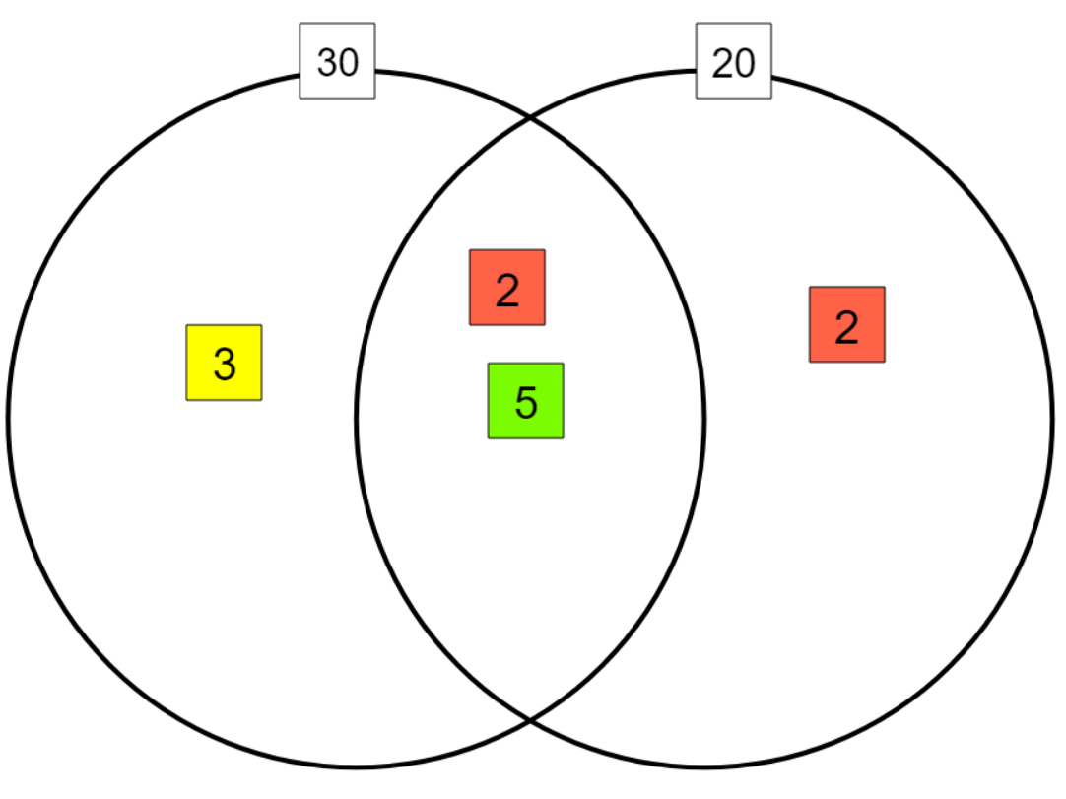
I DO:
WE DO:
Find the HCF of 30 and 25.
Find the HCF of 30 and 20.
Prime Factor Tiles (mathsbot.com)
RETRIEVE
INSTRUCT
PRACTISE
SECURE

Slide 9
I DO:
WE DO:
Find the LCM of 30 and 25.
Find the LCM of 30 and 20.
Prime Factor Tiles (mathsbot.com)
RETRIEVE
INSTRUCT
PRACTISE
SECURE

Slide 10
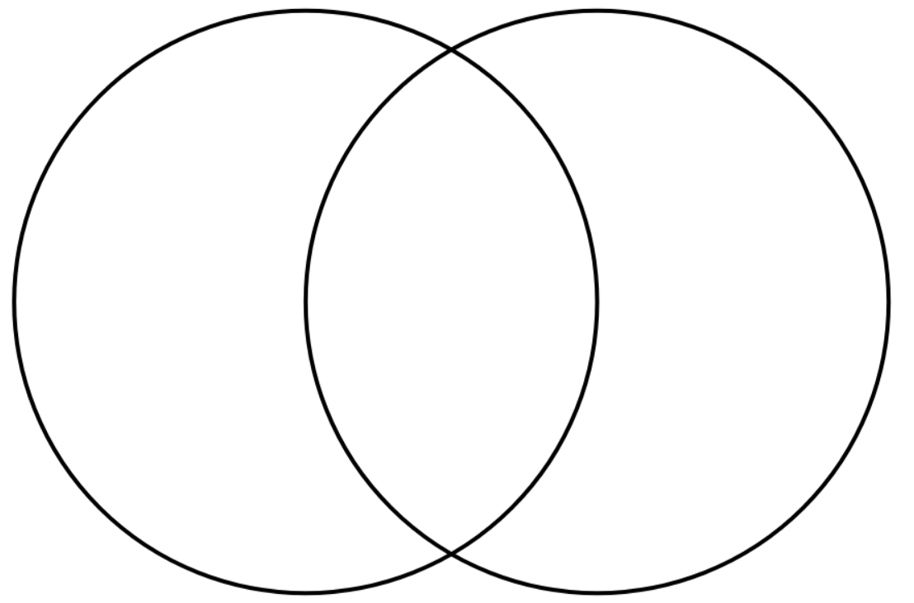
I DO:
WE DO:
Find the HCF of 45 and 27.
Find the HCF of 50 and 40.
Find the LCM of 45 and 27.
Find the LCM of 50 and 40.
Prime Factor Tiles (mathsbot.com)
RETRIEVE
INSTRUCT
PRACTISE
SECURE

Slide 11
I DO:
WE DO:
90 = $2×3×3×5$
40 = $2×2×2×5$
60 = $2×2×3×5$
60 = $2×2×3×5$
Find the HCF of 90and 60.
Find the HCF of 60 and 40.
Find the LCM of 90 and 60.
Find the LCM of 60 and 40.
Prime Factor Tiles (mathsbot.com)
RETRIEVE
INSTRUCT
PRACTISE
SECURE

Slide 12
Mini WBs:
Prime Factor Tiles (mathsbot.com)
RETRIEVE
INSTRUCT
PRACTISE
SECURE

Slide 13
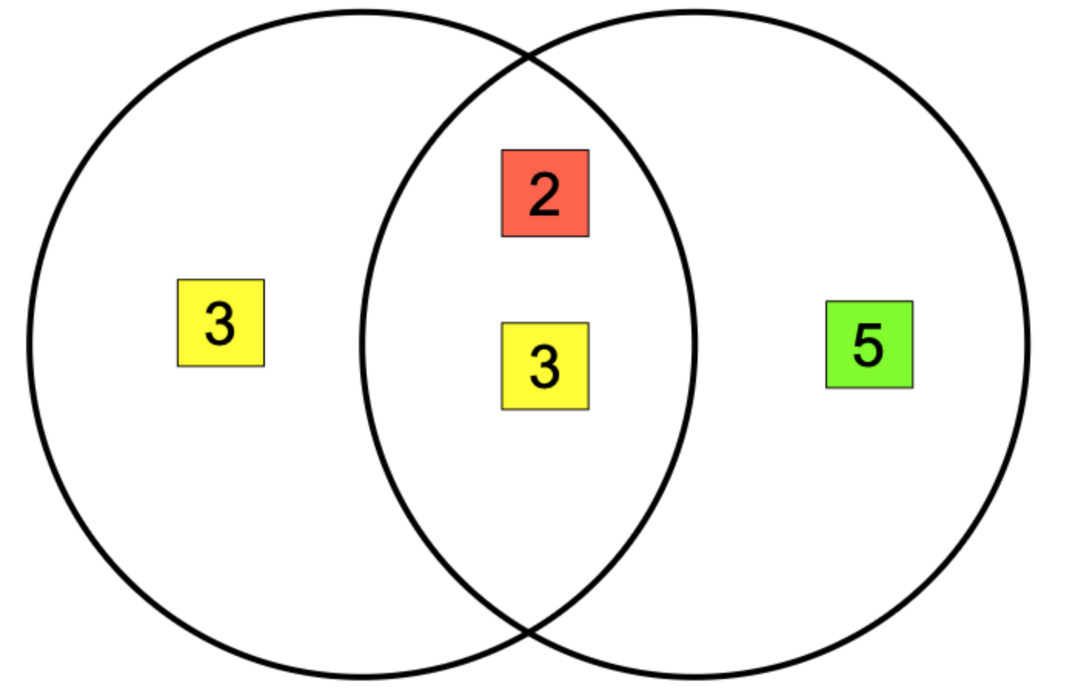
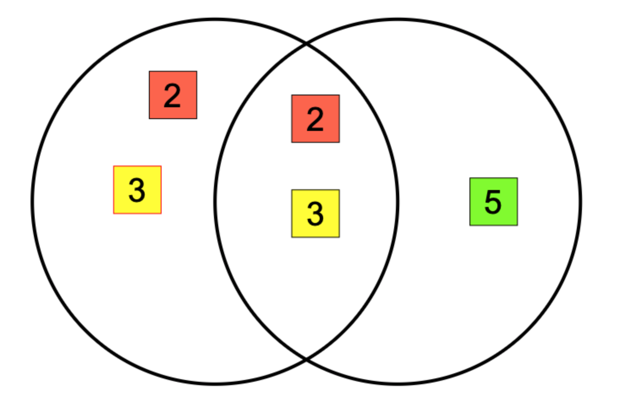
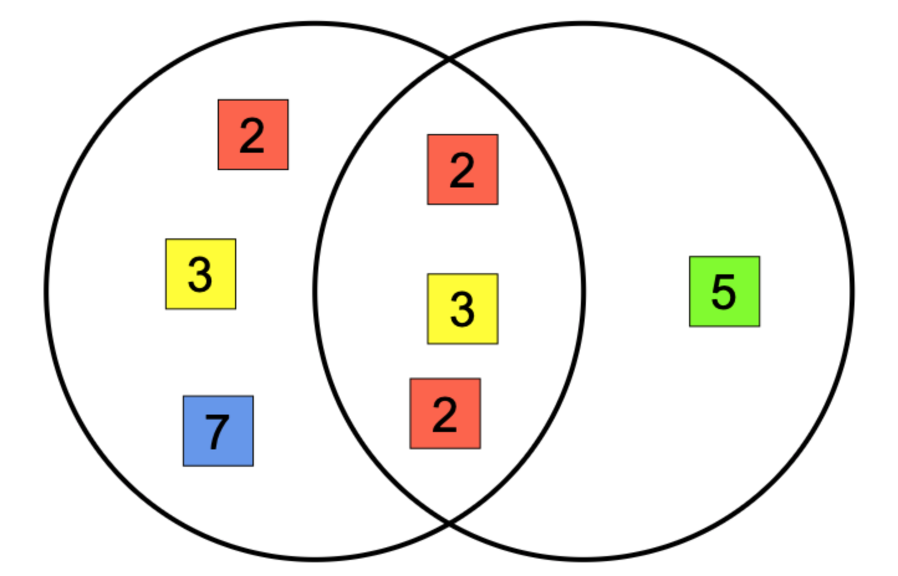
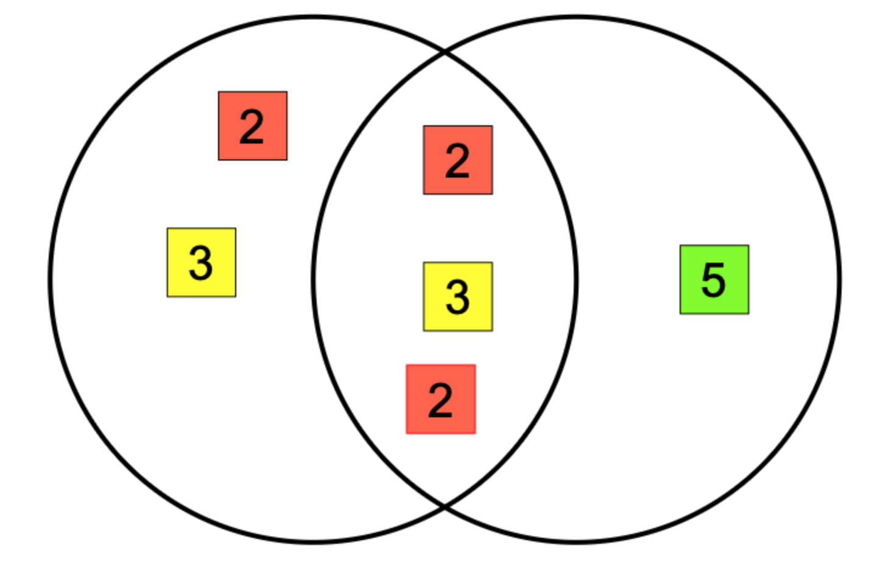
Independent practice:
For the following, find the HCF and LCM:
18
30
36
30
504
60
72
60
RETRIEVE
INSTRUCT
PRACTISE
SECURE

Slide 14
Depth:
Use a calculator to find the prime factor decomposition of the following and then find the HCF and LCM:
50 and 90
45 and 80
120 and 300
180 and 900
RETRIEVE
INSTRUCT
PRACTISE
SECURE

Slide 15
LO: To identify the LCM of numbers using prime factors
Key vocabulary:
Word | Definition
Prime | A number with exactly 2 factors
Factor | A number that goes into another number with no remainder
Decomposition | To break something down into smaller parts
Retrieve from memory without prompts or discussion. You must write something for each.
RETRIEVE
INSTRUCT
PRACTISE
SECURE

Slide 16
PRE REQUISITES:
Find the LCM of 10 and 4.
RETRIEVE
INSTRUCT
PRACTISE
SECURE

Slide 17
PRE REQUISITES:
8118 =
8118 is a multiple of 2 because it has 2 as a factor.
8118 is a multiple of 3 because it has _____________
_____ is a multiple of 11 because it has 11 as a factor
8118 is a multiple of ___ because it has 6 as a factor
RETRIEVE
INSTRUCT
PRACTISE
SECURE

Slide 18
The lowest common multiple of two numbers is the smallest multiple that has both of the two numbers as factors.
15
35
105 is the LCM of 15 and 35 because it is the smallest number (fewest amount of tiles needed) that has both 15 and 35 as a factor. If you remove any of the tiles above we wouldn’t have one of 15 or 35 as a factor anymore.
RETRIEVE
INSTRUCT
PRACTISE
SECURE

Slide 19
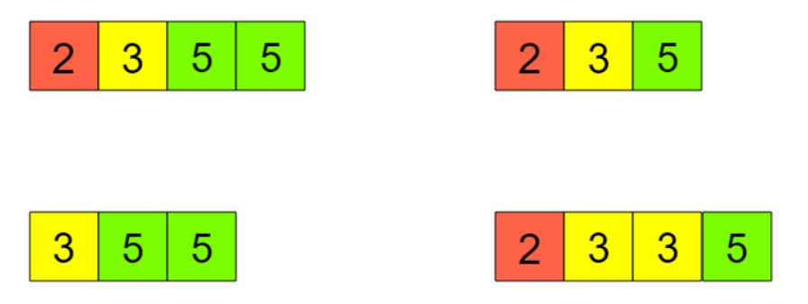
Here are two numbers, 15 and 10.
Which of the below sets of tiles is the fewest number of tiles needed that contain both 15 and 10 as a factor?
RETRIEVE
INSTRUCT
PRACTISE
SECURE

Slide 20
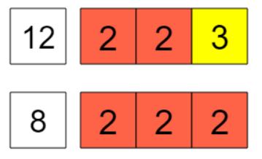
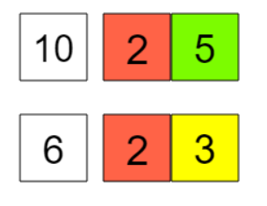
I DO:
WE DO:
Find the LCM:
Prime Factor Tiles (mathsbot.com)
RETRIEVE
INSTRUCT
PRACTISE
SECURE

Slide 21
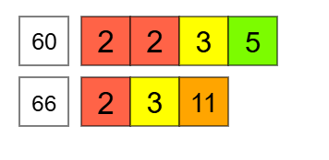
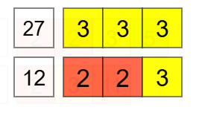
I DO:
WE DO:
Find the LCM:
Find the LCM:
Prime Factor Tiles (mathsbot.com)
RETRIEVE
INSTRUCT
PRACTISE
SECURE

Slide 22
Find the LCM of 18 & 42

Slide 23
Find the LCM of 16, 24 & 25

Slide 24
Mini WBs:
Prime Factor Tiles (mathsbot.com)
RETRIEVE
INSTRUCT
PRACTISE
SECURE

Slide 25
Independent practice:
Using the prime factors (tiles) above, find the LCM of the following.
a) 8 and 10 b) 8 and 12 c) 15 and 10 d) 9 and 15
e) 10 and 25 f) 18 and 12 g) 15 and 20 h) 12 and 25
i) 18 and 9 j) 20 and 25 k) 15 and 25 l) 20, 12 and 25
RETRIEVE
INSTRUCT
PRACTISE
SECURE

Slide 26
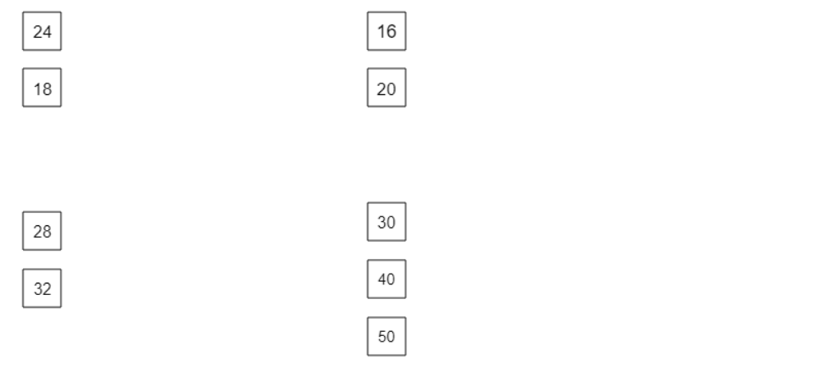
Depth:
By first using a calculator to find the prime factor decomposition of the following, find their lowest common multiples.
RETRIEVE
INSTRUCT
PRACTISE
SECURE

