Slide 1
LESSON TITLE: Using Prime Factorisation to find the HCF

Slide 2
LO: To identify the HCF of numbers using prime factors
Key vocabulary:
Word | Definition
Prime | A number with exactly 2 factors
Factor | A number that goes into another number with no remainder
Decomposition | To break something down into smaller parts
Retrieve from memory without prompts or discussion. You must write something for each.
RETRIEVE
INSTRUCT
PRACTISE
SECURE

Slide 3
PRE REQUISITES:
8118 =
How many factors can you spot?
RETRIEVE
INSTRUCT
PRACTISE
SECURE

Slide 4
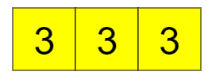
8118 =
27 =
Do both numbers have 2 as a factor?
Do both numbers have 3 as a factor?
Do both numbers have 11 as a factor?
Do both numbers have 41 as a factor?
Do both numbers have 6 as a factor?
Do both numbers have 9 as a factor?
Do both numbers have 33 as a factor?
Do both numbers have 27 as a factor?
RETRIEVE
INSTRUCT
PRACTISE
SECURE

Slide 5
If we can identify the largest number that fits inside of both numbers we have identified their highest common factor.
9 is the biggest factor that can be made within BOTH numbers so must be the HCF
RETRIEVE
INSTRUCT
PRACTISE
SECURE

Slide 6
The prime factors above represent 18 and 48.
What is the largest factor that can be found within BOTH numbers?
RETRIEVE
INSTRUCT
PRACTISE
SECURE

Slide 7
I DO:
WE DO:
Prime Factor Tiles (mathsbot.com)
RETRIEVE
INSTRUCT
PRACTISE
SECURE

Slide 8
I DO:
WE DO:
Prime Factor Tiles (mathsbot.com)
RETRIEVE
INSTRUCT
PRACTISE
SECURE

Slide 9
Mini WBs:
Prime Factor Tiles (mathsbot.com)
RETRIEVE
INSTRUCT
PRACTISE
SECURE

Slide 10
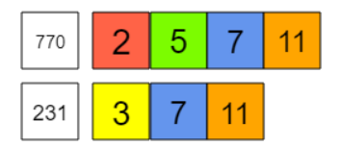
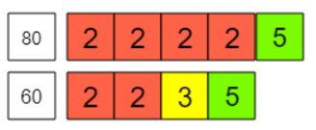
Independent practice:
Find the HCF of the following:
RETRIEVE
INSTRUCT
PRACTISE
SECURE

