Slide 1















Dual coding symbols:
Practise
Explain
Organise
Big Question
Reflect
Present
Compare
Evaluate
Activate
Discuss
Predict
Connect
Summarise
Recall
Vocabulary

Slide 2










Editable reading ruler
Every child in an Archway school will become a fluent reader
 | RETRIEVE the words or phrases you need from the text | DECODE the words or phrase to address a breakdown | CONNECT with words or phrases you know from the text or your memory | VISUALISE the images in as much detail as possible | SUMMARISE the main ideas of the text in a few words | INFER meanings that might be within the text | PREDICT what might happen next using details from the text | EXAMINE how the writer uses words to construct meaning
 | ASK THOUGHTFUL QUESTIONS TO HELP YOU UNDERSTAND THE TEXT

Slide 3






A
B

Slide 4
LESSON TITLE: Lowest Common Multiple Problems

Slide 5


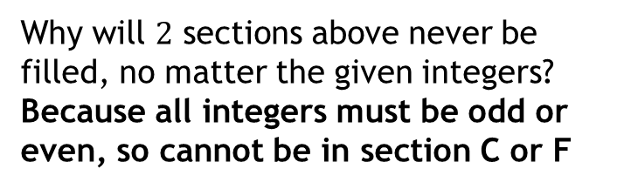




















1
a
From the list below which are square numbers?
$$1, 5, 10, 16, 24, 25$$
$$1, 16, 25$$
List the first $4$ cube numbers
$$1, 8, 27, 64$$
4
a
Place the numbers into the correct section:
$$1, 2, 4, 5, 6, 10, 11, 15, 16, 30, 45, 60$$
Odd
Factors of $30$
Even
?
b
?
$$A$$
$$B$$
$$C$$
$$D$$
$$E$$
2
Find the first $5$ multiples of:
$$10 10, 20, 30, 40 50$$
a
?
$$F$$
$$12 12, 24, 36, 48, 60$$
b
?
$A$: 11, 45
$B$: 1, 5, 15
$C$: -
?
?
?
$$25 25, 50, 75, 100, 125$$
c
?
$D$: 2, 6, 10, 30
$E$: 4, 16, 60
$F$: -
?
?
?
3
Find the factors of:
b
Why will $2$ sections above never be filled, no matter the given integers?
Because all integers must be odd or even, so cannot be in section C or F
$$10 1, 2, 5, 10$$
a
?
?
$$12 1, 2, 3, 4, 6, 12$$
b
?
c
$$25 1, 5, 25$$
?
Show all solutions
Notes:
Teaching Notes:
Recap of prerequisite knowledge needed: multiples and factors and types of numbers.
Click green box to reveal answers.

Slide 6
































Common Multiples
What are the first $3$ common multiples of $10$ and $15$?
List the first few multiples of each number
1
$$10$$
$$10$$
$$10$$
$$10$$
$$10$$
$$10$$
$$10$$
$$10$$
$$10$$
$$10: 10, 20 , 30, 40, 50$$
$$90$$
$$80$$
$$50$$
$$10$$
$$70$$
$$60$$
$$40$$
$$30$$
$$20$$
$$60, 70, 80, 90$$
$$75$$
$$30$$
$$60$$
$$45$$
$$15$$
$$90$$
$$15: 15, 30, 45, 60, 75, 90$$
$$15$$
$$15$$
$$15$$
$$15$$
$$15$$
$$15$$
Find the values that appear in both/all lists
2
$$30,$$
$$60,$$
$$90$$
Notes:
Teaching notes:
This visual representation of finding common multiples uses bar models to highlight that values are the same in both sets of multiples.
Click through for animation

Slide 7
What are the first three common multiples of 4 & 10?
What are the first three common multiples of 6 & 8?
What do you notice? Any patterns?
Notes:
Here we want to draw out from students that all common multiples will be multiples of the first. We stay with addition of the first common multiple for now. Encourage pattern spotting to come to conclusions.

Slide 8








What are the first three common multiples of 16 & 24?
$$48,$$
$$96,$$
$$144,$$
$$192$$
$$→$$
$$→$$
$$→$$
$$+48$$
$$+48$$
$$+48$$
What do you notice? Any patterns?
All common multiples will be multiples of the first common multiple.
Notes:
Here we want to draw out from students that all common multiples will be multiples of the first. We stay with addition of the first common multiple for now. Encourage pattern spotting to come to conclusions.

Slide 9

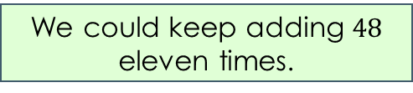
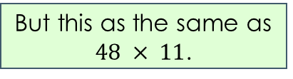
What is the 11th common multiple of 16 & 24?
$$48,$$
$$96,$$
$$144,$$
$$192$$
$$→$$
$$→$$
$$→$$
$$+48$$
$$+48$$
$$+48$$
We could keep adding $48$ eleven times.
But this as the same as $48 × 11$.
$$48 × 11=528$$

Slide 10
What is the 4th common multiple of 2 & 3?
What is the 50th common multiple of 4, 5 & 6?

Slide 11
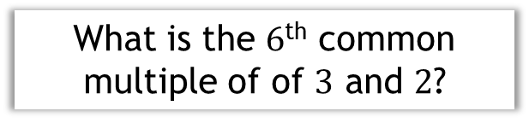


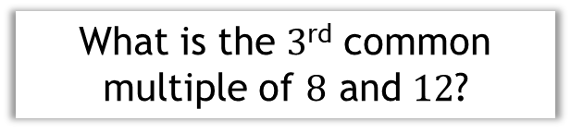

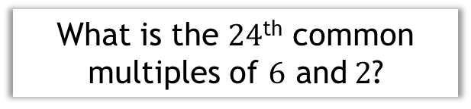
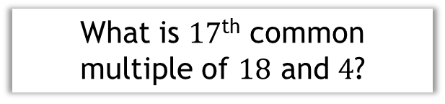
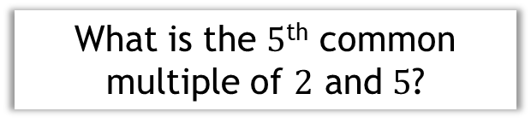
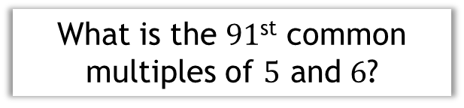



a
What is the $5$^{th} common multiple of $2$ and $5$?
d
What is the $24$^{th} common multiples of $6$ and$2$?
$$50$$
?
$$144$$
?
b
What is the $3$^{rd} common multiple of $8$ and $12$?
e
What is the $91$^{st} common multiples of $5$ and $6$?
?
?
$$2730$$
$$72$$
c
What is the $6$^{th} common multiple of of $3$ and $2$?
f
What is $17$^{th} common multiple of $18$ and $4$?
?
?
$$36$$
$$612$$
Notes:
Teaching notes:
Use quickfire questions (suitable for mini-whiteboards) to allow students practice on finding common multiples.
We want students to realise that while, possible, for the first couple of questions listing may work, but by e/f must use Prof Cheng otherwise it will take too long high chance of error
Click to reveal questions and answers sequentially. Click on prompt for answer.

Slide 12


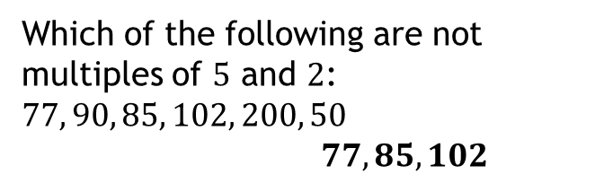

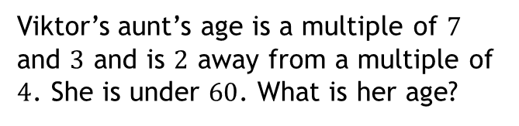
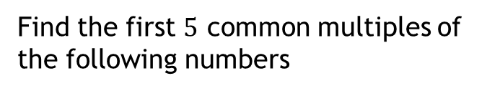
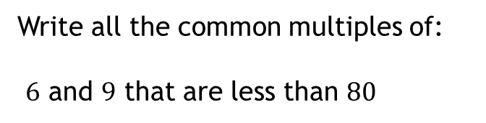





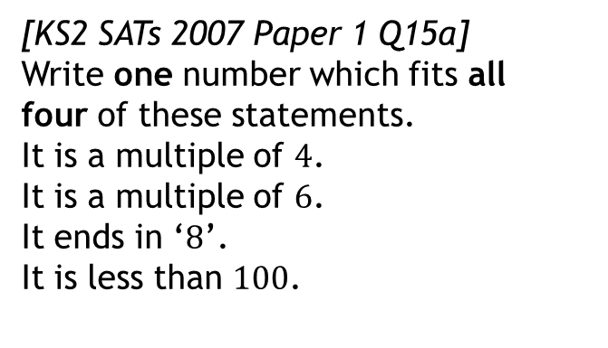
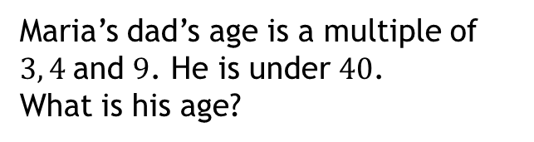




In your books
Show all solutions
1
Find the first $5$ common multiples of the following numbers
3
[KS2 SATs 2007 Paper 1 Q15a]
Write one number which fits all four of these statements.
It is a multiple of $4$.
It is a multiple of $6$.
It ends in ‘$8$’.
It is less than $100$.
$3$ and $4$ $12, 24, 36, 48, 60$
a
?
$10$ and $3$ $30, 60, 90, 120, 150$
b
?
$5$ and $15$ $15, 30, 45, 60, 75$
c
?
$$48$$
?
?
d
$7$ and $1$ $7, 14, 21, 28, 35$
Which of the following are not multiples of $5$ and $2$:
$$77, 90, 85, 102, 200, 50$$
$77, 85, 102$
4
$1, 5$ and $15$ $15, 30, 45, 60, 75$
e
?
?
f
$3, 4$ and $6$ $12, 24, 36, 48, 60$
?
2
Write all the common multiples of:
$6$ and $9$ that are less than $80$
5
Maria’s dad’s age is a multiple of $3, 4$and $9$. He is under $40$.
What is his age?
a
$$36$$
?
$$18, 36, 54, 72$$
?
b
$7$and $13$ under $100$
6
Viktor’s aunt’s age is a multiple of $7$ and $3$ and is $2$ away from a multiple of $4$. She is under $60$. What is her age?
$$91$$
?
c
$3$ and $8$ between $30$ and $70$
$$42$$
?
$$48$$
?
Notes:
Independent task. This is also available as a separate worksheet.
Click the green rectangles to reveal the answers.
Teaching notes:
Question 1-4 gives practice of common questions.
Question 5-8 allow students a chance to think more deeply about what factors are.

Slide 13

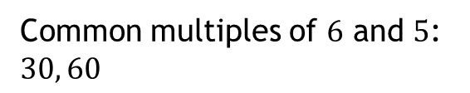


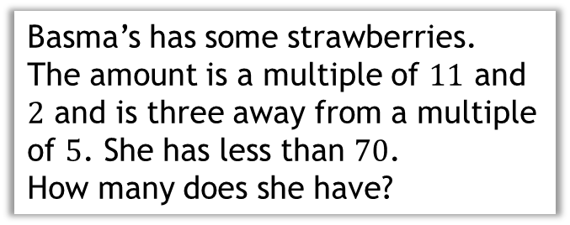


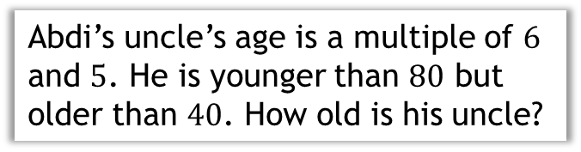




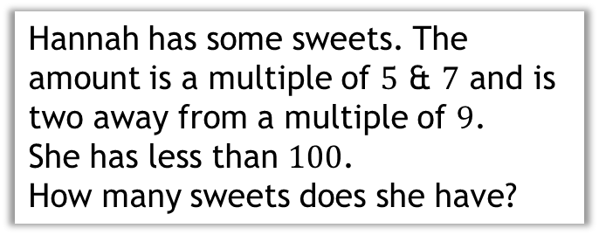
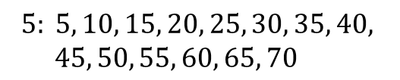


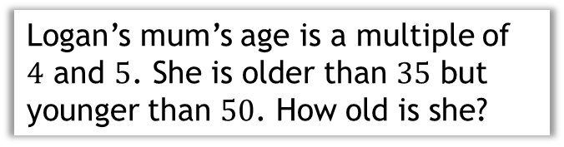
1
Logan’s mum’s age is a multiple of $4$ and $5$. She is older than $35$ but younger than $50$. How old is she?
3
Abdi’s uncle’s age is a multiple of $6$ and $5$. He is younger than $80$ but older than $40$. How old is his uncle?
Find the lowest common multiple of 4 and 5
?
Common multiples of $6$ and $5$:
$$30, 60$$
$$4: 4, 8, 12, 16, 20, 24, 28$$
$$5: 5, 10, 15, 20$$
Abdi’s uncle is $60$
?
Write the multiples of this number until we find one in the range
4
Basma’s has some strawberries.
The amount is a multiple of $11$ and $2$ and is three away from a multiple of $5$. She has less than $70$.
How many does she have?
$$20,$$
$40$, so Logan’s mum is $40$
2
Hannah has some sweets. The amount is a multiple of $5$ & $7$ and is two away from a multiple of $9$.
She has less than $100$.
How many sweets does she have?
Common multiples of $11$ and $2$:
?
$$22, 44, 66$$
Find the common multiples of $5$ and $7$ under $90$
$$5: 5, 10, 15, 20, 25, 30, 35, 40,$$
$45, 50, 55, 60, 65, 70$
$$35,$$
$$70$$
Basma has $22$ strawberries
Compare these to the multiples of
?
$$9: 9, 18, 27, 36, 45, 54, 63, 72$$
Hannah has $72$ sweets
Notes:
Further Contextual Problems

Slide 14





What is the Lowest Common Multiple (LCM) of 9 and 12?
List the first few multiples of each number
1
$$1 × 16 =16$$
$$9: 9, 18, 27, 36, 45$$
$$12: 12, 24, 36$$
As soon as there is a number in both/all lists, we stop as we just want the lowest.
Find the lowest number that appears in both/all lists
2
LCM of $9$ and $12$:
$$36$$

Slide 15
What is the LCM of 4 & 10?
What is the LCM of 4, 10 & 15?

Slide 16
What is the LCM of 8 & 12?
What is the LCM of 8, 12 & 20?

Slide 17
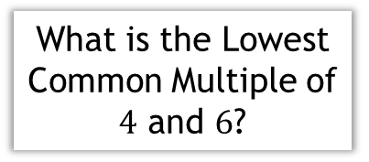

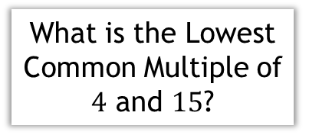


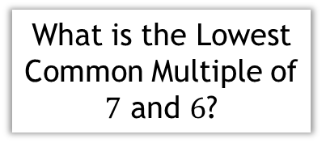

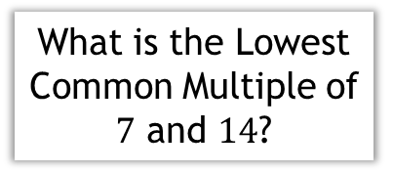

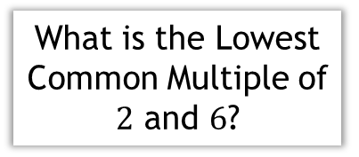
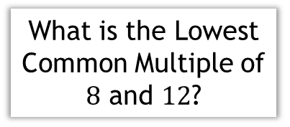

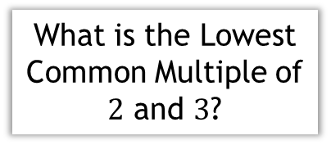

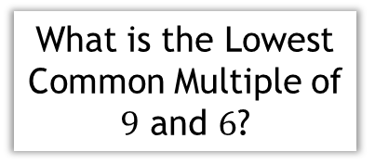




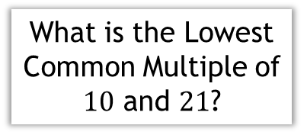
a
What is the Lowest Common Multiple of $2$ and $3$?
e
What is the Lowest Common Multiple of $9$ and $6$?
h
What is the Lowest Common Multiple of $4$ and $15$?
$$6$$
$$18$$
?
?
$$60$$
?
b
What is the Lowest Common Multiple of $7$ and $6$?
f
What is the Lowest Common Multiple of $12$ and $6$?
i
What is the Lowest Common Multiple of $2$ and $6$?
?
$$12$$
$$6$$
$$42$$
?
?
c
What is the Lowest Common Multiple of $4$ and $6$?
g
What is the Lowest Common Multiple of $7$ and $14$?
j
What is the Lowest Common Multiple of $10$ and $21$?
$$12$$
$$7$$
$$210$$
?
?
?
d
What is the Lowest Common Multiple of $8$ and $12$?
Do you notice anything about the answers compared to the numbers in the questions?
?
$$24$$
Notes:
Use quickfire questions (suitable for mini-whiteboards) to allow students practice of lowest common multiples. Questions are a range of one of the question numbers being the answer, the answer being the product and other that are in between. This is discussed in the next couple of slides and looked at further in the PP.
Click to reveal questions and answers sequentially.

Slide 18

The LCM of 4 and 6 is not 4 x 6
The LCM of 5 and 6 is 5 x 6
Explain why
When numbers have only a common factor of $1$, their LCM is their product.
Notes:
We want students to realise that although multiplying two numbers together will give a common multiple, but not always the lowest common multiple. Emphasis to students this is why we cannot just multiply two numbers together to find the first common multiple. We than draw out that because they are in the same times table, the product is not the LCM.

Slide 19

















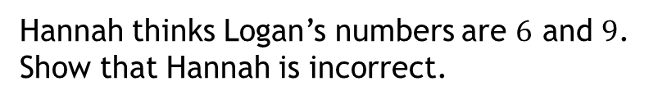





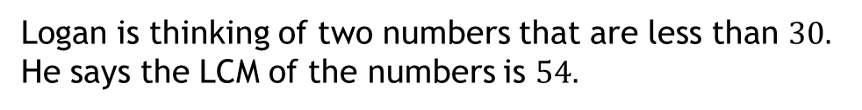
1
Find the LCM of the following numbers:
$60$ and $600$ $600$
$6$ and $27$ $54$
$4$ and $54$ $108$
?
a
?
f
?
k
?
$9$ and $27$ $27$
$12$ and $54$ $108$
$120$ and $600$ $600$
b
?
g
?
l
?
$6$ and $54$ $54$
$120$ and $300$ $600$
$18$ and $27$ $54$
h
?
m
c
?
$6$ and $60$ $60$
$2$ and $27$ $54$
i
?
d
?
$6$ and $600$ $600$
$2$ and $54$ $54$
?
e
?
j
2
Find the LCM of the following numbers:
a
$3, 6$ and $27$ $54$
c
$2, 4$ and $27$ $108$
e
$20, 40$ and $30$ $120$
?
?
?
b
$6, 12$ and $54$ $108$
d
$20, 40$ and $3$ $120$
f
$15, 35$ and $25$ $525$
?
?
?
N
Logan is thinking of two numbers that are less than $30.$ He says the LCM of the numbers is $54.$
?
a
Hannah thinks Logan’s numbers are $6$ and $9$.
Show that Hannah is incorrect.
$$6:6,12,18 9:9, 18$$
LCM of $6$ and $9$: $18$
b
What are the possible pairs of numbers Logan is thinking of?
?
$18$ and $27$ or $6$and $27$
Show all solutions
Notes:
Independent task. This is also available as a separate worksheet.
Click the green rectangles to reveal the answers.
Teaching notes:
Question 1 and 2 – common questions, but order chosen to highlight similarities/differences/patterns between numbers. Stretch students by asking if they can predict and check the HCF from previous questions.
Questions 3, 4 and 5 are using real life examples, which are common types of example questions.
Question 6 is a reverse question similar to slides 30-32.

Slide 20
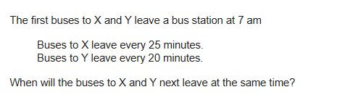
EXAM QUESTION 1

Slide 21
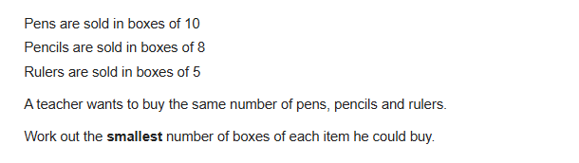
EXAM QUESTION 2

Slide 22
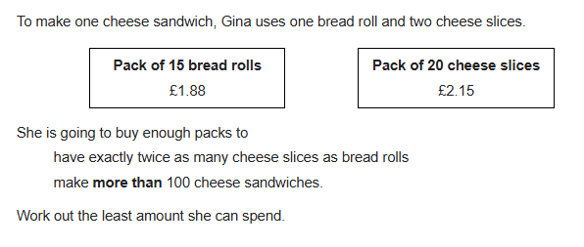
EXAM QUESTION 3

Slide 23
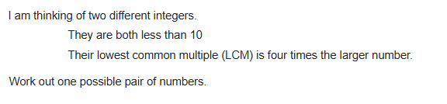
EXAM QUESTION 4

