Slide 1
From Year 8: Expanding double brackets
Notes:
Note: challenge with triangles requires expanding double brackets…

Slide 2
Expand

Slide 3
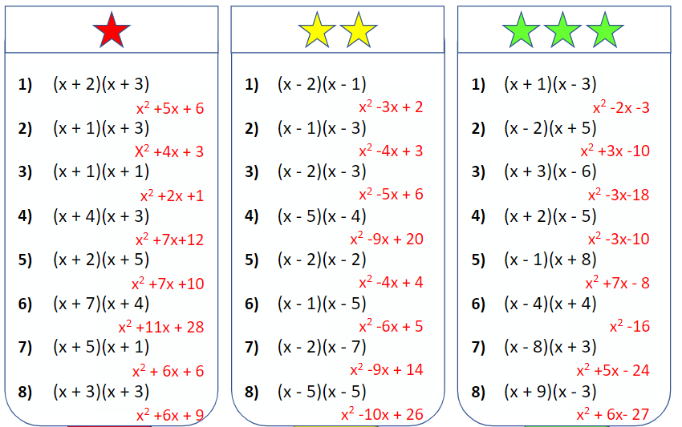

Slide 4
Expand
$$(\sqrt{2}+1)(4+\sqrt{3})$$
$$\sqrt{2}$$
$$+ 1$$
$$4$$
$$4\sqrt{2}$$
$$+ 4$$
$$≡4\sqrt{2}+\sqrt{3}+\sqrt{6}+4$$
$$+ \sqrt{3}$$
$$+\sqrt{6}$$
$$\sqrt{3}$$

Slide 5
Expand
$$(\sqrt{2}+1)(\sqrt{2}+10)$$
$$\sqrt{2}$$
$$+ 1$$
$$\sqrt{2}$$
$$2$$
$$\sqrt{2}$$
$$≡11\sqrt{2}+12$$
+$10$
$$10\sqrt{2}$$
$$10$$

Slide 6
We Do
Expand
$$(\sqrt{2}+1)(\sqrt{2}−10)$$
$$\sqrt{2}$$
$$+ 1$$
$$\sqrt{2}$$
$$2$$
$$\sqrt{2}$$
$$≡−9\sqrt{2}−8$$
-$10$
$$−10\sqrt{2}$$
$$−10$$

Slide 7
Expand and simplify:
$$\left( 2+\sqrt{5} \right) \left( 3+\sqrt{3} \right)$$
$$2$$
$$+\sqrt{5}$$
$$3$$
$$6$$
$$3\sqrt{5}$$
$$+\sqrt{3}$$
$$2\sqrt{3}$$
$$\sqrt{15}$$
$$6+3\sqrt{5}+2\sqrt{3}+\sqrt{15}$$
Can we simplify?

Slide 8
Expand and simplify:
$$\left( 2+\sqrt{3} \right) \left( 4+\sqrt{3} \right)$$
$$2$$
$$+\sqrt{3}$$
$$4$$
$$8$$
$$4\sqrt{3}$$
$$+\sqrt{3}$$
$$2\sqrt{3}$$
$$3$$
$$8+4\sqrt{3}+2\sqrt{3}+3$$
$$11+6\sqrt{3}$$

Slide 9
Expand and simplify:
$$\left( 3+\sqrt{5} \right) \left( 4−\sqrt{5} \right)$$
$$3$$
$$+\sqrt{5}$$
$$4$$
$$12$$
$$4\sqrt{5}$$
$$−\sqrt{5}$$
$$−3\sqrt{5}$$
$$−5$$
$$12+4\sqrt{5}−3\sqrt{5}−5$$
$$7+\sqrt{5}$$

Slide 10
Expand and simplify
a)
$$4\left(2+\sqrt{2} \right)$$
$$=8+4\sqrt{2}$$
$$\left( 3+\sqrt{5} \right) \left( 4−\sqrt{5} \right)$$
b)
$$\sqrt{3}\left(5+\sqrt{3} \right)$$
$$=5\sqrt{3}+3$$
$$3$$
$$+\sqrt{5}$$
c)
$$\sqrt{2}\left(1−\sqrt{2} \right)$$
$$=\sqrt{2}−2$$
$$4$$
$$12$$
$$4\sqrt{5}$$
d)
$$\left(2+\sqrt{3} \right)\left(3+\sqrt{3} \right)$$
$$=9+5\sqrt{3}$$
$$−\sqrt{5}$$
$$−3\sqrt{5}$$
$$−5$$
e)
$$\left(1+\sqrt{6} \right)\left(2+\sqrt{6} \right)$$
$$=8+3\sqrt{6}$$
f)
$$\left(3+\sqrt{2} \right)\left(4−\sqrt{2} \right)$$
$$=10+\sqrt{2}$$
$$12+4\sqrt{5}−3\sqrt{5}−5$$
g)
$$\left(3−\sqrt{2} \right)\left(4−\sqrt{2} \right)$$
$$=14−7\sqrt{2}$$
$$7+\sqrt{5}$$
h)
$$\left(5−\sqrt{3} \right)\left(1−\sqrt{3} \right)$$
$$=8−6\sqrt{3}$$
i)
$${\left(4−\sqrt{8} \right)}^{2}$$
$$=24−16\sqrt{2}$$

Slide 11
Calculate the area
(all dimensions are in cm)
Challenge: What is the perimeter of each shape?
$$\sqrt{5}−2$$
$$\sqrt{5}−2$$
$\sqrt{3}$+1
$$\sqrt{5}+7$$
$$\sqrt{5}−1$$
$$\sqrt{5}−1$$
$$2\sqrt{2}+2$$
$$\sqrt{2}+2$$
$$\sqrt{2}+2$$
$$\sqrt{2}+6$$
$$\sqrt{2}−14$$
$$\sqrt{2}+6$$

Slide 12
Calculate the area
(all dimensions are in cm)
Challenge: What is the perimeter of each shape?
$=$ $\sqrt{15}−\sqrt{3}+\sqrt{5} −1$
$$=5\sqrt{5}−9$$
$$=7−3\sqrt{5}$$
$$\sqrt{5}−2$$
$$\sqrt{5}−2$$
$\sqrt{3}$+1
$$\sqrt{5}+7$$
$$\sqrt{5}−1$$
$$\sqrt{5}−1$$
$$2\sqrt{2}+2$$
$$=7+4\sqrt{2}$$
$$=−13−6\sqrt{2}$$
$$=8+7\sqrt{2}$$
$$\sqrt{2}+2$$
$$\sqrt{2}+2$$
$$\sqrt{2}+6$$
$$\sqrt{2}−14$$
$$\sqrt{2}+6$$

Slide 13
Problems

Slide 14
Problems

Slide 15
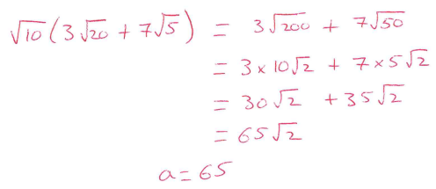
Problems

Slide 16
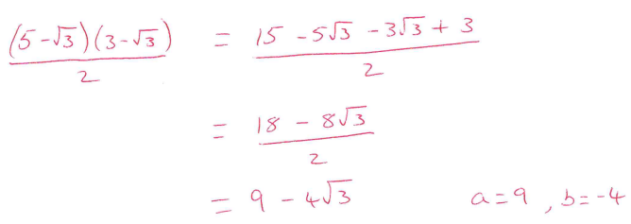
Problems

