Slide 1
Simplify the following fractions
$$\frac{4}{16}$$
$$\frac{3}{6x}$$
$$\frac{5}{15\sqrt{2}}$$
$$\frac{12}{15\sqrt{2}}$$
$$\frac{16}{4}$$
$$\frac{6x}{3}$$
$$\frac{15\sqrt{2}}{5}$$
$$\frac{15\sqrt{2}}{12}$$
Notes:
Top row vs bottom row to illustrate proper vs improper
Model answers

Slide 2
Work out
$$\frac{2}{5}×\frac{3}{3}$$
$$\frac{21}{\sqrt{7}}×\frac{\sqrt{3}}{\sqrt{3}}$$
$$\frac{21}{\sqrt{7}}×\frac{\sqrt{7}}{\sqrt{7}}$$
$$\frac{20}{\sqrt{5}}×\frac{\sqrt{2}}{\sqrt{2}}$$
$$\frac{20}{\sqrt{5}}×\frac{\sqrt{5}}{\sqrt{5}}$$
$$\frac{2}{\sqrt{5}}×\frac{3}{3}$$

Slide 3
Work out
$$\frac{2}{5}×\frac{3}{3}$$
$$=\frac{6}{15}$$
$$\frac{21}{\sqrt{7}}×\frac{\sqrt{3}}{\sqrt{3}}$$
$$=\frac{21\sqrt{3}}{\sqrt{21}}$$
$$\frac{21}{\sqrt{7}}×\frac{\sqrt{7}}{\sqrt{7}}$$
$$=\frac{21\sqrt{3}}{7}$$
$$\frac{20}{\sqrt{5}}×\frac{\sqrt{2}}{\sqrt{2}}$$
$$=\frac{20\sqrt{2}}{\sqrt{10}}$$
$$\frac{20}{\sqrt{5}}×\frac{\sqrt{5}}{\sqrt{5}}$$
$$=\frac{20\sqrt{5}}{5}$$
$$\frac{2}{\sqrt{5}}×\frac{3}{3}$$
$$=\frac{6}{3\sqrt{5}}$$
Simplify the answers; what do you notice?

Slide 4
If we modify each fraction by multiplying,
how does its value change?
$$\frac{2}{3}×\frac{2}{2}$$
$$=\frac{4}{6}$$
$$\frac{3}{4}×\frac{a}{a}$$
$$=\frac{3a}{4a}$$
$$\frac{3}{4}×\frac{\sqrt{2}}{\sqrt{2}}$$
$$=\frac{3\sqrt{2}}{4\sqrt{2}}$$
$$\frac{4}{7}×1$$
$$=\frac{4}{7}$$
The value does not change!
We can manipulate a fraction by multiplying by 1 & keep its value the same.

Slide 5
Rationalising the Denominator
In maths we want to standardise how we express numbers.
It is easier to divide by an integer, so we want to avoid having an irrational number as a denominator.
× $\sqrt{5}$
$$\frac{2×\sqrt{5}}{\sqrt{5}×\sqrt{5}}$$
$$\frac{2\sqrt{5}}{5}$$
$$\frac{2}{\sqrt{5}}$$
$$=$$
$$=$$
× $\sqrt{5}$
rational
irrational

Slide 6
Rationalising the Denominator
We Do
× $\sqrt{7}$
$$\frac{1×\sqrt{7}}{\sqrt{7}×\sqrt{7}}$$
$$\frac{\sqrt{7}}{7}$$
$$\frac{1}{\sqrt{7}}$$
$$=$$
$$=$$
× $\sqrt{7}$
rational
irrational

Slide 7
Rationalising the Denominator
You Do
Can this be simplified?
× $\sqrt{3}$
$$\frac{3×\sqrt{3}}{\sqrt{3}×\sqrt{3}}$$
$$\frac{3\sqrt{3}}{3}$$
$$\frac{3}{\sqrt{3}}$$
$$=$$
$$=\sqrt{3}$$
$$=$$
× $\sqrt{3}$
rational
irrational

Slide 8
Rationalising the Denominator
× $\sqrt{3}$
$$\frac{5×\sqrt{3}}{2×\sqrt{3}×\sqrt{3}}$$
$$\frac{5\sqrt{3}}{6}$$
$$\frac{5}{2\sqrt{3}}$$
$$=$$
$$=$$
× $\sqrt{3}$
rational
irrational

Slide 9
Rationalising the Denominator
You Do
Can this be simplified?
× $\sqrt{6}$
$$\frac{4×\sqrt{6}}{5\sqrt{6}×\sqrt{6}}$$
$$=\frac{2\sqrt{6}}{15}$$
$$\frac{4}{5\sqrt{6}}$$
$$\frac{4\sqrt{6}}{30}$$
$$=$$
$$=$$
× $\sqrt{6}$

Slide 10
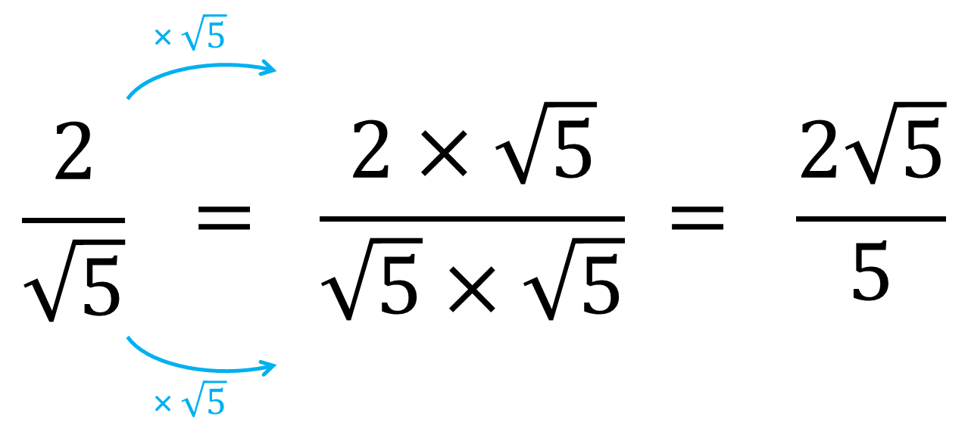
Rationalise these denominators:
$$\frac{2}{\sqrt{3}}$$
$$=\frac{2\sqrt{3}}{3}$$
$$\frac{4}{\sqrt{5}}$$
$$=\frac{4\sqrt{5}}{5}$$
$$\frac{1}{\sqrt{10}}$$
$$=\frac{\sqrt{10}}{10}$$
a)
b)
c)
$$\frac{5}{2\sqrt{3}}$$
$$=\frac{5\sqrt{3}}{6}$$
$$\frac{2}{3\sqrt{5}}$$
$$=\frac{2\sqrt{5}}{15}$$
$$\frac{3}{2\sqrt{6}}$$
$$=\frac{\sqrt{6}}{4}$$
d)
e)
f)

Slide 11
Rationalise:
$$\frac{2+\sqrt{5}}{\sqrt{5}}$$
$$×\frac{\sqrt{5}}{\sqrt{5}}$$
How could we simplify this further?
$$\frac{2\sqrt{5}}{5}+\frac{5}{5}$$
$$\frac{\left(2+\sqrt{5}\right)\sqrt{5}}{\sqrt{5}×\sqrt{5}}$$
$$\frac{2\sqrt{5}}{5}+1$$
$$\frac{2\sqrt{5}+5}{5}$$

Slide 12
We Do
Rationalise:
$$\frac{3+\sqrt{2}}{\sqrt{2}}$$
$$×\frac{\sqrt{2}}{\sqrt{2}}$$
$$\frac{\left(3+\sqrt{2}\right)\sqrt{2}}{\sqrt{2}×\sqrt{2}}$$
$$\frac{3\sqrt{2}+2}{2}$$
How else can you express your answer?

Slide 13
You Do
Rationalise:
$$\frac{5−\sqrt{2}}{\sqrt{2}}$$
$$\frac{6+\sqrt{5}}{\sqrt{3}}$$
$$\frac{5\sqrt{2}−2}{2}$$
$$=\frac{5\sqrt{2}}{2}−1$$
$$\frac{6\sqrt{3}+\sqrt{15}}{3}$$
$$=2\sqrt{3}+\frac{\sqrt{15}}{3}$$

Slide 14
Rationalise:
$$\frac{5+3\sqrt{5}}{2\sqrt{5}}$$
$$\frac{5\sqrt{5}−15}{10}$$
$$=\frac{\sqrt{5}}{2}−\frac{3}{2}$$

Slide 15
You Do
Rationalise:
$$\frac{2\sqrt{5}−20}{\sqrt{5}}$$
$$\frac{2\sqrt{5}+5\sqrt{2}}{\sqrt{10}}$$
$$\frac{10−20\sqrt{5}}{5}$$
$$\frac{10\sqrt{2}+10\sqrt{5}}{10}$$
$$=2−4\sqrt{5}$$
$$=\sqrt{2}+\sqrt{5}$$

Slide 16
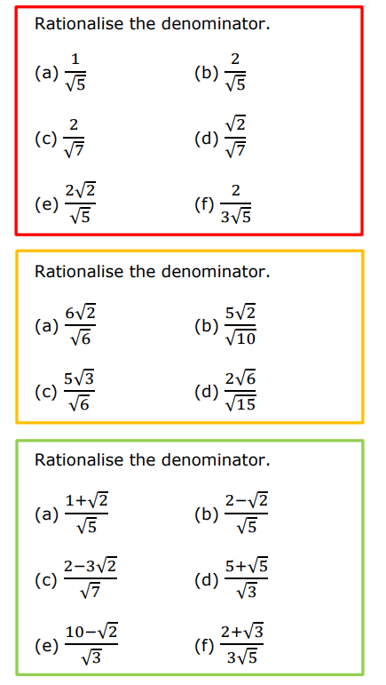
Rationalising the denominator

Slide 17
Check the accuracy of your work

Slide 18
Problem 1
$$8\sqrt{2}$$
Problem 2
$$\frac{15\sqrt{2}}{2}$$

Slide 19
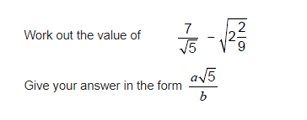
Problem 3
$$\frac{7\sqrt{5}}{20}$$
Problem 4
$$\frac{11\sqrt{5}}{15}$$

