Slide 1
True or False?
$$\sqrt{3}+\sqrt{3}=\sqrt{6}$$
$$\sqrt{3}+\sqrt{3}=2×\sqrt{3}=2\sqrt{3}$$
$$\sqrt{3}+\sqrt{5}=\sqrt{8}$$
$$\sqrt{3}+\sqrt{3}+\sqrt{3}+\sqrt{3}=4\sqrt{3}$$
$$\sqrt{3}+\sqrt{3}=\sqrt{9}$$

Slide 2
Calculate
We can only collect terms with
like radicands.
$$\sqrt{8}+\sqrt{2}$$
$$\sqrt{4×2}$$
$$2\sqrt{2} + \sqrt{2}$$
$$3\sqrt{2}$$

Slide 3
Calculate
$$\sqrt{8}+\sqrt{18}$$
$$\sqrt{4×2}$$
$$\sqrt{9×2}$$
$$2\sqrt{2} + 3\sqrt{2}$$
$$5\sqrt{2}$$

Slide 4
Calculate
We Do
Calculate
You Do
$$\sqrt{12}+\sqrt{27}$$
$$\sqrt{24}+\sqrt{54}$$
$$5\sqrt{6}$$
Calculate
$$\sqrt{125}−\sqrt{45}$$
$$2\sqrt{5}$$

Slide 5
What’s different with this question?
Write in the form $a\sqrt{5}$ where $a$ and $b$ are integers
$$\sqrt{80}+\sqrt{125}$$
$$9\sqrt{5}$$

Slide 6
What’s about this one?
Write in the form $a\sqrt{b}$ where $a$ and $b$ are integers
$$\sqrt{75}−\sqrt{27}$$
$$2\sqrt{3}$$

Slide 7
Adding & Subtracting Surds
Calculate:
Calculate:
a)
$$4\sqrt{2}+\sqrt{8}$$
$$=6\sqrt{2}$$
$$\sqrt{8}+\sqrt{18}$$
b)
$$\sqrt{45}+2\sqrt{5}$$
$$=5\sqrt{5}$$
$$\sqrt{4×2}$$
$$\sqrt{9×2}$$
c)
$$6\sqrt{10}−\sqrt{90}$$
$$=3\sqrt{10}$$
$$2\sqrt{2} + 3\sqrt{2}$$
d)
$$\sqrt{32}+\sqrt{18}$$
$$=7\sqrt{2}$$
$$5\sqrt{2}$$
$$\sqrt{27}−\sqrt{20}$$
e)
$$=3\sqrt{3}−2\sqrt{5}$$
f)
$$2\sqrt{24}+3\sqrt{54}$$
$$=13\sqrt{6}$$
g)
$$2\sqrt{98}−5\sqrt{50}$$
$$=−11\sqrt{2}$$

Slide 8
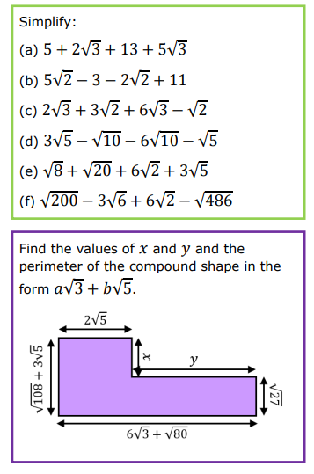

Slide 9
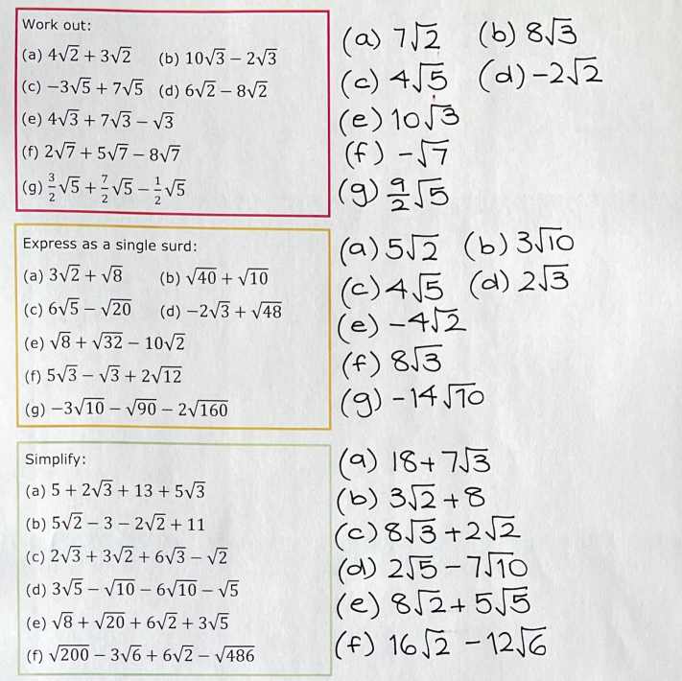

Slide 10
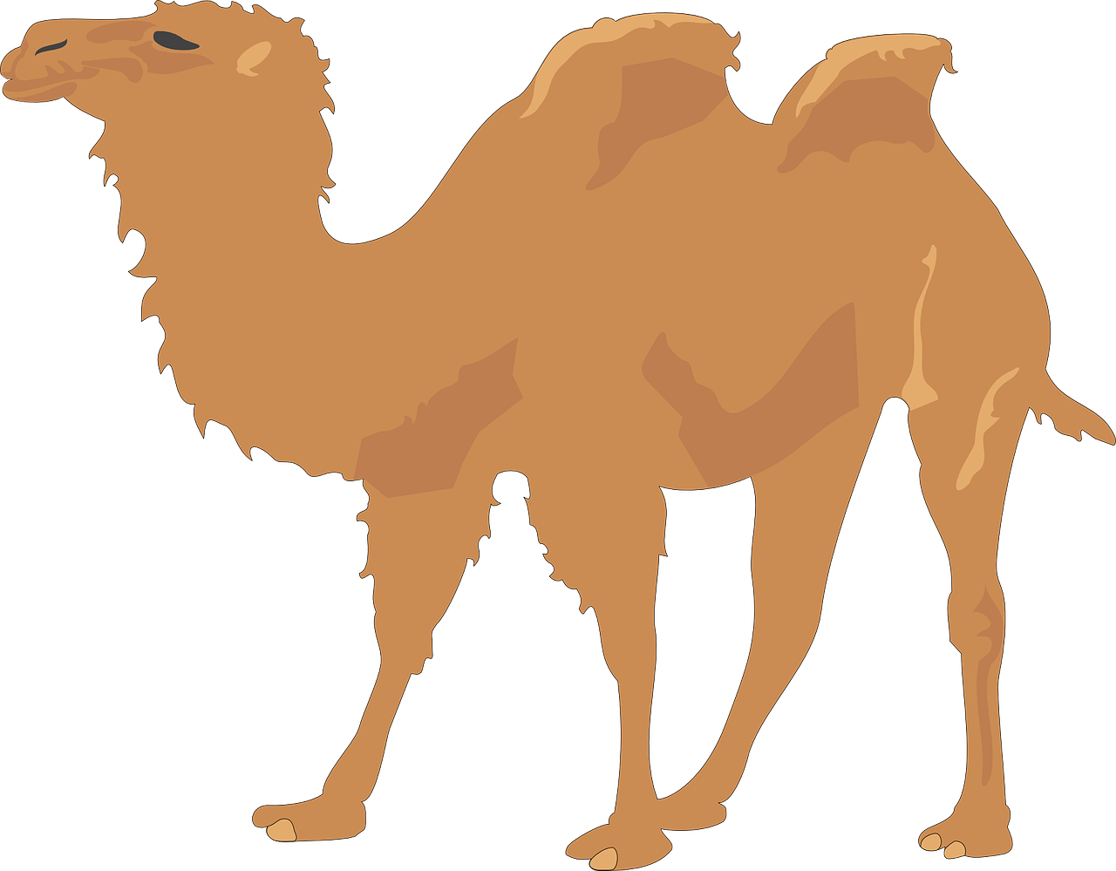
Surd Pyramids
①
Each brick is the two bricks below it added together.
A)
$$6\sqrt{2}$$
B)
$$9\sqrt{2}$$
$$\sqrt{32}$$
$$\sqrt{2}$$
$$2\sqrt{2}$$
$$\sqrt{2}$$
$$\sqrt{18}$$
$$\sqrt{8}$$
C)
$$\sqrt{300}$$
D)
$$13\sqrt{5}$$
$$\sqrt{75}$$
$$\sqrt{12}$$
$$\sqrt{27}$$
$$\sqrt{20}$$
$$\sqrt{80}$$
$$\sqrt{45}$$
E)
$$\sqrt{72}$$
$$\sqrt{98}$$
$$\sqrt{32}$$
$$\sqrt{8}$$
$$\sqrt{18}$$
$$22\sqrt{3}$$
F)
$$\sqrt{75}$$
$$\sqrt{108}$$
$$\sqrt{27}$$
$$\sqrt{48}$$
$$\sqrt{3}$$
$$\sqrt{12}$$
$$\sqrt{27}$$

Slide 11
Surd Pyramids
②
Each brick is the two bricks below it added together.
A)
$$11\sqrt{2}$$
B)
$$13\sqrt{3}$$
$$\sqrt{32}$$
$$\sqrt{8}$$
$$\sqrt{18}$$
$$\sqrt{12}$$
$$\sqrt{48}$$
$$\sqrt{27}$$
C)
$$13\sqrt{5}$$
D)
$$\sqrt{20}$$
$$\sqrt{45}$$
$$\sqrt{125}$$
$$\sqrt{112}$$
$$\sqrt{28}$$
$$\sqrt{63}$$
E)
$$\sqrt{98}$$
$$\sqrt{200}$$
$$\sqrt{72}$$
$$\sqrt{32}$$
$$\sqrt{300}$$
F)
$$\sqrt{75}$$
$$\sqrt{108}$$
$$\sqrt{48}−\sqrt{3}$$
$$\sqrt{27}$$
$$\sqrt{12}$$

Slide 12
Surd Pyramids
①
Surd Pyramids
②
Each brick is the two bricks below it added together.
Each brick is the two bricks below it added together.
A)
$$6\sqrt{2}$$
B)
$$9\sqrt{2}$$
A)
$$11\sqrt{2}$$
B)
$$13\sqrt{3}$$
$$\sqrt{32}$$
$$\sqrt{2}$$
$$2\sqrt{2}$$
$$\sqrt{2}$$
$$\sqrt{18}$$
$$\sqrt{8}$$
$$\sqrt{32}$$
$$\sqrt{8}$$
$$\sqrt{18}$$
$$\sqrt{12}$$
$$\sqrt{48}$$
$$\sqrt{27}$$
C)
$$\sqrt{300}$$
D)
$$13\sqrt{5}$$
C)
$$13\sqrt{5}$$
D)
$$\sqrt{75}$$
$$\sqrt{12}$$
$$\sqrt{27}$$
$$\sqrt{20}$$
$$\sqrt{80}$$
$$\sqrt{45}$$
$$\sqrt{20}$$
$$\sqrt{45}$$
$$\sqrt{125}$$
$$\sqrt{112}$$
$$\sqrt{28}$$
$$\sqrt{63}$$
E)
E)
$$\sqrt{72}$$
$$\sqrt{98}$$
$$\sqrt{98}$$
$$\sqrt{200}$$
$$\sqrt{32}$$
$$\sqrt{72}$$
$$\sqrt{8}$$
$$\sqrt{18}$$
$$\sqrt{32}$$
$$22\sqrt{3}$$
$$\sqrt{300}$$
F)
$$\sqrt{75}$$
$$\sqrt{108}$$
F)
$$\sqrt{75}$$
$$\sqrt{108}$$
$$\sqrt{27}$$
$$\sqrt{48}$$
$$\sqrt{48}−\sqrt{3}$$
$$\sqrt{27}$$
$$\sqrt{3}$$
$$\sqrt{12}$$
$$\sqrt{27}$$
$$\sqrt{12}$$

Slide 13
Surd Pyramids
①
Each brick is the two bricks below it added together.
A)
$$6\sqrt{2}$$
B)
$$9\sqrt{2}$$
$$3\sqrt{2}$$
$$3\sqrt{2}$$
$$5\sqrt{2}$$
$$\sqrt{32}$$
$$\sqrt{2}$$
$$2\sqrt{2}$$
$$\sqrt{2}$$
$$\sqrt{18}$$
$$\sqrt{8}$$
$$2\sqrt{2}$$
C)
$$\sqrt{300}$$
D)
$$13\sqrt{5}$$
$$5\sqrt{3}$$
$$\sqrt{75}$$
$$6\sqrt{5}$$
$$7\sqrt{5}$$
$$\sqrt{12}$$
$$\sqrt{27}$$
$$2\sqrt{3}$$
$$\sqrt{20}$$
$$\sqrt{80}$$
$$\sqrt{45}$$
E)
$$13\sqrt{2}$$
$$\sqrt{72}$$
$$7\sqrt{2}$$
$$3\sqrt{2}$$
$$3\sqrt{2}$$
$$\sqrt{32}$$
$$\sqrt{2}$$
$$\sqrt{8}$$
$$\sqrt{2}$$
$$\sqrt{18}$$
$$22\sqrt{3}$$
Answers
$$11\sqrt{3}$$
$$11\sqrt{3}$$
F)
$$6\sqrt{3}$$
$$\sqrt{75}$$
$$\sqrt{108}$$
$$3\sqrt{3}$$
$$\sqrt{27}$$
$$\sqrt{12}$$
$$\sqrt{48}$$
$$\sqrt{3}$$
$$\sqrt{12}$$
$$\sqrt{3}$$
$$\sqrt{3}$$
$$\sqrt{27}$$

Slide 14
Surd Pyramids
②
Each brick is the two bricks below it added together.
A)
$$11\sqrt{2}$$
B)
$$13\sqrt{3}$$
$$6\sqrt{2}$$
$$5\sqrt{2}$$
$$6\sqrt{3}$$
$$7\sqrt{3}$$
$$\sqrt{32}$$
$$\sqrt{8}$$
$$\sqrt{18}$$
$$\sqrt{12}$$
$$\sqrt{48}$$
$$\sqrt{27}$$
C)
$$13\sqrt{5}$$
D)
$$11\sqrt{7}$$
$$5\sqrt{5}$$
$$8\sqrt{5}$$
$$6\sqrt{7}$$
$$5\sqrt{7}$$
$$\sqrt{20}$$
$$\sqrt{45}$$
$$\sqrt{125}$$
$$\sqrt{112}$$
$$\sqrt{28}$$
$$\sqrt{63}$$
E)
$$17\sqrt{2}$$
$$\sqrt{98}$$
$$\sqrt{200}$$
$$3\sqrt{2}$$
$$\sqrt{32}$$
$$\sqrt{72}$$
$$\sqrt{2}$$
$$2\sqrt{2}$$
$$2\sqrt{2}$$
$$\sqrt{32}$$
$$21\sqrt{3}$$
Answers
$$\sqrt{300}$$
$$11\sqrt{3}$$
F)
$$5\sqrt{3}$$
$$\sqrt{75}$$
$$\sqrt{108}$$
$$\sqrt{48}−\sqrt{3}$$
$$2\sqrt{3}$$
$$\sqrt{27}$$
$$3\sqrt{3}$$
$$2\sqrt{3}$$
$$\sqrt{3}$$
$$\sqrt{3}$$
$$\sqrt{12}$$
$$\sqrt{3}$$

