Slide 1
From Year 8: Expanding a single bracket
Notes:
Note: challenge with triangles requires expanding double brackets…

Slide 2
Expand

Slide 3
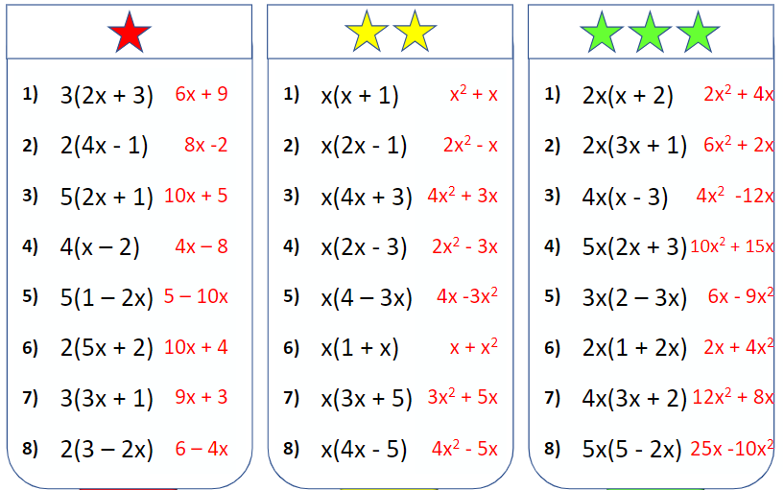

Slide 4
Expand
$$\sqrt{2}(4+\sqrt{3})$$
$$4$$
$$\sqrt{3}$$
$$\sqrt{2}$$
$$4\sqrt{2}$$
$$\sqrt{6}$$
$$4\sqrt{2}+\sqrt{6}$$

Slide 5
Expand
$$\sqrt{3}(2−\sqrt{3})$$
$$2$$
$$−\sqrt{3}$$
$$\sqrt{3}$$
$$2\sqrt{3}$$
$$−3$$
$$2\sqrt{3}−3$$

Slide 6
Expand
I DO
$$\sqrt{5} \left( 4−\sqrt{6} \right)$$
$$4\sqrt{5}$$
$$−$$
$$\sqrt{5×6}$$
$4\sqrt{5} −$ $\sqrt{30}$
Can we simplify any further?

Slide 7
Expand
WE DO
$$\sqrt{6} \left( 4−\sqrt{5} \right)$$
$$4\sqrt{6}$$
$$−$$
$$\sqrt{6×5}$$
$4\sqrt{6} −$ $\sqrt{30}$
Can we simplify any further?

Slide 8
Expand
You Do
$$\sqrt{3} \left( 5+\sqrt{3} \right)$$
$$5\sqrt{3}$$
$$+$$
$$\sqrt{3×3}$$
$5\sqrt{3} +$ $\sqrt{9}$
$5\sqrt{3} +$ $3$
Can we simplify any further?

Slide 9
Brackets & Surds
Multiply out & simplify (if possible).
Simplify:
$$3 \left(4+\sqrt{2} \right)$$
$$=12+3\sqrt{2}$$
a)
b)
$$\sqrt{3} \left(4+\sqrt{2} \right)$$
$$=4\sqrt{3}+\sqrt{6}$$
$$\sqrt{3} \left( 5+\sqrt{3} \right)$$
c)
$$\sqrt{2} \left(2+\sqrt{5} \right)$$
$$=2\sqrt{2}+\sqrt{10}$$
d)
$$\sqrt{3} \left(\sqrt{5}−2 \right)$$
$$=\sqrt{15}−2\sqrt{3}$$
$$5\sqrt{3}$$
$$+$$
$$\sqrt{3×3}$$
e)
$$\sqrt{3} \left(\sqrt{3}+4 \right)$$
$$=3+4\sqrt{3}$$
$5\sqrt{3} +$ $\sqrt{9}$
f)
$$\sqrt{7} \left(1+\sqrt{7} \right)$$
$$=\sqrt{7}+7$$
g)
$$\sqrt{6} \left(3−\sqrt{6} \right)$$
$$=3\sqrt{6}−6$$
$5\sqrt{3} +$ $3$
h)
$$2\sqrt{6} \left(\sqrt{3}+5 \right)$$
$$=6\sqrt{2}+10\sqrt{6}$$

Slide 10
Calculate the area
(all dimensions are in cm)
Challenge: What is the perimeter of each shape?
$$\sqrt{5}$$
$$\sqrt{5}$$
$$\sqrt{3}$$
$$\sqrt{5}+7$$
$$\sqrt{5}−1$$
$$\sqrt{5}−1$$
$$2\sqrt{2}$$
$$\sqrt{2}$$
$$\sqrt{2}$$
$$\sqrt{2}+6$$
$$\sqrt{2}−14$$
$$\sqrt{2}+6$$

Slide 11
Calculate the area
(all dimensions are in cm)
Challenge: What is the perimeter of each shape?
$$=5+7\sqrt{5}$$
$$=5−\sqrt{5}$$
$$\sqrt{3}$$
$$=\sqrt{15}−\sqrt{3}$$
$$\sqrt{5}$$
$$\sqrt{5}$$
$$\sqrt{5}+7$$
$$\sqrt{5}−1$$
$$\sqrt{5}−1$$
$$2\sqrt{2}$$
$$=1−7\sqrt{2}$$
$$=2+6\sqrt{2}$$
$$\sqrt{2}$$
$$=1+3\sqrt{2}$$
$$\sqrt{2}$$
$$\sqrt{2}+6$$
$$\sqrt{2}−14$$
$$\sqrt{2}+6$$

