Slide 1
Dual coding symbols:
Practise
Explain
Organise
Big Question
Reflect
Present
Compare
Evaluate
Activate
Discuss
Predict
Connect
Summarise
Recall
Vocabulary

Slide 2
Editable reading ruler
Every child in an Archway school will become a fluent reader
 | RETRIEVE the words or phrases you need from the text | DECODE the words or phrase to address a breakdown | CONNECT with words or phrases you know from the text or your memory | VISUALISE the images in as much detail as possible | SUMMARISE the main ideas of the text in a few words | INFER meanings that might be within the text | PREDICT what might happen next using details from the text | EXAMINE how the writer uses words to construct meaning
 | ASK THOUGHTFUL QUESTIONS TO HELP YOU UNDERSTAND THE TEXT

Slide 3
A
B

Slide 4
LESSON TITLE: Prime Factorisation

Slide 5
LO: To find the prime factor decomposition of a given number
Key vocabulary:
Word | Definition
Prime | A number with exactly 2 factors
Factor | A number that goes into another number with no remainder
Decomposition | To break something down into smaller parts
Retrieve from memory without prompts or discussion. You must write something for each.
RETRIEVE
INSTRUCT
PRACTISE
SECURE

Slide 6
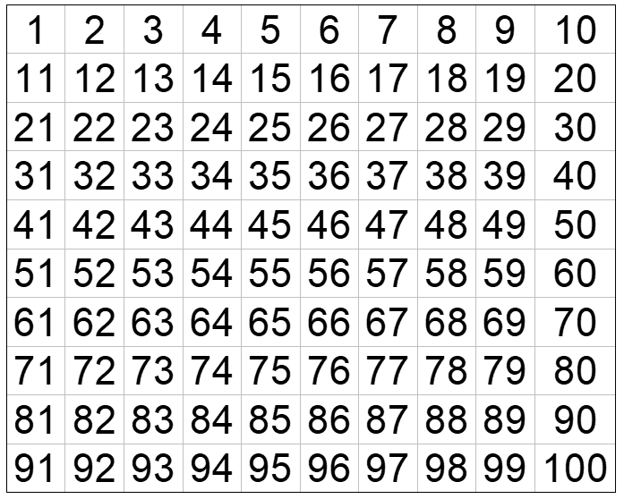
PRE REQUISITES:
Try and circle as many prime numbers as you can.
You have 40 seconds.
RETRIEVE
INSTRUCT
PRACTISE
SECURE

Slide 7
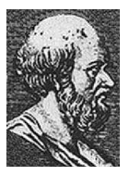
Eratosphenes (Born 275 BC) was an ancient Greek scholar who developed an interesting way to identify prime numbers on a 100 grid. He made other notable contributions to various fields but we will focus on his system for identifying primes.
RETRIEVE
INSTRUCT
PRACTISE
SECURE

Slide 8
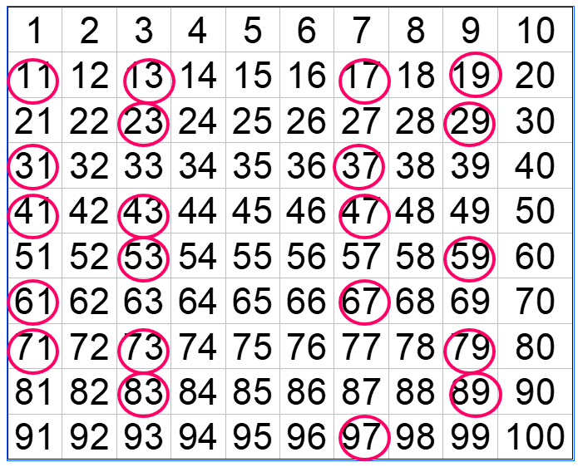
Cross out 1. It isn’t prime.
Circle 2. Cross out all other numbers in the 2 times table(as these all have at least 3 factors – 1, itself and 2).
Circle 3. Cross out all other numbers in the 3 times table (as these all have at least 3 factors – 1, itself and 3)
Continue this and you end up with:
RETRIEVE
INSTRUCT
PRACTISE
SECURE

Slide 9
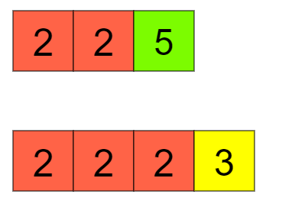
For modelling: Prime Factor Tiles (mathsbot.com)
$20=2×2×5$
$24=2×2×2×3$
Both numbers above can be made by just multiplying prime numbers together. We can represent this using prime factor tiles (on the right).
Think:
Can you come up with another number that this can be done for?
What numbers can you find that use exactly 3 tiles?
RETRIEVE
INSTRUCT
PRACTISE
SECURE

Slide 10
This can be done for every non-prime (composite) number.
Finding the combination of prime numbers that multiply together to make a composite number is referred to as Prime Factor Decomposition.
2: prime
3: prime
4: 2 x 2
5: prime
6: 2 x 3
7: prime
8: 2 x 2 x 2
9: 3 x 3
RETRIEVE
INSTRUCT
PRACTISE
SECURE

Slide 11
Can you find the tiles that make up the rest of the composite numbers from 10 up to 20?
RETRIEVE
INSTRUCT
PRACTISE
SECURE

Slide 12
Understanding check:
Which of these are products of prime factors?
$2 ×7$
$2+7$
$2 ×9$
$2×7 ×3$
$2^{2}×7$
$11×21$
$3,5,7$
RETRIEVE
INSTRUCT
PRACTISE
SECURE

Slide 13
Sometimes numbers are easy to spot the prime factors of: 21 = 3 x 7
Sometimes it isn’t as obvious: 60 = ?
We will look at a way of finding the prime factors of any given number.
RETRIEVE
INSTRUCT
PRACTISE
SECURE

Slide 14
I DO:
WE DO:
Display 300 as a product of prime factors:
Display 40 as a product of prime factors:
RETRIEVE
INSTRUCT
PRACTISE
SECURE

Slide 15
I DO:
WE DO:
Display 45 as a product of prime factors, leaving your answer in index form:
Display 12 as a product of prime factors leaving your answer in index form:
RETRIEVE
INSTRUCT
PRACTISE
SECURE

Slide 16
Mini WBs:
10
?
2
RETRIEVE
INSTRUCT
PRACTISE
SECURE

Slide 17
Mini WBs:
24
8
?
RETRIEVE
INSTRUCT
PRACTISE
SECURE

Slide 18
Mini WBs:
?
4
5
RETRIEVE
INSTRUCT
PRACTISE
SECURE

Slide 19
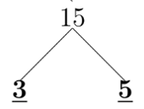
Independent practice:
Find the following numbers as products of their prime factors: The trees have been started for you.
Find the following numbers as products of their prime factors:
RETRIEVE
INSTRUCT
PRACTISE
SECURE

Slide 20
Depth:
RETRIEVE
INSTRUCT
PRACTISE
SECURE

Slide 21
LO: To find the prime factor decomposition of a given number on your calculator
Key vocabulary:
Word | Definition
Prime | A number with exactly 2 factors
Factor | A number that goes into another number with no remainder
Decomposition | To break something down into smaller parts
Retrieve from memory without prompts or discussion. You must write something for each.
RETRIEVE
INSTRUCT
PRACTISE
SECURE

Slide 22
PRE REQUISITES:
What is the prime factor decomposition of 10?
$2,5$ $2×5$ $2+5$ $2+2+2+2+2$
RETRIEVE
INSTRUCT
PRACTISE
SECURE

Slide 23
Some of these products have indices (index form), some of these products do not (expand form).
Can you find matching pairs of expressions?
$$3×3×5$$
$$3×5^{2}$$
$$3×3×3×5$$
$$3^{3}$$
$$3×3×5×5$$
$$3^{2}×5$$
$$3×3×3$$
$$3×5^{2}$$
$$3×5×5$$
$$3^{3}×5$$
RETRIEVE
INSTRUCT
PRACTISE
SECURE

Slide 24
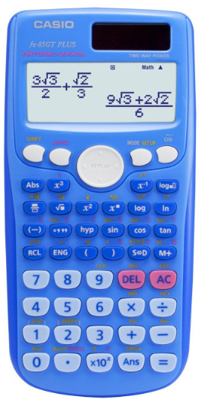
Most modern calculators will decompose numbers for you if you know how.
Model 1: fx-85GT plus
Press shift once and then press ‘fact’.
24
24
$2^{3}×3$
Type in the number you want and press $=$
RETRIEVE
INSTRUCT
PRACTISE
SECURE

Slide 25
I DO:
WE DO:
Display 900 as a product of prime factors, leaving your answer in index form:
Display 500 as a product of prime factors leaving your answer in index form:
RETRIEVE
INSTRUCT
PRACTISE
SECURE

Slide 26
Mini WBs:
RETRIEVE
INSTRUCT
PRACTISE
SECURE

Slide 27
Independent practice:
Use your calculator to find the product of prime factors for the following numbers:
a) 300 b) 920
c) 1012 d) 911
e) 876 f) 12003
g) 34 x 195 h) 16170 ÷ 15
Can you rewrite your answers in expanded form?
RETRIEVE
INSTRUCT
PRACTISE
SECURE

Slide 28
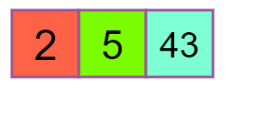
430 =
430 has a factor of 10.
Can you see where 10 appears in the prime factors?
430 has a factor of 86.
Can you see where 86 appears in the prime factors?
Challenge: Can you find another factor of 430 within the prime factors?
RETRIEVE
INSTRUCT
PRACTISE
SECURE

Slide 29
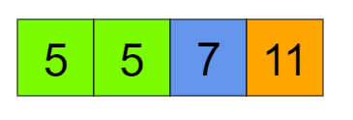
1925 =
True or false:
1925 has a factor of 25
1925 has a factor of 10
1925 has a factor of 77
Challenge:
Come up with a factor that is in 1925 based on these prime factors.
Come up with a factor that isn’t in 1925 but you think other students will think is in 1925.
RETRIEVE
INSTRUCT
PRACTISE
SECURE

Slide 30
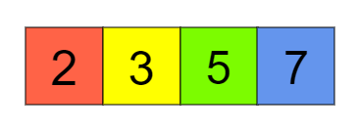
True or false:
The number above has a factor of 30
The number above has a factor of 42
The number above has a factor of 105
RETRIEVE
INSTRUCT
PRACTISE
SECURE

Slide 31
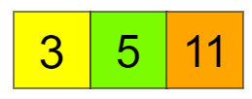
I DO:
WE DO:
List all factors of 165 based on its prime factors.
1 x 165
Show them on visualiser with the tiles.
Instead of drawing rings around them – move the tiles around so that 3 is on its own and 5 and 11 are together, then move so 5 is at the front on its own and 3 and 11 are together and so on…
3 x 55
5 x 33
11 x 15
RETRIEVE
INSTRUCT
PRACTISE
SECURE

Slide 32
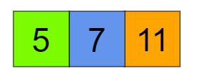
I DO:
WE DO:
List all factors of 385 based on its prime factors.
List all factors of 165 based on its prime factors.
Prime Factor Tiles (mathsbot.com)
RETRIEVE
INSTRUCT
PRACTISE
SECURE

Slide 33
WE DO:
List all factors of 130 based on its prime factors.
Prime Factor Tiles (mathsbot.com)
RETRIEVE
INSTRUCT
PRACTISE
SECURE

Slide 34
Mini WBs:
Prime Factor Tiles (mathsbot.com)
RETRIEVE
INSTRUCT
PRACTISE
SECURE

Slide 35
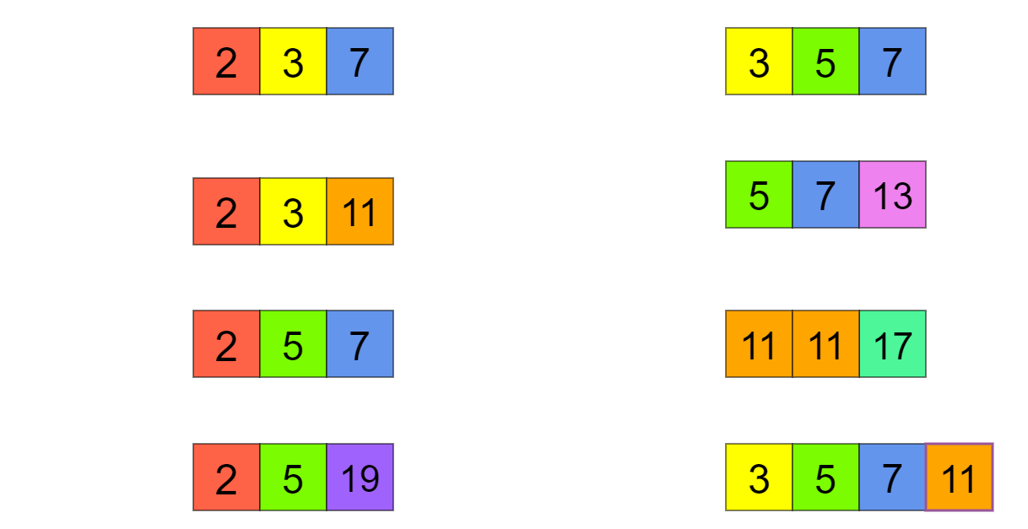
Independent practice:
Using the prime factor tiles for the following numbers, list all of their factors:
42 =
105 =
66 =
455 =
70 =
2057 =
190 =
1155 =
RETRIEVE
INSTRUCT
PRACTISE
SECURE

Slide 36
Depth:
By first using your calculator to find the prime factors of the following numbers – list all factors.
42 =
66 =
70 =
190 =
RETRIEVE
INSTRUCT
PRACTISE
SECURE

