Slide 1
Dual coding symbols:
Practise
Explain
Organise
Big Question
Reflect
Present
Compare
Evaluate
Activate
Discuss
Predict
Connect
Summarise
Recall
Vocabulary

Slide 2
Editable reading ruler
Every child in an Archway school will become a fluent reader
 | RETRIEVE the words or phrases you need from the text | DECODE the words or phrase to address a breakdown | CONNECT with words or phrases you know from the text or your memory | VISUALISE the images in as much detail as possible | SUMMARISE the main ideas of the text in a few words | INFER meanings that might be within the text | PREDICT what might happen next using details from the text | EXAMINE how the writer uses words to construct meaning
 | ASK THOUGHTFUL QUESTIONS TO HELP YOU UNDERSTAND THE TEXT

Slide 3
A
B

Slide 5
LESSON TITLE: Equations & Indices

Slide 6
Solve
$$x^{\frac{1}{2}}−9=2$$
Solve
$$x^{\frac{1}{3}}−9=1$$

Slide 7
Solve
$$x^{\frac{1}{3}}=\frac{6}{\sqrt{x}}$$
Solve
$$x^{\frac{1}{3}}=\frac{4}{\sqrt[3]{x}}$$

Slide 8
Solve
$$x^{−3}=\frac{1}{1000}$$
Solve
$$x^{−2}=\frac{1}{81}$$

Slide 9
Solve
$$4x^{−\frac{1}{3}}−2=0$$
Solve
$$3x^{−\frac{1}{4}}−1=0$$

Slide 10
Solve
$$\left(x^{\frac{1}{3}}+1\right)\left(x^{\frac{1}{2}}−7\right)=0$$
Solve
$$\left(x^{\frac{1}{3}}−7\right)\left(x^{\frac{1}{2}}+7\right)=0$$

Slide 11
Solve
$$x−5x^{\frac{1}{2}}+6=0$$
Solve
$$x+7x^{\frac{1}{2}}+6=0$$
Notes:
Factorise

Slide 12
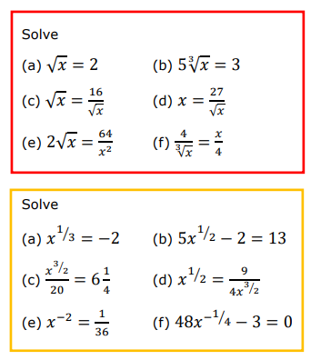
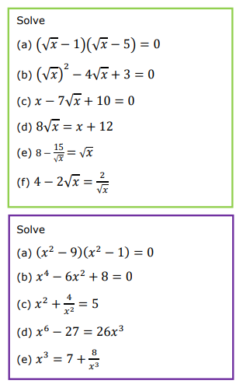

Slide 13
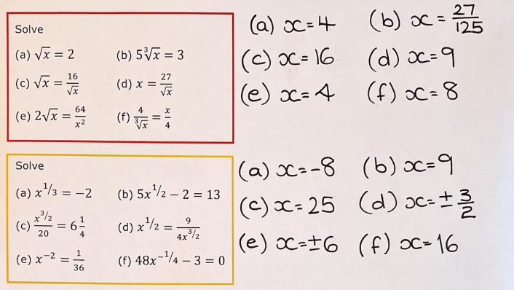
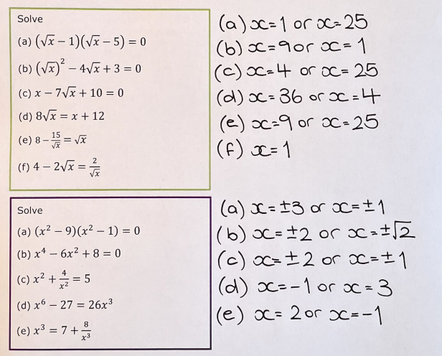

Slide 14
Exam Question

Slide 15
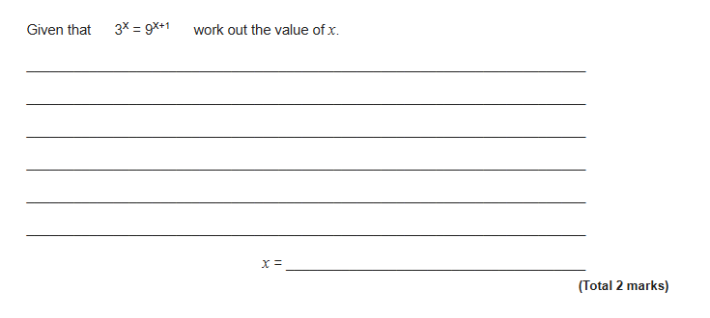
Exam Question

Slide 16
Exam Question
Notes:
From Further Maths

Slide 17
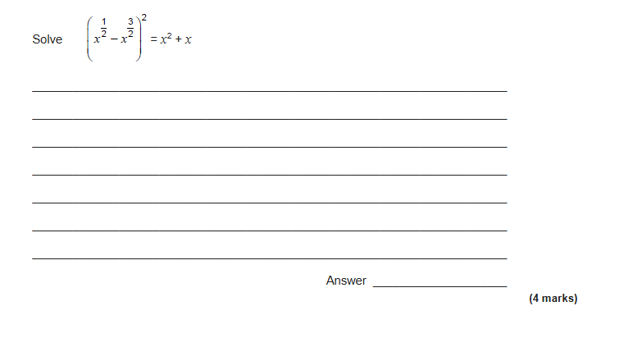
Exam Question
Notes:
From Further Maths

