Slide 1
Dual coding symbols:
Practise
Explain
Organise
Big Question
Reflect
Present
Compare
Evaluate
Activate
Discuss
Predict
Connect
Summarise
Recall
Vocabulary

Slide 2
Editable reading ruler
Every child in an Archway school will become a fluent reader
 | RETRIEVE the words or phrases you need from the text | DECODE the words or phrase to address a breakdown | CONNECT with words or phrases you know from the text or your memory | VISUALISE the images in as much detail as possible | SUMMARISE the main ideas of the text in a few words | INFER meanings that might be within the text | PREDICT what might happen next using details from the text | EXAMINE how the writer uses words to construct meaning
 | ASK THOUGHTFUL QUESTIONS TO HELP YOU UNDERSTAND THE TEXT

Slide 3
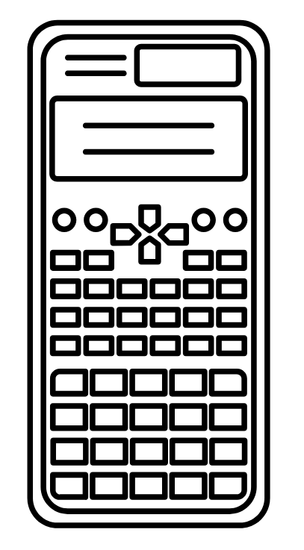
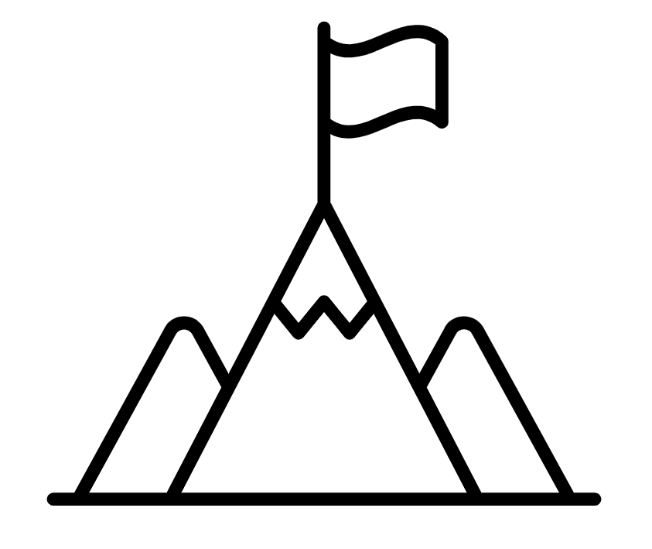
A
B

Slide 4
LESSON TITLE: Approximating Powers & Roots

Slide 5
$$\sqrt{41}$$
Which integers does the solution lie between?
We can test values:
$52$ = 25
$62$ = 36
$72$ = 49
$$5$$
$$6$$
$$7$$
$$25$$
$$36$$
$$49$$
$x$ is greater than 6
$x$ is smaller than 7
$$6<x<7$$

Slide 6
cube root
$$\sqrt[3]{26}$$
$$? × ? × ? =26$$
Which integers does the solution lie between?
We can test values:
$23$ = 8
$33$ = 27
$43$ = 64
$$2$$
$$3$$
$$4$$
$$8$$
$$27$$
$$64$$
$x$ is greater than 2
$x$ is smaller than 3
$$2<x<3$$

Slide 8
For each question, express the solution as an inequality.
$$a=\sqrt{5}$$
$$b=\sqrt{29}$$
$$c=\sqrt{22}$$
$$<a<$$
$$2<a<3$$
$$<b<$$
$$5<b<6$$
$$4<c<5$$
$$d=\sqrt[2]{98}$$
$$e=\sqrt[2]{44}$$
$$f=\sqrt[2]{145}$$
$$9<d<10$$
$$6<e<7$$
$$12<f<13$$
$$g=\sqrt[3]{29}$$
$$h=\sqrt[3]{998}$$
$$i=\sqrt[4]{30}$$
$$3<g<4$$
$$9<h<10$$
$$2<i<3$$

Slide 9
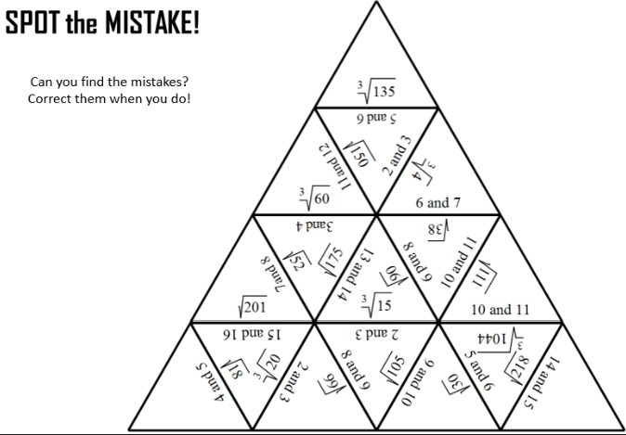

Slide 10
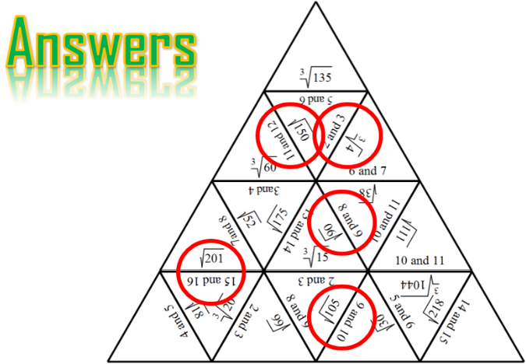

Slide 14
Between which two integers does $x$ lie?
$$9^{x}=7000$$
$$5^{x}=400,000$$
$${0.2}^{x}=\frac{1}{600}$$

Slide 15
Use trial and improvement to find the value of $x$ to the nearest integer
$$9^{x}=7000$$
$$5^{x}=400,000$$
$${0.2}^{x}=\frac{1}{600}$$

Slide 16
Use trial and improvement to find the value of $x$ to 1 decimal place
$$9^{x}=7000$$
$$5^{x}=400,000$$
$${0.2}^{x}=\frac{1}{600}$$

Slide 17
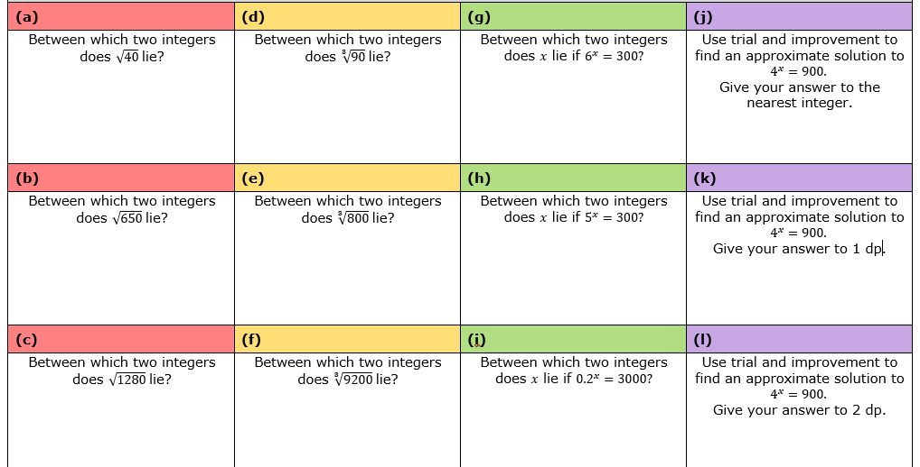

Slide 18
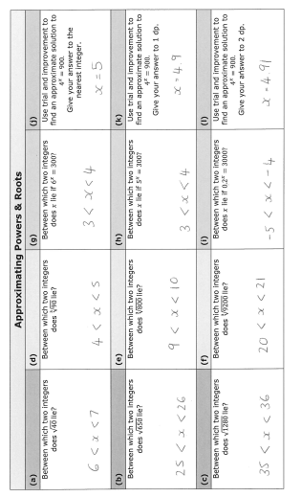

Slide 19
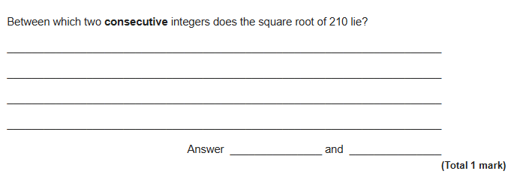
Exam Question

Slide 20
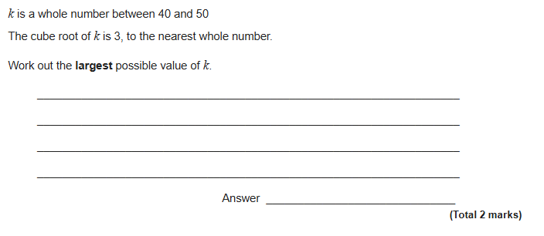
Exam Question

Slide 21
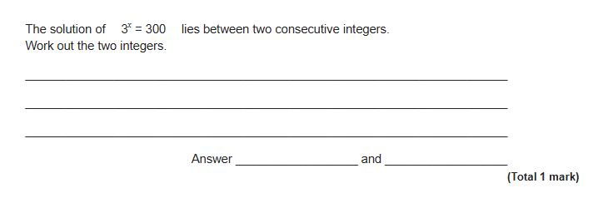
Exam Question (Higher)

