Slide 1
Dual coding symbols:
Practise
Explain
Organise
Big Question
Reflect
Present
Compare
Evaluate
Activate
Discuss
Predict
Connect
Summarise
Recall
Vocabulary

Slide 2
Editable reading ruler
Every child in an Archway school will become a fluent reader
 | RETRIEVE the words or phrases you need from the text | DECODE the words or phrase to address a breakdown | CONNECT with words or phrases you know from the text or your memory | VISUALISE the images in as much detail as possible | SUMMARISE the main ideas of the text in a few words | INFER meanings that might be within the text | PREDICT what might happen next using details from the text | EXAMINE how the writer uses words to construct meaning
 | ASK THOUGHTFUL QUESTIONS TO HELP YOU UNDERSTAND THE TEXT

Slide 3
A
B

Slide 5
LESSON TITLE: Fractional Indices

Slide 6
Copy and complete the following calculations:
$$\sqrt{4}×\sqrt{4}=\sqrt{16}=4$$
$$\sqrt{9}×\sqrt{9}=\sqrt{81}=9$$
$$\sqrt{16}×\sqrt{16}=16$$
$$\sqrt{x}×\sqrt{x}=x$$
Notes:
Linking to prior learning

Slide 7
SQUARE ROOTS
In general:
$$\sqrt{x}×\sqrt{x}=x$$
$$x^{\frac{1}{2}}×x^{\frac{1}{2}}=x^{1}$$

Slide 8
CUBED ROOTS
In general:
$$\sqrt[3]{x}×\sqrt[3]{x}×\sqrt[3]{x}=x$$
$${x^{\frac{1}{3}}×x}^{\frac{1}{3}}×x^{\frac{1}{3}}=x^{1}$$

Slide 9
CUBED ROOTS
In general:
$$\sqrt[4]{x}×\sqrt[4]{x}×\sqrt[4]{x}×\sqrt[4]{x}=x$$
$${{x^{\frac{1}{4}}×x}^{\frac{1}{4}}×x}^{\frac{1}{4}}×x^{\frac{1}{4}}=x^{1}$$

Slide 10
FRACTIONAL INDICES
In general:
$$x^{\frac{1}{n}}=\sqrt[n]{x}$$

Slide 12
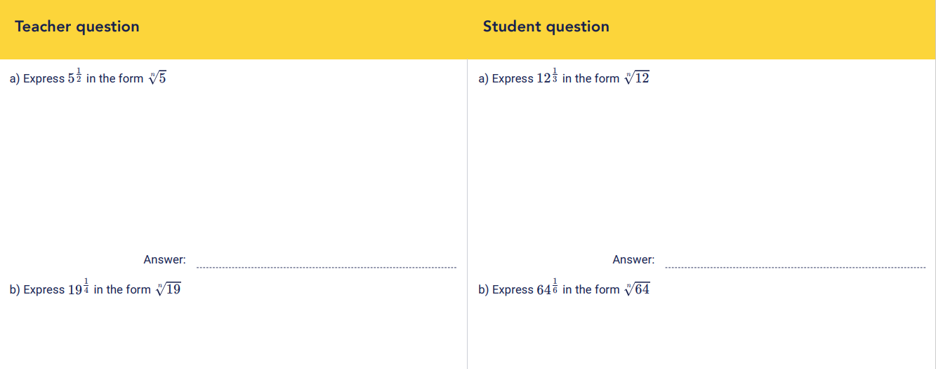

Slide 14
Work out
$${\left(\frac{225}{9}\right)}^{\frac{1}{2}}$$
Work out
$${\left(\frac{64}{125}\right)}^{\frac{1}{3}}$$

Slide 16
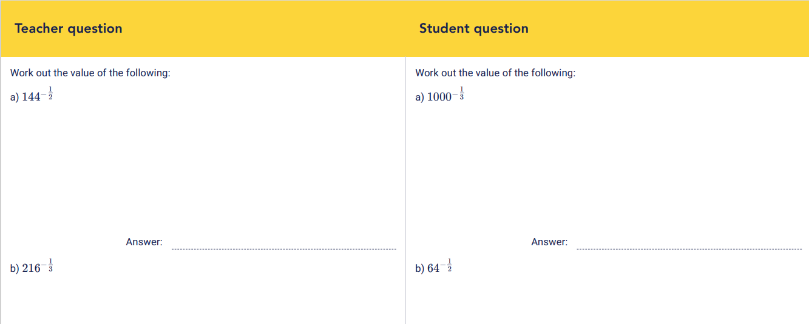

Slide 17
Work out
$${\left(\frac{64}{25}\right)}^{−\frac{1}{2}}$$
Work out
$${\left(\frac{8}{125}\right)}^{−\frac{1}{3}}$$

Slide 18
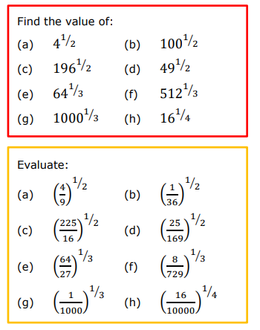
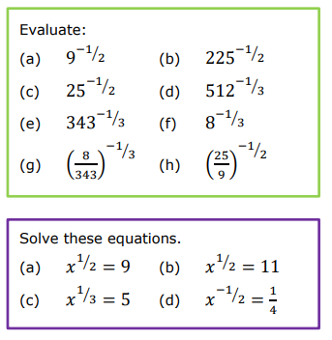

Slide 19
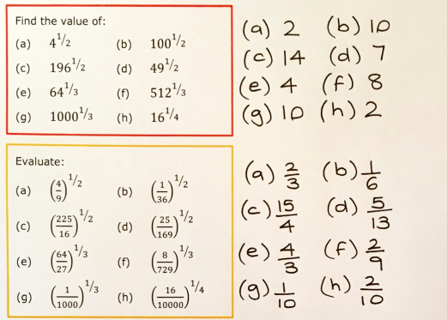
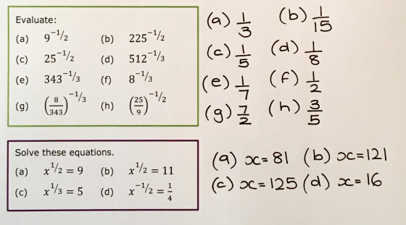

Slide 23
Work out
$${\left(\frac{4}{25}\right)}^{−\frac{3}{2}}$$
Work out
$${\left(\frac{1}{125}\right)}^{−\frac{2}{3}}$$

Slide 24
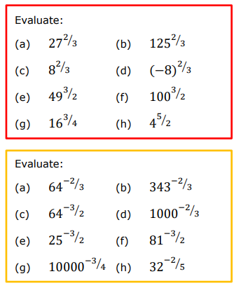
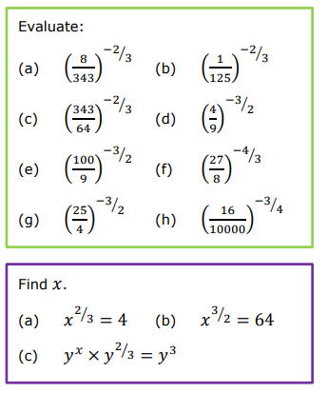

Slide 25
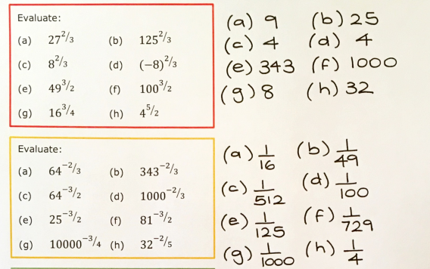
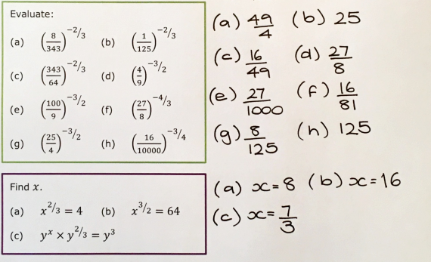

Slide 26
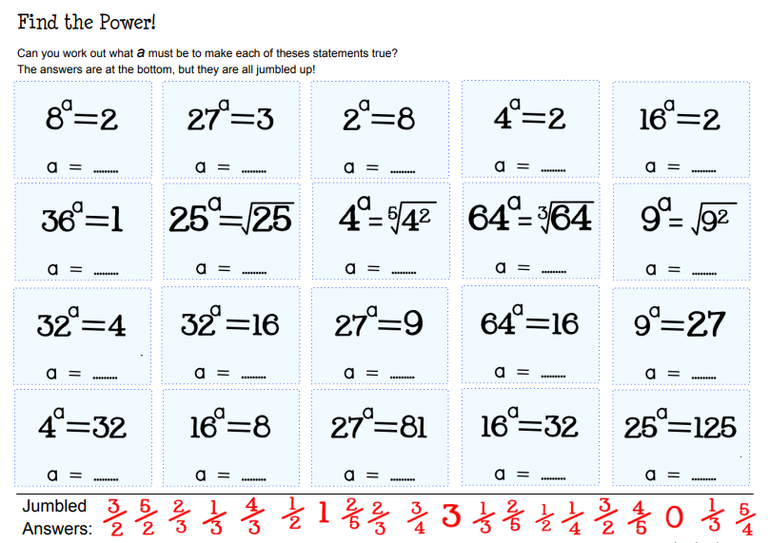

Slide 27
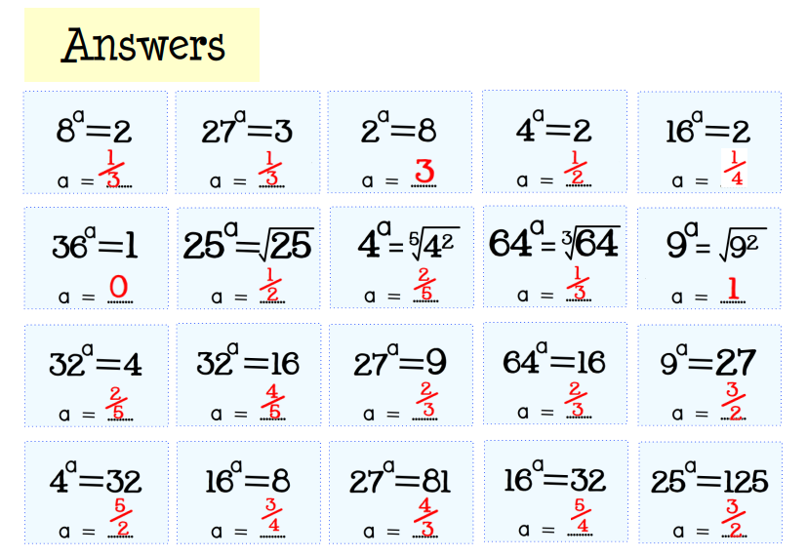

Slide 28
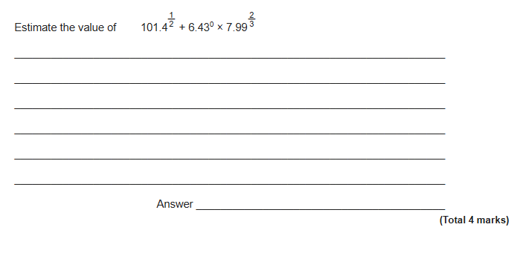
Exam Question
Notes:
From Further Maths

Slide 29
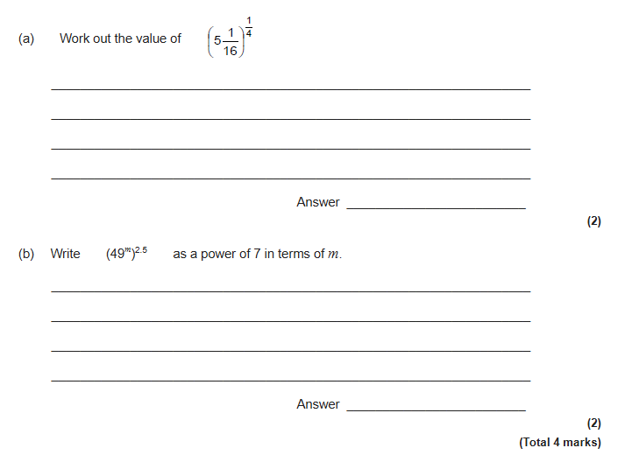
Exam Question

Slide 30
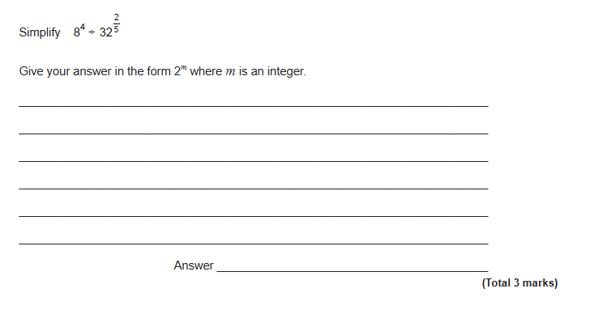
Exam Question

Slide 31
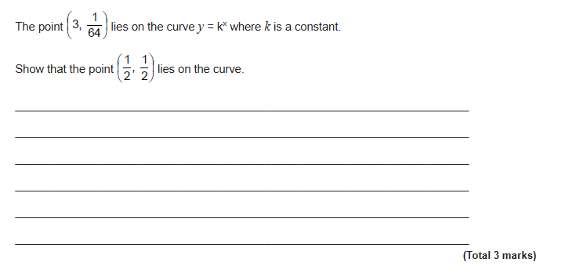
Exam Question
Notes:
From Further Maths

