Slide 1
Dual coding symbols:
Practise
Explain
Organise
Big Question
Reflect
Present
Compare
Evaluate
Activate
Discuss
Predict
Connect
Summarise
Recall
Vocabulary

Slide 2
Editable reading ruler
Every child in an Archway school will become a fluent reader
 | RETRIEVE the words or phrases you need from the text | DECODE the words or phrase to address a breakdown | CONNECT with words or phrases you know from the text or your memory | VISUALISE the images in as much detail as possible | SUMMARISE the main ideas of the text in a few words | INFER meanings that might be within the text | PREDICT what might happen next using details from the text | EXAMINE how the writer uses words to construct meaning
 | ASK THOUGHTFUL QUESTIONS TO HELP YOU UNDERSTAND THE TEXT

Slide 3
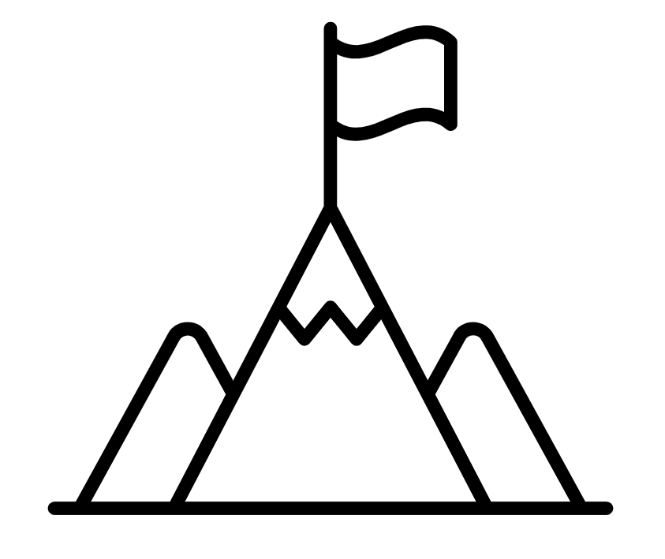
A
B

Slide 5
LESSON TITLE: Generating Sequences using the nth term

Slide 7
What type of sequences have we generated?

Slide 8
What type of sequences have we generated?

Slide 9
What type of sequences have we generated?

Slide 11
What type of sequences have we generated?

Slide 12
What type of sequences have we generated?

Slide 13
What type of sequences have we generated?

Slide 14
What are the first four terms of the following sequences?
$$10n$$
$$10n+1$$
$$10n−7$$
Challenge: Can you think of another nth term that would have the same term to term rule?

Slide 15
What are the first four terms of the following sequences?
$$−3n$$
$$10−3n$$
$$−10−3n$$
Challenge: Can you think of another nth term that would have the same term to term rule?

Slide 16
What are the first four terms of the following sequences?
$n^{2}$
$$n^{2}+10$$
$${10n}^{2}$$
Challenge: Can you think of another nth term that would create a quadratic sequence?

Slide 17
What are the first four terms of the following sequences?
$n^{2}+n$
$$n^{2}+10n$$
$${10n}^{2}−2n+3$$
Challenge: Can you think of another nth term that would have the same second difference as any of these sequences?

Slide 18
What are the first four terms of the following sequences?
$2^{n}$
$$2^{n}+3$$
$$2^{n+3}$$
Challenge: Can you think of another nth term that would have the same term to term rule as any of these sequences?

Slide 19
Match the nth term to its’ sequence

Slide 21
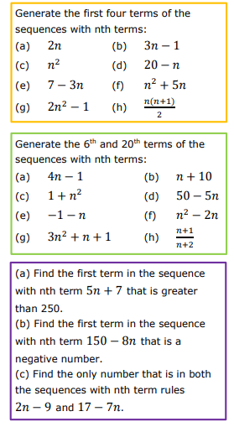
Notes:
Further Practice

Slide 22
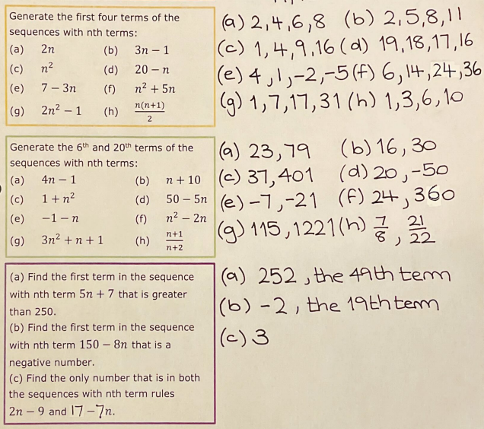

Slide 23
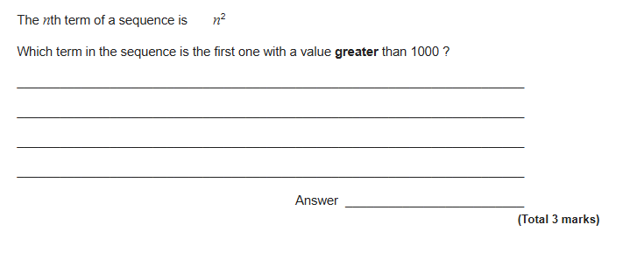
Exam Question 1

Slide 24
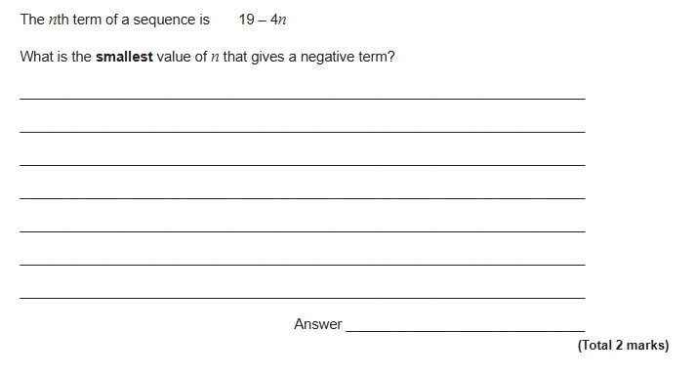
Exam Question 2

Slide 25
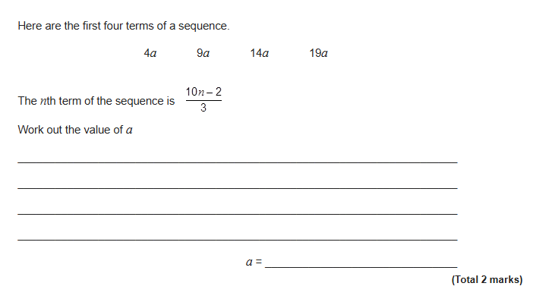
Exam Question 3

