Slide 1
Dual coding symbols:
Practise
Explain
Organise
Big Question
Reflect
Present
Compare
Evaluate
Activate
Discuss
Predict
Connect
Summarise
Recall
Vocabulary

Slide 2
Editable reading ruler
Every child in an Archway school will become a fluent reader
 | RETRIEVE the words or phrases you need from the text | DECODE the words or phrase to address a breakdown | CONNECT with words or phrases you know from the text or your memory | VISUALISE the images in as much detail as possible | SUMMARISE the main ideas of the text in a few words | INFER meanings that might be within the text | PREDICT what might happen next using details from the text | EXAMINE how the writer uses words to construct meaning
 | ASK THOUGHTFUL QUESTIONS TO HELP YOU UNDERSTAND THE TEXT

Slide 3
A
B

Slide 5
LESSON TITLE: Generating Sequences

Slide 6
Each value or pattern in a sequence is called a term.
A term-to-term rule describes how to calculate the next term in the sequence from the previous term.
How many terms do these sequences have?
What comes next? How do you know?
10, 8, 6, 4…
1, 4, 9, 16, 25…
1, 3, 6, 10, 15…
3, 9, 27…

Slide 7
I DO:
WE DO:
A term-to-term rule for a sequence is “add 5”
What would the next three terms be if the first term is 124?
A term-to-term rule for a sequence is “subtract 11”
What would the next four terms be if the first term is 91?
These are linear sequences
RETRIEVE
PRACTISE
SECURE

Slide 8
I DO:
WE DO:
A term-to-term rule for a sequence is “multiply 5”
What would the next three terms be if the first term is 4?
A term-to-term rule for a sequence is “divide by 2”
What would the next four terms be if the first term is 400?
These are geometric sequences
RETRIEVE
PRACTISE
SECURE

Slide 9
I DO:
WE DO:
To find the next term add the two previous terms
What would the next three terms be if the sequences starts 1, 6…?
To find the next term add the two previous terms
What would the next three terms be if the sequences starts 4, 6…?
These are Fibonacci style sequences
RETRIEVE
PRACTISE
SECURE

Slide 10
I DO:
WE DO:
This is a quadratic sequence because it has a constant second difference.
What would the next three terms be if the sequences starts:
2, 8, 18…
This is a quadratic sequence because it has a constant second difference.
What would the next three terms be if the sequences starts:
5, 6, 8…
These are Quadratic sequences
RETRIEVE
PRACTISE
SECURE

Slide 11
Starting with 6, find the next three terms
Add −4 to the previous term to get the next term.
+ (−4)
+ (−4)
+ (−4)
6, 2, −2, -6, …
6, …
Multiply the previous term by 5 to get the next term.
× 5
× 5
× 5
6, …
6, 30, 150, 750, …
Multiply the previous term by 2 then add 3 to get the next term.
× 2 + 3
6, 15, 33, 69, …
6, …

Slide 12
For each sequence, use the term to term rule to find the desired term.
Start on 2 and add 7 each time. Find the value of the 3rd term
Start on 1 and multiply by 3 each time. Find the value of the 4th tern
Start on 6, double then add 10 each time. Find the value of the 4th term
Start on 5, add −4 each time. Find the value of the 6th term
Start on 10, multiply by 2 each time. Find the value of the 7th term
Start on −4, add 5 each time. Find the value of the 10th term

Slide 13
Describe a term-to-term rule for each sequence below
4, 7, 10, …
13, 26, 52, …
0.2, 2, 20, …
5, −3, −11, …
7, -21, 63, …
2, 5, 11, …

Slide 14
Andeep’s classmates are trying to guess his geometric sequence.
The term-to-term rule is ‘× 0.1’
500, 50, 5,…
Aisha
Andeep
0.1, 0.01, 0.001,…
Jacob
Which of them are correct?
How do you know?
82, 8.2, 0.82,…
Lucas

Slide 15
Andeep has added some extra information.
400, 40, 4,…
The term-to-term rule is ‘× 0.1’
My sequence has the number 4 as a term.
Aisha
Andeep
4, 0.4, 0.04,…
Which sequence is Andeep describing?
Jacob
4000, 400, 40,…
They are all correct. Lucas’ sequence will have the number 4 in it if he writes out more terms.
Lucas

Slide 16
Andeep rephrases his statement.
The term-to-term rule is ‘× 0.1’
The second term is 4
Andeep
What are the first 5 terms in his sequence?
÷ 10
× 0.1
× 0.1
× 0.1
× 0.1
40
,
4
,
0.4
,
0.04
,
0.004
, …
× 10
÷ 0.1

Slide 17
Andeep thinks of a new rule .
The term-to-term rule is add 3. The third term is 7.
What are the first 5 terms in his sequence?
Andeep
+ 3
+ 3
1
,
4
,
7
,
10
,
13
, …
− 3
− 3

Slide 18
If you know a sequence has a constant additive pattern then you can find a term-to-term rule even when you have missing terms.
This sequence is a linear sequence.
What is the term-to-term rule?
1
,
,
17
,
,
33
, …

Slide 19
+ 8
+ 8
+ ?
1
,
,
17
,
,
33
, …
+ 16

Slide 20
Which term-to-term rule could describe the sequence which starts: 2, 6, …
A) Multiply the previous term by 3 to get the next term
B) Multiply the previous term by 6 to get the next term
C) Add −4 to the previous term to get the next term
D) Add 4 to the previous term to get the next term

Slide 21
Which term-to-term rule could describe the sequence which starts: 3, 5, …
A) Add 2 to the previous term to get the next term
B) Multiply the previous term by 2 to get the next term
C) Multiply the previous term by 2 then subtract 1 to get the next term
D) Subtract 2 from the previous term then multiply by 5 to get the next term

Slide 22
This sequence is a geometric sequence.
What is the term-to-term rule?
What are the missing values?
1
,
,
9
,
,
81
, …

Slide 23
This sequence is a geometric sequence.
What is the term-to-term rule?
What are the missing values?
40
,
,
10
,
,
5
, …

Slide 24
This sequence is a Fibonacci sequence.
What are the missing values?
2
,
,
5
,
,
13
, …

Slide 25
This sequence is a Fibonacci sequence.
What are the missing values?
1
,
,
10
,
,
29
, …

Slide 26
This sequence is a quadratic sequence.
What are the missing values?
3
,
,
6
,
,
13
, …

Slide 27
This sequence is a quadratic sequence.
What are the missing values?
6
,
,
12
,
,
26
, …

Slide 28
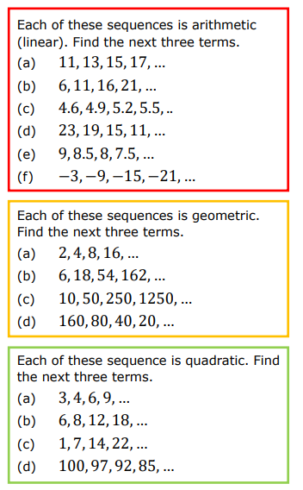

Slide 29
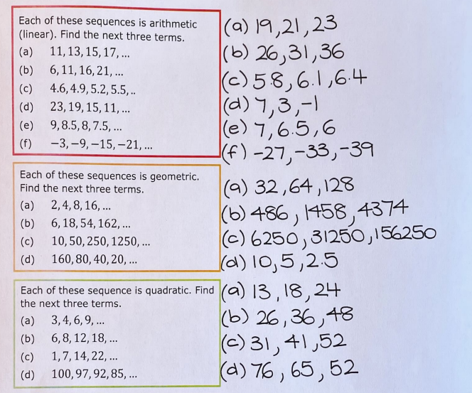

Slide 30
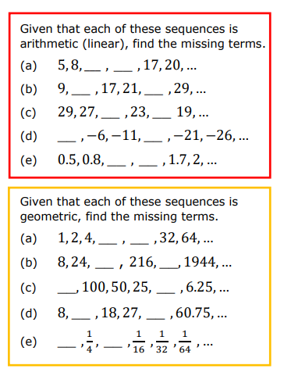
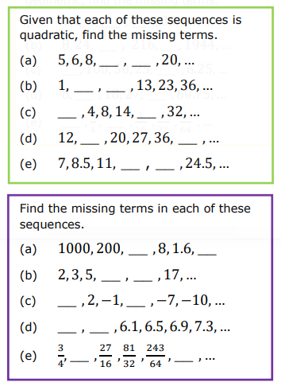

Slide 31
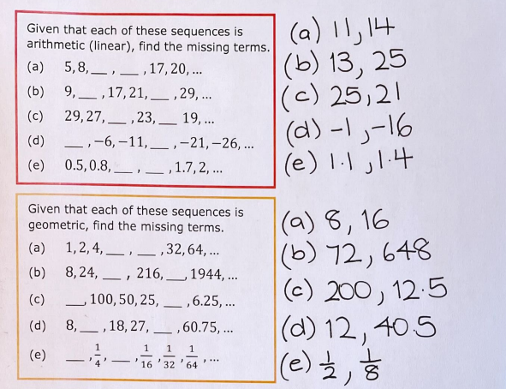
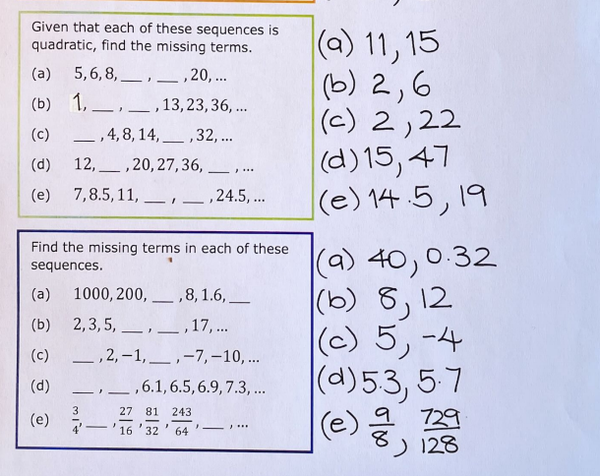

Slide 32
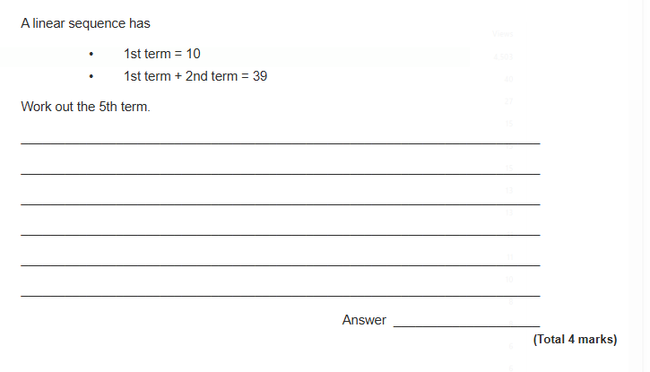
Exam Question 1

Slide 33
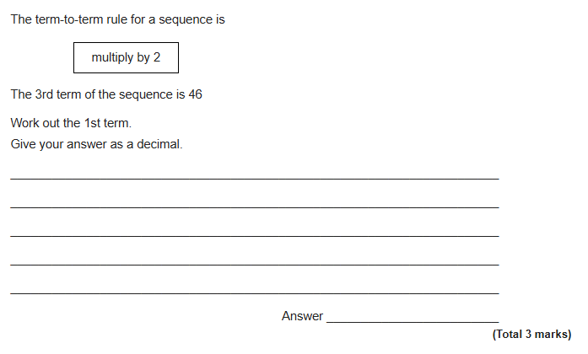
Exam Question 2

Slide 34
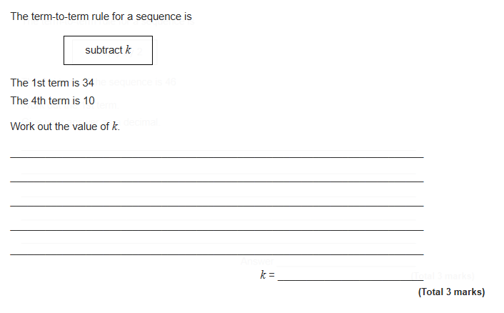
Exam Question 3

Slide 35
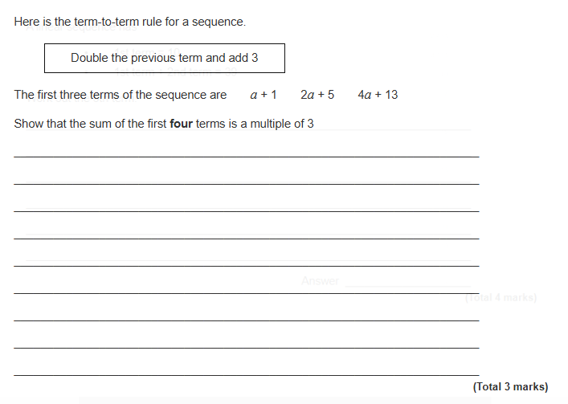
Exam Question 4

