Slide 1
Dual coding symbols:
Practise
Explain
Organise
Big Question
Reflect
Present
Compare
Evaluate
Activate
Discuss
Predict
Connect
Summarise
Recall
Vocabulary

Slide 2
Editable reading ruler
Every child in an Archway school will become a fluent reader
 | RETRIEVE the words or phrases you need from the text | DECODE the words or phrase to address a breakdown | CONNECT with words or phrases you know from the text or your memory | VISUALISE the images in as much detail as possible | SUMMARISE the main ideas of the text in a few words | INFER meanings that might be within the text | PREDICT what might happen next using details from the text | EXAMINE how the writer uses words to construct meaning
 | ASK THOUGHTFUL QUESTIONS TO HELP YOU UNDERSTAND THE TEXT

Slide 3
A
B

Slide 5
LESSON TITLE: Laws of Indices

Slide 6
Key vocabulary:
Decode the word
Definition
.
Indices
Examples
Non-examples

Slide 7
Evaluate:
$$6^{2}$$
$$4^{3}$$
$${10}^{1}$$
$$5^{0}$$
Evaluate:
$$8^{2}$$
$$2^{3}$$
$${13}^{1}$$
$$7^{0}$$

Slide 8
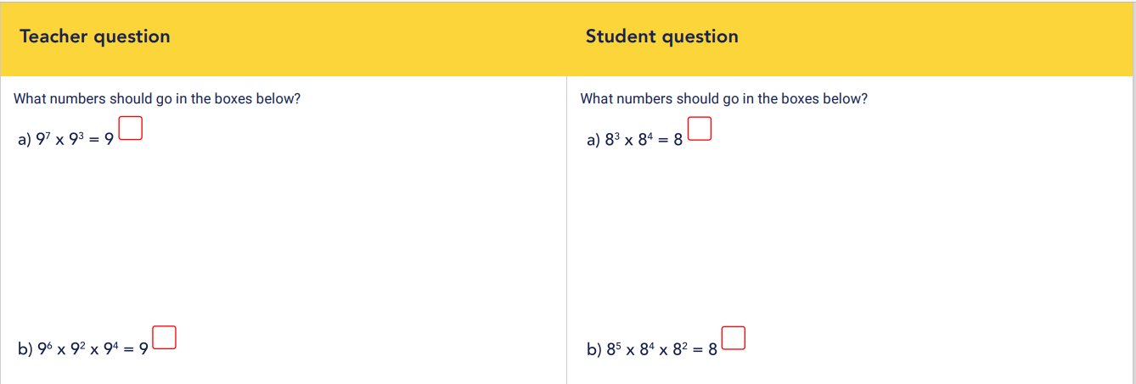

Slide 9
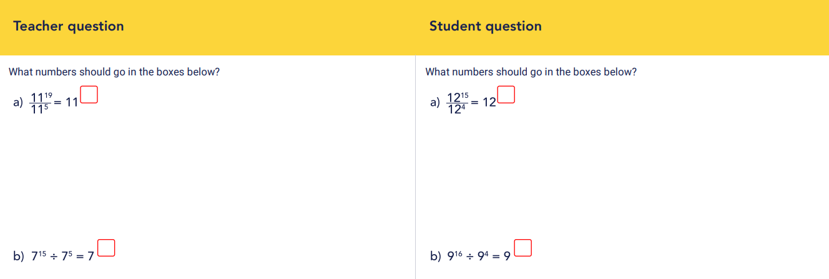

Slide 15
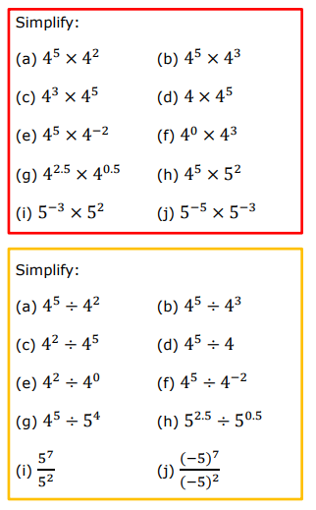
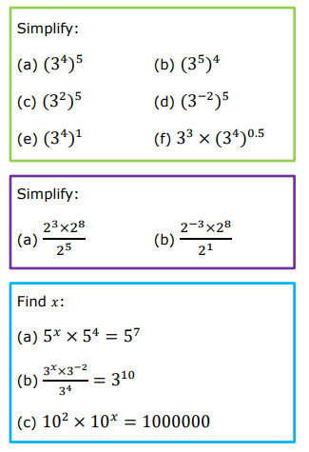

Slide 16
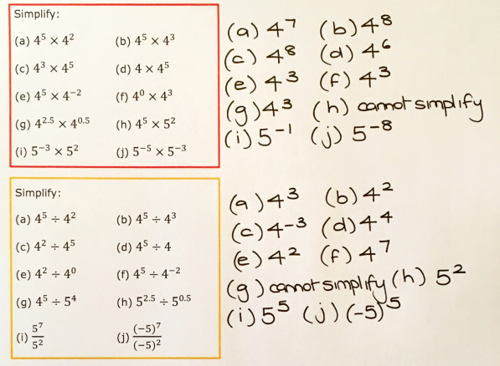
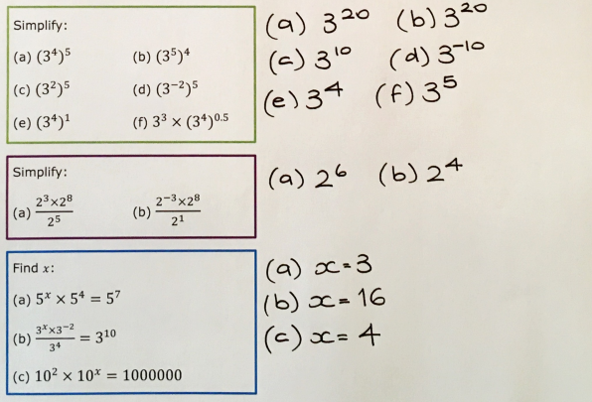

Slide 21
Fully simplify:
$${4x}^{3}×2x^{7}×3x^{2}$$
$${4x}^{3}×0.5x^{−7}×3x^{2}$$
$${5x}^{−3}×2x^{−7}×0.2x^{2}$$
Challenge: Write a different expression that simplifies to each answer

Slide 22
Fully simplify:
$$\frac{{9x}^{15}}{2x^{3}}$$
$${4x}^{7}÷2x^{3}$$
$$\frac{{9x}^{15}×{4x}^{3}}{2x^{3}}$$
$${2x}^{3}÷4x^{7}$$
Challenge: Write a different expression that simplifies to each answer

Slide 23
Fully simplify:
$${\left({4x}^{2}\right)}^{3}$$
$${\left({4x}^{2}\right)}^{3}×{\left({2x}^{4}\right)}^{2}$$
$$\frac{{6x}^{15}×{4x}^{3}}{{\left({2x}^{2}\right)}^{3}}$$
$${\left({2x}^{−2}\right)}^{5}$$
Challenge: Write a different expression that simplifies to each answer

Slide 24
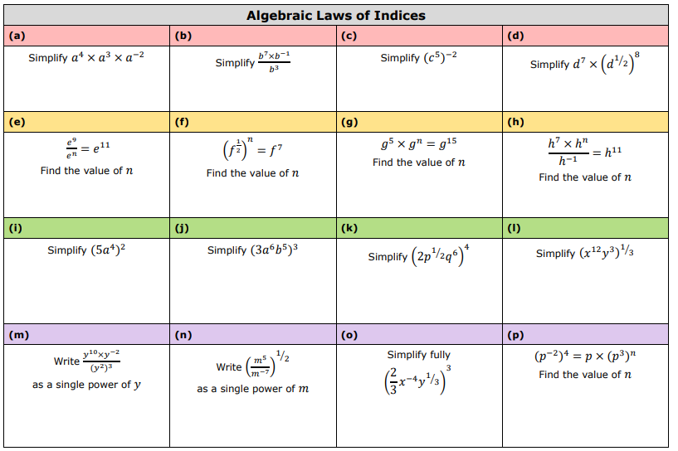

Slide 25
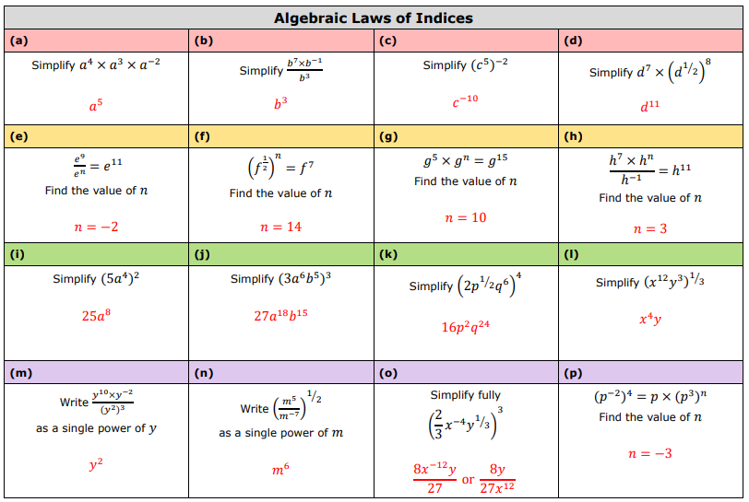

Slide 26
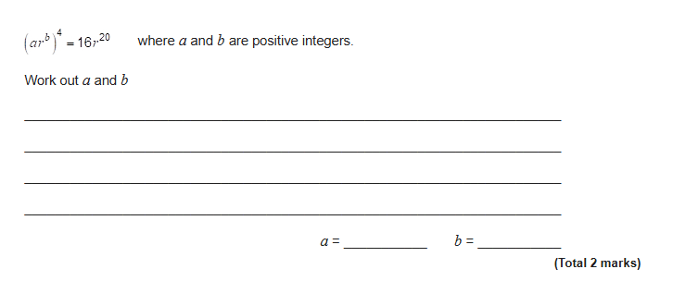
Exam Question

Slide 27
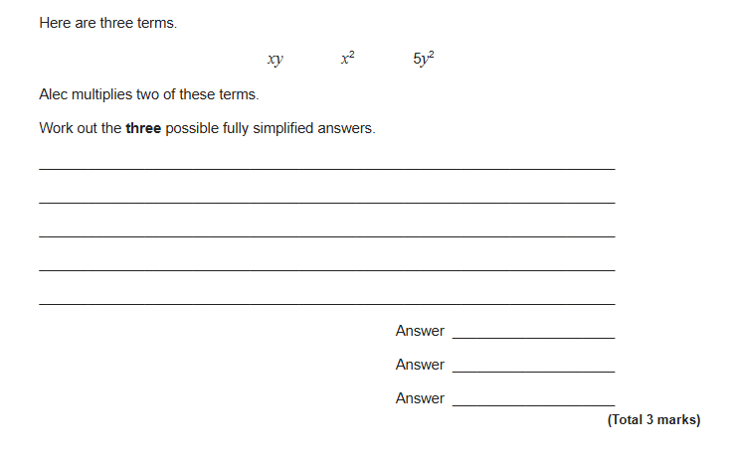
Exam Question

Slide 28
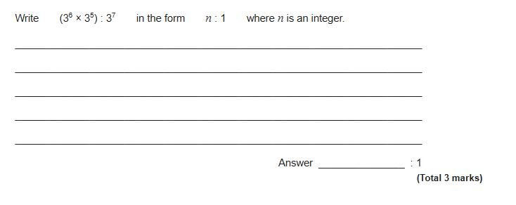
Exam Question

Slide 29
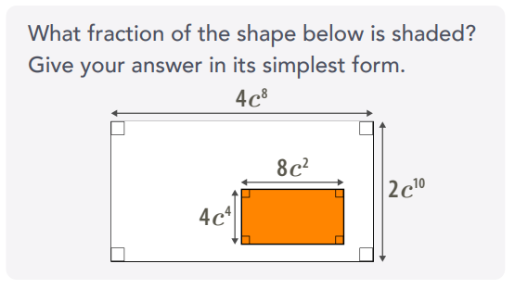
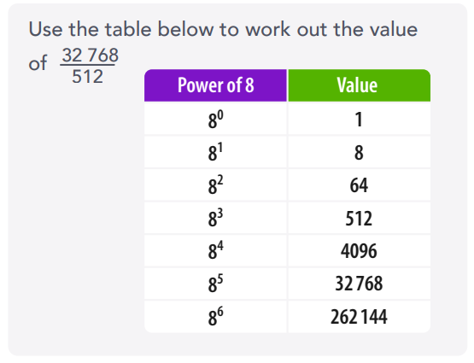
Further Problems

