Slide 1
Dual coding symbols:
Practise
Explain
Organise
Big Question
Reflect
Present
Compare
Evaluate
Activate
Discuss
Predict
Connect
Summarise
Recall
Vocabulary

Slide 2
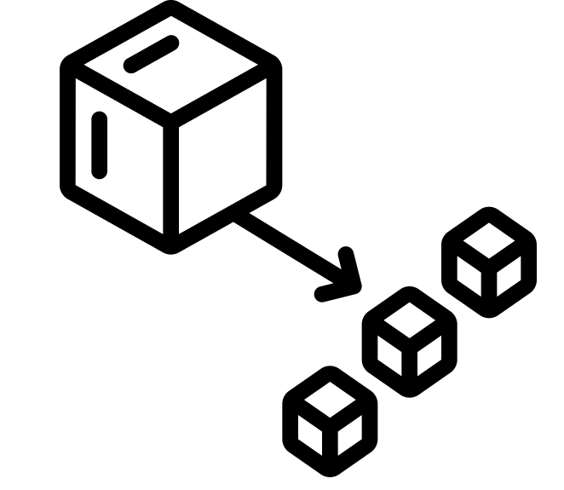
Editable reading ruler
Every child in an Archway school will become a fluent reader
 | RETRIEVE the words or phrases you need from the text | DECODE the words or phrase to address a breakdown | CONNECT with words or phrases you know from the text or your memory | VISUALISE the images in as much detail as possible | SUMMARISE the main ideas of the text in a few words | INFER meanings that might be within the text | PREDICT what might happen next using details from the text | EXAMINE how the writer uses words to construct meaning
 | ASK THOUGHTFUL QUESTIONS TO HELP YOU UNDERSTAND THE TEXT

Slide 3
A
B

Slide 5
LESSON TITLE: Laws of Indices

Slide 6
What pattern can you see?
How can we complete the table?
$$24$$ | $$16$$
$$23$$ | $$8$$
$$22$$ | $$4$$
$$21$$ | $$2$$
$$20$$ | $$1$$
$$2^{−1}$$ | $$\frac{1}{2}$$
$$2^{−2}$$ | $$\frac{1}{4}$$
÷ 2
÷ 2
÷ 2
÷ 2
÷ 2
÷ 2

Slide 7
What pattern can you see?
How can we complete the table?
$$34$$ | $$1×3×3×3×3$$ | $$81$$
$$33$$ | $$1×3×3×3$$ | $$27$$
$$32$$ | $$1×3×3$$ | $$9$$
$$31$$ | $$1×3$$ | $$3$$
$$30$$ | $$1$$ | $$1$$
$$3^{−1}$$ | $$1÷3$$ | $$\frac{1}{3}$$
$$3^{−2}$$ | $$1÷3÷3$$ | $$\frac{1}{9}$$
÷ 3
÷ 3
÷ 3
÷ 3
÷ 3
÷ 3

Slide 8
Key vocabulary:
Decode the word
Definition
.
Reciprocal
Examples
Non-examples

Slide 9
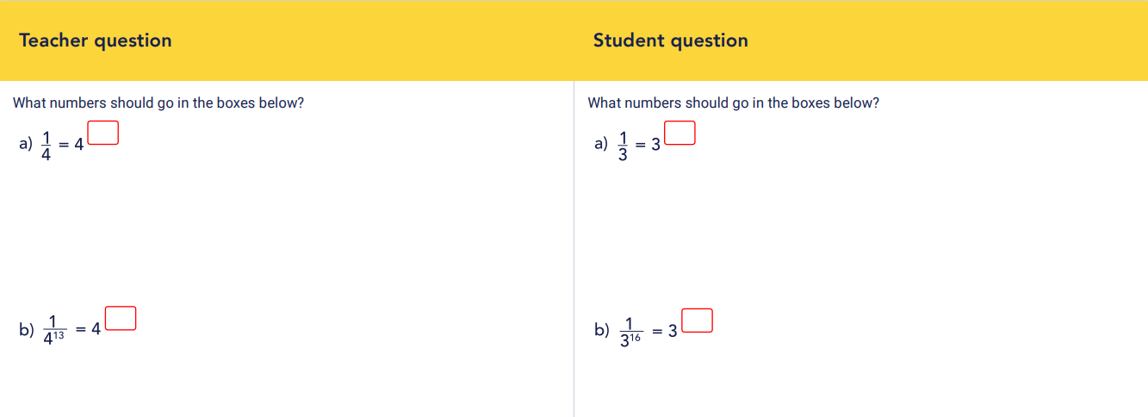

Slide 12
Work out ${\left(\frac{1}{2}\right)}^{−2}$
Work out ${\left(\frac{1}{4}\right)}^{−3}$

Slide 13
Work out ${\left(\frac{5}{2}\right)}^{−2}$
Work out ${\left(\frac{3}{4}\right)}^{−3}$

Slide 14
Work out ${0.2}^{−2}$
Work out ${0.7}^{−3}$

Slide 15
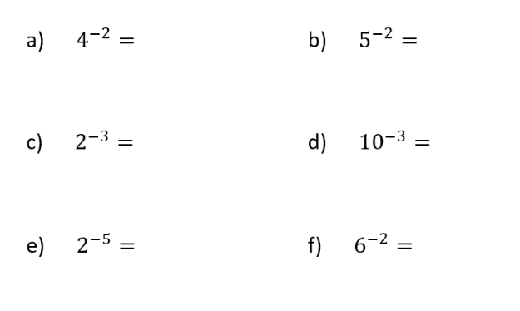
Evaluate:

Slide 16
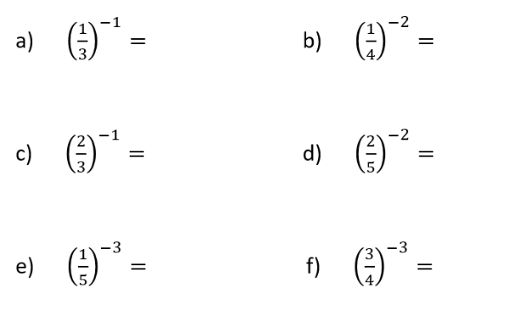
Evaluate:

Slide 17
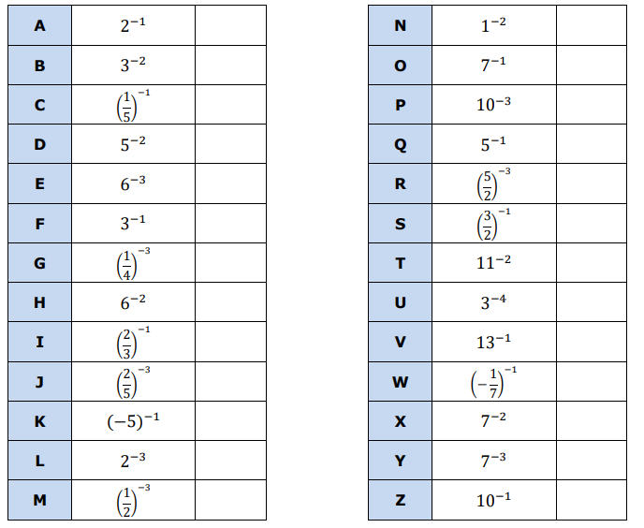
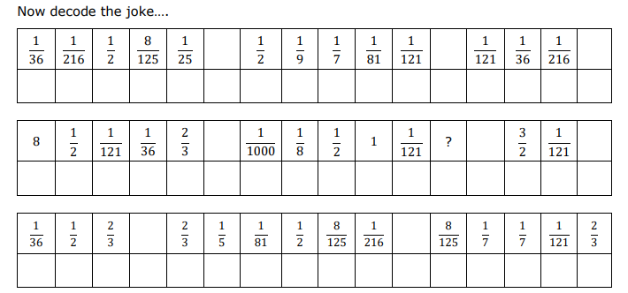
DECODE THE JOKE

Slide 18
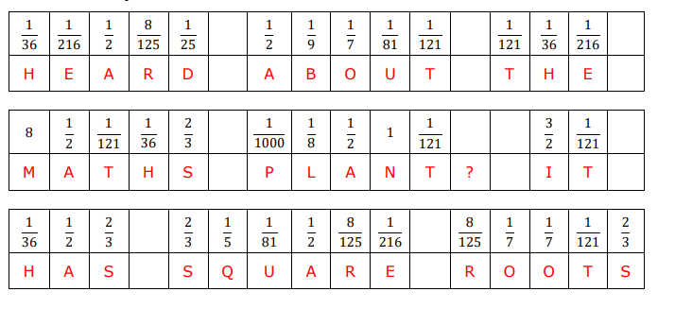

Slide 19
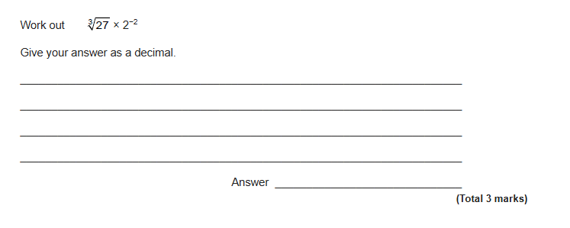
Exam Question

Slide 20
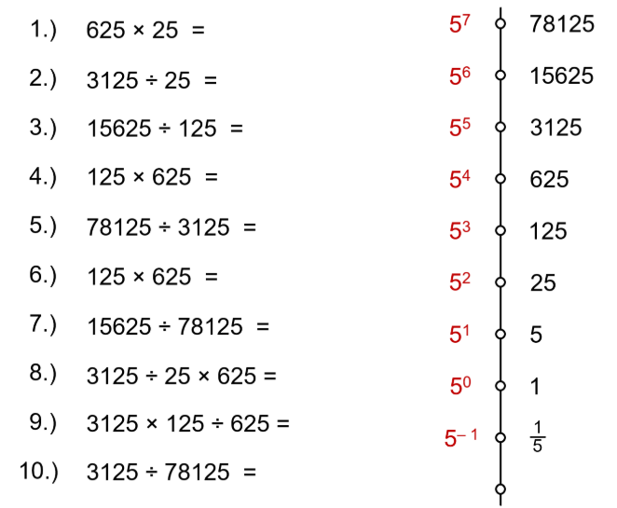
Use the powers of 5 to work out the following:

