Slide 1
Dual coding symbols:
Practise
Explain
Organise
Big Question
Reflect
Present
Compare
Evaluate
Activate
Discuss
Predict
Connect
Summarise
Recall
Vocabulary

Slide 2
Editable reading ruler
Every child in an Archway school will become a fluent reader
 | RETRIEVE the words or phrases you need from the text | DECODE the words or phrase to address a breakdown | CONNECT with words or phrases you know from the text or your memory | VISUALISE the images in as much detail as possible | SUMMARISE the main ideas of the text in a few words | INFER meanings that might be within the text | PREDICT what might happen next using details from the text | EXAMINE how the writer uses words to construct meaning
 | ASK THOUGHTFUL QUESTIONS TO HELP YOU UNDERSTAND THE TEXT

Slide 3
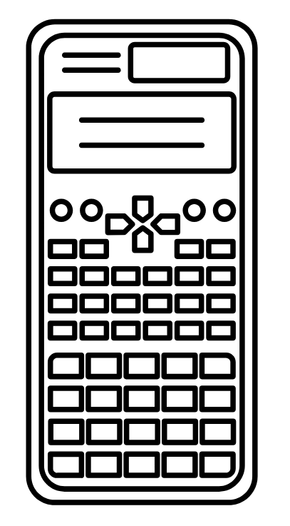
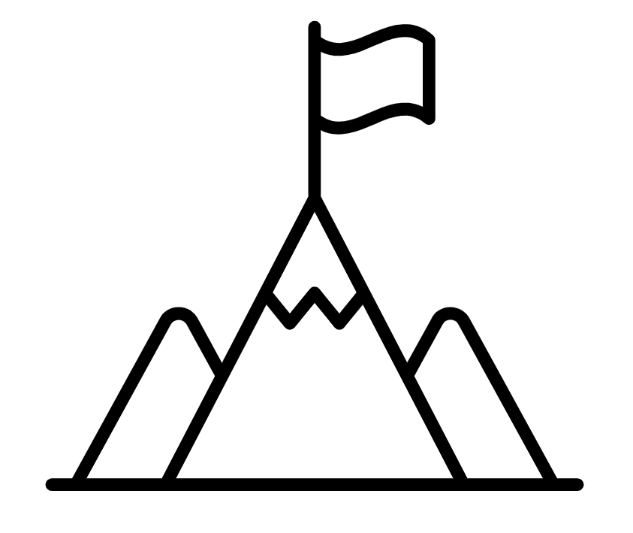
A
B

Slide 4
LESSON TITLE: Powers & Roots

Slide 5
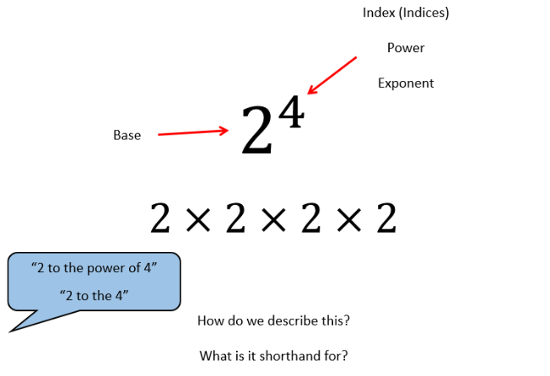

Slide 7
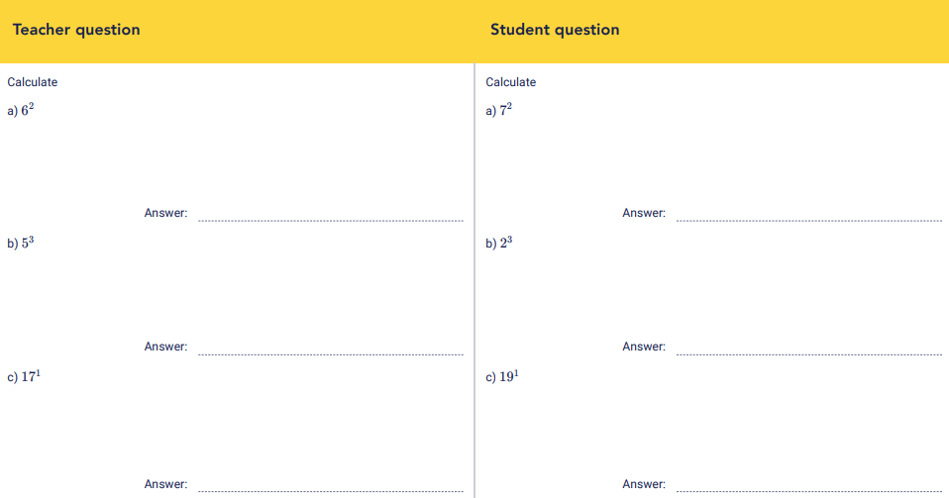

Slide 9
Evaluate ${(−3)}^{3}$
Evaluate ${(−2)}^{3}$

Slide 10
Evaluate ${(0.5)}^{2}$
Evaluate ${(0.7)}^{2}$

Slide 11
Evaluate ${\left(\frac{1}{9}\right)}^{2}$
Evaluate ${\left(\frac{2}{5}\right)}^{3}$

Slide 12
Evaluate
$$9^{2}$$
$$3^{3}$$
$$4^{3}$$

Slide 13
Evaluate
$${(−3)}^{2}$$
$${(−3)}^{3}$$
$${(−5)}^{3}$$

Slide 14
Evaluate
$${(0.8)}^{2}$$
$${(0.12)}^{2}$$
$${(0.4)}^{3}$$

Slide 15
Evaluate
$${\left(\frac{1}{4}\right)}^{2}$$
$${\left(\frac{1}{4}\right)}^{3}$$
$${\left(\frac{3}{4}\right)}^{2}$$
$${\left(\frac{3}{5}\right)}^{3}$$

Slide 16
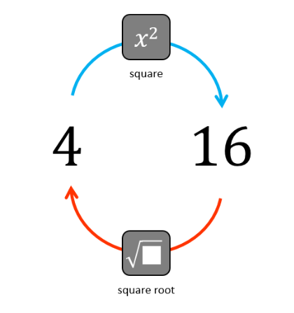
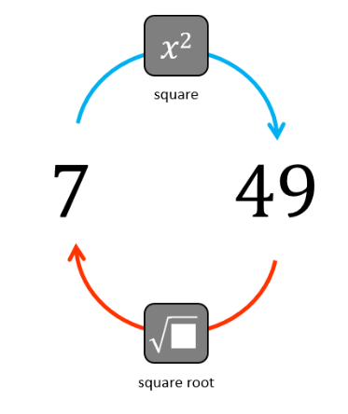
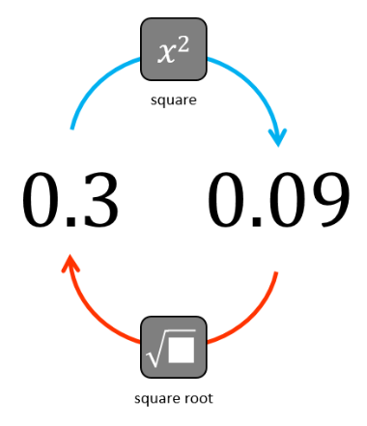

Slide 17
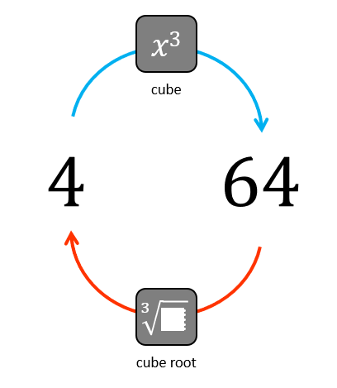
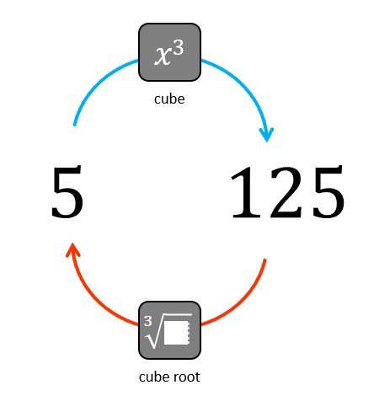
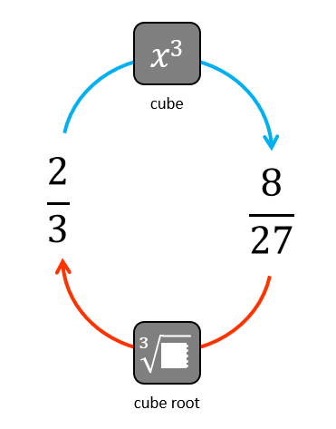

Slide 18
Evaluate $\sqrt{121}$
Evaluate $\sqrt{36}$

Slide 19
Evaluate $\sqrt[3]{125}$
Evaluate $\sqrt[3]{64}$

Slide 20
Evaluate $\sqrt[3]{−125}$
Evaluate $\sqrt[3]{−8}$

Slide 21
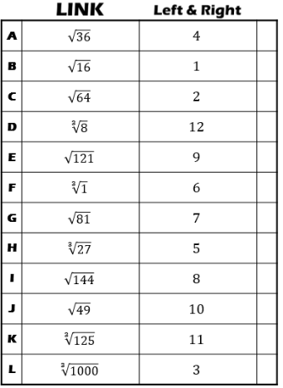

Slide 22
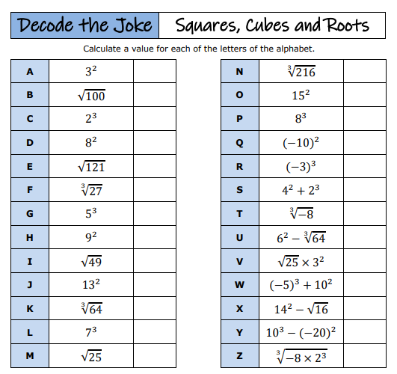
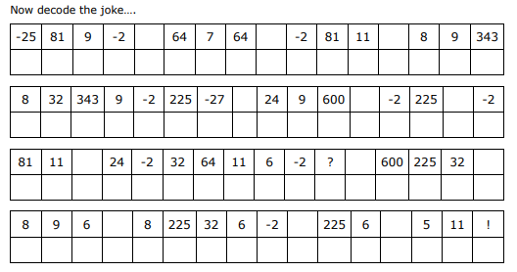

Slide 23
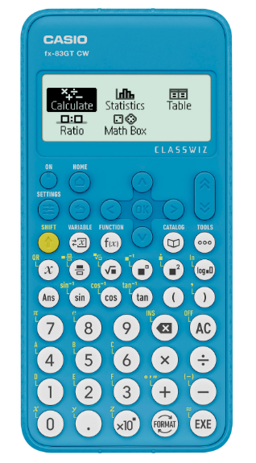
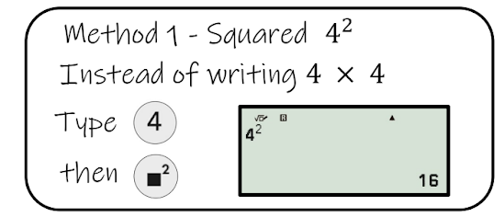
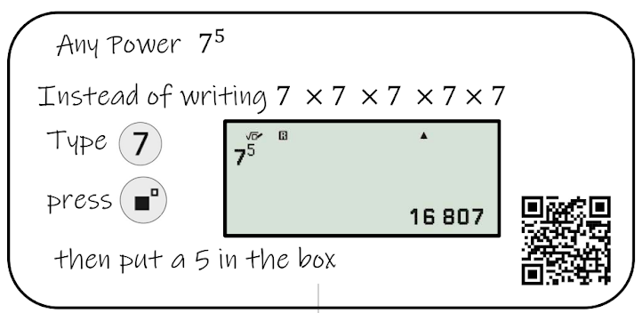

Slide 24
Evaluate ${(−0.5)}^{3}$
Round your answer to 1 decimal place
Evaluate ${(−0.8)}^{5}$
Round your answer to 1 decimal place

Slide 25
Evaluate $4^{−3}$
Round your answer to 1 decimal place
Evaluate $2^{−4}$
Round your answer to 1 decimal place

Slide 26
Evaluate ${\left(\frac{2}{9}\right)}^{−1}$
Evaluate ${\left(\frac{4}{3}\right)}^{−1}$

Slide 27
Enter $1\frac{1}{2}$
Shift > fraction button

Slide 28
Evaluate ${\left(3\frac{2}{9}\right)}^{−2}$
Evaluate ${\left(4\frac{1}{3}\right)}^{−1}$

Slide 29
Enter $\sqrt{225}$
> Square root button

Slide 30
Enter $\sqrt[3]{125}$
Shift > Square root button

Slide 31
Evaluate
$$\sqrt{324}$$
$$\sqrt[3]{729}$$
$$\sqrt[3]{2744}$$

Slide 32
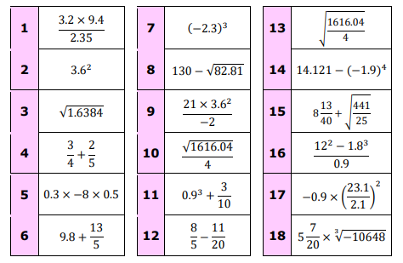
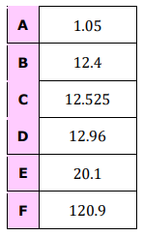
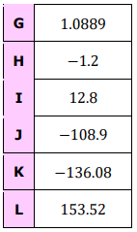
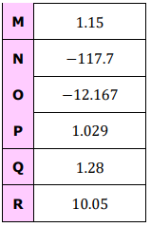

Slide 33
Exam Question

Slide 34
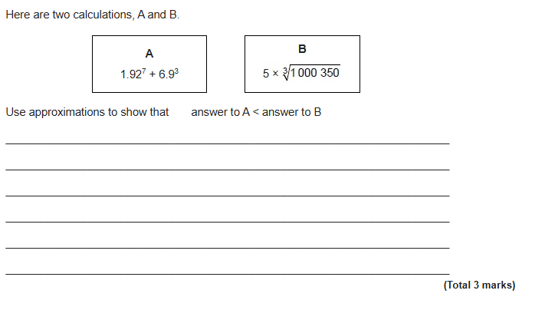
Exam Question

