Slide 1
Dual coding symbols:
Practise
Explain
Organise
Big Question
Reflect
Present
Compare
Evaluate
Activate
Discuss
Predict
Connect
Summarise
Recall
Vocabulary

Slide 2
Editable reading ruler
Every child in an Archway school will become a fluent reader
 | RETRIEVE the words or phrases you need from the text | DECODE the words or phrase to address a breakdown | CONNECT with words or phrases you know from the text or your memory | VISUALISE the images in as much detail as possible | SUMMARISE the main ideas of the text in a few words | INFER meanings that might be within the text | PREDICT what might happen next using details from the text | EXAMINE how the writer uses words to construct meaning
 | ASK THOUGHTFUL QUESTIONS TO HELP YOU UNDERSTAND THE TEXT

Slide 3
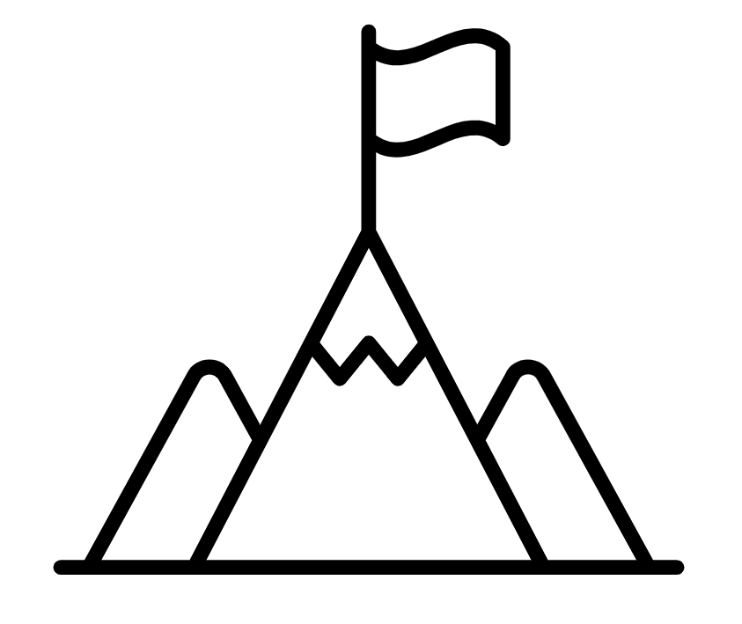
A
B

Slide 5
LESSON TITLE: Finding the nth term of a Quadratic sequence

Slide 6
Linear Sequences Revision
3
6
9
12
15
8
11
14
17
20
+3
+3
+3
+3
These are called the first differences
This sequence is the three times table add five
3n
+ 5

Slide 7
What is the n^{th} term?
2
4
6
8
10
8
10
12
14
16
+2
+2
+2
+2
2n
+ 6

Slide 8
What is the n^{th} term?
10
20
30
40
50
8
18
28
38
48
+10
+10
+10
+10
10n
- 2

Slide 9
What is the n^{th} term?
-10
-20
-30
-40
-50
8
-2
-12
-22
-32
-10
-10
-10
-10
-10n
+ 18

Slide 10
What is the same?
What is different?
What is the n^{th} term?
1
4
9
16
25
These are called the first differences
+3
+5
+7
+9
These are called the second differences
+2
+2
+2

Slide 11
These are the square numbers.
The n^{th} term of this sequence is $n^{2}$.
The second difference is always constant for a quadratic sequence.
1
4
9
16
25
+3
+5
+7
+9
+2
+2
+2

Slide 12
Here we have the sequence of ${2n}^{2}$
Work out the value of the second difference
2
8
18
32
50
+6
+10
+14
+18
+4
+4
+4

Slide 13
Here we have the sequence of ${3n}^{2}$
Work out the value of the second difference
3
12
27
48
75
+9
+15
+21
+27
+6
+6
+6

Slide 14
Here we have the sequence of ${10n}^{2}$
What do you expect the value of the second difference to be?
Are you correct?
10
40
90
160
250
+30
+50
+70
+90
+20
+20
+20

Slide 15
$${ 5n}^{2}$$
What is the nth term?
5
20
45
80
125
+15
+25
+35
+45
+10
+10
+10

Slide 16
What is the nth term?
7
22
47
82
127
+15
+25
+35
+45
${ 5n}^{2}$?
+10
+10
+10

Slide 17
What is the nth term?
5
20
45
80
125
7
22
47
82
127
$${5n}^{2}+2$$

Slide 18
n | 1 | 2 | 3 | 4 | 5
Original | 6 | 9 | 14 | 21 | 30
n² | 1 | 4 | 9 | 16 | 25
Remainder
n | 1 | 2 | 3 | 4 | 5
Original | 13 | 16 | 21 | 28 | 37
n² | 1 | 4 | 9 | 16 | 25
Remainder

Slide 19
n | 1 | 2 | 3 | 4 | 5
Original
Remainder
n | 1 | 2 | 3 | 4 | 5
Original
Remainder

Slide 20
n | 1 | 2 | 3 | 4 | 5
Original
Remainder
n | 1 | 2 | 3 | 4 | 5
Original
Remainder

Slide 21
n | 1 | 2 | 3 | 4 | 5
Original
Remainder
n | 1 | 2 | 3 | 4 | 5
Original
Remainder

Slide 22
n | 1 | 2 | 3 | 4 | 5
Original
Remainder
n | 1 | 2 | 3 | 4 | 5
Original
Remainder

Slide 23
n | 1 | 2 | 3 | 4 | 5
Original
Remainder
n | 1 | 2 | 3 | 4 | 5
Original
Remainder

Slide 24
n | 1 | 2 | 3 | 4 | 5
Original
Remainder
n | 1 | 2 | 3 | 4 | 5
Original
Remainder

Slide 25
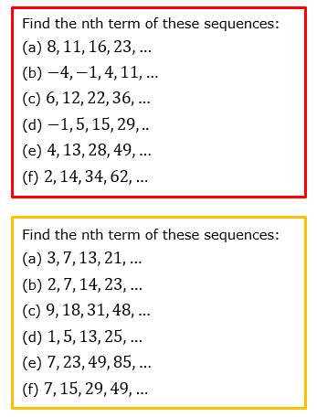

Slide 27
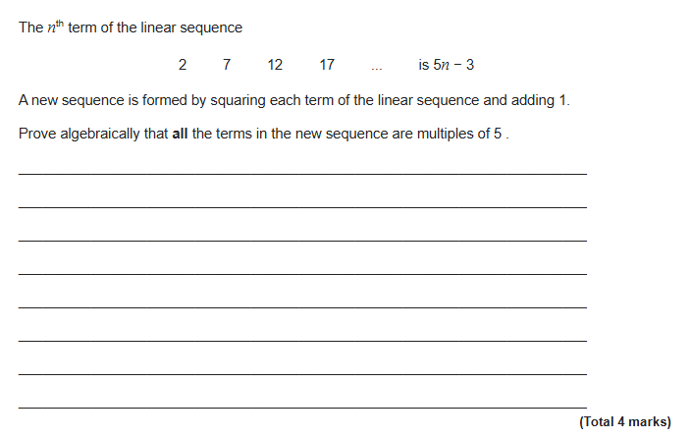
EXAM QUESTION

