Slide 1
Dual coding symbols:
Practise
Explain
Organise
Big Question
Reflect
Present
Compare
Evaluate
Activate
Discuss
Predict
Connect
Summarise
Recall
Vocabulary

Slide 2
Editable reading ruler
Every child in an Archway school will become a fluent reader
 | RETRIEVE the words or phrases you need from the text | DECODE the words or phrase to address a breakdown | CONNECT with words or phrases you know from the text or your memory | VISUALISE the images in as much detail as possible | SUMMARISE the main ideas of the text in a few words | INFER meanings that might be within the text | PREDICT what might happen next using details from the text | EXAMINE how the writer uses words to construct meaning
 | ASK THOUGHTFUL QUESTIONS TO HELP YOU UNDERSTAND THE TEXT

Slide 3
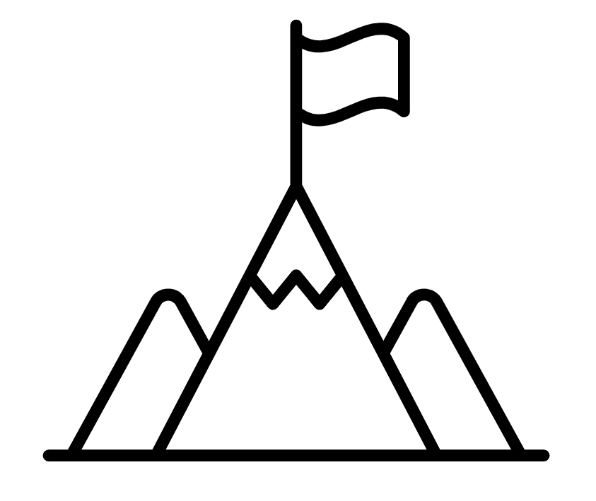
A
B

Slide 4
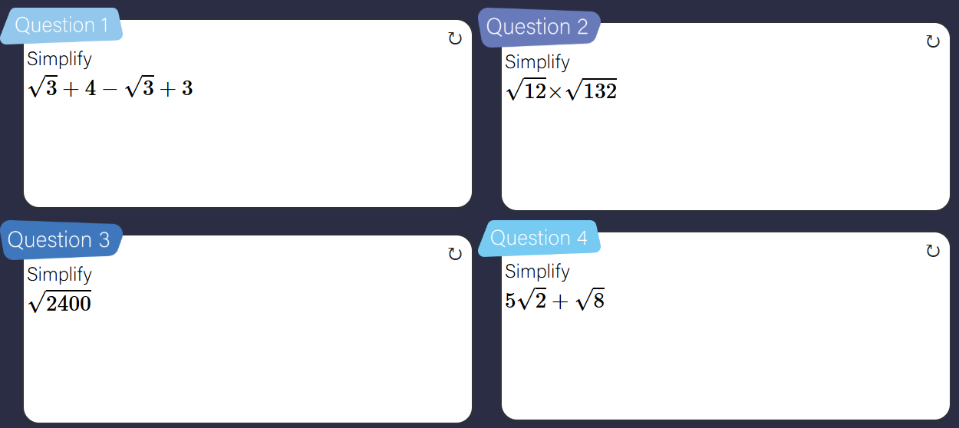

Slide 5
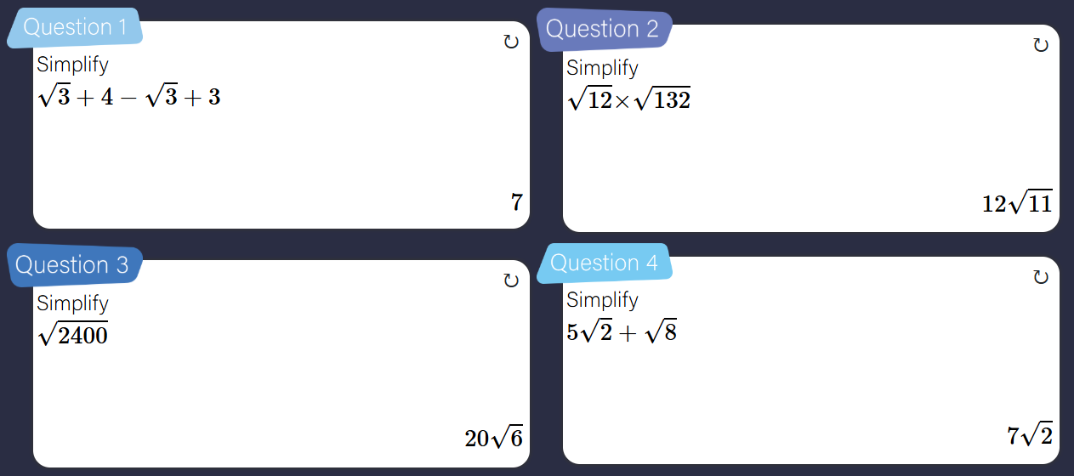

Slide 6
LESSON TITLE: Sequences and Surds

Slide 7
$$\sqrt{3}, 3\sqrt{3}, 5\sqrt{3}…$$
This is a linear sequence
What is the next term?
What is the nth term?
$$5\sqrt{2}, 8\sqrt{2}, 11\sqrt{2}…$$
This is a linear sequence
What is the next term?
What is the nth term?

Slide 8
$$10\sqrt{2}, 7\sqrt{2}, 4\sqrt{2}…$$
This is a linear sequence
What is the next term?
What is the nth term?
$$5\sqrt{2}, −3\sqrt{2}, −11\sqrt{2}…$$
This is a linear sequence
What is the next term?
What is the nth term?

Slide 10
$\sqrt{2}$, $2, 2\sqrt{2}$…
This is a geometric sequence
What is the term to term rule?
What is the next term?
$3\sqrt{2}$, $6, 6\sqrt{2}$…
This is a geometric sequence
What is the term to term rule?
What is the next term?

Slide 11
$\frac{\sqrt{3}}{2}$, $\frac{\sqrt{6}}{2}, \sqrt{3}…$
This is a geometric sequence
What is the term to term rule?
What is the next term?
$\frac{4\sqrt{3}}{3}$, $4, 4\sqrt{3}$…
This is a geometric sequence
What is the term to term rule?
What is the next term?

Slide 12
$\frac{\sqrt{5}}{3}$, $\frac{5}{9}, \frac{5\sqrt{5}}{27}…$
This is a geometric sequence
What is the term to term rule?
What is the next term?
$\frac{\sqrt{2}}{9}$, $\frac{\sqrt{6}}{36}, \frac{\sqrt{2}}{48}$…
This is a geometric sequence
What is the term to term rule?
What is the next term?

Slide 13
$$(1+\sqrt{2})^{n}$$
Work out the 2nd term
$$(3+\sqrt{3})^{n}$$
Work out the 2nd term

Slide 14
$$(1+\sqrt{2})^{n}$$
Work out the 3rd term
$$(3+\sqrt{3})^{n}$$
Work out the 3rd term

Slide 15
$$(1+6\sqrt{2})^{n}$$
Work out the 2nd term
$$(3+5\sqrt{3})^{n}$$
Work out the 2nd term

Slide 16
What is the nth term of this linear sequence?
$5\sqrt{3}, 7\sqrt{3}$, $9\sqrt{3}…$

Slide 17
What is the nth term of this linear sequence?
$2\sqrt{3}, 5\sqrt{3}$, $8\sqrt{3}…$

Slide 18
What is the nth term of this linear sequence?
$−2\sqrt{3}, −5\sqrt{3}$, $−8\sqrt{3}…$

Slide 19
What is the next term of this geometric progression?
$\sqrt{3},\sqrt{6}$, $2\sqrt{3}…$
Give your answer in the simplest form

Slide 20
What is the next term of this geometric progression?
$2\sqrt{3}, 12$, $24\sqrt{3}…$
Give your answer in the simplest form

Slide 21
What is the next term of this geometric progression?
$2\sqrt{3}, 12\sqrt{2}$, $48\sqrt{3}…$
Give your answer in the simplest form

Slide 22
Work out the 2nd term
$$2(n+\sqrt{3})$$
Give your answer in the simplest form

Slide 23
Work out the 2nd term
$$(5+\sqrt{3})^{n}$$
Give your answer in the simplest form

Slide 24
Work out the 3rd term
$$(5+\sqrt{3})^{n}$$
Give your answer in the simplest form

Slide 25
Work out the 3rd term
$$(n−\sqrt{3})^{n}$$
Give your answer in the simplest form

Slide 26
Work out the 3rd term
$$(n−5\sqrt{3})^{n}$$
Give your answer in the simplest form

Slide 27
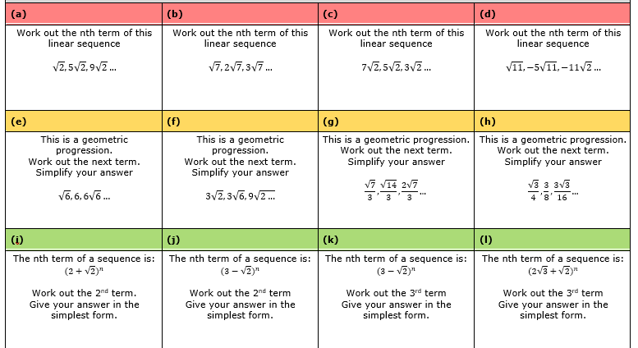

Slide 28
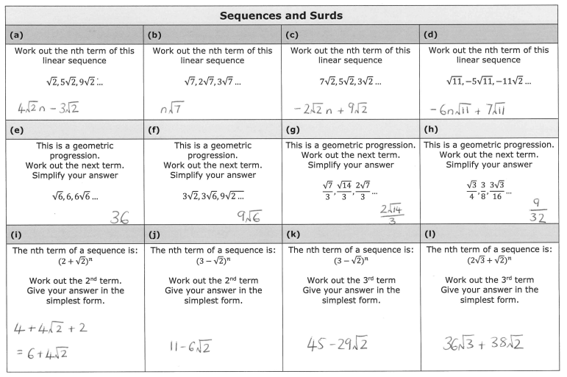

Slide 29
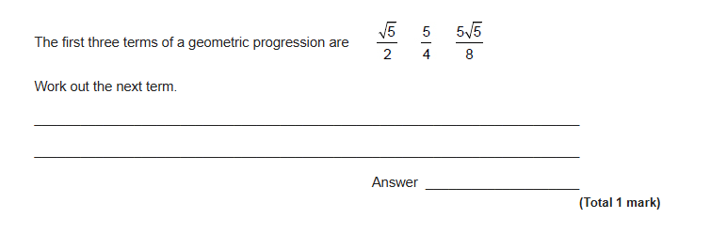
EXAM QUESTION

Slide 30
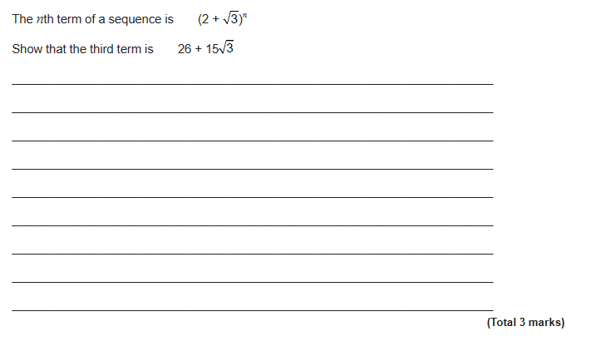
EXAM QUESTION

Slide 31
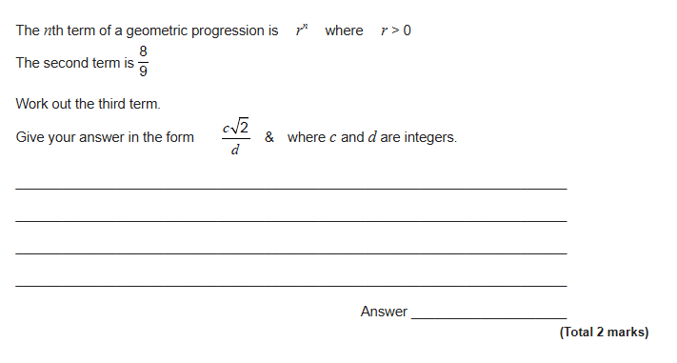
EXAM QUESTION

