Slide 1
Dual coding symbols:
Practise
Explain
Organise
Big Question
Reflect
Present
Compare
Evaluate
Activate
Discuss
Predict
Connect
Summarise
Recall
Vocabulary

Slide 2
Editable reading ruler
Every child in an Archway school will become a fluent reader
 | RETRIEVE the words or phrases you need from the text | DECODE the words or phrase to address a breakdown | CONNECT with words or phrases you know from the text or your memory | VISUALISE the images in as much detail as possible | SUMMARISE the main ideas of the text in a few words | INFER meanings that might be within the text | PREDICT what might happen next using details from the text | EXAMINE how the writer uses words to construct meaning
 | ASK THOUGHTFUL QUESTIONS TO HELP YOU UNDERSTAND THE TEXT

Slide 3
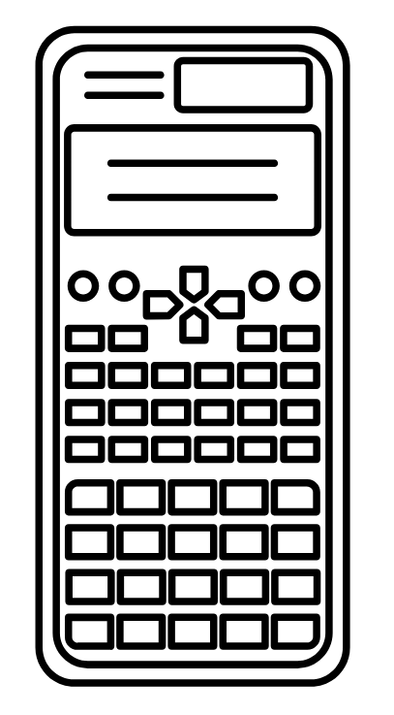
A
B

Slide 4
LESSON TITLE: Standard Form

Slide 5
Calculate:
Calculate:
1)
15.08 × 1000 =
1)
5 × 10
1)
2.7 × 100
65.03 ÷ 10000 =
2)
2)
5 × 100
2)
0.09 × 100
3)
a quarter × ten ×
one hundred thousand =
3)
12 × 100
3)
4.07 × 1000
4)
9 × 1000
4)
178 ÷ 100
4)
4.03 multiplied by
one million then
divided by
one thousand equals…
5)
600 ÷ 10
5)
6.5 ÷ 1000
6)
8300 ÷ 100
6)
109 × 10 ÷ 100
5)
A factory uses 630 kg
of flour per day to
produce 3000 cakes.
How much flour is in a
box of 4 cakes?
7)
9000 ÷ 100
7)
0.0108 ÷ 10 × 1000
8)
0.9 × 100
8)
17 × ten thousand
9)
15 ÷ 10
9)
6 ÷ 2 thousand

Slide 6
Calculate:
Calculate:
1)
15.08 × 1000 =
15 080
1)
5 × 10
50
1)
2.7 × 100
270
65.03 ÷ 10000 =
2)
0.006503
2)
5 × 100
500
2)
0.09 × 100
9
3)
a quarter × ten ×
one hundred thousand =
3)
12 × 100
1 200
3)
4.07 × 1000
4 070
250 000
4)
9 × 1000
9 000
4)
178 ÷ 100
1.78
4)
4.03 multiplied by
one million then
divided by
one thousand equals…
5)
600 ÷ 10
60
5)
6.5 ÷ 1000
0.0065
6)
8300 ÷ 100
83
6)
109 × 10 ÷ 100
10.9
4 030
5)
A factory uses 630 kg
of flour per day to
produce 3000 cakes.
How much flour is in a
box of 4 cakes?
7)
9000 ÷ 100
90
7)
0.0108 ÷ 10 × 1000
1.08
8)
0.9 × 100
90
8)
17 × ten thousand
170 000
9)
15 ÷ 10
1.5
9)
6 ÷ 2 thousand
0.003
0.84 kg

Slide 7
Key vocabulary:
Decode the word
Definition
.
Standard Form
Examples
Non-examples

Slide 12
Write as ordinary numbers
$${2.5×10}^{4}$$
$${2.05×10}^{3}$$
$${2.51×10}^{3}$$

Slide 13
Convert to Standard Form
$$6000$$
$$6200$$
$$60200$$
$$6 million$$

Slide 14
Convert to Standard Form
$$15×{10}^{2}$$
$$150×{10}^{3}$$
$$15.9×{10}^{4}$$

Slide 15
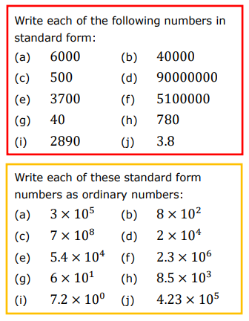
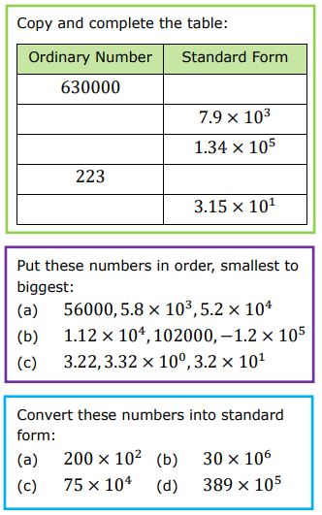
Writing large numbers in standard form

Slide 16
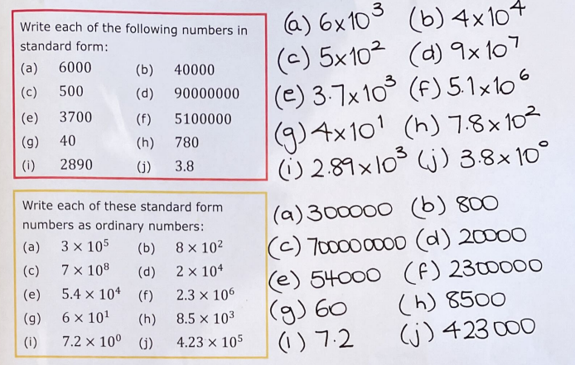
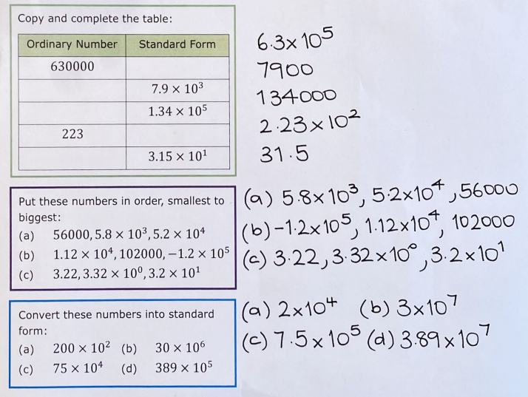

Slide 17
Ordinary Number | Standard Form
6000 | 6 × 10³
600 | 6 × 10²
60 | 6 × 10¹
6 | 6 × 10⁰
0.6 | 6 × 10⁻¹
0.06 | 6 × 10⁻²
0.006 | 6 × 10⁻³
A negative power means
the reciprocal.
10⁻³
‘how many times to
divide by that number’
6 × 10⁻³
= 6 × $\frac{1}{103}$
= $\frac{6}{1000}$
10⁰
= $1$
= $\frac{1}{101}$
= $\frac{1}{10}$
10⁻¹
= $\frac{1}{102}$
= $\frac{1}{100}$
10⁻²
= $\frac{1}{103}$
= $\frac{1}{1000}$
10⁻³

Slide 21
Write as ordinary numbers
$${2.5×10}^{−4}$$
$${2.05×10}^{−3}$$
$${2.51×10}^{−3}$$

Slide 22
Convert to Standard Form
$$0.07$$
$$0.072$$
$$0.0702$$
$$Seven tenths$$

Slide 23
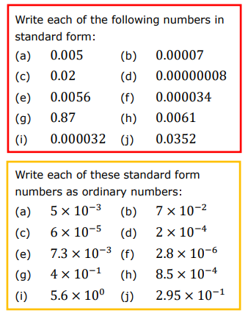
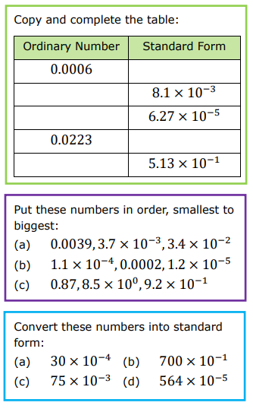

Slide 24
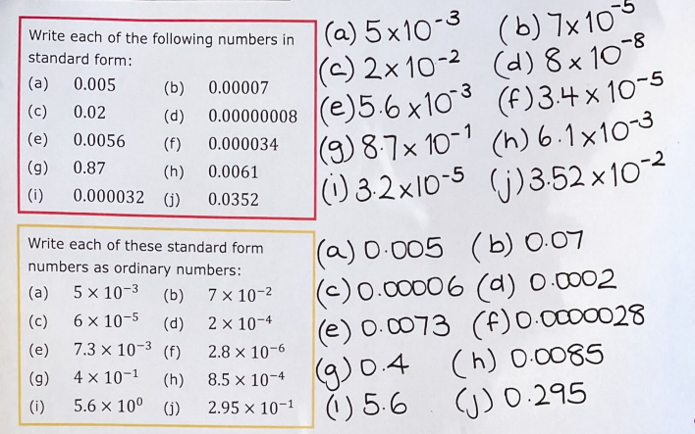
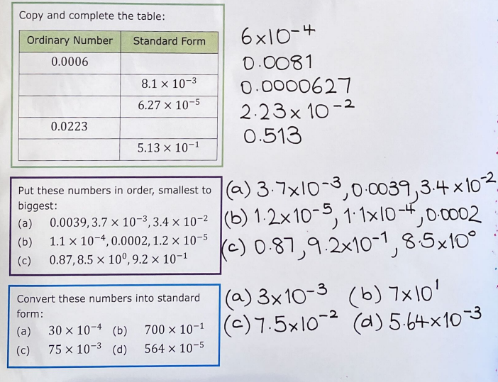

Slide 25
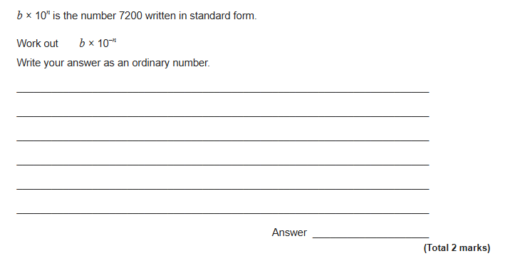
Exam Question

Slide 26
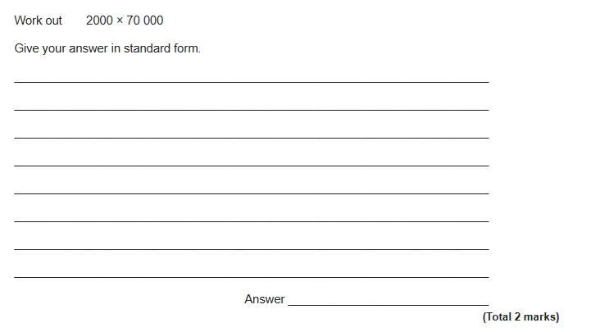
Exam Question

Slide 27
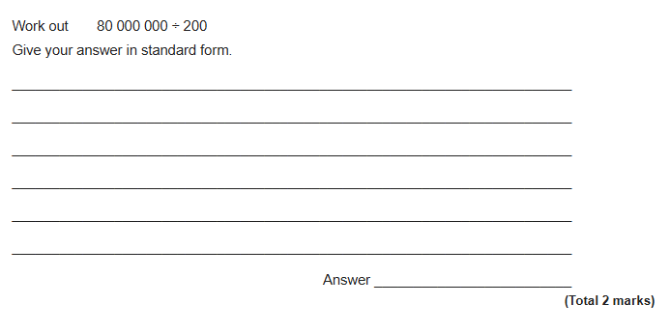
Exam Question

Slide 28
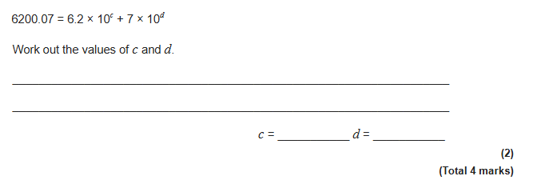
Exam Question

Slide 29
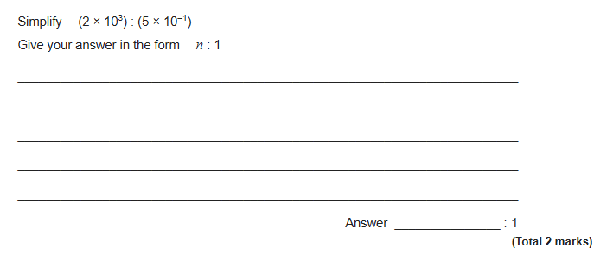
Exam Question (Higher)

