Slide 1
10 mins
Rolling Recall – Year 9 – Autumn 1 - Start
ANSWERS
Maths Challenge Questions
11
£10:£40
1/6
54
$x^{7}$
6) $9x+27$
7) Any value less than 3
8) $x=4$
9) $2n+1$
10) $£90$
Notes:
Challenge questions from UKMT junior maths challenge 2020 Q1, 17

Slide 2
Challenge 1
Challenge 2
Notes:
Challenge questions from UKMT junior maths challenge 2015 Q4, 11
Further investigation problems can be found in this doc https://www.ukmt.org.uk/sites/default/files/ukmt/junior-mathematical-challenge/JMC-2020-extended.pdf

Slide 3
10 mins
Rolling Recall – Year 9 – Autumn 1 - Middle
ANSWERS
Challenge
10.5
£24:£36
2/9
113
$x^{2}$
$2x−6$
5, 6, 7…
$x=15$
$6n−3$
96
Notes:
Challenge questions from UKMT junior maths challenge 2020 Q2, 18

Slide 4
Challenge 1
Challenge 2
Notes:
Challenge questions from UKMT junior maths challenge 2015 Q12, 14
Further investigation problems can be found in this doc https://www.ukmt.org.uk/sites/default/files/ukmt/junior-mathematical-challenge/JMC-2020-extended.pdf

Slide 5
10 mins
Rolling Recall – Year 9 – Autumn 1 - End
ANSWERS
Challenge
7
£42: £28
2/15
45
$2x^{8}$
$8+4y$
4, 5, 6…
$x=10$
2n+8
£110
Notes:
Challenge questions from UKMT junior maths challenge 2015 Q17, 24

Slide 6
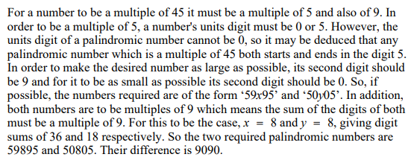
Challenge 1
Challenge 2
Notes:
Challenge questions from UKMT junior maths challenge 2020 Q3, 20
Further investigation problems can be found in this doc https://www.ukmt.org.uk/sites/default/files/ukmt/junior-mathematical-challenge/JMC-2020-extended.pdf

