Slide 1
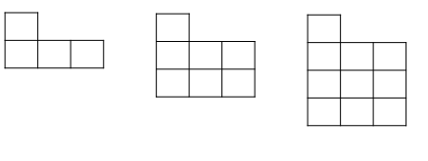
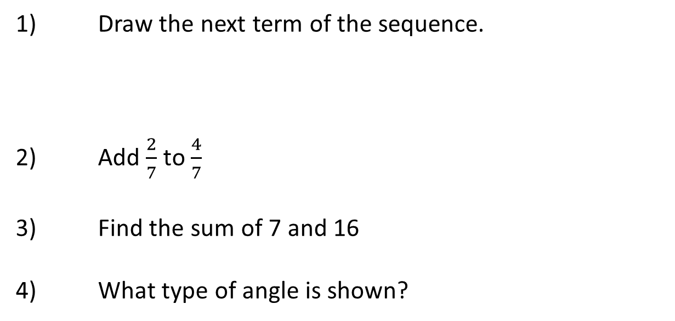
Representing Sequences
1) Draw the next term of the sequence.
2) Add $\frac{2}{7}$ to $\frac{4}{7}$
3) Find the sum of 7 and 16
4) What type of angle is shown?
Vocabulary check: Percent

Slide 2
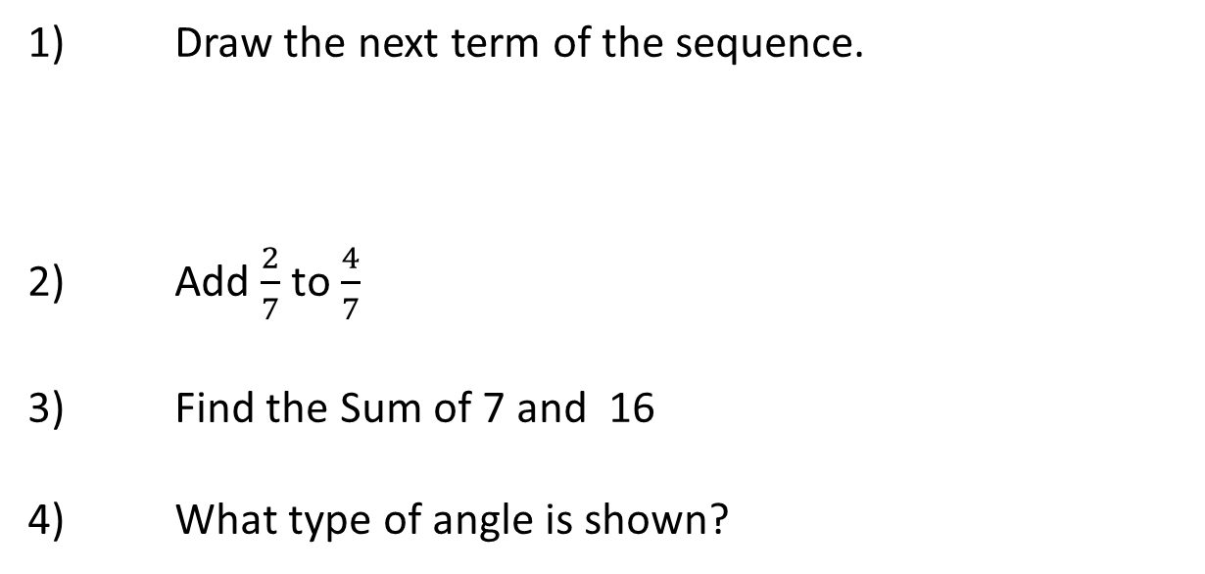

Answers
1) Draw the next term of the sequence.
2) Add $\frac{2}{7}$ to $\frac{4}{7}$
3) Find the Sum of 7 and 16
4) What type of angle is shown?
$\frac{6}{7}$
23
Obtuse
Vocabulary check: Percent

Slide 3
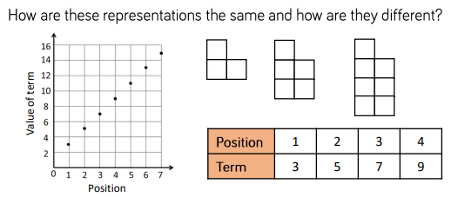

What do you notice?
Can you draw the next term?
Key word

Slide 4
What do you notice?
5
?
11
?
Can you fill in the missing numbers?

Slide 5
What does this show?

Slide 6
How are these linked?
How many squares would be in the 7th pattern?

Slide 7
What do these have in common?
What is different about them?

Slide 8

We Do
Draw the next two terms of the following sequence:

Slide 9
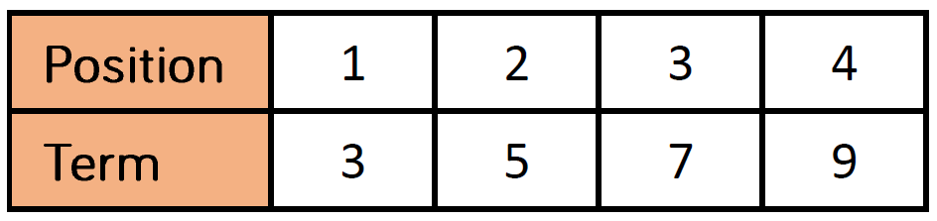
We Do
Draw the next two terms of the following sequence:
Use your sequence to complete the table:
1
2
3
4
Value of Term
1
4
7
10

Slide 10
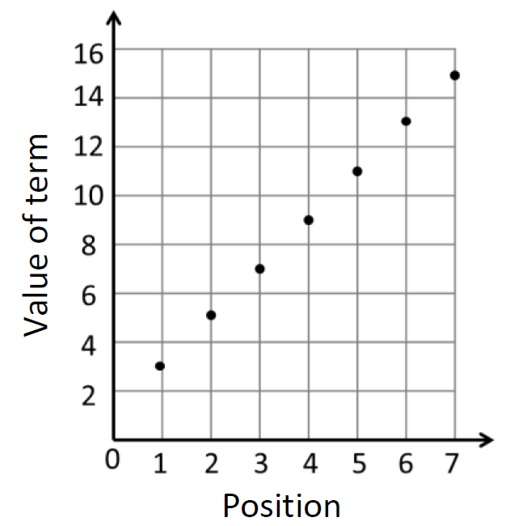
We Do
How could you represent this sequence on a graph?
1
2
3
4
Value of Term
1
4
7
10

Slide 11
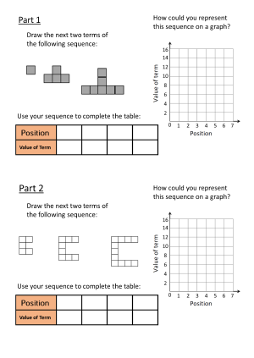
You Do
In full sentences, summarise what you have discovered about the two sequences in parts 1 and 2.
In parts 1 and 2, I have noticed…
Graph 1 and graph 2 are similar because…
Graph 1 and graph 2 are different because…

Slide 12

Solutions - visualiser

Slide 13
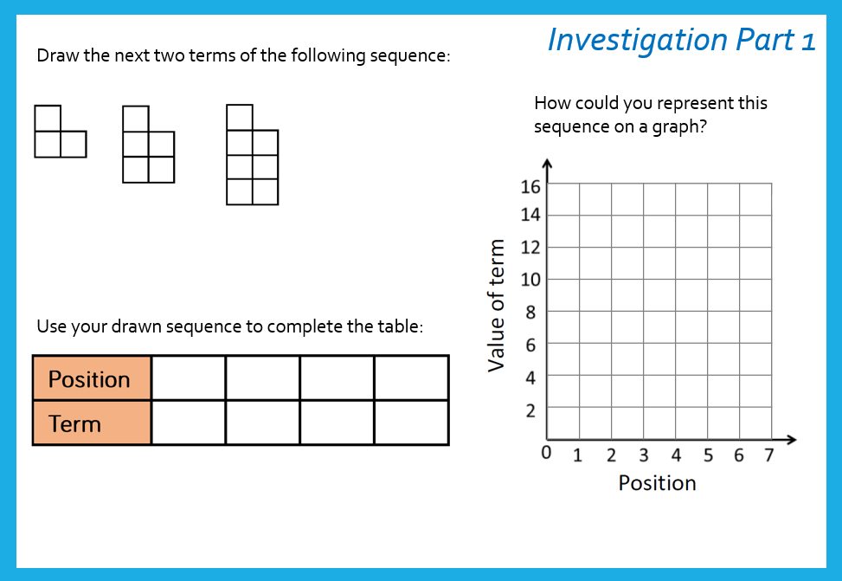
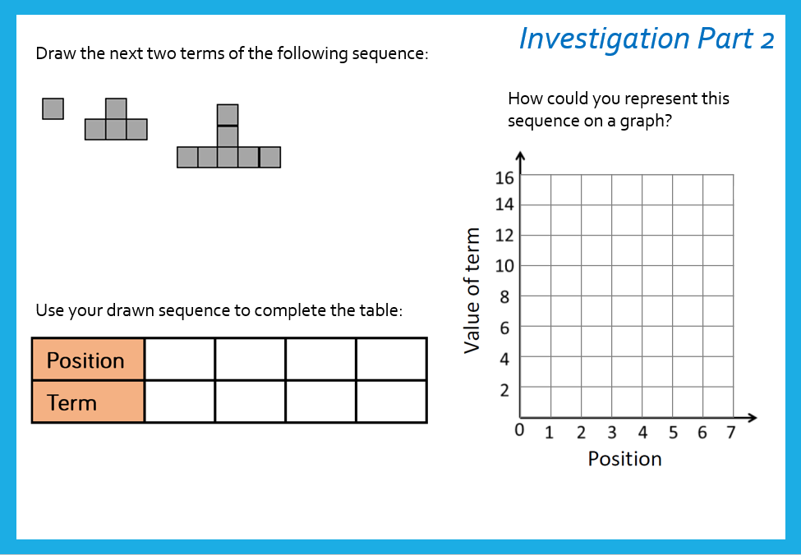
What did you notice?
In parts 1 and 2, I have noticed…
Graph 1 and graph 2 are similar because…
Graph 1 and graph 2 are different because…

Slide 14
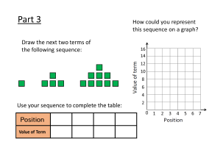
Investigation worksheet 2
In full sentences, summarise what you have discovered about the two sequences in parts 1 and 2.
In parts 1 and 2, I have noticed…
Graph 1 and graph 2 are similar because…
Graph 1 and graph 2 are different because…

Slide 15
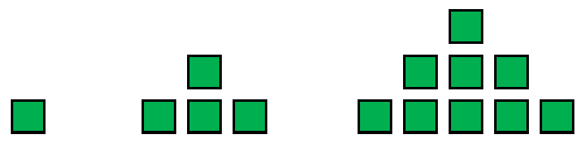
Solutions
How could you represent this sequence on a graph?
Draw the next two terms of the following sequence:
Use your sequence to complete the table:
Value of Term

Slide 16
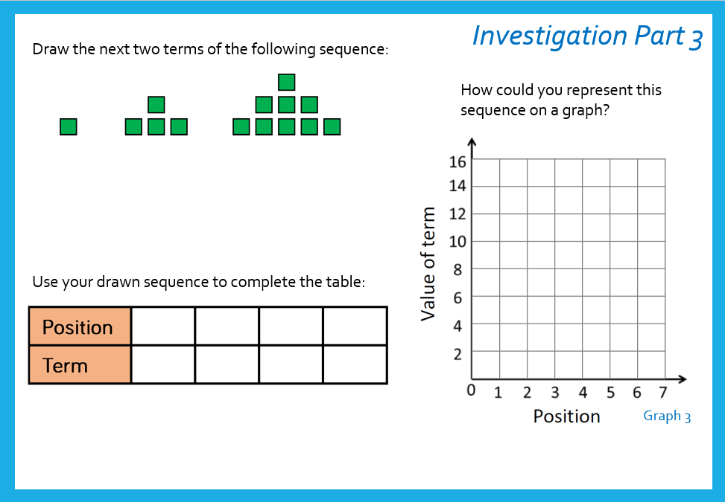
Discussion...
After completing part 3, I have noticed…
Graph 3 is similar to graphs 1 and 2 because…
Graph 3 is different to graphs 1 and 2 because…

Slide 17
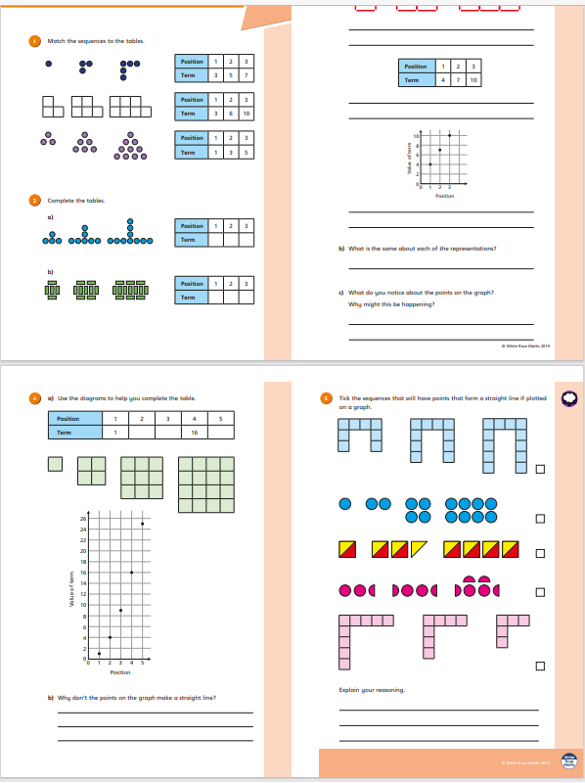
Independent worksheet

Slide 18
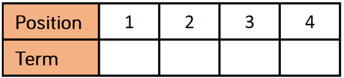
Complete the table to represent the sequence:
For each sequence state whether the points lie on a straight line and explain how you know.

Slide 19

To finish…
On your whiteboards
1. Represent the following sequence on a table.
2. a) If the points from this table were put on a graph, would the line be straight or curved? Could you describe any other features of the graph?
b) How do you know?
c) How could you prove it?

