Slide 1

Complete in silence
Linear Sequences
1) Draw the next term of the sequence.
2) Work out $\frac{2}{3}$ of 21
3) Find the perimeter of the rectangle.
4) What is the mathematical name of the shape?
Vocabulary check:
Mean
14
20.6 cm
2.3 cm
8 cm
Hexagon
On your whiteboards…

Slide 2
What comes next?
a)
b)
c)
Explain how you know.

Slide 3
Here are the first four terms of a sequence.
1st term
1 square
2nd term
3 squares
3rd term
5 squares
4th term
7 squares
How many squares are there in each term of the sequence?
Describe what is happening in the sequence.
Two more squares are added each time.

Slide 4
Whiteboards Ready

Slide 5
Can you draw the next two terms?
(1)
(2)

Slide 6
(3)
(4)

Slide 7
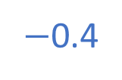




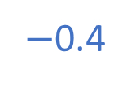

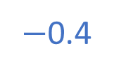


Continue the linear sequence.
17
21
25
5, 9, 13, ___, ___, ___, …
$+$4
$+$4
$+$4
$+$4
$+$4
2.4
2
1.6
3.6, 3.2, 2.8, ____, ____, ____, …
$−$0.4
$−$0.4
$−$0.4
$−$0.4
$−$0.4
What’s the same? What’s different?

Slide 8




This is an example of an ascending linear sequence
8
12
16
20
24
$$+4$$
$$+4$$
$$+4$$
$$+4$$

Slide 9




The first term is 8
The constant difference is 4
8
12
16
20
24
$$+4$$
$$+4$$
$$+4$$
$$+4$$

Slide 10




This is an example of a descending linear sequence
32
28
24
20
16
$$−4$$
$$−4$$
$$−4$$
$$−4$$

Slide 11




What is the first term?
What is the second term?
What is the constant difference?
32
28
24
20
16
$$−4$$
$$−4$$
$$−4$$
$$−4$$

Slide 12
Whiteboards Ready

Slide 13
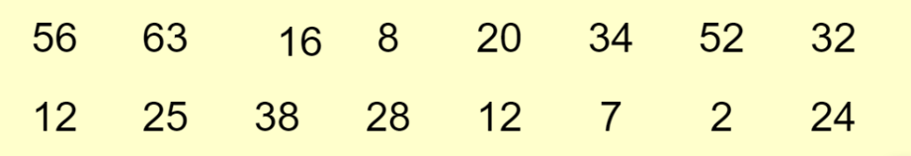
Hidden in these numbers are 5 that form a sequence.
Find as many sequences as you can.
On your whiteboards…
Notes:
On mini whiteboards
Collect in student responses and write examples on the board
Pick out the linear sequences

Slide 14
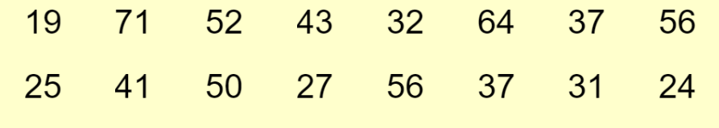
Hidden in these numbers are 5 that form an ascending linear sequence.
Can you find it?
Any others?
On your whiteboards…

Slide 15




What are the next
three terms?
On your whiteboards…
19
25
31
37
43
$$+6$$
$$+6$$
$$+6$$
$$+6$$
Notes:
On mini whiteboards
Collect in student responses and write examples on the board

Slide 16







What are the next
three terms?
19
25
31
37
43
$$+6$$
$$+6$$
$$+6$$
$$+6$$
$$+6$$
$$+6$$
$$+6$$
Notes:
On mini whiteboards
Collect in student responses and write examples on the board

Slide 17
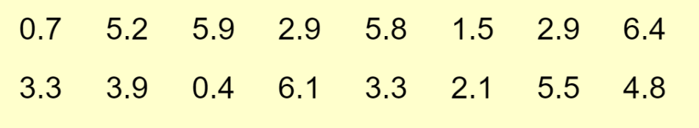
Hidden in these numbers are 5 that form a descending linear sequence.
Can you find it?
Any others?
On your whiteboards…
Notes:
Calculators

Slide 18




What are the next
three terms?
On your whiteboards…
6.4
6.1
5.8
5.5
5.2
$$−0.3$$
$$−0.3$$
$$−0.3$$
$$−0.3$$

Slide 19







What are the next
three terms?
6.4
6.1
5.8
5.5
5.2
$$−0.3$$
$$−0.3$$
$$−0.3$$
$$−0.3$$
$$−0.3$$
$$−0.3$$
$$−0.3$$
Notes:
On mini whiteboards
Collect in student responses and write examples on the board

Slide 20
What are the definitions of the key vocabulary?
Click on a word to reveal the definition.
list of items in a given order, usually following a rule
sequence
where a number or diagram is located in a sequence
position
term immediately before a given term
previous term
number/object that relates to a specific position in a sequence
term
description to generate terms in a sequence
rule
term immediately after a given term
next term

Slide 21
Whiteboards Ready

Slide 22

On your whiteboards…
… a linear sequence that starts at 7.

Slide 23
On your whiteboards…
… a linear sequence with
a common difference of 5.

Slide 24
On your whiteboards…
… a linear sequence with
a common difference of 1.5

Slide 25
On your whiteboards…
… a linear sequence with
a negative common difference.

Slide 26
On your whiteboards…
… a linear sequence that includes
24 as a term.

Slide 27
On your whiteboards…
… a linear sequence that includes
10 & 22 as terms.

Slide 28
On your whiteboards…
… a linear sequence that includes
8 & 15 as terms.

Slide 29
On your whiteboards…
… a linear sequence that includes
6 & 22 as terms after the 1st term.

Slide 30
Q1. Find the next three terms in each linear sequence
Q2. Write the first five terms of each linear sequence
The first term is 15, the constant difference is 14
The first term is 15, the constant difference -2
The first term is 8000, the constant difference is 999
The first term is 4.7, the constant difference is 2.5
The first term is 4.7, the constant difference is -0.2
15, 29, 43…
60, 74, 88…
800, 1100, 1400…
90, 85, 80…
0.9, 1.2, 1.5…
7.42, 6.81, 6.2…
90, 88…
100, 101.5…
99…
Notes:
Calculator Allowed

Slide 31
Q1. Find the next three terms in each linear sequence
Q2. Write the first five terms of each linear sequence
15, 29, 43, 57, 71, 85
60, 74, 88, 102, 116, 130
800, 1100, 1400, 1700, 2000, 2300
90, 85, 80, 75, 70, 65
0.9, 1.2, 1.5, 1.8, 2.1, 2.4
7.42, 6.81, 6.2, 5.59, 4.98, 4.37
90, 88, 86, 84, 82
100, 101.5, 103, 104.5, 1.6
99…(an infinite number of options)
The first term is 15, the constant difference is 14
The first term is 15, the constant difference -2
The first term is 8000, the constant difference is 999
The first term is 4.7, the constant difference is 2.5
The first term is 4.7, the constant difference is -0.2
Notes:
Calculator Allowed

Slide 32
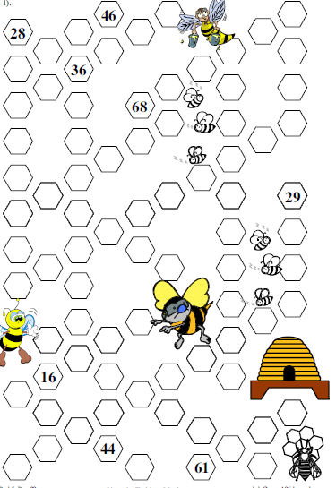
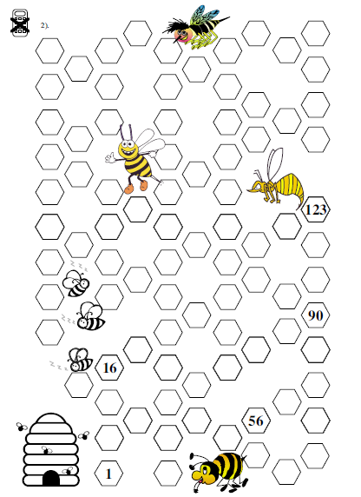
Each line of Hexagons forms a linear sequence.
Fill in the missing terms
Notes:
Print for students

Slide 33
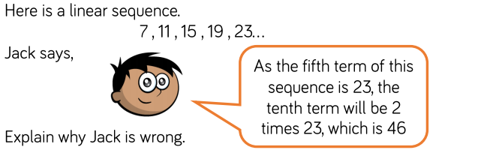
A problem to finish

Slide 34
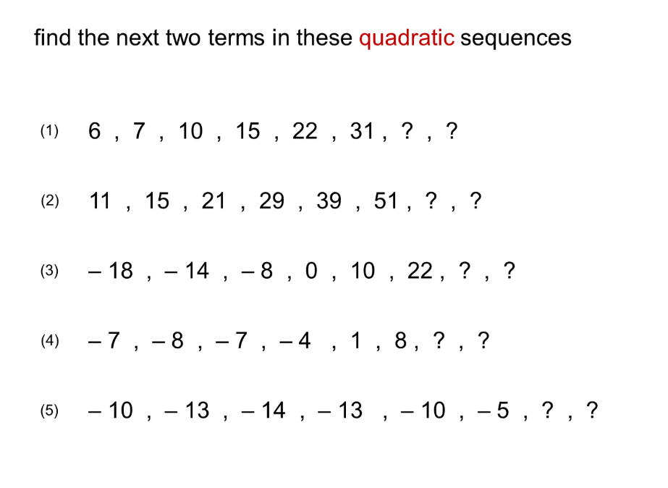
Challenge

