Slide 1


Complete in silence
Non-Linear Sequences
1) Write the next term in the sequence 5.4, 5.6, 5.8 …
2) Draw the next term of the sequence.
3) What is the value of the 5 in the number 7532?
4) Write the coordinates of the point
marked with a cross.
Vocabulary check:
Multiple
$$y$$
5
4
3
2
x
1
0
1
2
3
4
5
$$x$$

Slide 2

On your whiteboards…
Complete in silence
Non-Linear Sequences
1) Find the next term in the sequence 5, 8, 11…
2) Calculate 10% of 640
3) Divide 370 by 100
4) Calculate the area of the rectangle.
Vocabulary check:
Digit
14
64
3.7
3 cm
54 cm²
18 cm

Slide 3
1) Write the number of circles used underneath each term of the sequence.
2) Draw the next term in the sequence.
3) How many circles will be needed for the fifth term?
4) How many terms can you draw using circles?

Slide 4
1) Write the number of circles used underneath each term of the sequence.
2) Draw the next term in the sequence.
3) How many circles will be needed for the fifth term?
4) How many terms can you draw using circles?
14
11
8
2
5

Slide 5

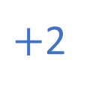



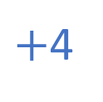

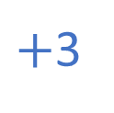

Decide if each of these sequences is linear
or non-linear.
$+$2
$+$3
$+$4
90, 80, 70, 60, …
$−$10
$−$10
$−$10
10, 5, 10, 5, …
$−$5
$+$5
$−$5

Slide 6
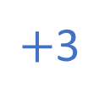
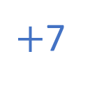

Position | 1 | 2 | 3 | 4
Term | 1 | 4 | 9 | 16
Position | 1 | 2 | 3 | 4
Term | 1 | 4 | 9
Position | 1 | 2 | 3 | 4
Term | 1 | 4 | 7
Position | 1 | 2 | 3 | 4
Term | 1 | 4
Position | 1 | 2 | 3 | 4
Term | 1 | 4 | 7 | 10
Position | 1 | 2 | 3 | 4
Term | 1 | 4
$+$3
$+$5
$+$7
10
16
8
Value of term
12
6
Value of term
8
4
4
2
0
1
2
3
4
0
1
2
3
4
Position
Position
LINEAR
NON-LINEAR

Slide 7
Sequence 1: 1, 2, 4, 8, ….
Sequence 2: 5, 10, 20, 40, ….
Sequence 3: 1000, 500, 250, 125, ….
Sequence 4: 19, 17, 15, 13, ….
Sequence 5: 2, 4, 6, 10, 16, ….
Which sequence is linear? How do you know?

Slide 8
Sequence 4: 19, 17, 15, 13, ….
This is a linear sequence because it decreases by a constant difference.
Linear sequences are sometimes known as Arithmetic sequences.

Slide 9
Sequence 1: 1, 2, 4, 8, ….
Sequence 2: 5, 10, 20, 40, ….
Sequence 3: 1000, 500, 250, 125, ….
Sequence 4: 19, 17, 15, 13, ….
Sequence 5: 2, 4, 6, 10, 16, ….
Which sequence is Fibonacci-like? How do you know?

Slide 10
Sequence 5: 2, 4, 6, 10, 16, ….
This sequence is a Fibonacci sequence as the next term is the sum of the two previous terms.

Slide 11
Sequence 1: 1, 2, 4, 8, ….
Sequence 2: 5, 10, 20, 40, ….
Sequence 3: 1000, 500, 250, 125, ….
What do these sequences have in common?

Slide 12
Sequence 1: 1, 2, 4, 8, ….
Sequence 2: 5, 10, 20, 40, ….
Sequence 3: 1000, 500, 250, 125, ….
The next number is found by multiplying or dividing the previous term by a fixed, non-zero number.
These sequences are called Geometric sequences.

Slide 13
Whiteboards Ready

Slide 14
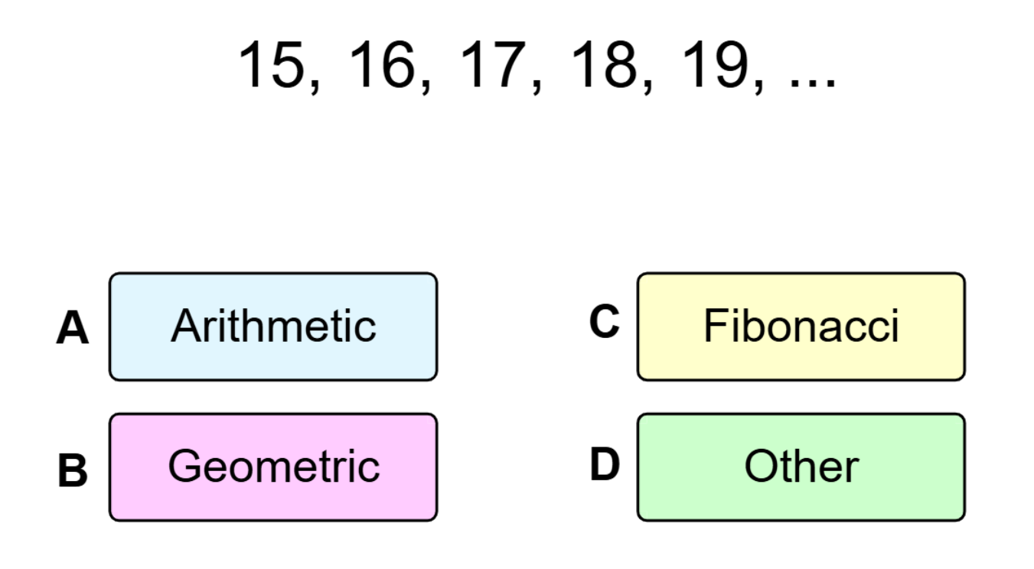

Slide 15
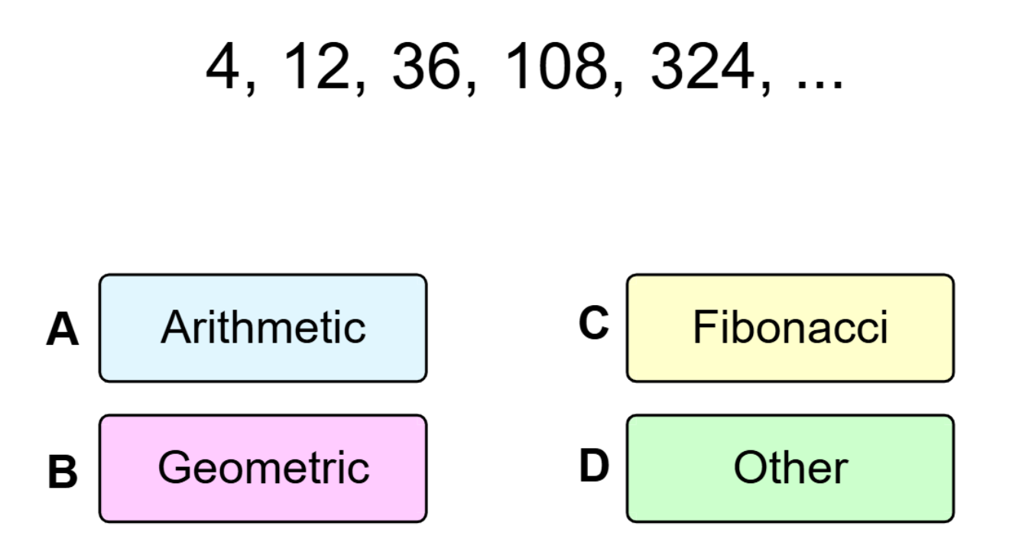

Slide 16
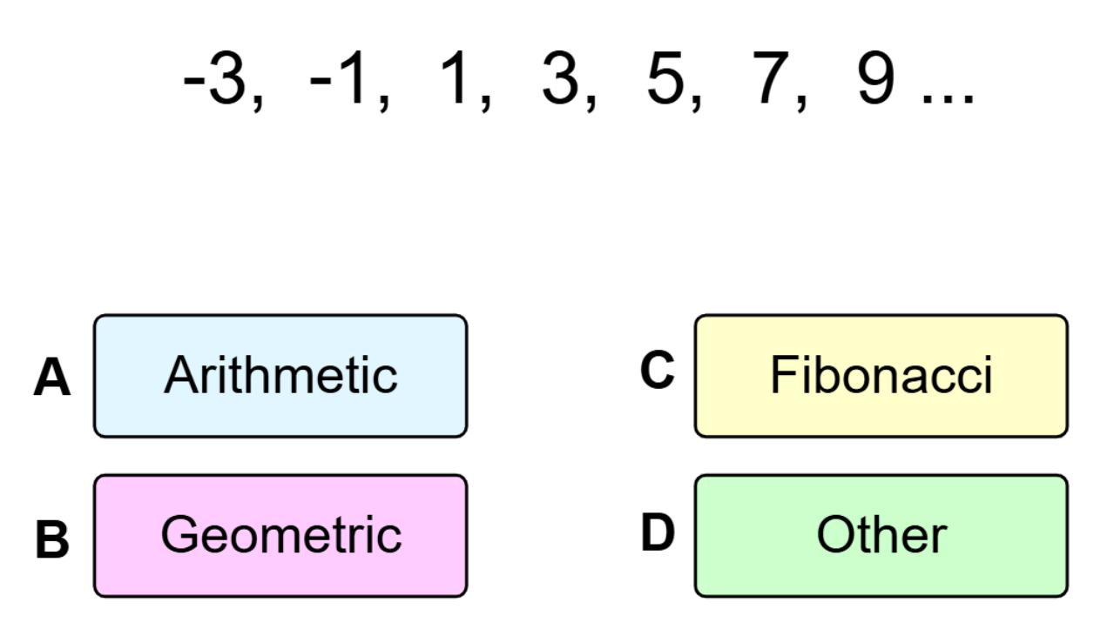

Slide 17
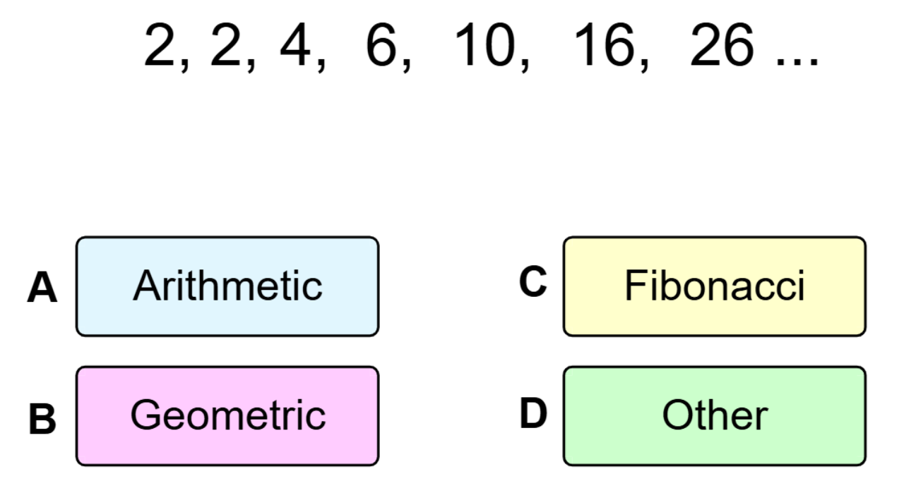

Slide 18
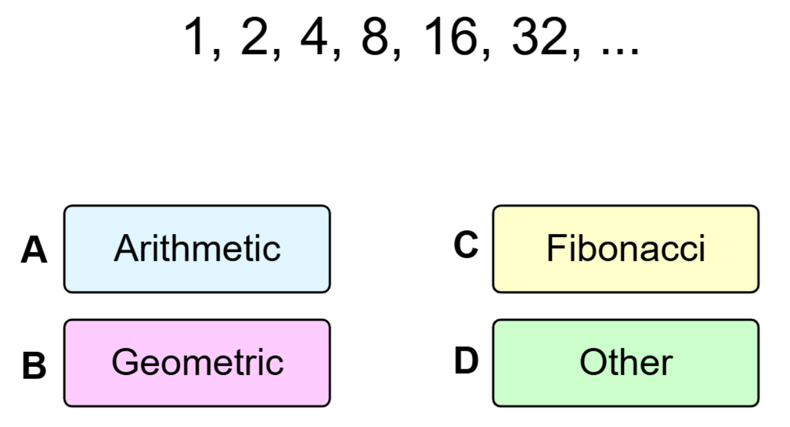

Slide 19
Sequence 1: 1, 2, 4, 8, ….
Sequence 2: 5, 10, 20, 40, ….
Sequence 3: 1000, 500, 250, 125, ….
Sequence 4: 19, 17, 15, 13, ….
Sequence 5: 2, 4, 6, 10, 16, ….
Describe how to go from one term to the next term of each sequence
Notes:
After the introduction of iterative notation, iterative formulae will be used to find the approximate solution to an equation in a later lesson. The origins of the iterative formula, through the rearrangement of the original equation, are also considered. Display the following information on the board. Students could work in pairs or small groups to determine the answers.

Slide 20
Sequence 1: 1, 2, 4, 8, …. Multiply the previous term by 2, starting with 1
Sequence 2: 5, 10, 20, 40, …. Multiply the previous term by 2, starting with 5
Sequence 3: 1000, 500, 250, 125, …. Half the previous term, starting with 1000
Sequence 4: 19, 17, 15, 13, …. Subtract 2 from the previous term starting with 19
Sequence 5: 2, 4, 6, 10, 16, …. Add together the two previous terms, starting with 2 and 4 as the first two terms
This rules are known the “term to term” rules
Notes:
After the introduction of iterative notation, iterative formulae will be used to find the approximate solution to an equation. The origins of the iterative formula, through the rearrangement of the original equation, are also considered. Display the following information on the board. Students could work in pairs or small groups to determine the answers.

Slide 21
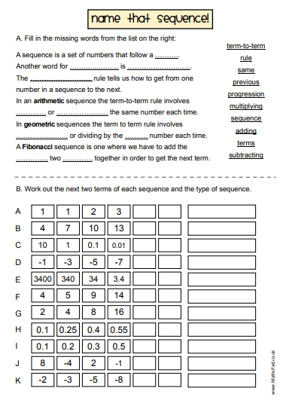
Worksheet

Slide 22
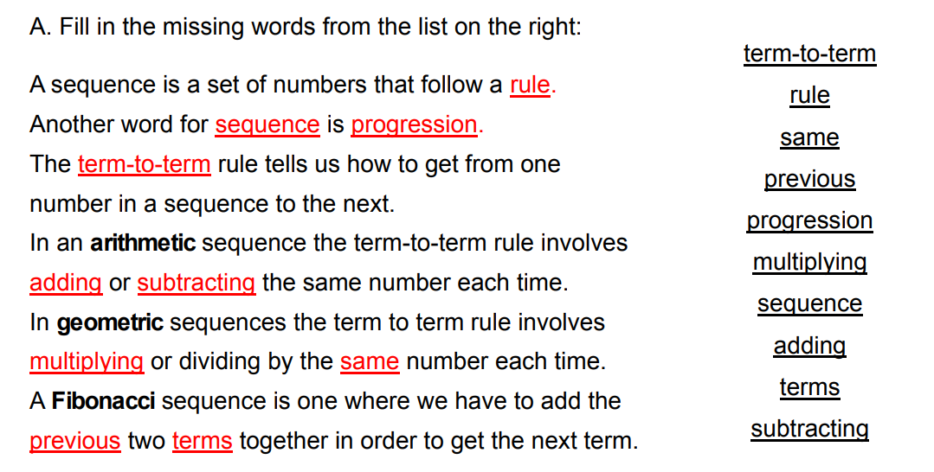
Mark in green pen

Slide 23
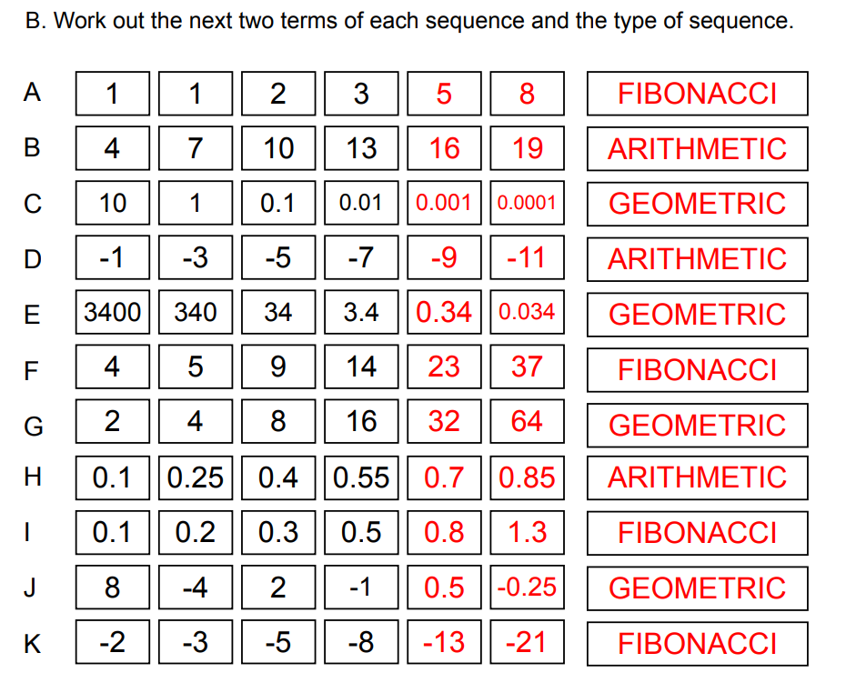
Mark in green pen

Slide 24
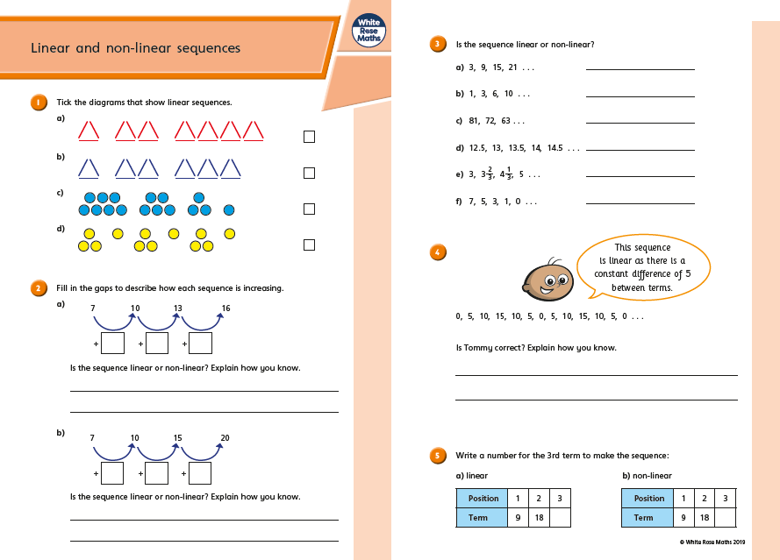
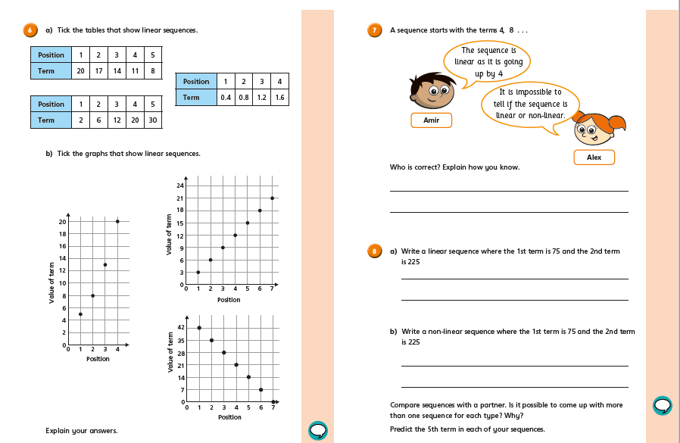
Worksheet

Slide 25
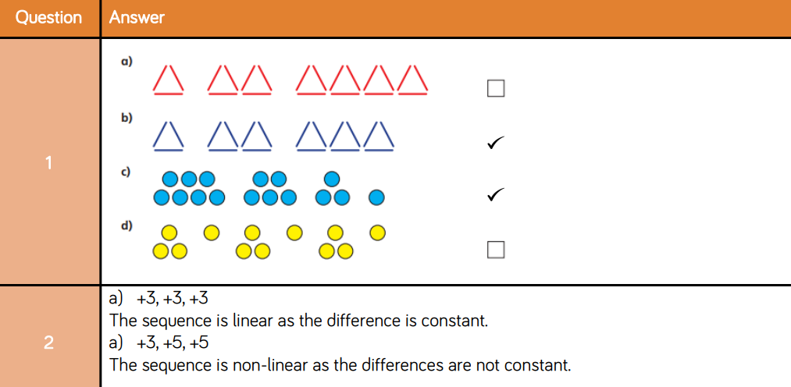
Answers

Slide 26
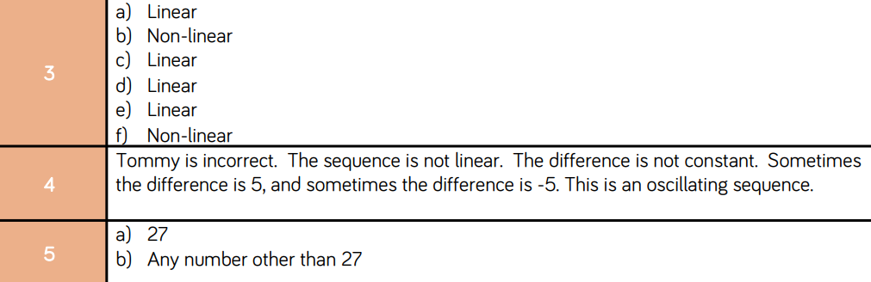
Answers

Slide 27
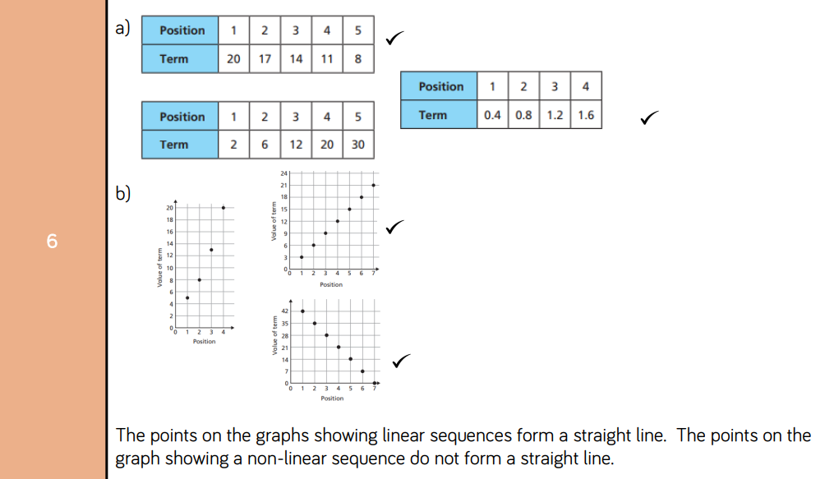

Slide 28
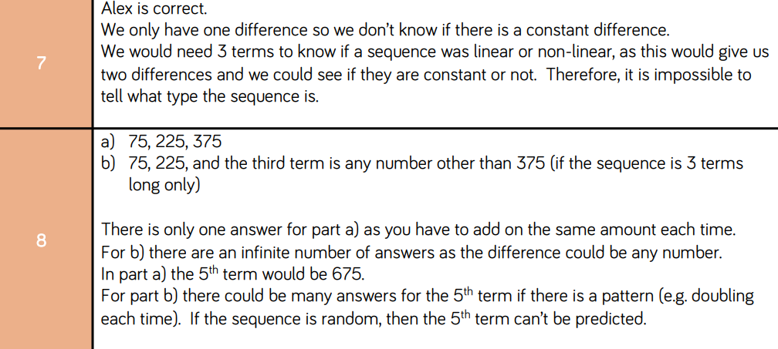

Slide 29
In your book
Title: Non - Linear Sequences
Q1. Find the next two terms in each sequence
Q2. Describe in words the term to term rule for each sequence from Q1
1, 2, 4, 8…
3, 6, 12, 24…
640, 320, 160…
1, 3, 6, 10…
1, 4, 9, 16, 25…
1, 1, 2, 3, 5…
100, 150, 225…
2, 2, 4, 6, 10…
1, 2…
Notes:
Calculator Allowed

Slide 30
Mark and correct your work
Q1. Find the next two terms in each sequence
Q2. Describe in words the term to term rule for each sequence from Q1
1, 2, 4, 8, 16, 32
3, 6, 12, 24, 48, 96
640, 320, 160, 80, 40
1, 3, 6, 10, 15, 21
1, 4, 9, 16, 25, 36, 49
1, 1, 2, 3, 5, 8, 13
100, 150, 225, 325, 450
2, 2, 4, 6, 10, 16, 26
1, 2…(lots of different answers!)
Multiply by 2
Multiply by 2
Divide by 2
Add one more each time
Add two to the first difference each time
Add the two previous terms
Add 25 to the first difference
Add the two previous terms
Notes:
Calculator Allowed

Slide 31
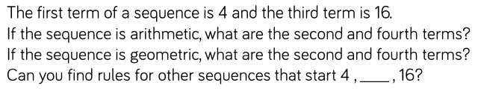
A problem to finish

Slide 32
Make 24
3, 4, 5, 5
2, 3, 4, 4
2, 3, 6, 7

Slide 33

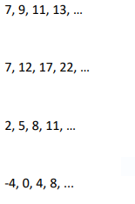
Exit Ticket
Find the next two terms in each sequence:
a)
b)
c)
d)

