Slide 1















Dual coding symbols:
Practise
Explain
Organise
Big Question
Reflect
Present
Compare
Evaluate
Activate
Discuss
Predict
Connect
Summarise
Recall
Vocabulary

Slide 2










Editable reading ruler
Every child in an Archway school will become a fluent reader
 | RETRIEVE the words or phrases you need from the text | DECODE the words or phrase to address a breakdown | CONNECT with words or phrases you know from the text or your memory | VISUALISE the images in as much detail as possible | SUMMARISE the main ideas of the text in a few words | INFER meanings that might be within the text | PREDICT what might happen next using details from the text | EXAMINE how the writer uses words to construct meaning
 | ASK THOUGHTFUL QUESTIONS TO HELP YOU UNDERSTAND THE TEXT

Slide 3






A
B

Slide 4
Write an expression for
Multiply a number by 2
Multiply a number by 2 and add 1
An even number
An odd number
What does the word consecutive mean?

Slide 5
Write an expression for
Multiply a number by 2 2n
Multiply a number by 2 and add 1 2n + 1
An even number 2n
An odd number 2n+1
What does the word consecutive mean? Numbers that are next to each other

Slide 6
LESSON TITLE:

Slide 7



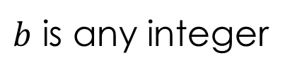
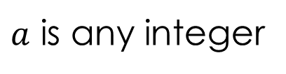
The sum of two even numbers is always even… why?
$a$ is any integer
$$2a+2b=2(a+b)$$
$b$ is any integer
now even numbers
a number with a factor of 2 = even
The sum of an even and an odd number is always odd… why?
$$2a+\left(2b+1\right)=2a+2b+1$$
$$=2(a+b)+1$$
an even number + 1 = odd
(a number with a factor of 2) + 1 = odd

Slide 8
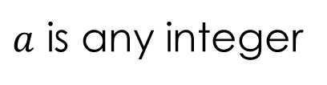



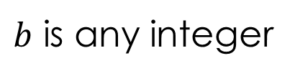
The product of two even numbers is always even… why?
$a$ is any integer
$$2a×2b=4ab=2(2ab)$$
$b$ is any integer
a number with a factor of 2 = even
The product of an even and an odd number is always even… why?
$$2a×\left(2b+1\right)=4ab+2a$$
$$=2(2ab+a)$$
a number with a factor of 2 = even

Slide 9
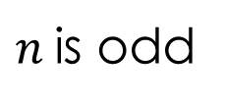
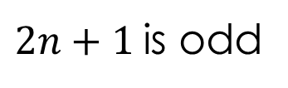
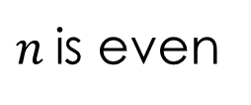
Even × Even =
Even
Even + Even =
Even
Includes 2 as
a factor
Even × Odd =
Even
Even + Odd =
Odd
even +1
even +1
Odd × Odd =
Odd
Odd + Odd =
Even
even +1
even +1
Can we use these facts to prove this statement?
$2n+1$is odd
$n$is odd
$n$is even
(even × odd) + odd
(even × even) + odd
even
+ odd
= odd
even
+ odd
= odd

Slide 10
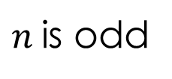

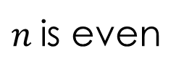
On your whiteboard
Multiplying
Adding
Even × Even =
Even
Even + Even =
Even
Even × Odd =
Even
Even + Odd =
Odd
Odd × Odd =
Odd
Odd + Odd =
Even
Can we use these facts to prove this statement?
$4n2$is even
$n$is odd
$n$is even
even × (odd × odd)
even × (even × even)
even × odd
= even
even × even
= even

Slide 11

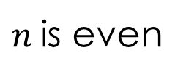
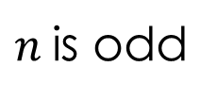
On your whiteboard
Multiplying
Adding
Even × Even =
Even
Even + Even =
Even
Even × Odd =
Even
Even + Odd =
Odd
Odd × Odd =
Odd
Odd + Odd =
Even
Can we use these facts to prove this statement?
$4n2$is even
$n$is odd
$n$is even
even × (odd × odd)
even × (even × even)
even × odd
= even
even × even
= even

Slide 12

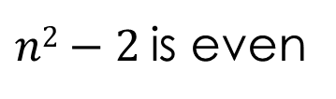
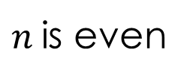
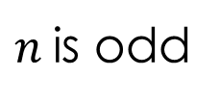
On your whiteboard
Multiplying
Adding
Even × Even =
Even
Even + Even =
Even
Even × Odd =
Even
Even + Odd =
Odd
Odd × Odd =
Odd
Odd + Odd =
Even
Can we use these facts to prove this statement?
$n2−2$is even
$n$is odd
$n$is even
(odd × odd) − even
(even × even) − even
odd − even
= odd
even − even
= even

Slide 13
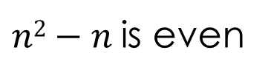
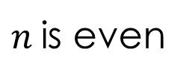
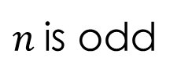
On your whiteboard
Multiplying
Adding
Even × Even =
Even
Even + Even =
Even
Even × Odd =
Even
Even + Odd =
Odd
Odd × Odd =
Odd
Odd + Odd =
Even
Can we use these facts to prove this statement?
$n2−n$is even
$n$is odd
$n$is even
(odd × odd) − odd
(even × even) − even
odd − odd
= even
even − even
= even

Slide 14




I do, we do
Multiply a number by 4 & then add 3,
the result is always an odd number.
To be odd,
it must have a
‘spare’ unit.
$$4n+3$$
$$4n+2+1$$
factorise
$$2(n+1)+1$$
Even + Odd = Odd

Slide 15






I do, we do
Multiply a number by 4 & then add 3,
the result is always an odd number.
Multiply a number by 2 & then add 7,
the result is always an odd number.
To be odd,
it must have a
‘spare’ unit.
$$4n+3$$
$$2n+7$$
$$4n+2+1$$
$$2n+6+1$$
factorise
$$2(n+1)+1$$
$$2(n+3)+1$$
Even + Odd = Odd

Slide 16



I do, we do
Multiply a number by 4 & then add 3,
the result is always an odd number.
Multiply a number by 4 & then add 5,
the result is always an odd number.
To be odd,
it must have a
‘spare’ unit.
$$4n+3$$
$$4n+5$$
$$4n+2+1$$
$$4n+4+1$$
factorise
$$2(n+1)+1$$
$$4(n+1)+1$$
Even + Odd = Odd

Slide 17



The product of 2 consecutive even numbers is divisible by 4.
$$(2n)×\left(2n+2\right)$$
$$4n2+4n$$
$$4(n2+n)$$

Slide 18



The sum of 3 consecutive even numbers is divisible by 6.
$$\left(2n\right)+\left(2n+2\right)+\left(2n+4\right)$$
$$6n+6$$
$$6(n+1)$$

Slide 19





The sum of the squares of 2 consecutive numbers is odd.
$$n2+\left(n+1\right)2$$
$$\left(n+1\right)2=n2+2n+1$$
$$n2+(n2+2n+1)$$
$$2n2+2n+1$$
$$2(n2+n)+1$$

Slide 20





The sum of the squares of 2 consecutive even numbers is divisible by 4.
$${(2n)}^{2} + \left(2n+2\right)2$$
$$\left(2n+2\right)2=4n2+8n+4$$
$$4n2+(4n2+8n+4)$$
$$8n2+8n+4$$
$$4(2n2+2n+1)$$

Slide 21
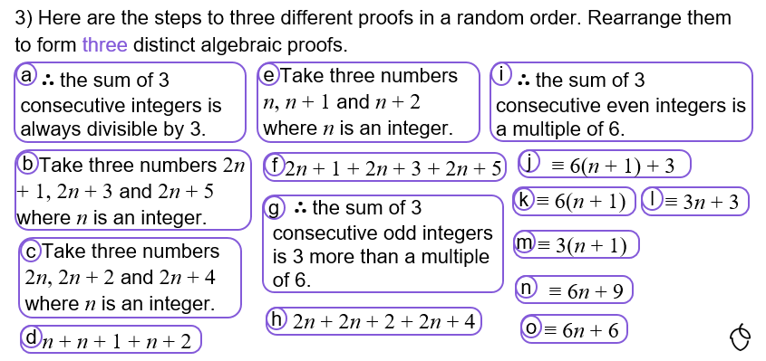

Slide 22
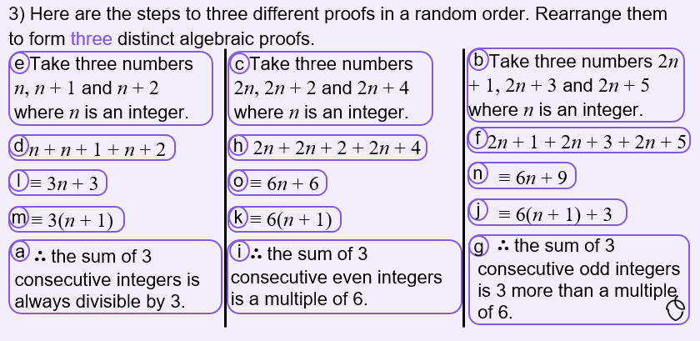

Slide 23
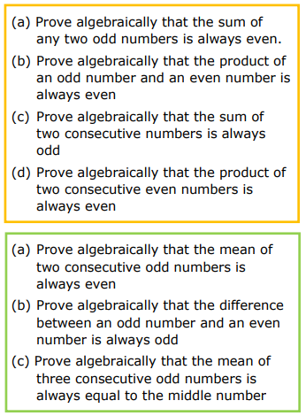
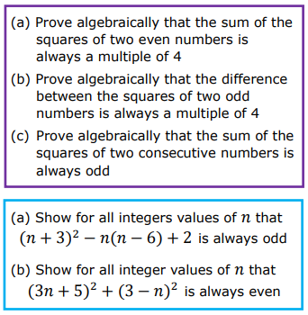

Slide 24
