Slide 1















Dual coding symbols:
Practise
Explain
Organise
Big Question
Reflect
Present
Compare
Evaluate
Activate
Discuss
Predict
Connect
Summarise
Recall
Vocabulary

Slide 2










Editable reading ruler
Every child in an Archway school will become a fluent reader
 | RETRIEVE the words or phrases you need from the text | DECODE the words or phrase to address a breakdown | CONNECT with words or phrases you know from the text or your memory | VISUALISE the images in as much detail as possible | SUMMARISE the main ideas of the text in a few words | INFER meanings that might be within the text | PREDICT what might happen next using details from the text | EXAMINE how the writer uses words to construct meaning
 | ASK THOUGHTFUL QUESTIONS TO HELP YOU UNDERSTAND THE TEXT

Slide 3






A
B

Slide 5
LESSON TITLE:

Slide 6






Key vocabulary:
Decode the word
Definition
.
Congruent
Examples
Non-examples

Slide 7
Congruence
Two shapes are said to be congruent if they are the same shape and size
The shapes may be a reflection of each other, or be rotated or translated
All of the angles and side lengths are the same
Notes:
Tes: Dannytheref

Slide 8
Which shapes are congruent?

Slide 9
Notes:
Tes: Dannytheref
Clicking a correct shape will remove it from the screen. Clicking an incorrect one will bring up the red circle.

Slide 10
Congruent Triangles
Suppose two triangles have the same side lengths.
Do the triangles have to be congruent?
Yes, because the all the angles are determined by the sides.
Would the same be true if two quadrilaterals had the same lengths?
No. A square and a rhombus can have the same side lengths but are different shapes.
?
?
Notes:
https://www.drfrostmaths.com/

Slide 11
Congruent Triangles
In pairs, determine whether comparing the following pieces of information would be sufficient to show the triangles are congruent.
3 sides the same.
✓ Congruent
a
b
c
d
Two sides the same and angle between them.
Two sides the same and angle not between them.
All angles the same.
Two angles the same and a side the same.
Click to reveal
Click to reveal
Click to reveal
✓Congruent
Click to reveal
✓Congruent
Not necessarily Congruent
(but Similar)
× Not necessarily Congruent (we’ll see why)
Notes:
https://www.drfrostmaths.com/

Slide 12
Proving Congruence
GCSE papers will often ask for you to prove that two triangles are congruent.
There’s 4 different ways in which we could show this:
!
a
?
SAS
Two sides and the included angle.
b
?
ASA
Two angles and a side.
c
?
SSS
Three sides.
?
d
RHS
Right-angle, hypotenuse and another side.
Notes:
https://www.drfrostmaths.com/

Slide 13
Proving Congruence
Why is it not sufficient to show two sides are the same and an angle are the same if the side is not included?
Try and draw a triangle with the same side lengths and indicated angle, but that is not congruent to this one.
Click to Reveal
Notes:
https://www.drfrostmaths.com/

Slide 14
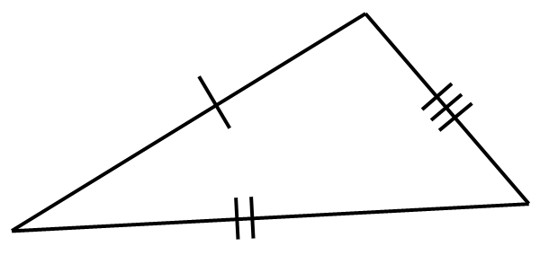
If two triangles both had the same properties indicated, would they be congruent? If so, which congruence test would prove this?
⎦
SSS
SAS
ASA
RHS
Notes:
https://www.drfrostmaths.com/
Ask why the features not sufficient for congruence are not sufficient.

Slide 15
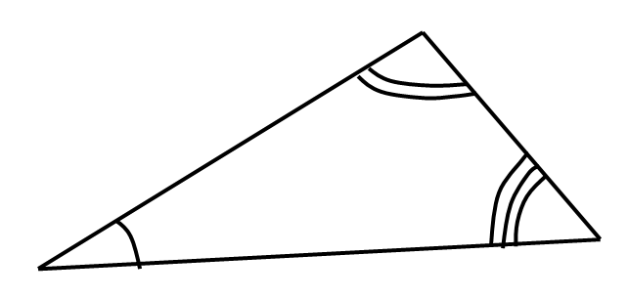
If two triangles both had the same properties indicated, would they be congruent? If so, which congruence test would prove this?
⎦
SSS
SAS
ASA
RHS
Notes:
https://www.drfrostmaths.com/
Ask why the features not sufficient for congruence are not sufficient.

Slide 16
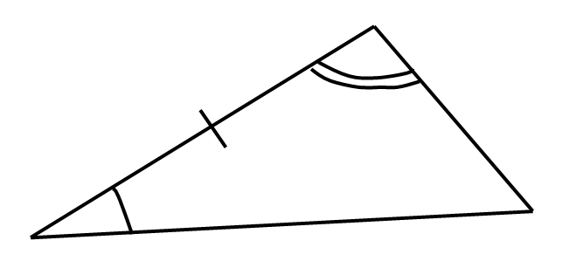
If two triangles both had the same properties indicated, would they be congruent? If so, which congruence test would prove this?
⎦
SSS
SAS
ASA
RHS
Notes:
https://www.drfrostmaths.com/
Ask why the features not sufficient for congruence are not sufficient.

Slide 17
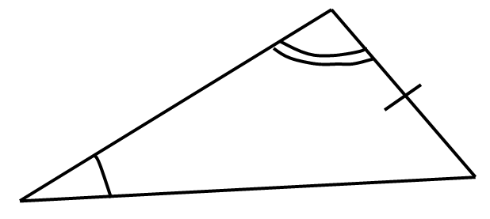
If two triangles both had the same properties indicated, would they be congruent? If so, which congruence test would prove this?
⎦
SSS
SAS
ASA
RHS
This angle is known from the other two.
This angle is known from the other two.
Notes:
https://www.drfrostmaths.com/
Ask why the features not sufficient for congruence are not sufficient.

Slide 18
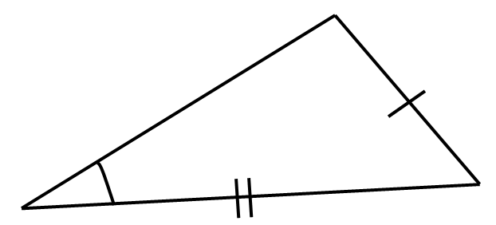
If two triangles both had the same properties indicated, would they be congruent? If so, which congruence test would prove this?
⎦
SSS
SAS
ASA
RHS
Notes:
https://www.drfrostmaths.com/
Ask why the features not sufficient for congruence are not sufficient.

Slide 19
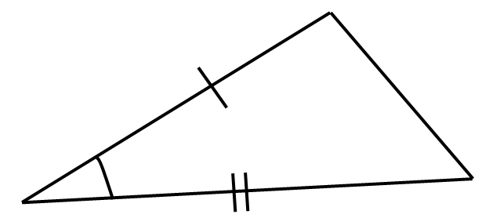
If two triangles both had the same properties indicated, would they be congruent? If so, which congruence test would prove this?
⎦
SSS
SAS
ASA
RHS
Notes:
https://www.drfrostmaths.com/
Ask why the features not sufficient for congruence are not sufficient.

Slide 20
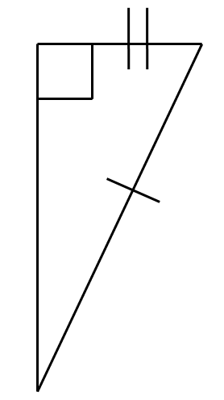
If two triangles both had the same properties indicated, would they be congruent? If so, which congruence test would prove this?
⎦
SSS
SAS
ASA
RHS
Notes:
https://www.drfrostmaths.com/
Ask why the features not sufficient for congruence are not sufficient.

Slide 21
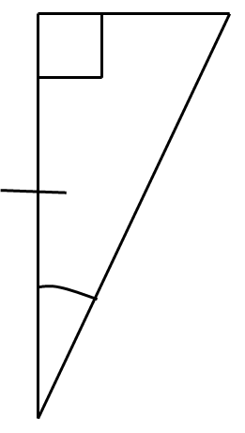
If two triangles both had the same properties indicated, would they be congruent? If so, which congruence test would prove this?
⎦
SSS
SAS
ASA
RHS
Notes:
https://www.drfrostmaths.com/
Ask why the features not sufficient for congruence are not sufficient.

Slide 22
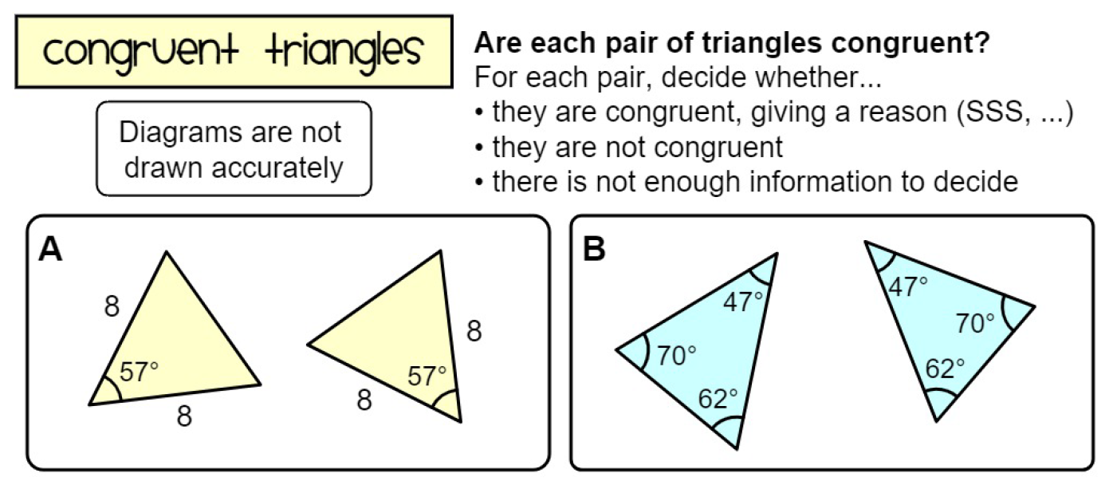
Worksheet
Notes:
https://www.mathspad.co.uk/

Slide 23
Solutions
A | Congruent – SAS | K | Not enough information
B | Not enough information | L | Congruent – ASA
C | Not congruent | M | Congruent – SAS
D | Congruent – RHS | N | Not congruent
E | Not enough information | O | Not enough information
F | Congruent – ASA | P | Congruent - SSS
G | Not enough information | Q | Not enough information
H | Not congruent | R | Not congruent
I | Congruent – SSS | S | Not enough information (ambiguous case – SSA)
J | Not congruent | T | Congruent - SAS
Notes:
https://www.mathspad.co.uk/

Slide 24
Show what you know
Use your whiteboards to write down the answers to each question
Is it A, B, C, D or E?
Notes:
https://www.transum.org/Maths/Activity/Congruent/Default.asp?Level=1

Slide 25
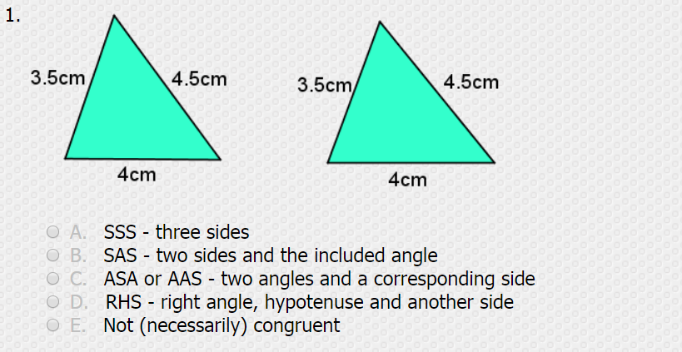

Show what you know
Notes:
https://www.transum.org/Maths/Activity/Congruent/Default.asp?Level=1

Slide 26
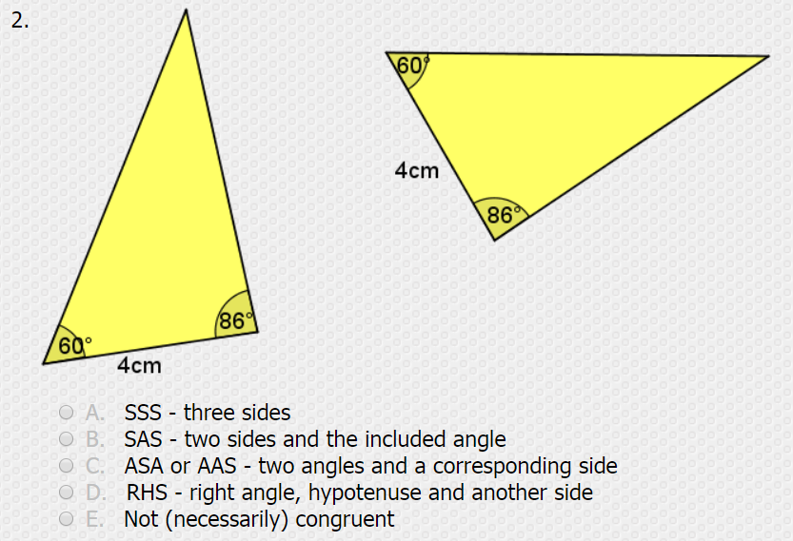
Show what you know
Notes:
https://www.transum.org/Maths/Activity/Congruent/Default.asp?Level=1

Slide 27
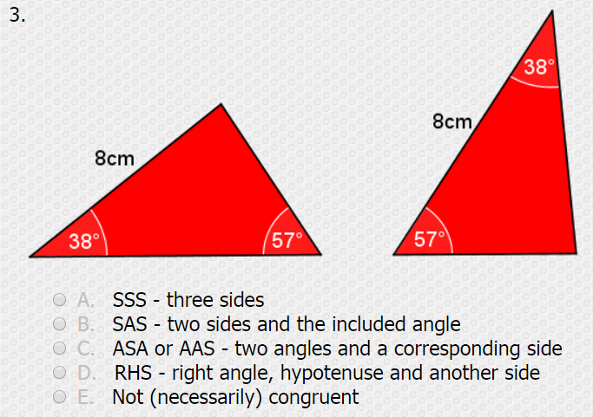
Show what you know
Notes:
https://www.transum.org/Maths/Activity/Congruent/Default.asp?Level=1

Slide 28
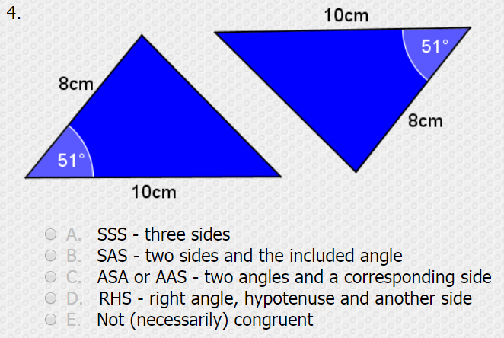
Show what you know
Notes:
https://www.transum.org/Maths/Activity/Congruent/Default.asp?Level=1

Slide 29
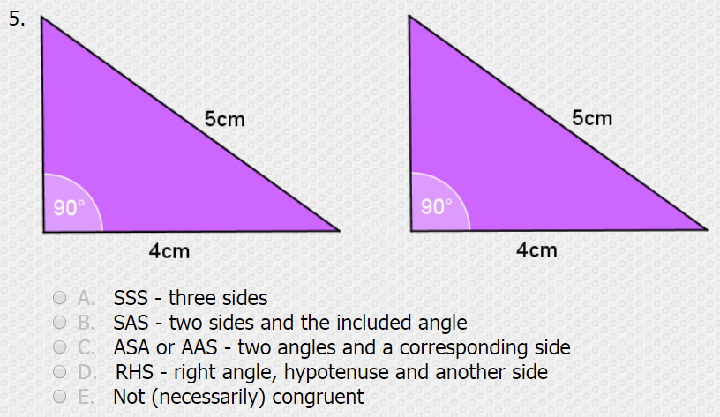
Show what you know
Notes:
https://www.transum.org/Maths/Activity/Congruent/Default.asp?Level=1

Slide 30
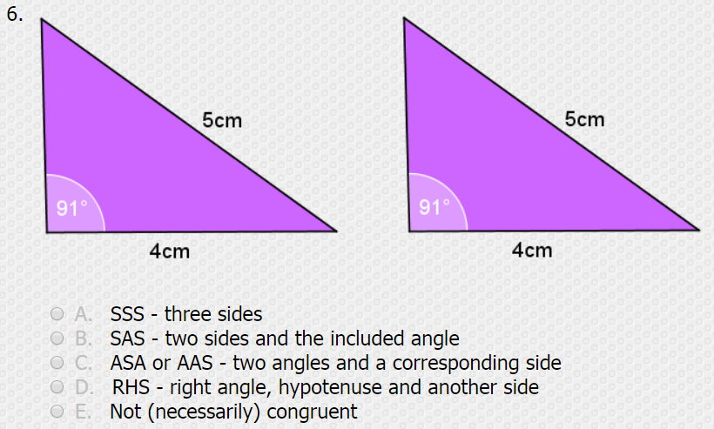
Show what you know
Notes:
https://www.transum.org/Maths/Activity/Congruent/Default.asp?Level=1

Slide 31
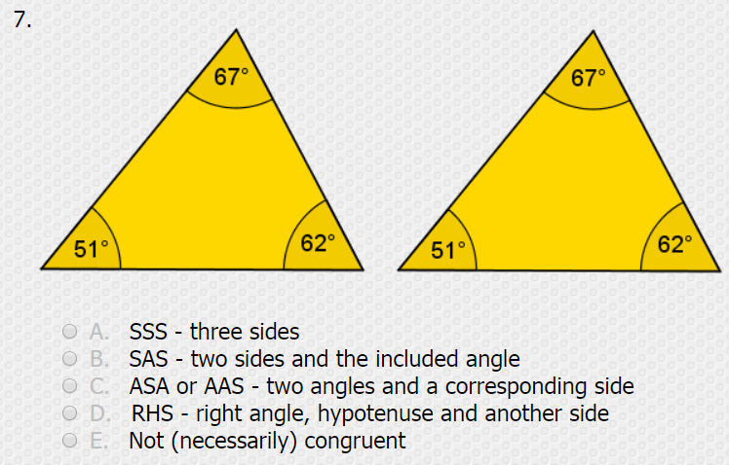
Show what you know
Notes:
https://www.transum.org/Maths/Activity/Congruent/Default.asp?Level=1

Slide 32
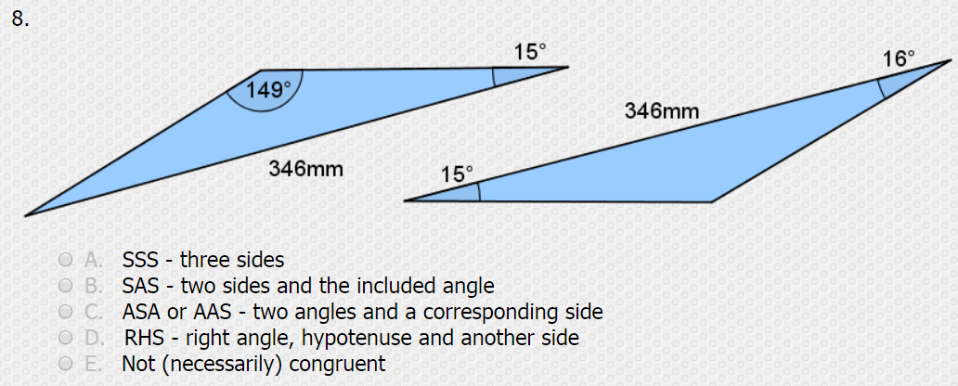

Show what you know
Notes:
https://www.transum.org/Maths/Activity/Congruent/Default.asp?Level=1

Slide 33
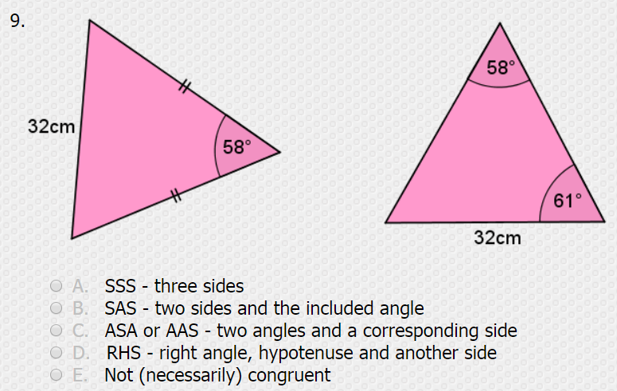
Show what you know
Notes:
https://www.transum.org/Maths/Activity/Congruent/Default.asp?Level=1

Slide 34
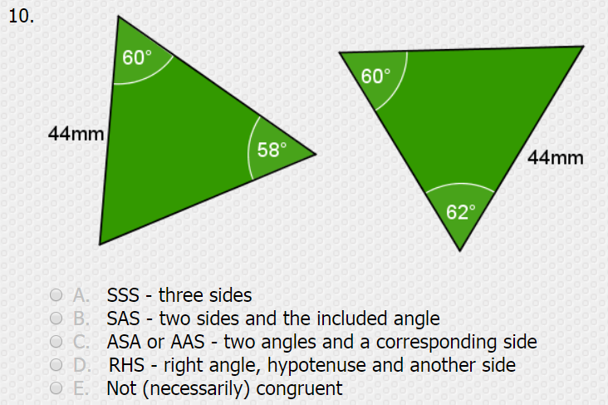
Show what you know
Notes:
https://www.transum.org/Maths/Activity/Congruent/Default.asp?Level=1

