Slide 1
Spaced Retrieval
1) Work out the missing term in the linear sequence.
2) How many circles will there be in the next term of the sequence?
3) Work out half of 86
3
43
7
3 , , 11 , 15 …
4) Round 343 to the nearest hundred.
300

Slide 2
27 June 2025
One step function machines

Slide 3

What are the definitions of the key vocabulary?
Click on a word to reveal the definition.
mathematical relationship between an input and output written as a rule
function
the number, term or expression that goes into a function and results in an output
input
number, term or expression that results from a function being applied to an input
output
mathematical process such as addition or multiplication
operation
opposite effect of
inverse

Slide 4



Match each calculation to the correct answer.
6²
9
4²
36
$$\sqrt{81}$$
8
10²
16
$$\sqrt{64}$$
100

Slide 5
Complete the sentences.
a) The inverse of addition is ____________.
subtraction
b) The inverse of division is _______________.
multiplication
c) The inverse of squaring is ______________.
square rooting

Slide 6
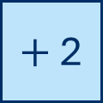
Here is a function machine.
input
output
$+$ 2
Label the input and the output on the function machine.

Slide 7
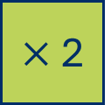
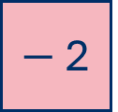
What’s the same? What’s different?
input
output
input
output
8
$×$ 2
16
8
$−$ 2
6
Using the number cards, identify the outputs of each function machine.
4
16
10
6

Slide 8
input
output
input
output
4
$×$ 2
8
10
$−$ 2
8
Using the number cards, identify the inputs of each function machine.
4
16
10
6

Slide 9



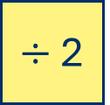
Dora and Annie are working out the input of the function machine.
input
output
$÷$ 2
24
The input is 12
The input is 48
Dora
Annie
Who do you agree with?
Explain your answer.

Slide 10
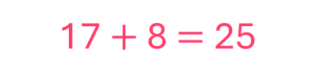
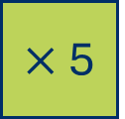

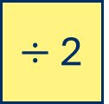
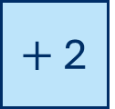
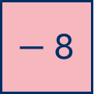
I do
You do
Complete the function machines.
Complete the function machines.
input
output
input
output
9
$×$ 5
45
37
$+$ 2
39
9 $×$ 5 $=$45
input
output
input
output
25
$−$ 8
17
28
$÷$ 2
14
17 $+$ 8 $=$25

Slide 11
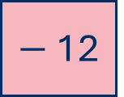
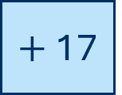
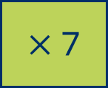
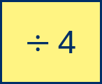
Complete the function machines.
input
output
input
output
a)
35
$+$ 17
c)
28
$÷$ 4
52
7
input
output
input
output
b)
$−$ 12
12
d)
$×$ 7
63
24
9

Slide 12
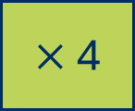
Is the statement true or false?
input
output
0.6
$×$ 4
2.4
The output is 0.24
false

Slide 13
Mo has calculated the output for the function machine.
input
output
8
squared
16
Explain the mistake Mo has made.

Slide 14
What’s the same? What’s different?
input
output
input
output
80
subtract 50
30
30
subtract from 50
20
Complete the function machines.

Slide 15
Complete the function machines.
a)
input
output
c)
input
output
12
subtract from 46
34
double
104
52
b)
input
output
d)
input
output
square
121
12
halve
6
11

Slide 16
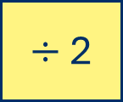
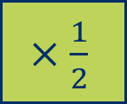
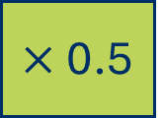
Dexter thinks that all the function machines will give the same output.
input
output
input
output
10
$÷$ 2
5
10
$×$ 0.5
5
input
output
input
output
10
halve
5
10
$×\frac{1}{2}$
5
Do you agree with Dexter?
Explain your answer.

Slide 17
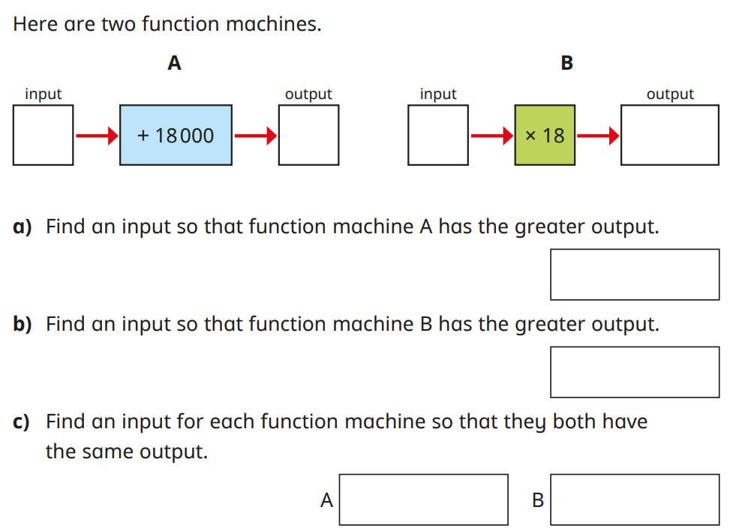

Slide 18

Connect a visualiser to use this slide.
Link to the abstract

Slide 19
I do
You do
Complete the function machines.
Complete the function machines.
input
output
input
output
9
$×$ 5
37
$+$ 2
input
output
input
output
$−$ 8
17
$÷$ 2
14

Slide 20
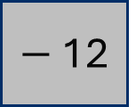
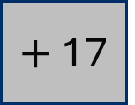
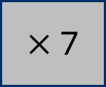
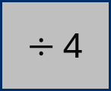
Complete the function machines.
input
output
input
output
a)
35
$+$ 17
c)
28
$÷$ 4
input
output
input
output
b)
$−$ 12
12
d)
$×$ 7
63

Slide 21
Complete the function machines.
a)
input
output
c)
input
output
12
subtract from 46
double
104
b)
input
output
d)
input
output
square
121
12
halve

Slide 22















Dual coding symbols:
Practise
Explain
Organise
Big Question
Reflect
Present
Compare
Evaluate
Activate
Discuss
Predict
Connect
Summarise
Recall
Vocabulary

Slide 23










Editable reading ruler
Every child in an Archway school will become a fluent reader
 | RETRIEVE the words or phrases you need from the text | DECODE the words or phrase to address a breakdown | CONNECT with words or phrases you know from the text or your memory | VISUALISE the images in as much detail as possible | SUMMARISE the main ideas of the text in a few words | INFER meanings that might be within the text | PREDICT what might happen next using details from the text | EXAMINE how the writer uses words to construct meaning
 | ASK THOUGHTFUL QUESTIONS TO HELP YOU UNDERSTAND THE TEXT

Slide 24




A
B

