Slide 1
What are we learning in this lesson?
Today we will be interpreting bar models by writing the fact family that they represent. You will also draw your own bar models for a given equation.
Why are we learning about this?
Fact families are 4 equations that are linked; so if you know one calculation you can use that to work out the other calculations. It is useful to link your timetables knowledge to division, and it will also help with more complex algebraic manipulation.

Slide 2




On your whiteboards…
What fact families (equations) can you write from this bar model?
37
15
22
$$15+22=37$$
$$22+15=37$$
$$37−22=15$$
$$37−15=22$$

Slide 3




What else do you notice about the bar model?
Would we get the same facts if the same bar was in a different orientation?
37
22
15
15
22
37
$$15+22=37$$
$$22+15=37$$
The same as these calculations!
$$37−22=15$$
$$37−15=22$$

Slide 4
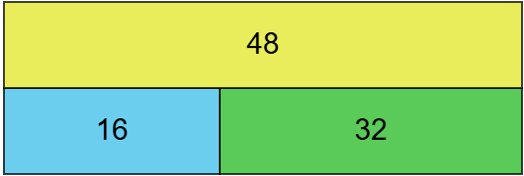
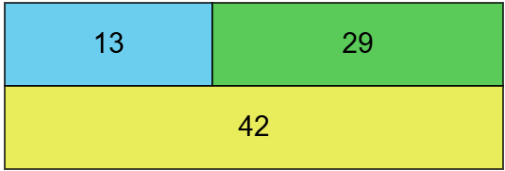
Create the fact families for these two bar models.
I do
We do

Slide 5

What’s the same and what is different?
35
10
35
Now write the fact family.

Slide 6
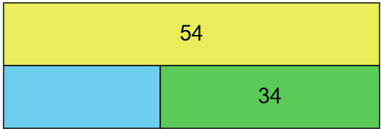
Think pair share.

Slide 7
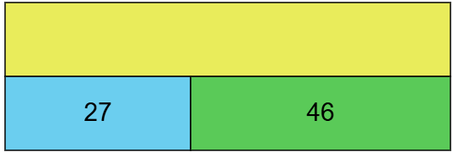
Think pair share.

Slide 8
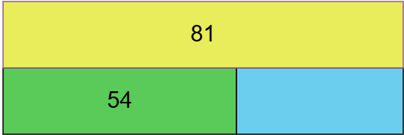
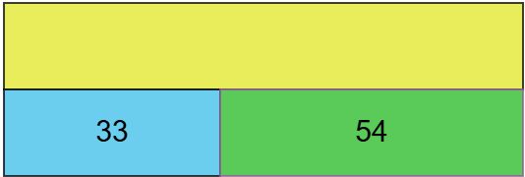
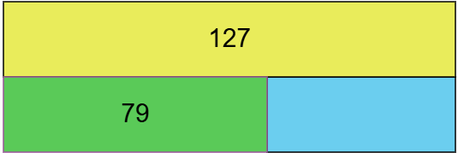
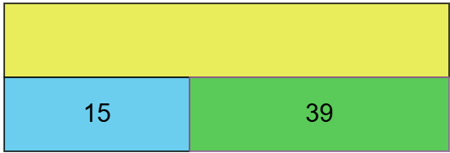
Create the fact families for these
I do
We do
You do
You do

Slide 9
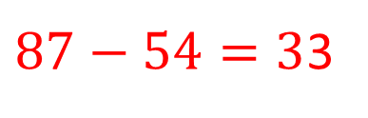

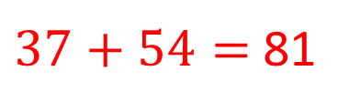
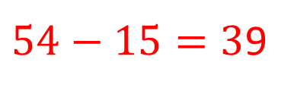
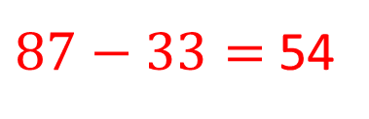
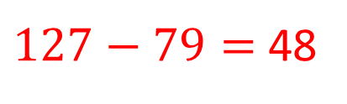

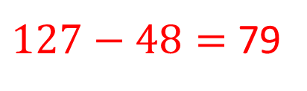
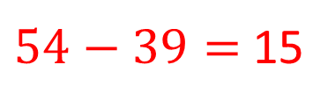
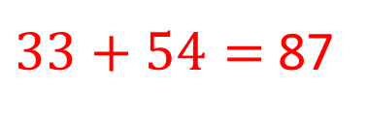

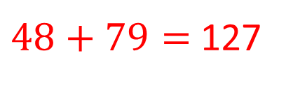
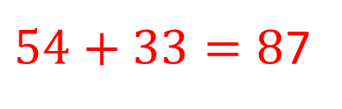
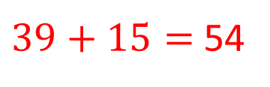
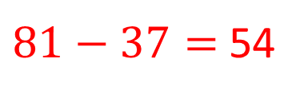

$$54+37=81$$
$54+33=8$7
$37+54=$ 81
$33+54=$ 87
$81−37=$ 54
$87−33=$ 54
$$81−54=37$$
$87−54=3$3
$$79+48=127$$
$$15+39=54$$
$48+79=$ 127
$39+15=$ 54
$127−48=$ 79
$54−39=$ 15
$127−79=$ 48
$54−15=3$9

Slide 10
Create the bar models for these equations.
5 + 17 = 22
18 + 14 = 32
48 = 27 + 21

Slide 11
Answers
22
5
17
32
18
14
48
21
27

Slide 12
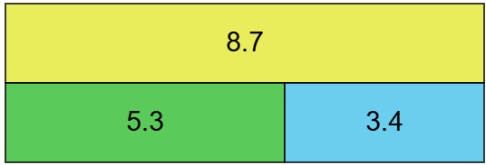
What’s the same and what is different?
Now write the fact family.

Slide 13
Create the fact families for these
I do
We do
13.1
27.6
4.2
8.9
18.9
You do
6.7
8.9

Slide 14
What’s the problem with this?
12.1
4.2
8.9

Slide 15
Create the bar models for these equations.
2.5 + 1.7 = 4.2
1.8 + 6.1 = 7.9
4.3 = 2.7 + 1.6

Slide 16
Answers
4.2
2.5
1.7
7.9
1.8
6.1
4.3
2.7
1.6

Slide 17


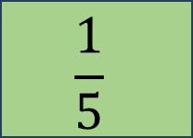
Think pair share.
$$\frac{3}{5}$$
$$\frac{1}{5}$$
$$\frac{2}{5}$$

Slide 18

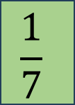
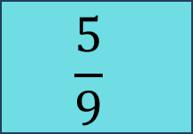

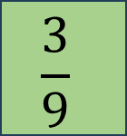
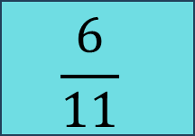

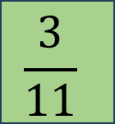
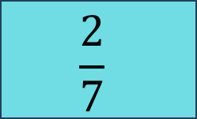
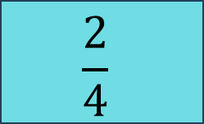
Create the fact families for these
I do
We do
$$\frac{3}{7}$$
$$\frac{8}{9}$$
$$\frac{1}{7}$$
$$\frac{2}{7}$$
$$\frac{3}{9}$$
$$\frac{5}{9}$$
You do
You do
$$\frac{3}{4}$$
$$\frac{2}{4}$$
$$\frac{3}{11}$$
$$\frac{6}{11}$$

Slide 19








Create the fact families for these
I do
We do
$$\frac{3}{7}$$
$$\frac{8}{9}$$
$$\frac{1}{7}$$
$$\frac{2}{7}$$
$$\frac{3}{9}$$
$$\frac{5}{9}$$
You do
You do
$$\frac{1}{4}+ \frac{2}{4}=\frac{3}{4}$$
$$\frac{3}{11}+ \frac{6}{11}=\frac{9}{11}$$
$$\frac{3}{4}$$
$$\frac{2}{4}+ \frac{1}{4}=\frac{3}{4}$$
$$\frac{6}{11}+ \frac{3}{11}=\frac{9}{11}$$
$$\frac{2}{4}$$
$$\frac{3}{11}$$
$$\frac{6}{11}$$
$$\frac{3}{4}− \frac{2}{4}=\frac{1}{4}$$
$$\frac{9}{11}− \frac{6}{11}=\frac{3}{11}$$
$$\frac{3}{4}− \frac{1}{4}=\frac{2}{4}$$
$$\frac{9}{11}− \frac{3}{11}=\frac{6}{11}$$

Slide 20
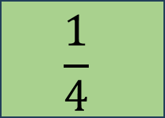


Challenge
Create the fact family
$$\frac{7}{8}$$
$$\frac{1}{4}$$
$$\frac{5}{8}$$

Slide 21
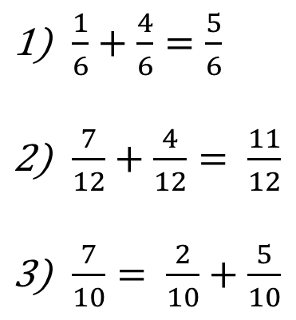
Create the bar models for these equations.
$\frac{1}{6}+\frac{4}{6}=\frac{5}{6}$
$\frac{7}{12}+\frac{4}{12}= \frac{11}{12}$
$\frac{7}{10}= \frac{2}{10}+\frac{5}{10}$

Slide 22
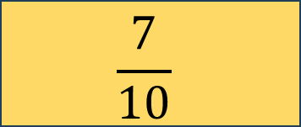
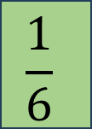
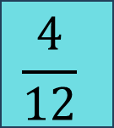

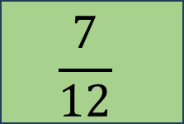
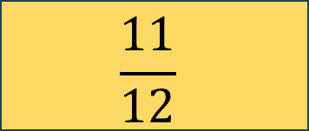
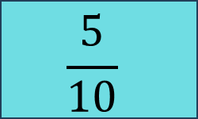
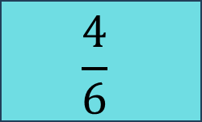
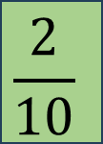
Answers
$$\frac{5}{6}$$
$$\frac{1}{6}$$
$$\frac{4}{6}$$
$$\frac{11}{12}$$
$$\frac{7}{12}$$
$$\frac{4}{12}$$
$$\frac{7}{10}$$
$$\frac{2}{10}$$
$$\frac{5}{10}$$

Slide 23
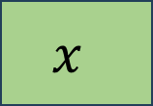
Think pair share.
13
$$x$$
8

Slide 24

Think pair share.
$$x$$
14
22

Slide 25



Create the fact families for these
I do
We do
45
61
$$x$$
21
19
$$x$$
You do
$$x$$
3.4
7.3

Slide 26
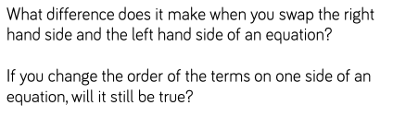
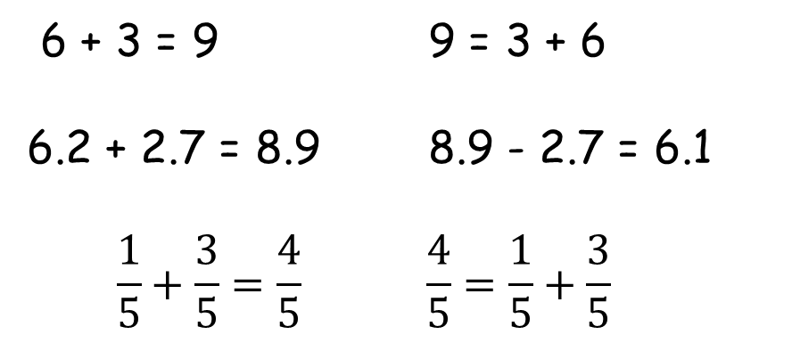
Discuss…
True or False?
6 + 3 = 9 9 = 3 + 6
6.2 + 2.7 = 8.9 8.9 - 2.7 = 6.1
$$\frac{1}{5}+\frac{3}{5}=\frac{4}{5} \frac{4}{5}=\frac{1}{5}+\frac{3}{5}$$

Slide 27
How many equations can you make?
8
4
7
5
10
2
3
3
3
3
Is there an odd one out?

Slide 28
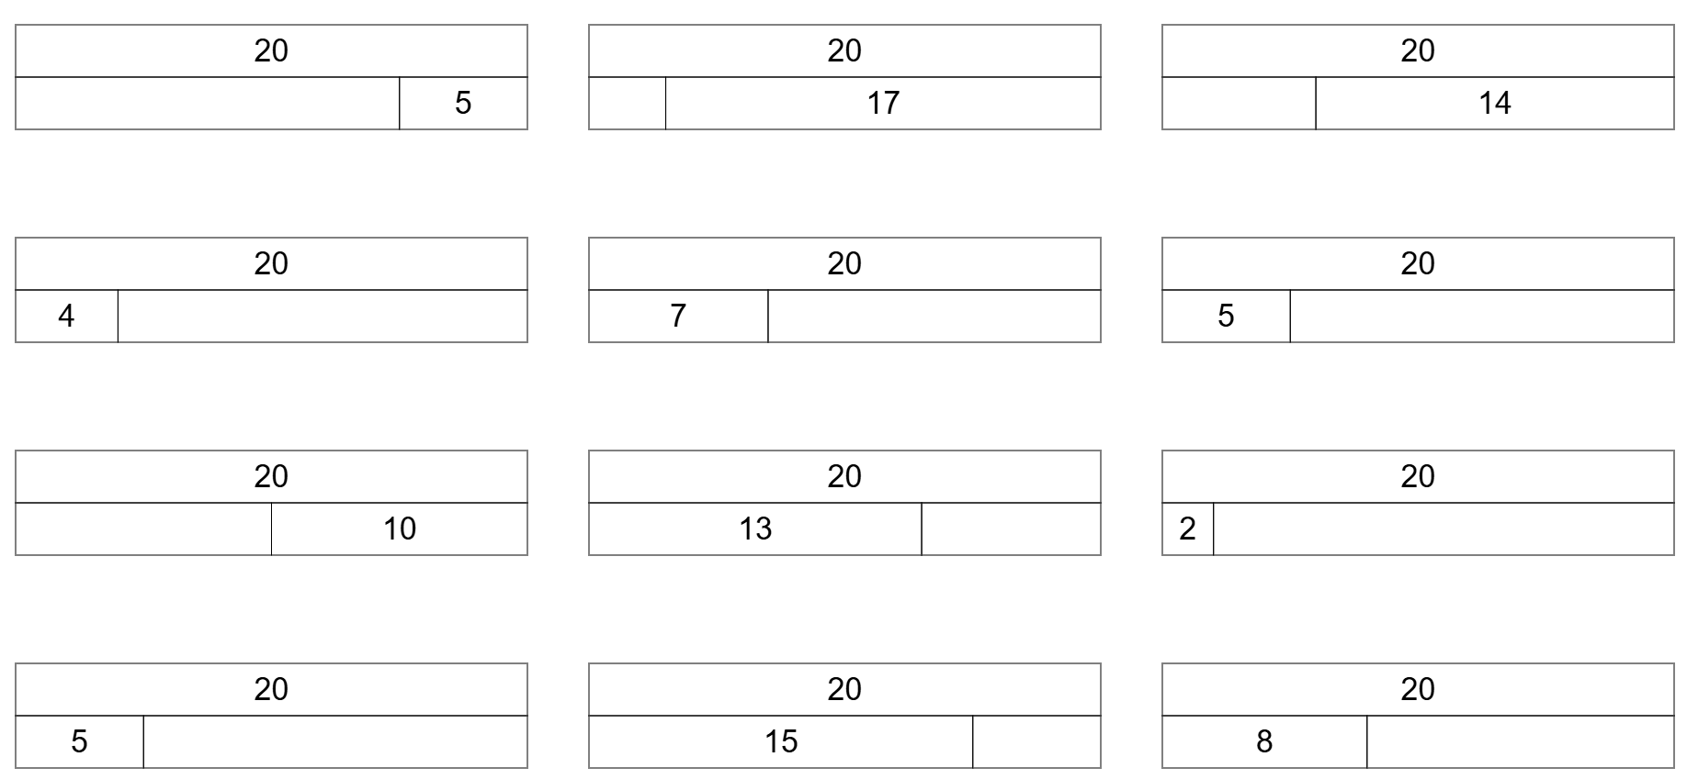

Slide 29
