Slide 1




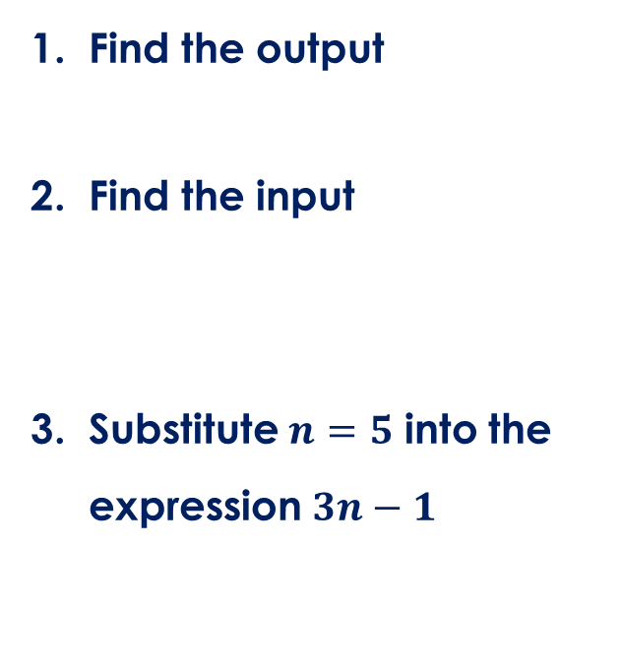



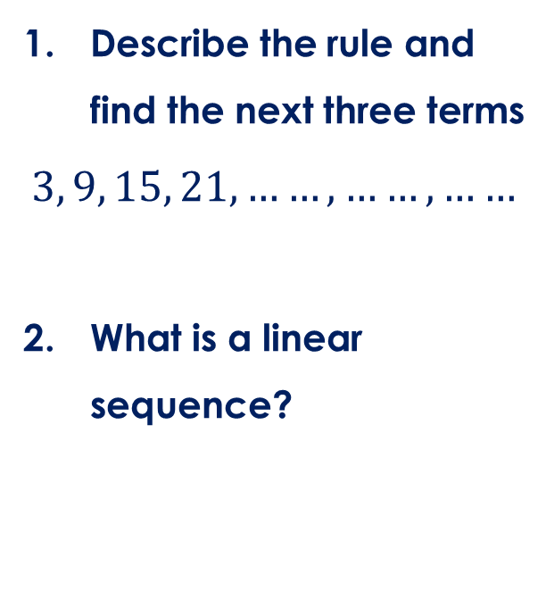

Friday, 14 February 2025
Generate linear sequence
Find the output
Find the input
Substitute $n=5$ into the expression $3n−1$
Describe the rule and find the next three terms
$$3, 9, 15, 21, ……, ……, ……$$
What is a linear sequence?
Calculate
$$\frac{1}{3}+\frac{1}{4}$$
Find 3/5 of 40
$$4$$
$$×2$$
$$+3$$
$$×2$$
$$+3$$
$$19$$

Slide 2


Key vocabulary:
Generate
Expression
Linear sequence

Slide 3
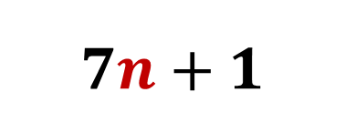
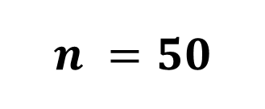
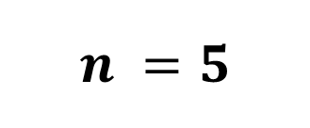
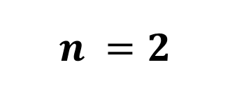
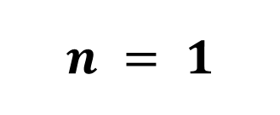
All linear sequence are represented by an expression
$$7n+1$$
The position of the term
1st term
$$n = 1$$
2nd term
$$n =2$$
5th term
$$n =5$$
50th term
$$n =50$$

Slide 4
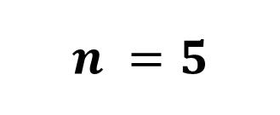
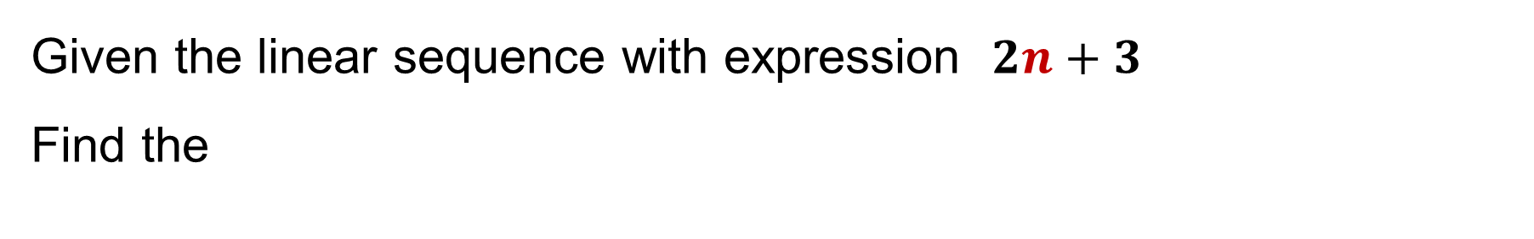
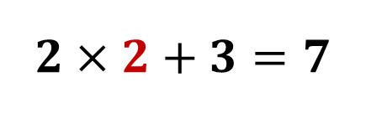
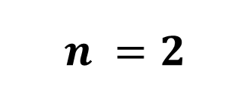
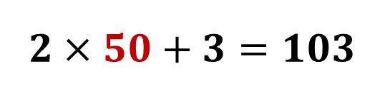
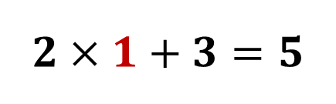
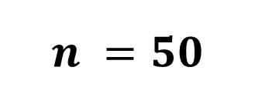
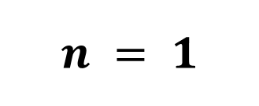
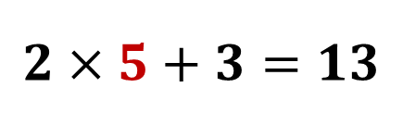
Example
Given the linear sequence with expression $2n+3$
Find the
1st term
$$n = 1$$
$$2×1+3=5$$
2nd term
$$n =2$$
$$2×2+3=7$$
5th term
$$n =5$$
$$2×5+3=13$$
50th term
$$n =50$$
$$2×50+3=103$$

Slide 5

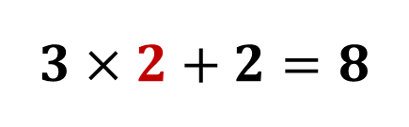


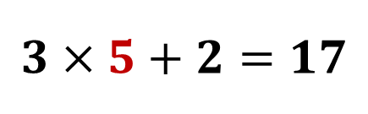
You have a go
Given the linear sequence with expression $3n+2$
Find the
1st term
$$n = 1$$
$$3×1+2=5$$
2nd term
$$n =2$$
$$3×2+2=8$$
5th term
$$n =5$$
$$3×5+2=17$$
50th term
$$n =50$$
$$3×50+2=152$$

Slide 6
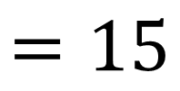


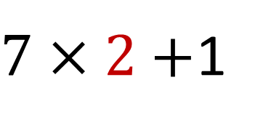




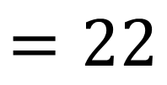
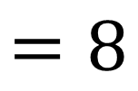

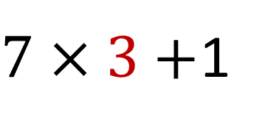

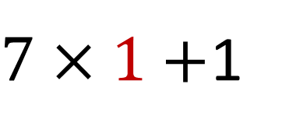


Table Format to generate the first 10 terms
$$n$$ | 1 | 2 | 3 | 4 | 5 | 6 | 7 | 8 | 9 | 10
$$7n+1$$
$$8$$
$$15$$
$$22$$
$$29$$
$$36$$
$$43$$
$$50$$
$$57$$
$$64$$
$$71$$
$7×1+$1
$$=8$$
$7×2+$1
$$=15$$
$7×3+$1
$$=22$$

Slide 7

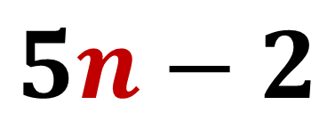
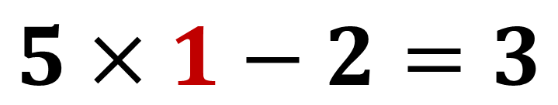
Mini White board
Find the 1st term of the sequence
$$5n−2$$
$$5×1−2=3$$

Slide 8
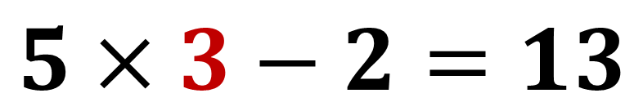
Mini White board
Find the 3rd term of the sequence
$$5n−2$$
$$5×3−2=13$$

Slide 9
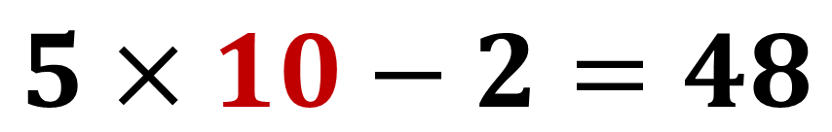
Mini White board
Find the 10th term of the sequence
$$5n−2$$
$$5×10−2=48$$

Slide 10
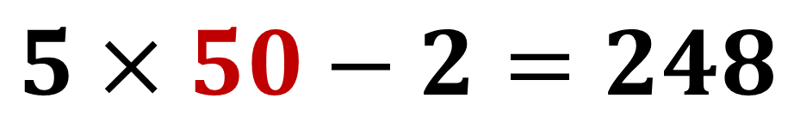
Mini White board
Find the 50th term of the sequence
$$5n−2$$
$$5×50−2=248$$

Slide 11

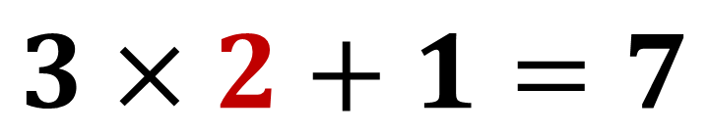
Mini White board
Find the 2nd term of the sequence
$$3n+1$$
$$3×2+1=7$$

Slide 12
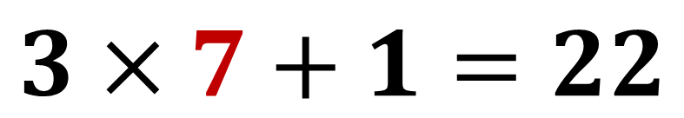
Mini White board
Find the 7th term of the sequence
$$3n+1$$
$$3×7+1=22$$

Slide 13
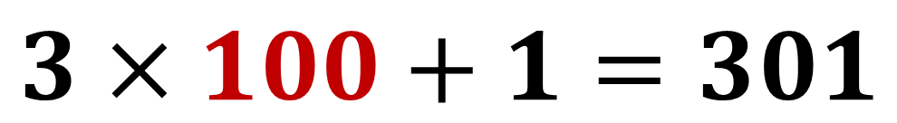
Mini White board
Find the 100th term of the sequence
$$3n+1$$
$$3×100+1=301$$

Slide 14
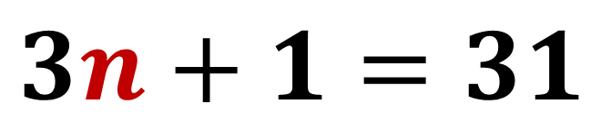
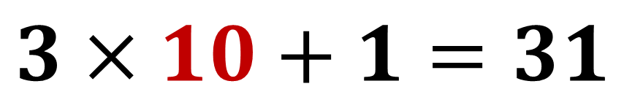
Mini White board
Which term in the sequence
$$3n+1=31$$
$$3×10+1=31$$
10th term

Slide 15
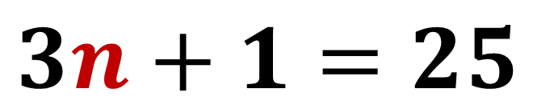
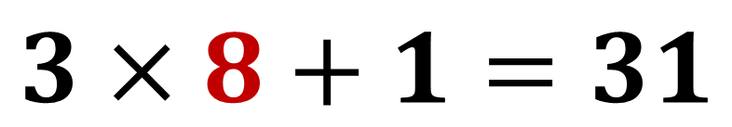
Mini White board
Which term in the sequence
$$3n+1=25$$
$$3×8+1=31$$
8th term

Slide 16
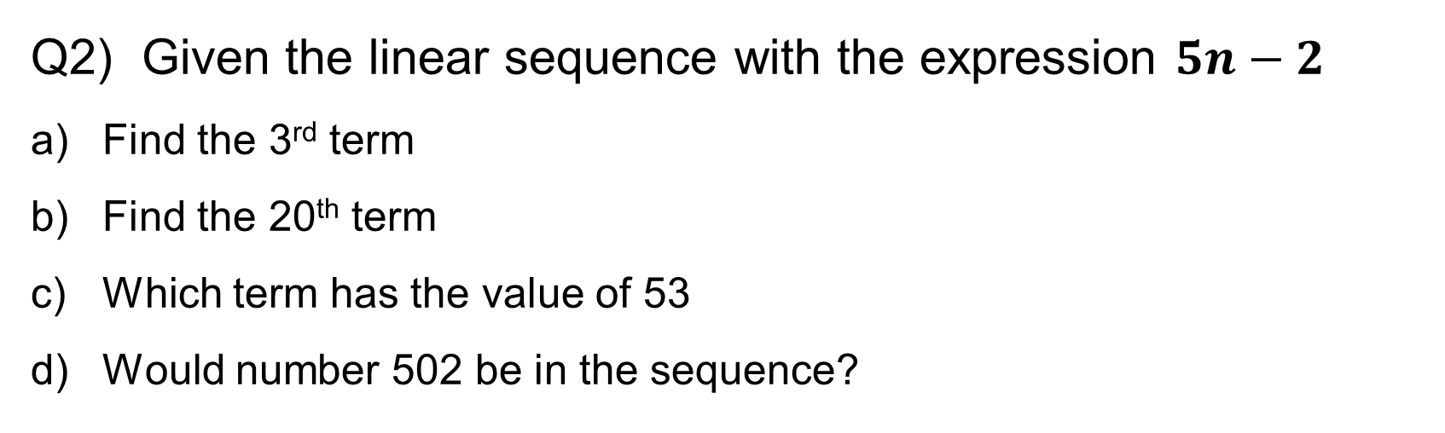
Independent work
Q1) Complete the table to generate the first 10 terms
$$n$$ | 1 | 2 | 3 | 4 | 5 | 6 | 7 | 8 | 9 | 10
$$4n+3$$
Q2) Given the linear sequence with the expression $5n−2$
Find the 3rd term
Find the 20th term
Which term has the value of 53
Would number 502 be in the sequence?

Slide 17

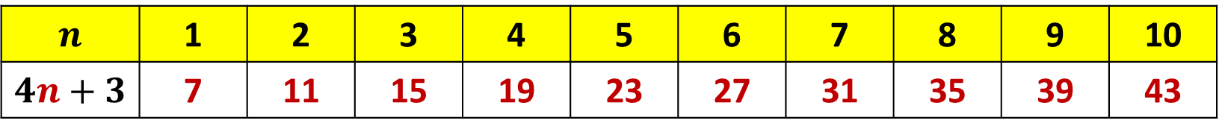




Mark it
Q1) Complete the table to generate the first 10 terms
$$n$$ | 1 | 2 | 3 | 4 | 5 | 6 | 7 | 8 | 9 | 10
$$4n+3$$ | 7 | 11 | 15 | 19 | 23 | 27 | 31 | 35 | 39 | 43
Q2) Given the linear sequence with the expression $5n−2$
Find the 3rd term
Find the 20th term
Which term has the value of 53
Would number 502 be in the sequence?
$$5×3−2=13$$
$$5×20−2=98$$
$$5×11−2=53$$
11th term
$$5×100−2=498$$
NO
$$5×101−2=503$$

