Slide 1
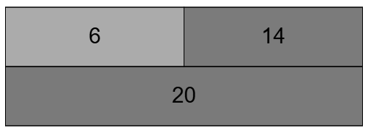
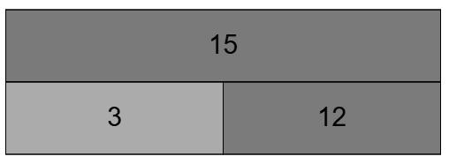
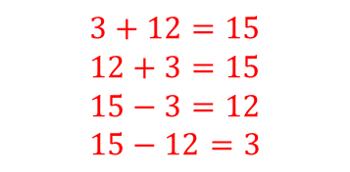
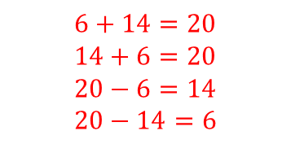
For each bar model, write down a fact family that it represents:
1) 2)
$$6+14=20$$
$$14+6=20$$
$$20−6=14$$
$$20−14=6$$
$$3+12=15$$
$$12+3=15$$
$$15−3=12$$
$$15−12=3$$
3) Vocab check
Write one sentence explaining what each word means:
Equation
Solve
Inverse

Slide 2
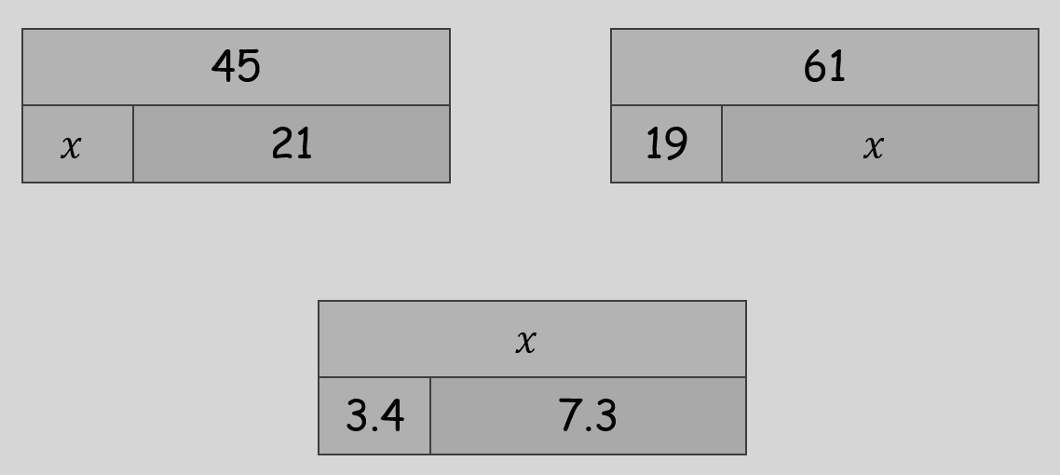


On your whiteboards
From last lesson… can you find the missing numbers
$$y$$
$$z$$

Slide 3

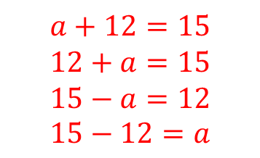
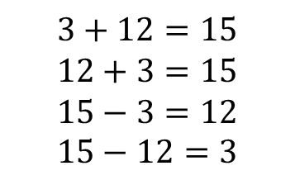
So, already we know that this bar model represents this fact family:
Now let’s look at this bar model
What’s the same, what’s different?
How will we write the fact family for this bar model?
$$3+12=15$$
$$12+3=15$$
$$15−3=12$$
$$15−12=3$$
$$a+12=15$$
$$12+a=15$$
$$15−a=12$$
$$15−12=a$$

Slide 4
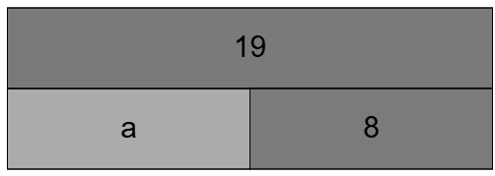
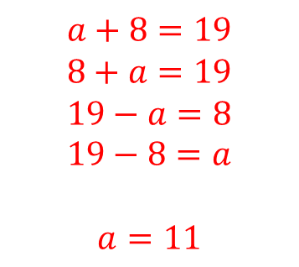
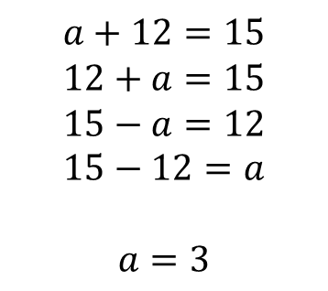
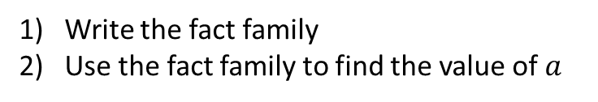
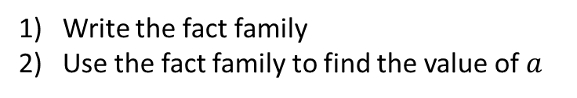
I Do
You Do
Write the fact family
Use the fact family to find the value of $a$
Write the fact family
Use the fact family to find the value of $a$
$$a+12=15$$
$$12+a=15$$
$$15−a=12$$
$$15−12=a$$
$$a=3$$
$$a+8=19$$
$$8+a=19$$
$$19−a=8$$
$$19−8=a$$
$$a=11$$

Slide 5
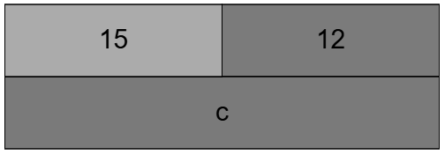
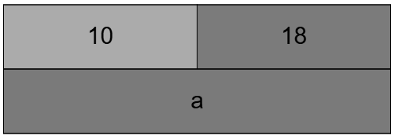
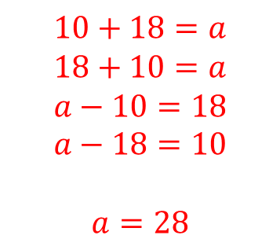
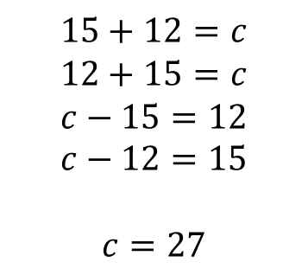
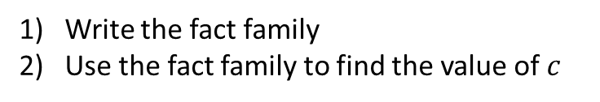
I Do
You Do
Write the fact family
Use the fact family to find the value of $c$
Write the fact family
Use the fact family to find the value of $a$
$$15+12=c$$
$$12+15=c$$
$$c−15=12$$
$$c−12=15$$
$$c=27$$
$$10+18=a$$
$$18+10=a$$
$$a−10=18$$
$$a−18=10$$
$$a=28$$
Challenge: Can you think of a different way to write each equation?

Slide 6

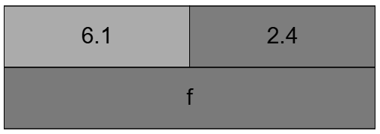
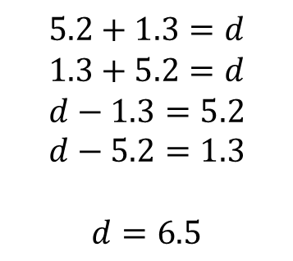
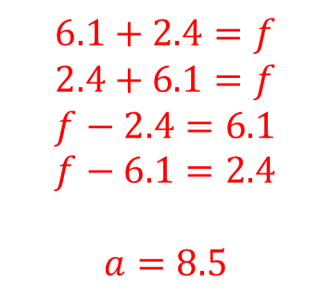
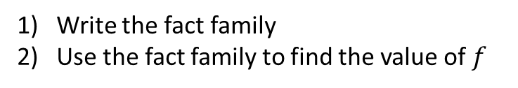
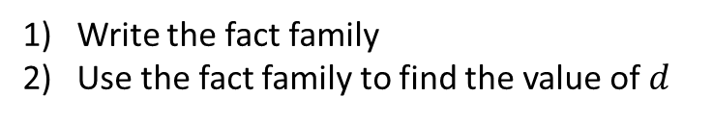
I Do
You Do
Write the fact family
Use the fact family to find the value of $d$
Write the fact family
Use the fact family to find the value of $f$
$$5.2+1.3=d$$
$$1.3+5.2=d$$
$$d−1.3=5.2$$
$$d−5.2=1.3$$
$$d=6.5$$
$$6.1+2.4=f$$
$$2.4+6.1=f$$
$$f−2.4=6.1$$
$$f−6.1=2.4$$
$$a=8.5$$
Challenge: Can you create a trickier bar model and fact family?

Slide 7




I Do
You Do
Sketch the bar model from the equation
Use your bar model to solve the equation
Sketch the bar model from the equation
Use your bar model to solve the equation
$$g+3=18$$
$$g+5=19$$
$$g=$$
$$g=$$

Slide 8


I Do
You Do
Sketch the bar model from the equation
Use your bar model to solve the equation
Sketch the bar model from the equation
Use your bar model to solve the equation
$$g−3=18$$
$$g−5=19$$
$$g=$$
$$g=$$

Slide 9
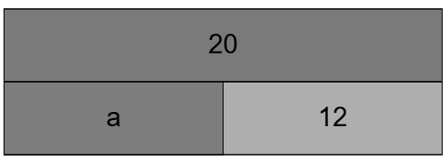
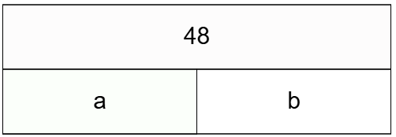

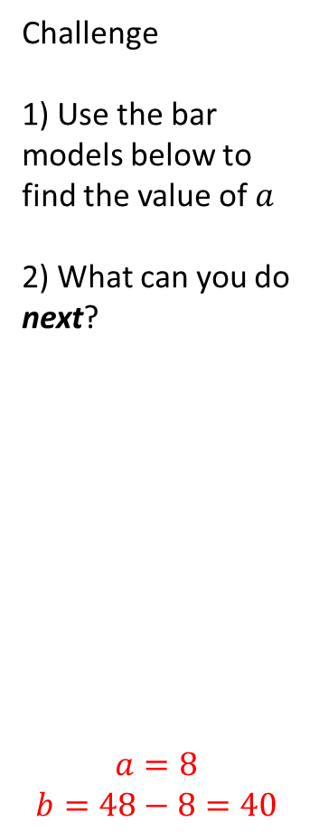

In your books:
Sketch the bar model from the equation
Use your bar model to solve the equation
Challenge
1) Use the bar models below to find the value of $a$
2) What can you do next?
$$a=8$$
$$b=48−8=40$$
1) $g+5.2=7.5$
2) $3.6+h=12.8$
3) $16−q=4$
4) $62=32+t$
5) $38=5.6+b$
6) $70−f=11.4$
$$g=2.3$$
$$h=9.2$$
$$q=12$$
$t=30$ or$30=t$
$$b=\text{32.4} \text{or} \text{32.4}=b$$
$$f=58.6$$

Slide 10
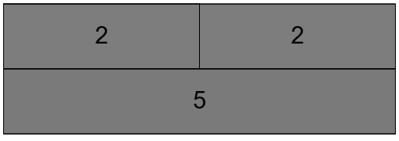

Why can’t I solve the examples below?
$$3.6+d$$
$$5+y=y$$

