Slide 1




On your whiteboards…
What fact families (equations) can you write from this bar model?
37
15
22
$$15+22=37$$
$$22+15=37$$
$$37−22=15$$
$$37−15=22$$

Slide 2




What else do you notice about the bar model?
Would we get the same facts if the same bar was in a different orientation?
37
22
15
15
22
37
$$15+22=37$$
The same as these calculations!
$$22+15=37$$
$$37−22=15$$
$$37−15=22$$

Slide 3





On your whiteboards…
What fact families (equations) can you write from this bar model?
18
7
$y$
$$7+y=18$$
$$y+7=18$$
$$18−y=7$$
$$18−7=y$$

Slide 4
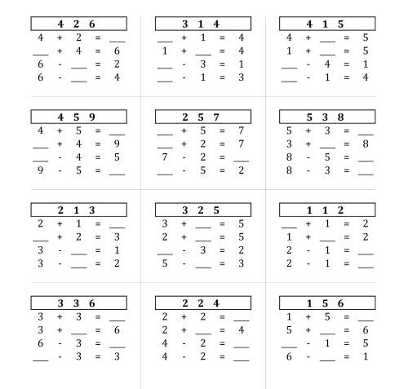
Notes:
Delete additional questions as appropriate

Slide 5
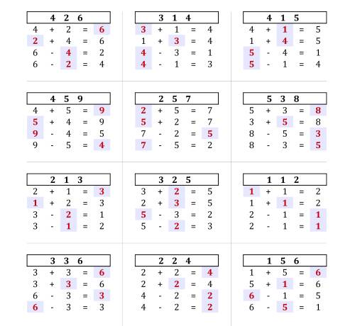

Slide 6
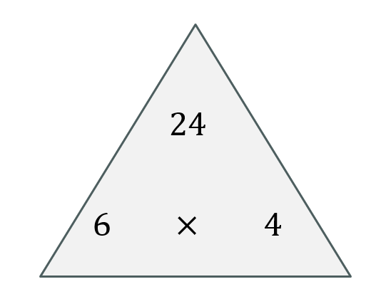








On your whiteboards…
What fact families (equations) can you write from this bar model?
24
6
6
6
6
$$6 × 4=24$$
$$24=6 × 4$$
$$4 × 6=24$$
$$24=4 × 6$$
$$24÷4=6$$
$$6=24÷4$$
$$24÷6=4$$
$$4=24÷6$$

Slide 7
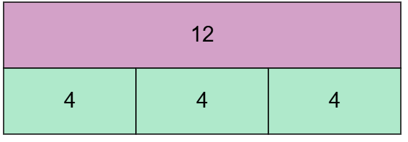
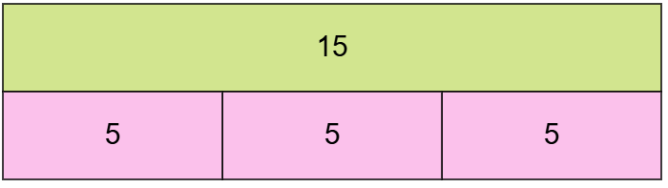
I do
We do
What fact families (equations) can you write from this bar model?
What fact families (equations) can you write from this bar model?

Slide 8

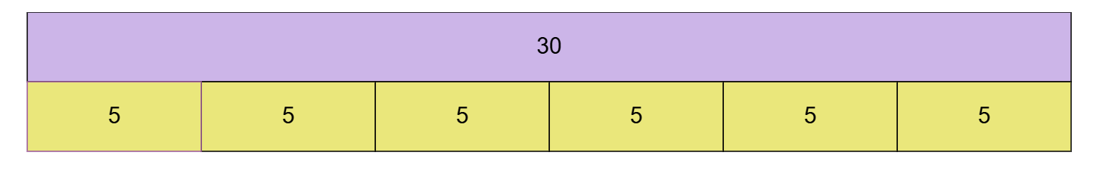
What fact families (equations) can you write from this bar model?

Slide 9
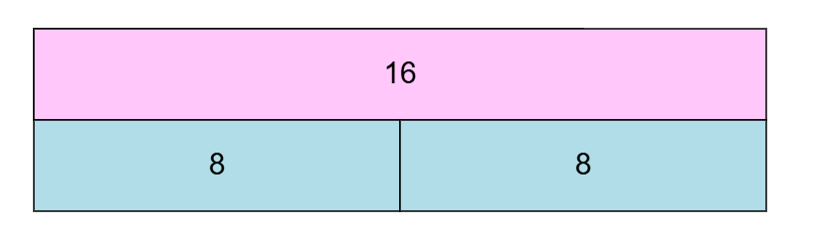
What fact families (equations) can you write from this bar model?

Slide 10
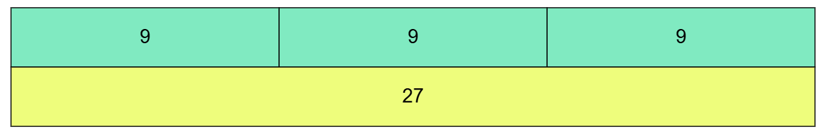
What fact families (equations) can you write from this bar model?

Slide 11
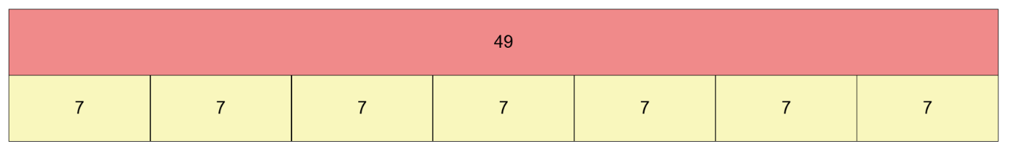
What fact families (equations) can you write from this bar model?

Slide 12
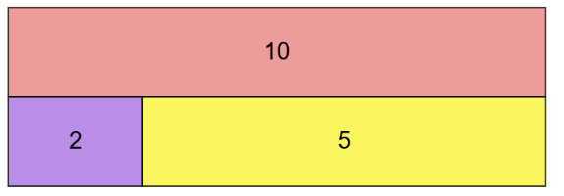

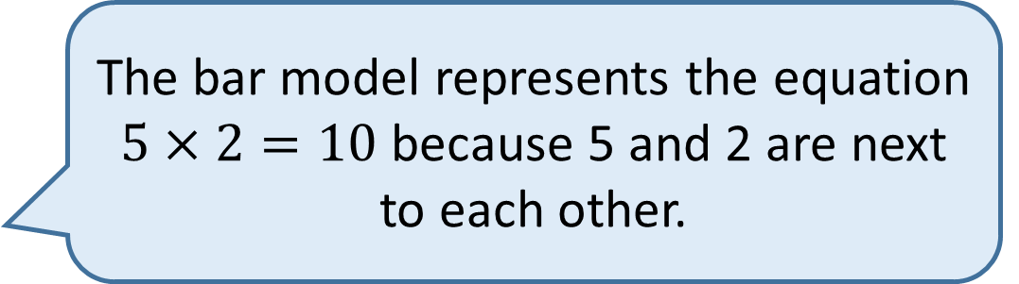
The bar model represents the equation $5×2=10$ because 5 and 2 are next to each other.
Do you agree with Jack?

Slide 13
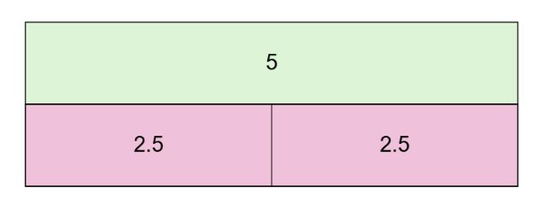
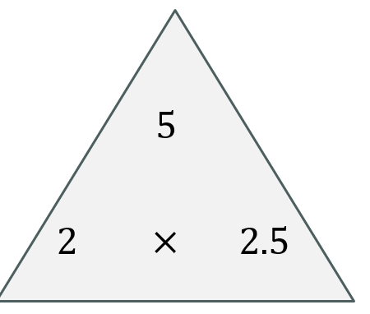








On your whiteboards…
What fact families (equations) can you write from this bar model?
$$2.5 ×2=5$$
$$5=2.5 ×2$$
$$2 ×2.5=5$$
$$5=2 ×2.5$$
$$5÷2=2.5$$
$$2.5=5÷2$$
$$5÷2.5=2$$
$$2=5÷2.5$$

Slide 14
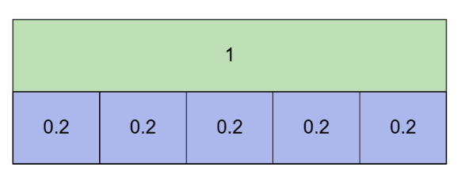
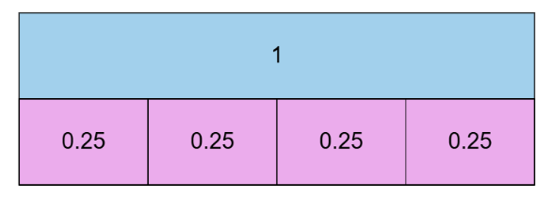
I do
We do
What fact families (equations) can you write from this bar model?
What fact families (equations) can you write from this bar model?

Slide 15
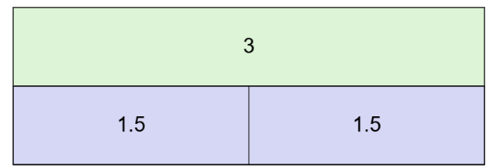
What fact families (equations) can you write from this bar model?

Slide 16
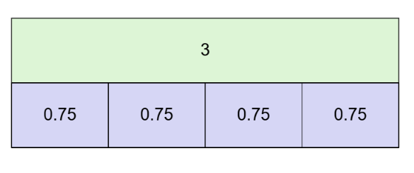
What fact families (equations) can you write from this bar model?

Slide 17
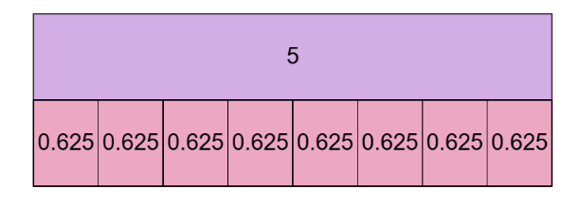
What fact families (equations) can you write from this bar model?

Slide 18
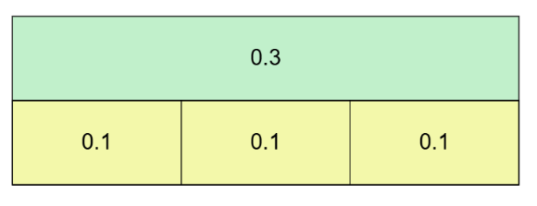
What fact families (equations) can you write from this bar model?

Slide 19
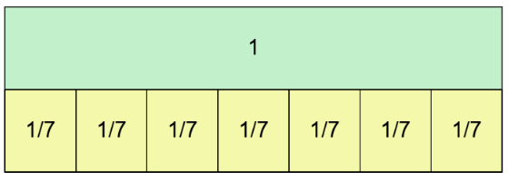
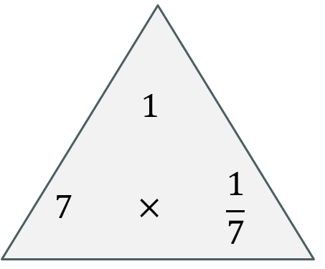








What fact families (equations) can you write from this bar model?
$$\frac{1}{7}× 7=1$$
$$1=\frac{1}{7}× 7$$
$$7×\frac{1}{7}=1$$
$$1=\frac{1}{7}× 7$$
$$1÷\frac{1}{7}=7$$
$$7=1÷\frac{1}{7}$$
$$1÷7=\frac{1}{7}$$
$$\frac{1}{7}=1÷7$$

Slide 20
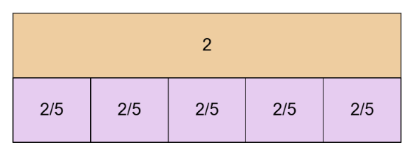
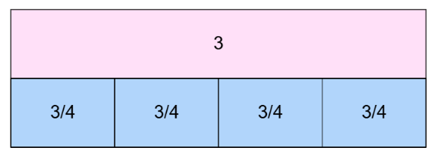
I do
We do
What fact families (equations) can you write from this bar model?
What fact families (equations) can you write from this bar model?

Slide 21
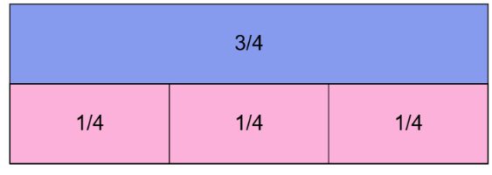
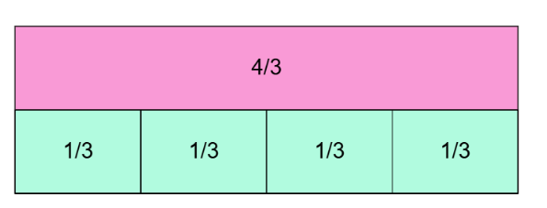
I do
We do
What fact families (equations) can you write from this bar model?
What fact families (equations) can you write from this bar model?

Slide 22
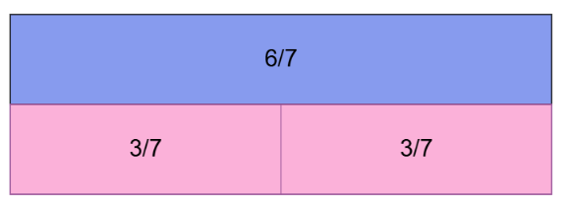
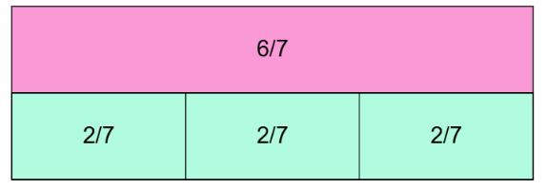
I do
We do
What fact families (equations) can you write from this bar model?
What fact families (equations) can you write from this bar model?

Slide 23
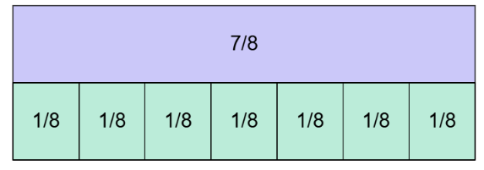
What fact families (equations) can you write from this bar model?

Slide 24
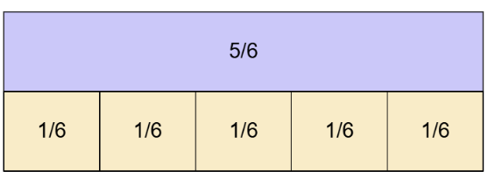
What fact families (equations) can you write from this bar model?

Slide 25
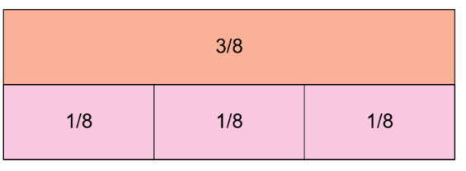
What fact families (equations) can you write from this bar model?

Slide 26


Draw a bar model for each of the following:
$3 × 7 = 21$
$36=4×9$
$30÷2=15$
$1.5×4=6$
$8=5×1.6$
$1÷5=\frac{1}{5}$
$\frac{2}{3}×3=2$
$a×5=20$
CH: Write some further facts to match your models.

Slide 27
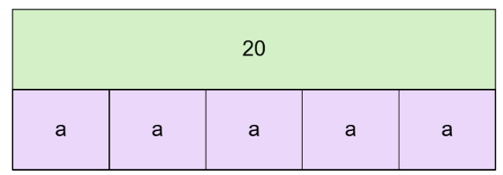
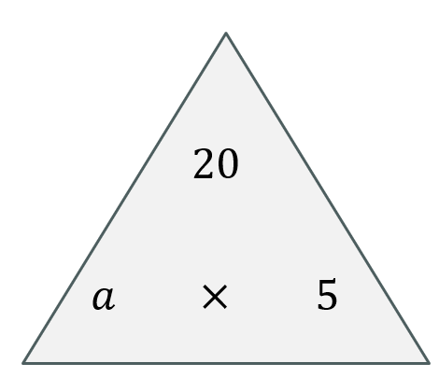




On your whiteboards…
What fact families (equations) can you write from this bar model?
$$a × 5=20$$
$$5 × a=20$$
$$20÷5=a$$
$$20÷a=5$$

