Slide 1
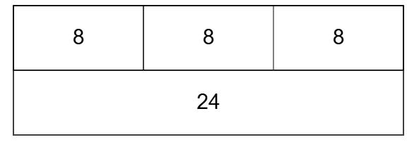
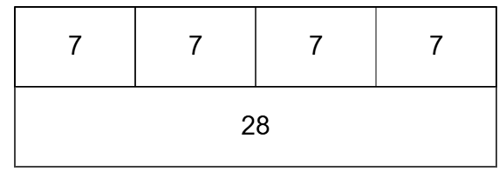
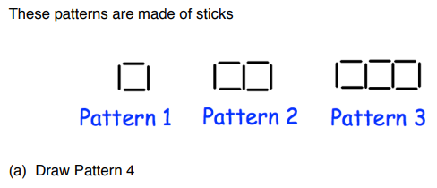
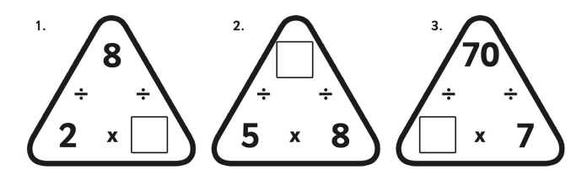
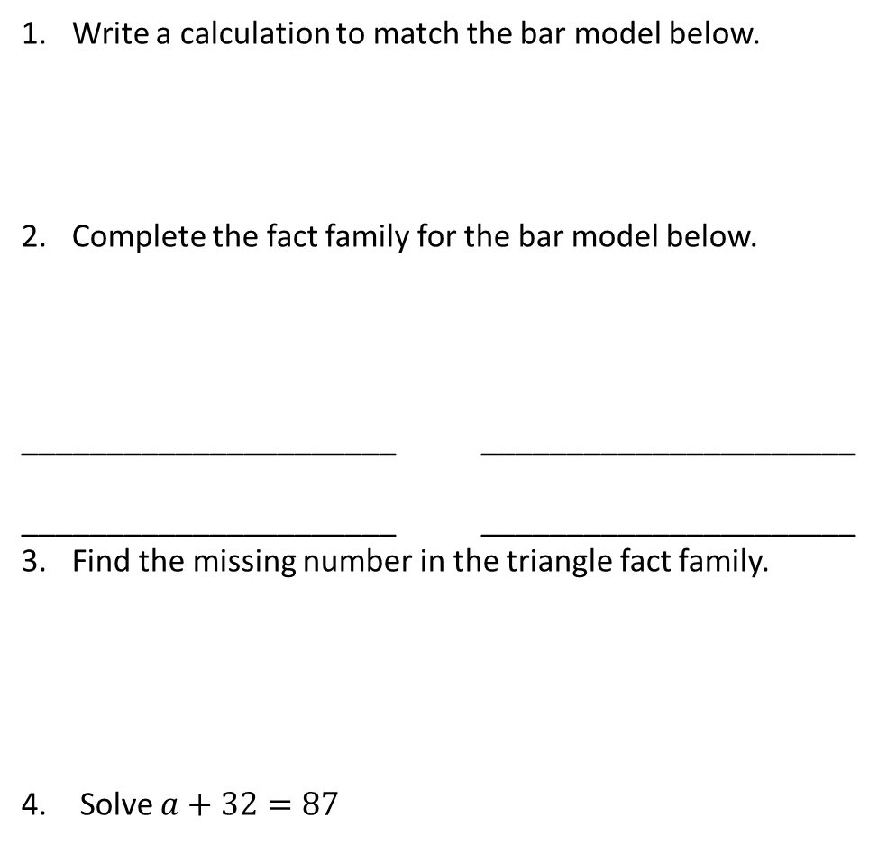
Solving Equations Using Fact Families
Friday, 27 June 2025
Earlier in This Topic
Write a calculation to match the bar model below.
Complete the fact family for the bar model below.
______________________ ______________________
______________________ ______________________
Find the missing number in the triangle fact family.
Solve $a+32=87$
Previous Topic

Slide 2
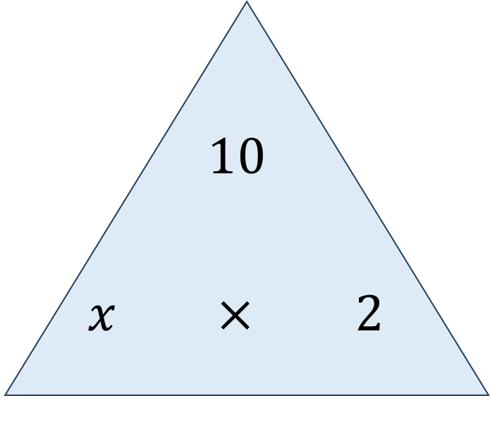


Write the fact family represented by this fact family triangle.
How could we write this using our algebraic notation from the previous unit?
$$x×2=10 \\ 2×x=10 \\ 10÷x=2 \\ 10÷2=x$$
$$2x=10 \\ \frac{10}{x}=2$$
$10÷2=x$ or $\frac{10}{2}=x$

Slide 3
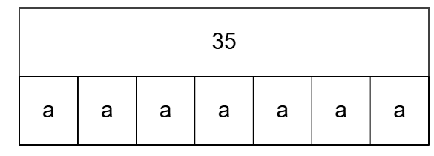
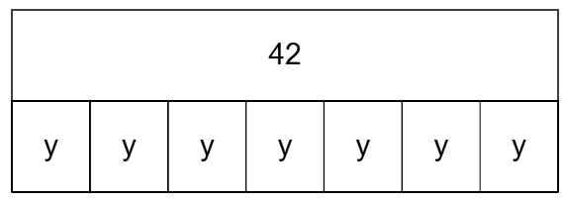
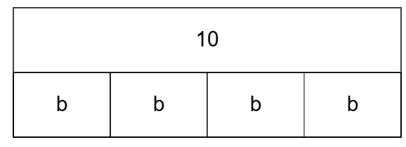

Write the fact family for the bar models below.
Don’t clear your boards, the next question needs your fact families.

Slide 4

Use your fact families to solve the following equations.
$7a=35$
$4b=10$

Slide 5
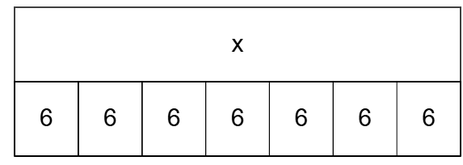
What is the same? What is different?

Slide 6
Write the fact families and fact family triangles for each. What is the same? What is different?

Slide 7
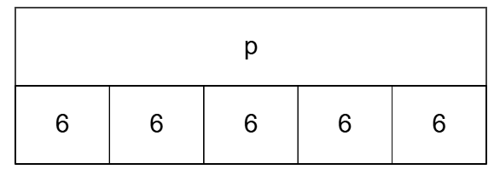
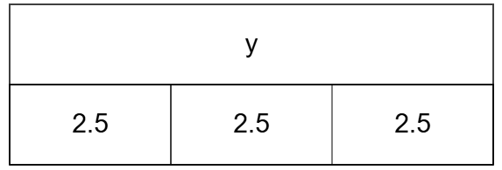
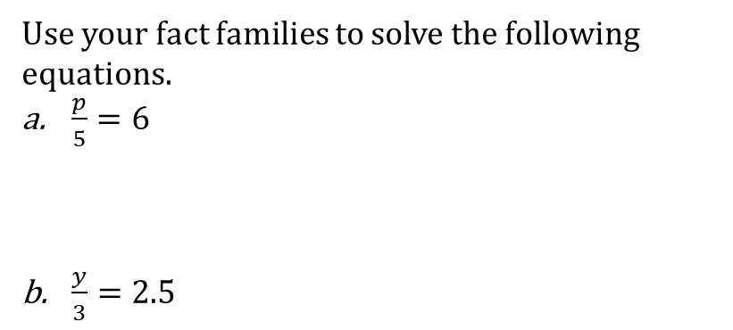
Use your fact families to solve the following equations.
$\frac{p}{5}=6$
$\frac{y}{3}=2.5$

Slide 8
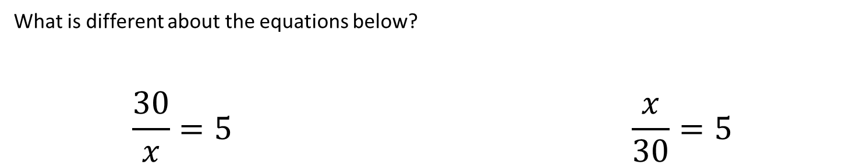
What is different about the equations below?
$$\frac{30}{x}=5 \frac{x}{30}=5$$

Slide 9


For each of the equations below, draw the fact family triangle, or write the fact families and use them to solve the equations. (You may wish to draw a bar model for each first).
$\frac{x}{11}=2$
$7k=56$
$5m=32$
$\frac{f}{4}=2.3$
$\frac{12}{x}=3$
$\frac{60}{m}=12$
$\frac{10}{w}=4$
$\frac{72}{p}=10$

Slide 10
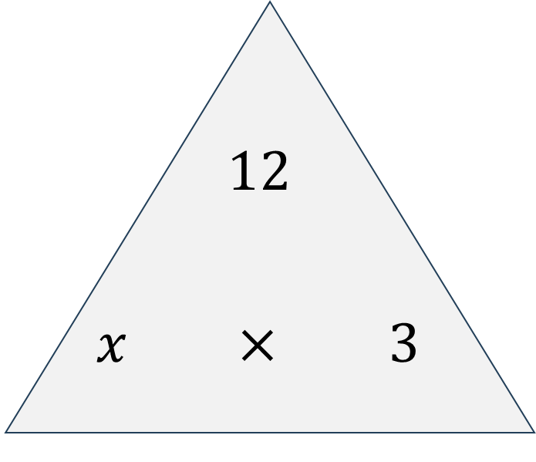
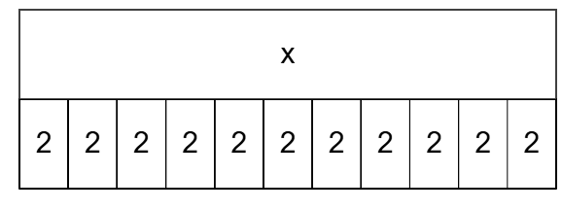
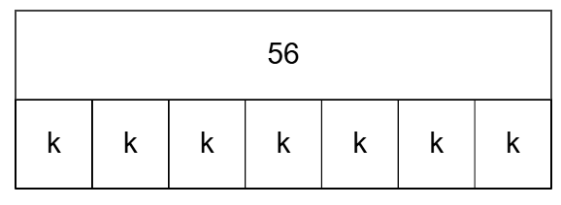
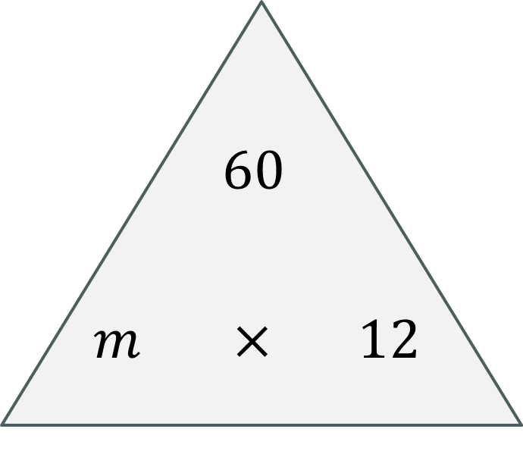


$\frac{x}{11}=2$
$7k=56$
$5m=32$
$\frac{f}{4}=2.3$
$\frac{12}{x}=3$
$\frac{60}{m}=12$
$\frac{10}{w}=4$
$\frac{72}{p}=10$

Slide 11

Solve each of the equations below.
$6p=18$
$\frac{x}{3}=2$
$11k=5.5$
$\frac{m}{7}=3$
$\frac{56}{d}=8$
$\frac{x}{0.1}=12$
$14s=196$
$\frac{8}{t}=0.2$

Slide 12
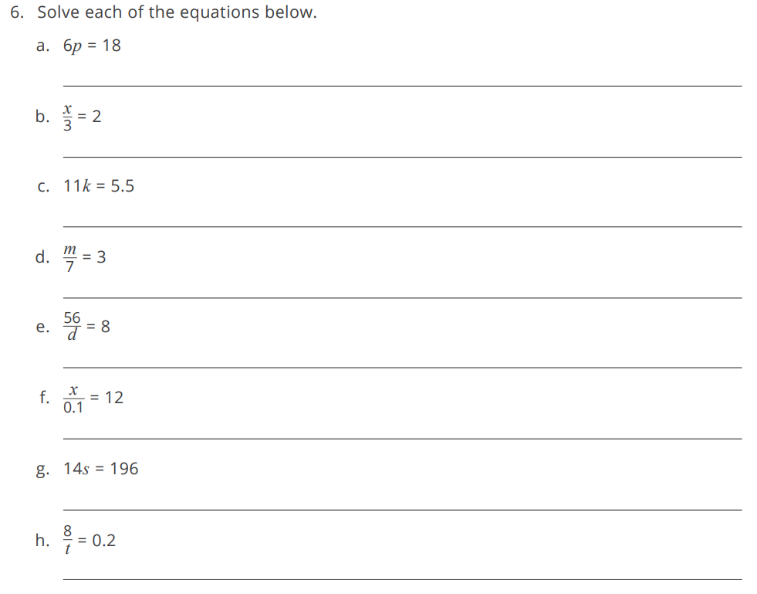

Slide 13
Form an equation to represent this question and then solve the equation.
a. Bella bought packs of stickers to give to her friends.
Each pack cost £4.
She spent a total of £12 on stickers.
How many packs did she buy?
b. Sudip bought stickers to give to 9 friends.
Each friend received 5 stickers.
How many stickers did he buy?
Form an equation to represent these questions and then solve the equation.
a. James had 42 sweets to give to his friends.
Each friend got 7 sweets.
How many friends did James give sweets to?
b. Jessica bought 8 pens which cost a total of £96.
How much does 1 pen cost?

Slide 14
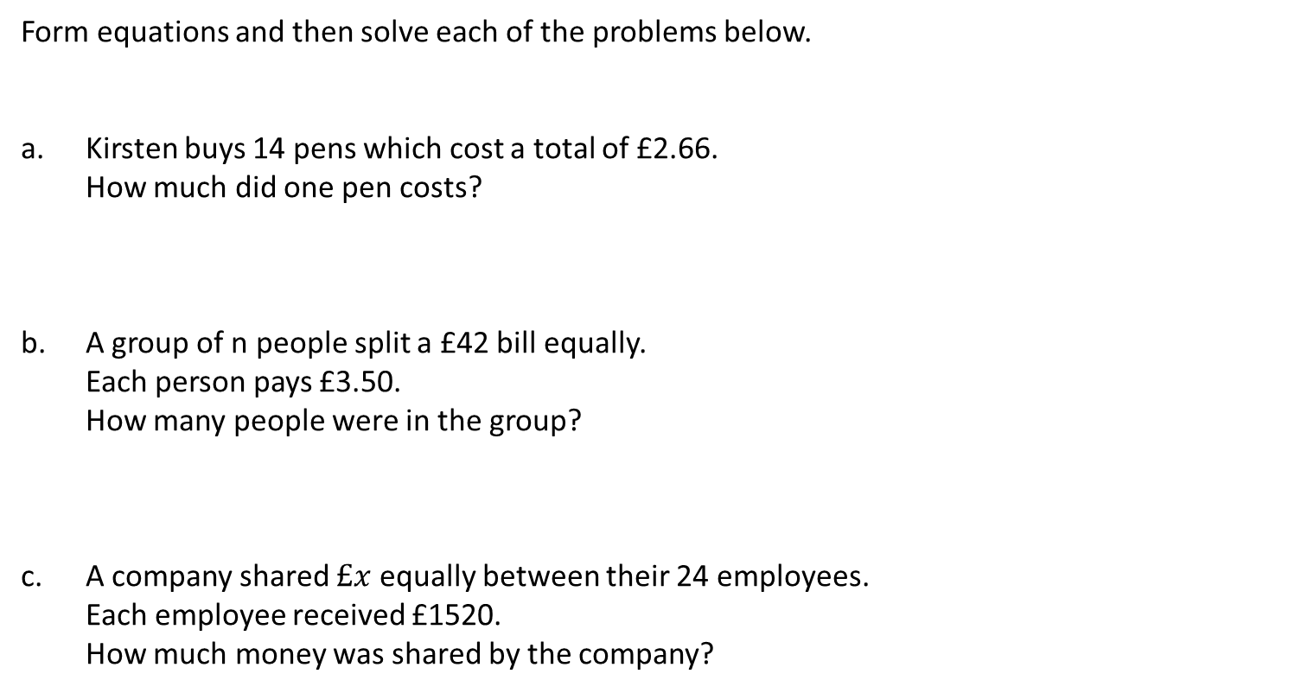
Form equations and then solve each of the problems below.
a. Kirsten buys 14 pens which cost a total of £2.66.
How much did one pen costs?
b. A group of n people split a £42 bill equally.
Each person pays £3.50.
How many people were in the group?
c. A company shared $£x$ equally between their 24 employees.
Each employee received £1520.
How much money was shared by the company?

Slide 15
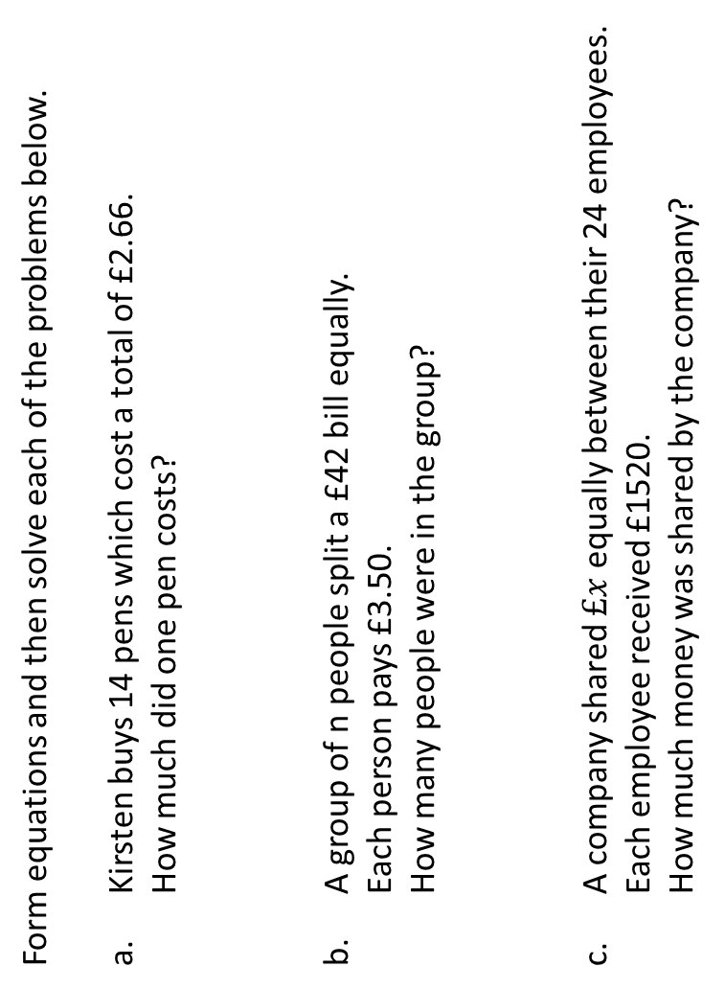
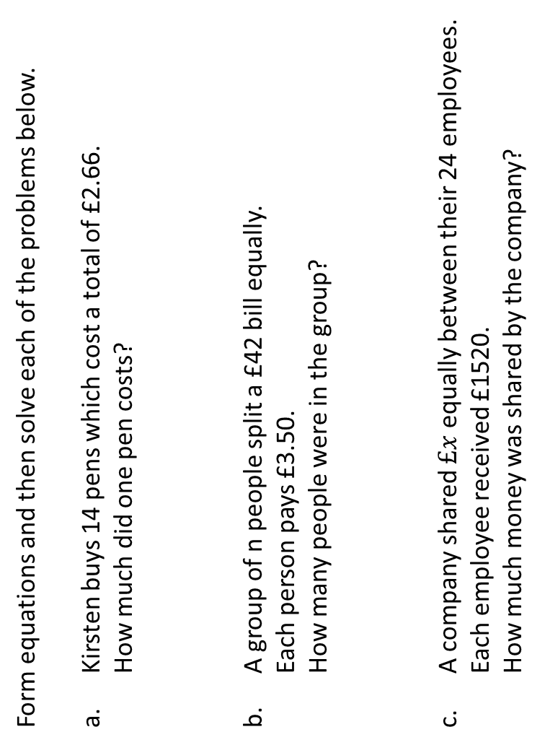
Form equations and then solve each of the problems below.
a. Kirsten buys 14 pens which cost a total of £2.66.
How much did one pen costs?
b. A group of n people split a £42 bill equally.
Each person pays £3.50.
How many people were in the group?
c. A company shared $£x$ equally between their 24 employees.
Each employee received £1520.
How much money was shared by the company?
Form equations and then solve each of the problems below.
a. Kirsten buys 14 pens which cost a total of £2.66.
How much did one pen costs?
b. A group of n people split a £42 bill equally.
Each person pays £3.50.
How many people were in the group?
c. A company shared $£x$ equally between their 24 employees.
Each employee received £1520.
How much money was shared by the company?

Slide 16

Challenge
Write equations that give each of the following solutions.
$x=3$
$p=7$
$t=1$
$k=0.4$

Slide 17
