Slide 1

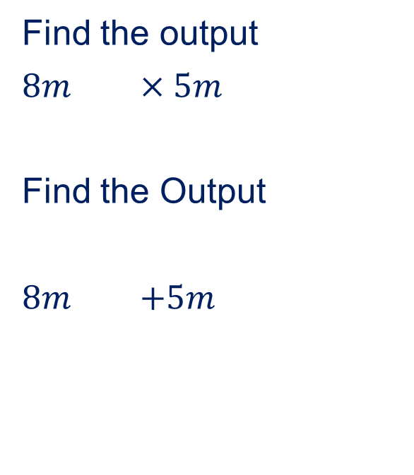


27/06/2025
Two step function machine
Find the output
$8m$ $×5m$
Find the Output
$8m$ $+5m$
Find 2/3 of 18
Convert 1700 into standard form
Find the missing angle
$$x$$
$$58°$$
$$47°$$

Slide 2

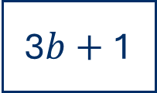

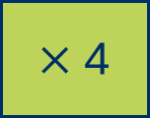


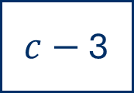
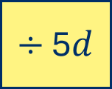
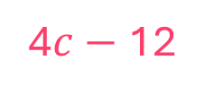
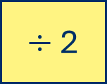
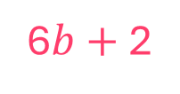
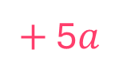
Complete the function machines.
input
output
a)
15$a$
$+$ 5$a$
20$a$
input
output
b)
6$b+$ 2
$÷$ 2
3$b+$ 1
input
output
c)
$c−$ 3
$×$4
4$c−$12
input
output
d)
100$d$
$÷$ 5$d$
20

Slide 3




Match each function to the correct inverse operation.
halve
$÷$ 2
square
$÷$ 3
triple
$×$ 2
double
square root
Subtract 10
$+$ 10

Slide 4
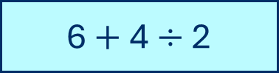
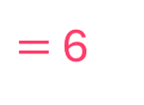

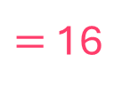

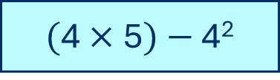

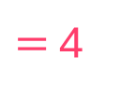
Complete the calculations.
a)
6 $+$4 $÷$ 2
$=$ 5
c)
18 $÷\sqrt{9}$
$=$ 6
b)
$($12 $−$ 8$)$²
$=$ 16
d)
$($4 $×$5$)$ $−$ 4²
$=$ 4

Slide 5

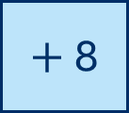
Think of a number.
Multiply the number by 2
Add 8
What is the new number?
Annie starts with the number 5
What is Annie’s new number?
18
input
output
input
output
5
$×$ 2
10
10
$+$ 8
18

Slide 6
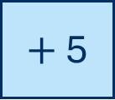
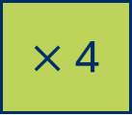
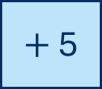

The output of the first function machine is the input for the second.
input
output
input
output
3
$×$ 4
12
12
$+$ 5
17
How else can this be written?
input
output
12
$×$ 4
$+$ 5
3
17
Work out the output of the function machine when the input is 3

Slide 7
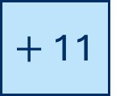

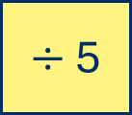
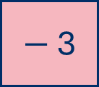
I do
Complete the function machine.
input
output
24
8
$×$ 3
$+$ 11
35
You do
Complete the function machine.
input
output
4
$−$ 3
20
$÷$ 5
1

Slide 8
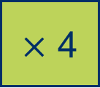
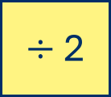
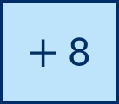
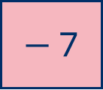
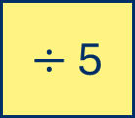
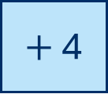

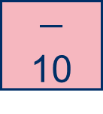
Complete the function machines.
input
output
16
$−$ 7
a)
32
$÷$ 2
9
input
output
42
b)
6
$×$ 7
$+$ 4
46
input
output
8
c)
40
$÷$ 5
$+$ 8
16
input
output
8
$×$ 4
32
$−$ 10
d)
22

Slide 9
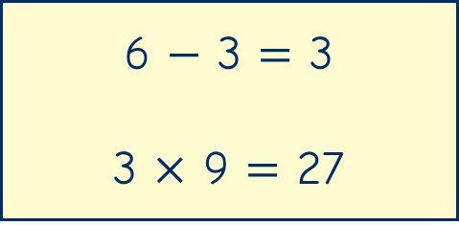
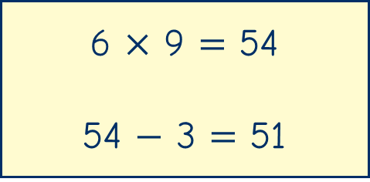
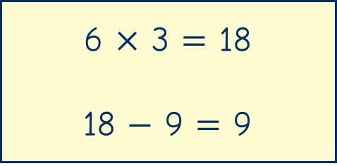



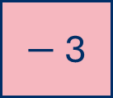
Which set of calculations is correct to find the output for the function machine?
input
output
54
6
$×$ 9
$−$ 3
51
A
B
C

Slide 10
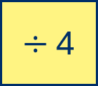
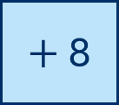
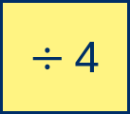
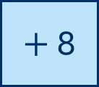
Is the statement true or false?
input
output
10
40
$÷$ 4
$+$ 8
18
input
output
$+$ 8
48
$÷$ 4
40
12
The function machines will have the same output.
false

Slide 11
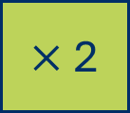

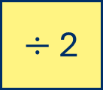
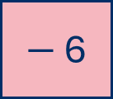
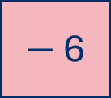
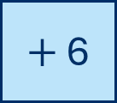

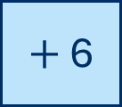
Work out the output of each function machine if the input is 24
input
output
12
$−$ 6
a)
24
$÷$ 2
6
input
output
48
b)
24
$×$ 2
$+$ 6
54
input
output
$−$ 6
18
$÷$ 2
c)
24
9
input
output
30
d)
$+$ 6
$×$ 2
60
24

Slide 12

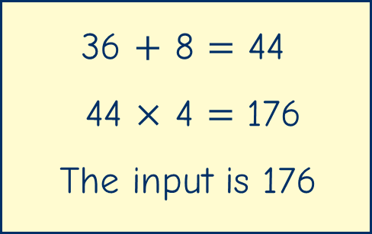

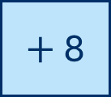
Dora is working out the input for the 2-step function machine.
input
output
$×$ 4
$+$ 8
36
Dora
Is Dora correct?
Explain your reasoning.

Slide 13
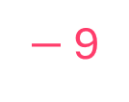
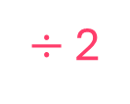
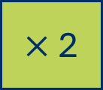


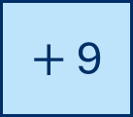
I do
Work out the input of the function machine.
input
output
$×$ 2
$+$ 9
43
17
34
43
17
$÷$ 2
$−$ 9
You do
Work out the input of the function machine.
input
output
34
$−$ 6
$÷$ 2
14

Slide 14
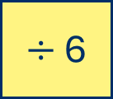
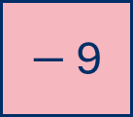






Complete the function machines.
input
output
a)
$×$ 7
$+$ 12
54
6
input
output
$−$ 5
$÷$ 6
4
b)
29
input
output
c)
$÷$ 2
$−$ 9
14
46
input
output
$+$ 13
$×$ 3
45
d)
2

Slide 15




Eva is thinking of a number.
If I halve my number and subtract 7, the result is 15.9
Eva
What number is Eva thinking of?
45.8
input
output
halve
$−$ 7
15.9
45.8
22.9
$×$ 2
$+$ 7
15.9
45.8

Slide 16


input
output
$−$ 10
$÷$ 4
The output is an integer.
The input could be…
The input can’t be…
The input must be…

Slide 17
I do
Complete the function machine.
input
output
8
$×$ 3
$+$ 11
You do
Complete the function machine.
input
output
20
$÷$ 5
$−$ 3

Slide 18
I do
Work out the input of the function machine.
input
output
$×$ 2
$+$ 9
43
You do
Work out the input of the function machine.
input
output
$−$ 6
$÷$ 2
14

Slide 19








Complete the function machines.
input
output
32
$÷$ 2
$−$ 7
9
a)
input
output
b)
6
$×$ 7
$+$ 4
46
input
output
c)
40
$÷$ 5
$+$ 8
16
input
output
d)
8
$×$ 4
$−$ 10
22

Slide 20








Work out the output of each function machine if the input is 24
input
output
a)
24
$÷$ 2
$−$ 6
6
input
output
b)
24
$×$ 2
$+$ 6
48
input
output
24
$−$ 6
$÷$ 2
9
c)
input
output
d)
24
$+$ 6
$×$ 2
60

Slide 21








Complete the function machines.
input
output
a)
6
$×$ 7
$+$ 12
54
input
output
29
$−$ 5
$÷$ 6
4
b)
input
output
c)
46
$÷$ 2
$−$ 9
14
input
output
2
$+$ 13
$×$ 3
45
d)

