Slide 1



















1) Match the terms on the left with the equivalent card on the right.
2) In the term $3x$, the letter $x$ is the __________ .
3) In a the term $3x$, the number $3$ is called the
___________ of $x$.
$x^{2}$
$2 × x$
$2x$
$2 × x × x$
$2x^{2}$
$x × x$
${\left(2x\right)}^{2}$
$2 × x × 2 × x$
4) Which expression is represented by the bar model?
$k$
$7$
$k$
$7$
$k$
$7$
$$3(k+7)$$
$$3k+7$$
$$3(k+21)$$
$$3k+21$$

Slide 2



















1) Match the terms on the left with the equivalent card on the right.
2) In the term $3x$, the letter $x$ is the __________ .
3) In a the term $3x$, the number $3$ is called the
___________ of $x$.
$x^{2}$
$2 × x$
$2x$
$2 × x × x$
$2x^{2}$
$x × x$
${\left(2x\right)}^{2}$
$2 × x × 2 × x$
variable
coefficient
4) Which expression is represented by the bar model?
$k$
$7$
$k$
$7$
$k$
$7$
$$3(k+7)$$
$$3k+7$$
$$3(k+21)$$
$$3k+21$$

Slide 3
What are we learning in this lesson?
To apply our understanding of algebraic notation to identifying “like terms”. Using identified “like terms” to confidently simplify an algebraic expression
Why are we learning about this?
Collecting like terms is a fundamental algebraic skill which allows us to simplify algebraic expressions. This makes equations, identities, formulas and inequalities clearer and easier to solve or manipulate.

Slide 4
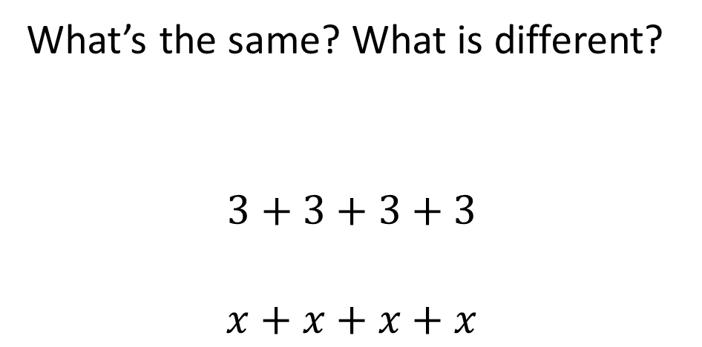
What’s the same? What is different?
$$3+3+3+3$$
$$x+x+x+x$$

Slide 5


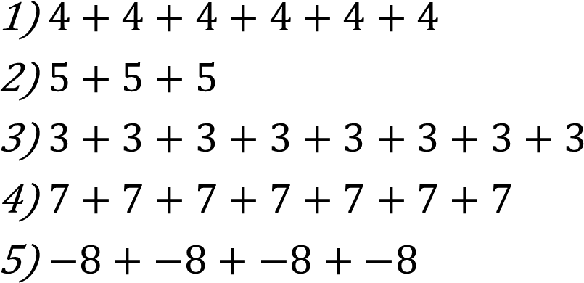



Activity: What is the multiplication sum?
$4+4+4+4+4+4$
$5+5+5$
$3+3+3+3+3+3+3+3$
$7+7+7+7+7+7+7$
$−8+−8+−8+−8$
1) $6×4$ or $4×6$
2) $3×5$or $5×3$
3) $8×3$ or $3×8$
4) $7×7$
5) $−8×4$ or $4×−8$

Slide 6

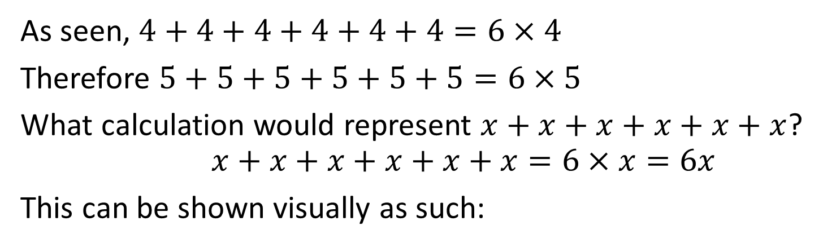
Representing expressions
As seen, $4+4+4+4+4+4=6×4$
Therefore $5+5+5+5+5+5=6×5$
What calculation would represent $x+x+x+x+x+x$?
$$x+x+x+x+x+x=6×x=6x$$
This can be shown visually as such:

Slide 7
What does the word
Equivalent
mean?

Slide 8

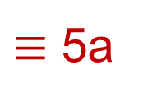
Two expressions are equivalent if they are equal for all values of the variables in each expression.
$$≡$$
Means equivalent (always equal)
a
+ a
+ a
+ a
+ a
$≡$ 5a
a
a
a
a
a
5a

Slide 9

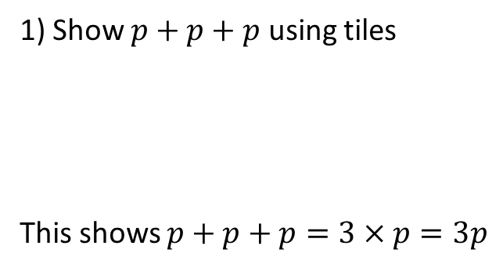
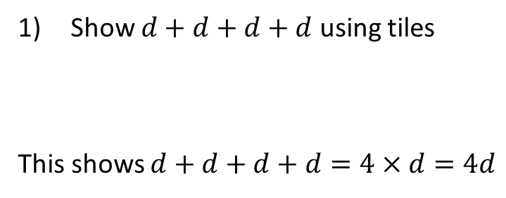
Representing expressions
I Do
You Do
1) Show $p+p+p$ using tiles
This shows $p+p+p=3×p=3p$
Show $d+d+d+d$ using tiles
This shows $d+d+d+d=4×d=4d$

Slide 10
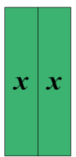
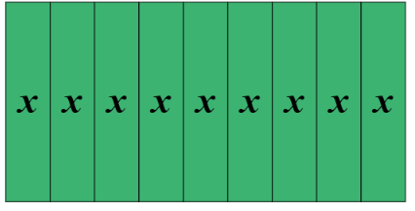
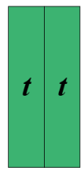
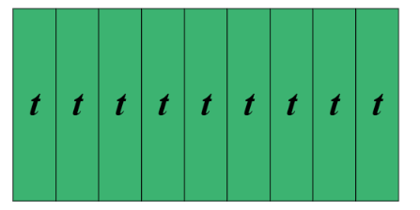


I Do
You Do
Simplify fully $2x+9x$
Simplify fully $2t+5t$

Slide 11
Simplify fully
(a)𝑎 + 𝑎 + 𝑎
(b) 𝑑 + 𝑑 + 𝑑 + 𝑑 + 𝑑
(c) 2𝑥 + 5𝑥
(d) 4𝑏 + 𝑏
(e) 𝑦 + 𝑦 + 4𝑦
(f) 𝑚 + 2𝑚 + 3𝑚

Slide 12

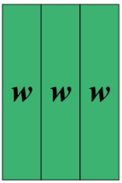

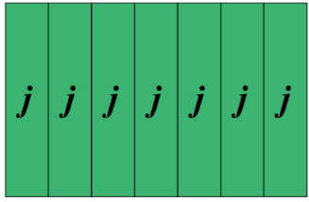


I Do
You Do
Simplify fully $w + 3w +5$
Simplify fully $j + 7j +4$

Slide 13
Zero pairs….
Now that we see that negative numbers exist, we can represent them using counters:
So this number is -3.
An important part of representing negatives using counters is the concept of a zero-pair.
= 1
= -1
This is a zero-pair because 1 and -1 makes 0.
Here we see three zero-pairs, so this still represents 0.

Slide 14
Activity…Representing negatives
Write down the number represented here:
Write down the number represented here:
Write down the number represented here:
Write down the number represented here:
Write down the number represented here:
-8
-4
0
-2
2

Slide 15




Which of these represents the number -8:
A. B.
C. D.

Slide 16
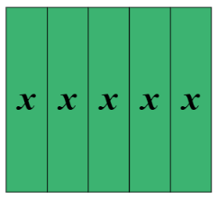
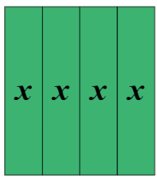
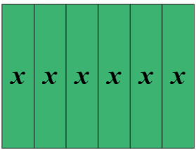
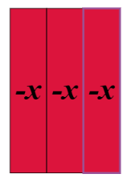



I Do
You Do
Simplify fully $5x−3x$
Simplify fully $6x−2x$

Slide 17
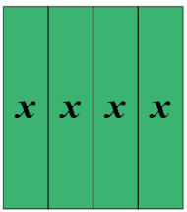
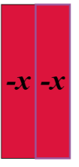


I Do
You Do
Simplify fully $6x+5x−3x$
Simplify fully $5x+4x−2x$

Slide 18
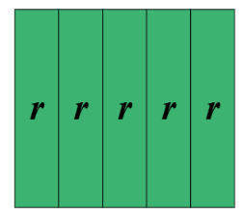

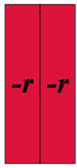

I Do
You Do
Fully simplify $5r + 7 − 2r + 2$
Fully simplify $6w + 1 − 4w + 3$

Slide 19
Simplify fully
𝑥 + 𝑥 + 𝑥 − 𝑥
𝑦 + 𝑦 − 𝑦 − 𝑦
7𝑎 − 2𝑎
3𝑏 − 2𝑏
𝑚 + 3𝑚 − 𝑚
5𝑛 − 𝑛 − 𝑛

Slide 20
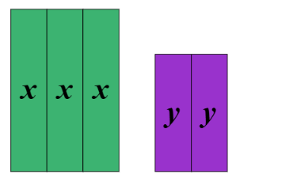
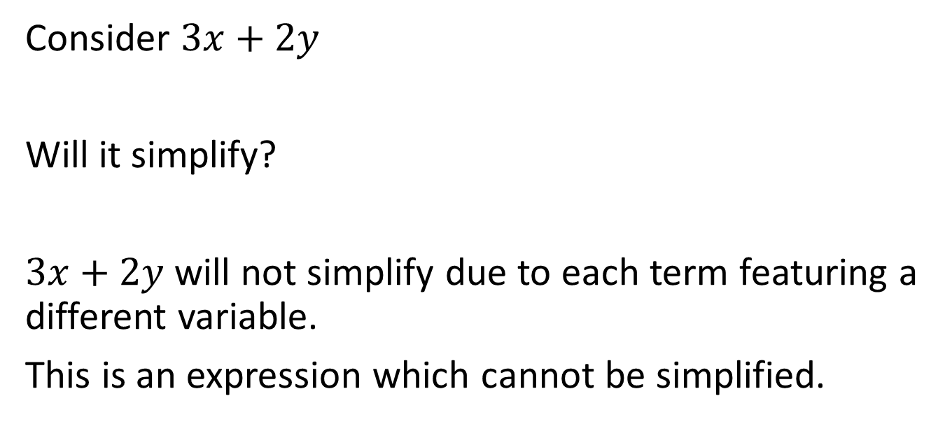
Simplifying expressions with more than one variable
Consider $3x+2y$
Will it simplify?
$3x+2y$will not simplify due to each term featuring a different variable.
This is an expression which cannot be simplified.

Slide 21



















Will it simplify?
$${5y}^{−2}+2y^{2}$$
yes / no
$${5y}^{−2}+2y^{−2}$$
yes / no
$$3p+3p$$
yes no
yes no
$${5y}^{−2}+2z^{−2}$$
yes / no
$$3p−3p$$
$$3p−2p$$
yes no
$${5y}^{−2}+2y^{−3}$$
yes / no
$$3p−2y$$
yes no
$${5y}^{−2}+2y^{−3}−y$$
yes / no
$$5y−2Y$$
yes no
$${5y}^{−4}+2y^{−4}−y^{−4}$$
yes / no
$${5y}^{2}−2y$$
yes no
$${5y}^{2}−2y^{2}$$
yes no
$${5y}^{−4.7}+2y^{−4.7}−y^{−4.7}$$
yes / no
$${5y}^{2}+2y^{2}$$
yes no
$${5y}^{\frac{4}{7}}+2y^{\frac{4}{7}}−y^{\frac{4}{7}}$$
$${−5y}^{2}+2y^{2}$$
yes no
yes / no
$$5xy+2yx$$
yes no
$${5x}^{\frac{4}{7}}+2y^{\frac{4}{7}}−z^{\frac{4}{7}}$$
yes / no

Slide 22










Your turn: Will it simplify?
$$6a+6b$$
yes / no
Challenge:
$$13a−27a$$
yes / no
$$5\sqrt{x}+2\sqrt{y}−\sqrt{z}$$
yes / no
$$13a^{2}−27a$$
yes / no
$$5\sqrt{x}+2\sqrt{x}−\sqrt{x}$$
yes / no
$$13a^{2}−27a^{−2}$$
yes / no
$$5x+2\sqrt{x}−\sqrt{x}$$
yes / no
$$13\sqrt{a}−27\sqrt{a}$$
yes / no
$$5x+2\sqrt{x}−x^{2}$$
yes / no
$$13{xy}^{2}−27x^{2}y$$
yes / no

Slide 23
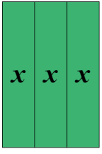
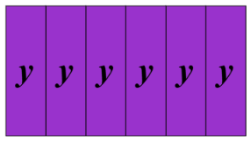
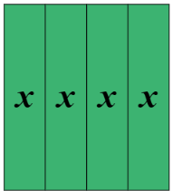

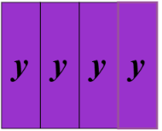
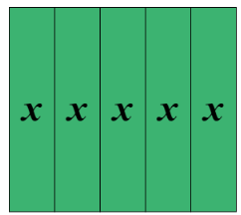


I Do
You Do
Simplify fully $3x+6y+4x$
Simplify fully $x+4y+5x$

Slide 24

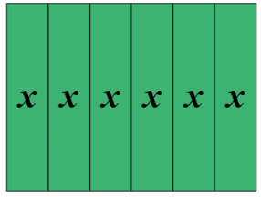
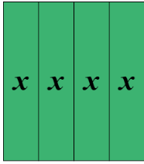
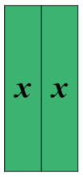
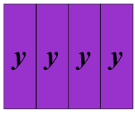
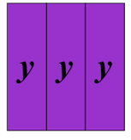

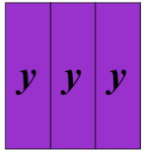


I Do
You Do
Simplify fully $x+6x+4y+3y$
Simplify fully$4x+y+3y+2x$

Slide 25

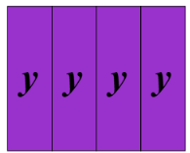
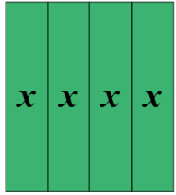


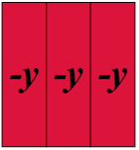
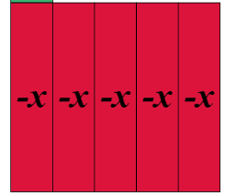
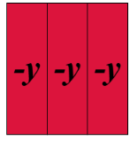


I Do
You Do
Simplify fully $x−6x+4y−3y$
Simplify fully$4x+y−3y−2x$

Slide 26
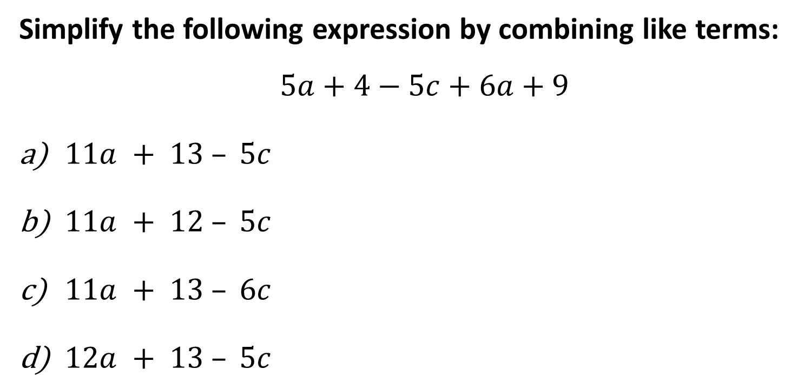
Simplify the following expression by combining like terms:
$$5a+4−5c+6a+9$$
$11a + 13 – 5c$
$11a + 12 – 5c$
$11a + 13 – 6c$
$12a + 13 – 5c$

Slide 27
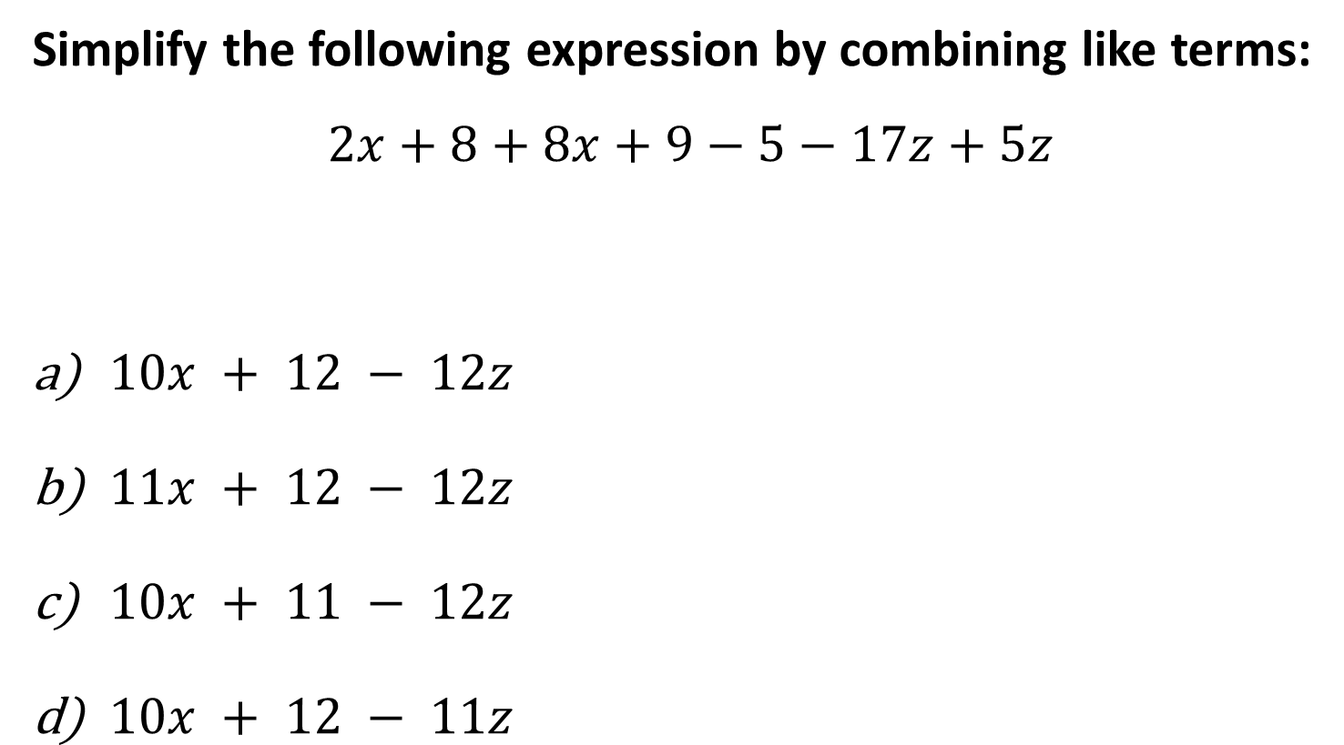
Simplify the following expression by combining like terms:
$$2x+8+8x+9−5−17z+5z$$
$10x + 12 − 12z$
$11x + 12 − 12z$
$10x + 11 − 12z$
$10x + 12 − 11z$

Slide 28
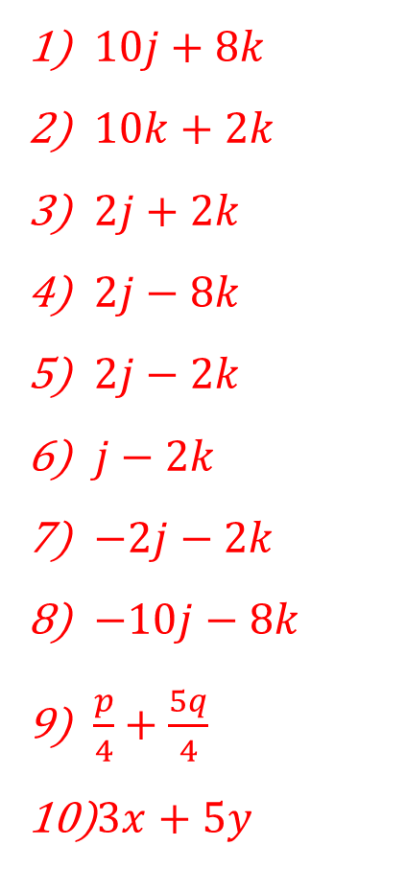
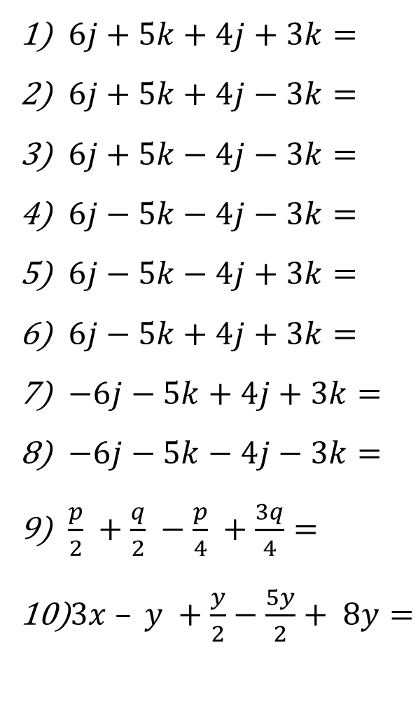
$6j+5k+4j+3k=$
$6j+5k+4j−3k=$
$6j+5k−4j−3k=$
$6j−5k−4j−3k=$
$6j−5k−4j+3k=$
$6j−5k+4j+3k=$
$−6j−5k+4j+3k=$
$−6j−5k−4j−3k=$
$\frac{p}{2} +\frac{q}{2} −\frac{p}{4} +\frac{3q}{4}=$
$3x – y +\frac{y}{2}−\frac{5y}{2}+ 8y=$
$10j+8k$
$10k+2k$
$2j+2k$
$2j−8k$
$2j−2k$
$j−2k$
$−2j−2k$
$−10j−8k$
$\frac{p}{4}+\frac{5q}{4}$
$3x+5y$

Slide 29
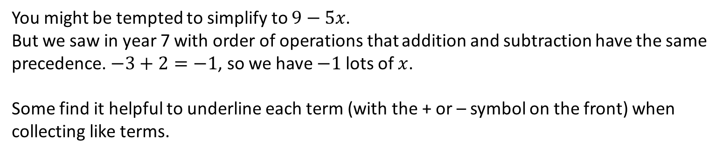

A common Schoolboy ErrorTM
?
$$9−3x+2x → 9−x$$
You might be tempted to simplify to $9−5x$.
But we saw in year 7 with order of operations that addition and subtraction have the same precedence. $−3+2=−1$, so we have $−1$ lots of $x$.
Some find it helpful to underline each term (with the + or – symbol on the front) when collecting like terms.

