Slide 1
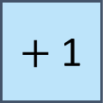
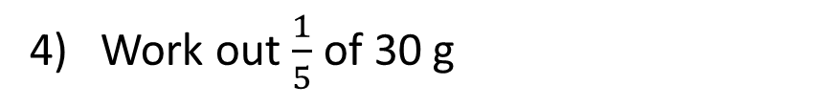
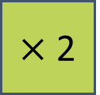
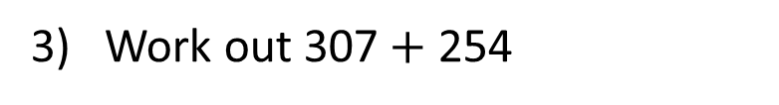

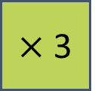
Two Step Function Machines - Algebra
Friday, 27 June 2025
1. Complete the function machines
2. a) out the next term in the linear sequence.
b) What is the term to term rule?
c) Create another sequences with the same rule.
3) Work out 307$+$ 254
4
$×$ 2
$+$ 1
11 , 19 , 27 , 35 …
?
4) Work out $\frac{1}{5}$ of 30 g
4
$×$ 3
$$?$$
10

Slide 2
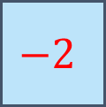
Two Step Function Machines - Algebra
Friday, 27 June 2025
1. Complete the function machines
2. a) out the next term in the linear sequence.
b) What is the rule?
c) Create another sequences with the same rule.
3) Work out 307$+$ 254
4
$×$ 2
$+$ 1
9
561
11 , 19 , 27 , 35 …
43
4) Work out $\frac{1}{5}$ of 30 g
6 g
4
$×$ 3
$$−2$$
10
+7

Slide 3
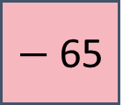
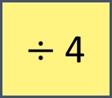
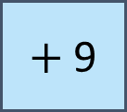
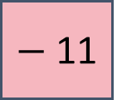
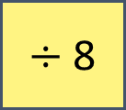
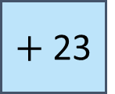
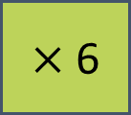
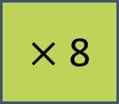
Complete the function machines.
input
output
48
$÷$ 4
$−$ 11
1
a)
input
output
b)
5
$×$ 6
$+$ 23
53
input
23
$+$ 9
$÷$ 8
4
c)
input
output
d)
11
$×$ 8
$−$ 65
23

Slide 4










Match each function to the correct inverse operation.
$$+ a$$
$$÷a$$
$$a^{2}$$
$×a$
$×a$
$$\sqrt{a}$$
$$÷a$$
$$+ a$$
$$− a$$
$$− a$$

Slide 5



Think of a number.
Multiply the number by 3
Add 4
Mo wants to use a cube to represent any number.
input
output
input
output
$×$ 3
$+$ 4

Slide 6


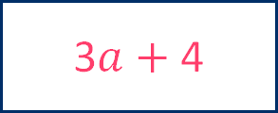

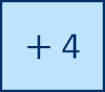

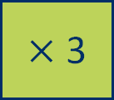

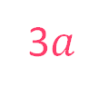
input
output
$×$ 3
$+$ 4
input
output
3$a$
$$a$$
$×$ 3
$+$ 4
3$a+$ 4
What’s the same? What’s different?

Slide 7
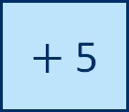
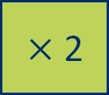
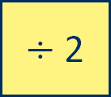
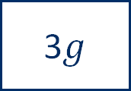

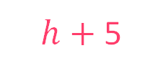

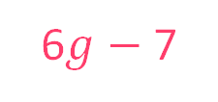
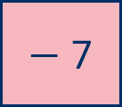

I do
Complete the function machine.
input
output
3$g$
$×$ 2
6$g$
$−$ 7
6$g−$ 7
You do
Complete the function machine.
input
output
2$h$
$÷$ 2
$$h$$
$+$5
$h+$5

Slide 8
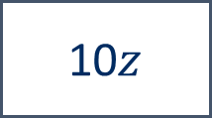
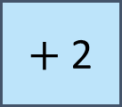
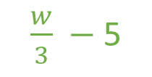

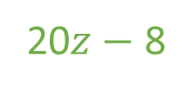

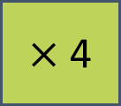
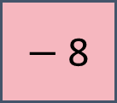

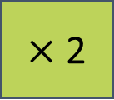
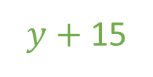

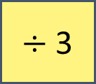
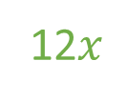
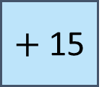
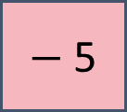
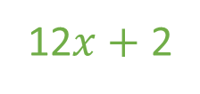
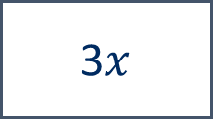
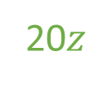
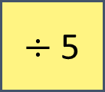
Complete the function machines.
input
output
$\frac{w}{3}$
$$w$$
$÷$ 3
$−$ 5
$\frac{w}{3} −$ 5
a)
input
output
12$x$
b)
3$x$
$×$ 4
$+$ 2
12$x+$ 2
input
output
$$y$$
c)
5$y$
$÷$ 5
$+$ 15
$y+$15
input
output
20$z$
d)
10$z$
$×$ 2
$−$ 8
20$z−$ 8

Slide 9


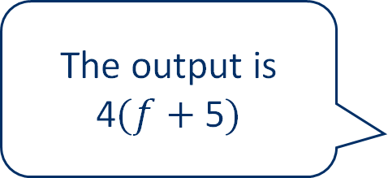
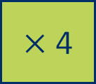

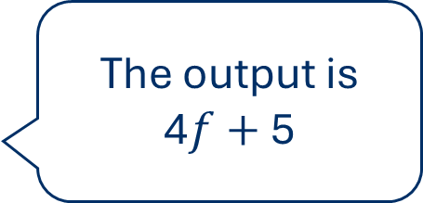
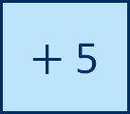
Whitney and Ron are working out the output for the function machine.
input
output
$$f$$
$+$ 5
$×$ 4
The output is 4$f+$5
The output is 4$(f+$ 5$)$
Whitney
Ron
Who do you agree with?
Explain your answer.

Slide 10
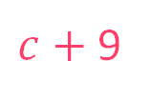

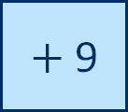
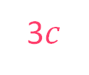
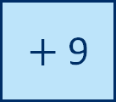
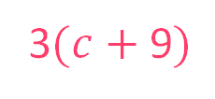


Is the statement true or false?
input
output
3$c$
$$c$$
$×$ 3
$+$ 9
3$c+$9
input
output
$$c$$
$+$ 9
$c+$ 9
$×$ 3
3$(c+$9$)$
The function machines will have the same output.
false

Slide 11




















Use the cards to complete each function machine.
input
output
$$j$$
$÷$ 4
$−$ 2
$\frac{j}{4}−$ 2
$\frac{j−2}{4}$
input
output
$$j$$
$−$ 2
$÷$ 4
$\frac{j−2}{4}$
4$(j−$ 2$)$
input
output
$$j$$
$×$ 4
$−$ 2
4$j−$ 2
$\frac{j}{4}−$ 2
input
output
$$j$$
$−$ 2
$×$ 4
4$(j−$ 2$)$
4$j−$ 2

Slide 12






input
output
$÷$ 3
4$k$
$+$ 7
4$k+$ 7
12$k$
Eva
Is Eva correct?
Explain your answer.

Slide 13













I do
Work out the input of the function machine.
input
output
$$m$$
$−$ 3
$÷$ 5
$\frac{m − 3}{5}$
$m−$ 3
$$m$$
$+$ 3
$×$ 5
$\frac{m − 3}{5}$
You do
Work out the input of the function machine.
input
output
$$n$$
$+$ 1
$×$ 2
2($n+$ 1$)$

Slide 14




















Complete the function machines.
input
output
$p+$4
a)
$$p$$
$+$ 4
$×$ 3
3$(p+$ 4$)$
input
output
$−$ 4
$$q−4$$
$÷$ 9
$\frac{q − 4}{9}$
b)
$$q$$
input
output
$\frac{2r}{3}$
c)
2$r$
$÷$ 3
$−$ 5
$\frac{2r}{3}−$ 5
input
output
$×$ 2
$$s$$
$+$ 6
$s+$ 6
d)
$\frac{s}{2}$

Slide 15



input
output
$×$ 2
$×$ 6
I could write this as a one-step function machine.
Amir
Show that Amir is correct.

Slide 16

To finish…
Complete the missing information for this function machine

Slide 17


Slide 18


Slide 19




Slide 20
What are the definitions of the key vocabulary?
Click on a word to reveal the definition.
opposite effect of
inverse
symbol, usually a letter, that can represent any value in mathematical expressions, identities and formulae
variable
number or variable or any combination of number and variable combined by multiplication or division
term
collection of terms involving variables and numbers
expression

Slide 21

Connect a visualiser to use this slide.
Link to the abstract

Slide 22
I do
Complete the function machine.
input
output
3$g$
$×$ 2
$−$ 7
You do
Complete the function machine.
input
output
2$h$
$÷$ 2
$+$5

Slide 23
I do
Work out the input of the function machine.
input
output
$−$ 3
$÷$ 5
$\frac{m − 3}{5}$
You do
Work out the input of the function machine.
input
output
$+$ 1
$×$ 2
2($n+$ 1$)$

Slide 24












Complete the function machines.
input
output
$$w$$
$÷$ 3
$−$ 5
a)
input
output
b)
3$x$
$×$ 4
$+$ 2
input
output
c)
5$y$
$÷$ 5
$+$ 15
input
output
d)
10$z$
$×$ 2
$−$ 8

Slide 25










Use the cards to complete each function machine.
input
output
$$j$$
$÷$ 4
$−$ 2
$\frac{j−2}{4}$
input
output
$$j$$
$−$ 2
$÷$ 4
4$(j−$ 2$)$
input
output
$$j$$
$×$ 4
$−$ 2
$\frac{j}{4}−$ 2
input
output
$$j$$
$−$ 2
$×$ 4
4$j−$ 2

Slide 26












Complete the function machines.
input
output
a)
$+$ 4
$×$ 3
3$(p+$ 4$)$
input
output
b)
$−$ 4
$÷$ 9
$\frac{q − 4}{9}$
input
output
c)
$÷$ 3
$−$ 5
$\frac{2r}{3}−5$
input
output
d)
$×$ 2
$+$ 6
$s+$ 6

