Slide 1
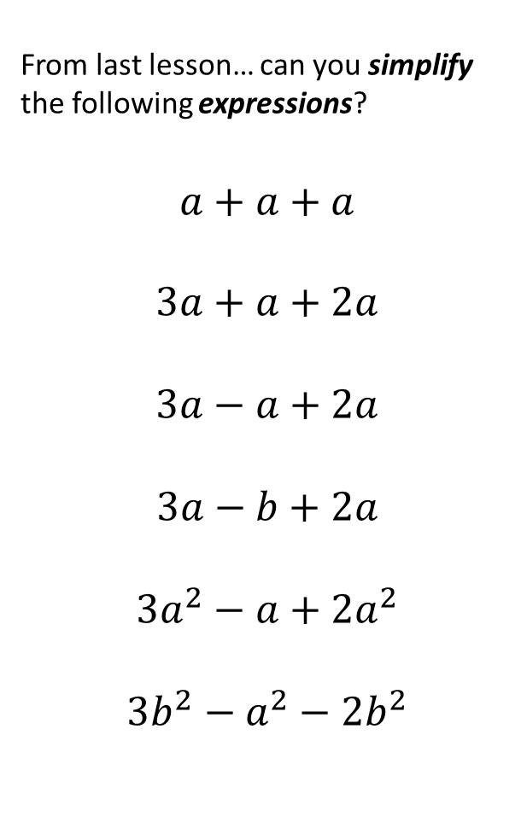
From last lesson… can you simplify the following expressions?
$$a+a+a$$
$$3a+a+2a$$
$$3a−a+2a$$
$$3a−b+2a$$
$$3a^{2}−a+2a^{2}$$
$$3b^{2}−a^{2}−2b^{2}$$
On your whiteboards
Show me…
… an example of an expression
… an example of an equation
… two like terms
What does it mean to simplify in maths?

Slide 2
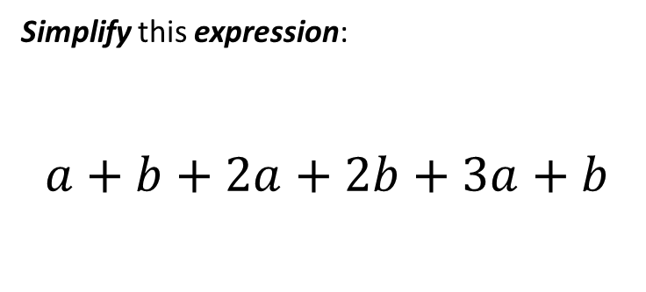
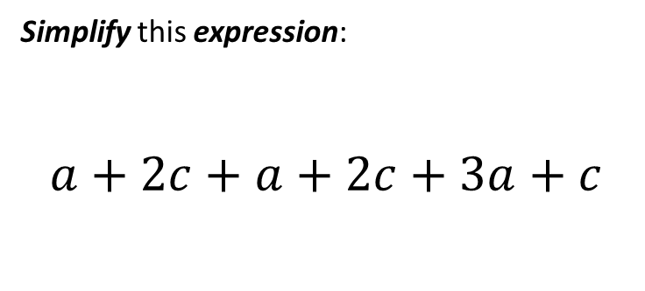
I Do
You Do
Simplify this expression:
$$a+b+2a+2b+3a+b$$
Simplify this expression:
$$a+2c+a+2c+3a+c$$

Slide 3
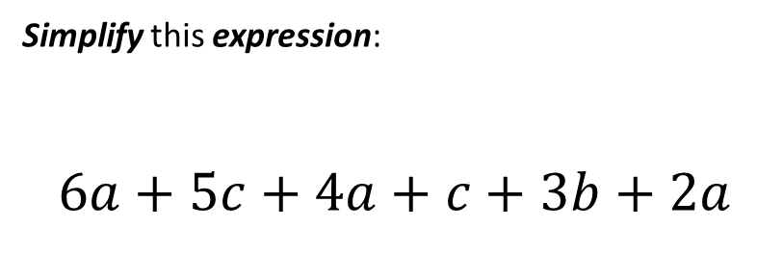
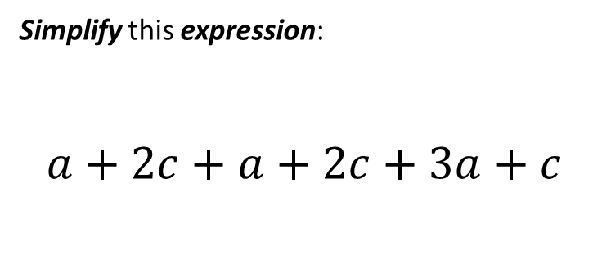
I Do
You Do
Simplify this expression:
$$6a+5c+4a+c+3b+2a$$
Simplify this expression:
$$a+2c+a+2c+3a+c$$

Slide 4
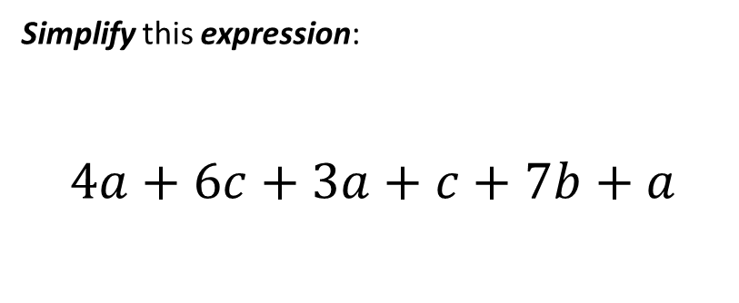
I Do
You Do
Simplify this expression:
$$6a+5c+4a+c+3b+2a$$
Simplify this expression:
$$4a+6c+3a+c+7b+a$$

Slide 5
Now let’s apply our knowledge about expressions, like terms and simplifying...
In a magic square:
a + b
b +2c
2a + b +c
Each of the squares contains an expression
2a + 2c + b
a + b + c
b
Each of the expressions is made up of terms
b + c
2a + b
a + b + 2c
The sum of every row, column and diagonal is the same

Slide 6
In a magic square:
Each of the squares contains an expression
a + b
b +2c
2a + b +c
Each of the expressions is made up of terms
The sum of every row, column and diagonal is the same
2a + 2c + b
a + b + c
b
Let’s test this square to see if it’s magic…
b + c
2a + b
a + b + 2c

Slide 7
In pairs:
Cut out the 9 cards
Arrange them into a 3 x 3 grid so that they form a magic square
Remember the rules…!
Each of the squares contains an expression
a + 4b
7a + 6b
8a + 3b
Each of the expressions is made up of terms
6a + 9b
3a + 8b
2a + b
The sum of every row, column and diagonal is the same
5a + 2b
4a + 5b
7b

Slide 8
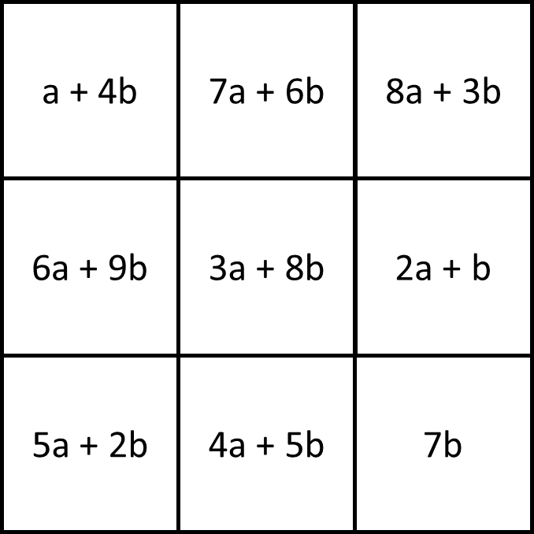

Slide 9
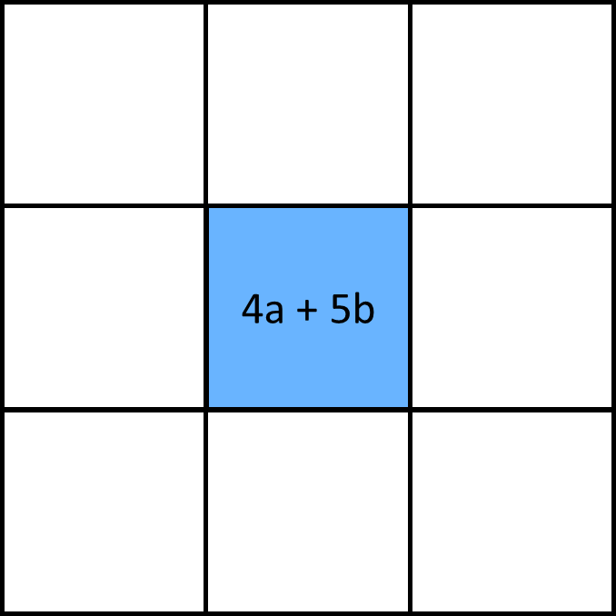
In pairs:
Cut out the 9 cards
Arrange them into a 3 x 3 grid so that they form a magic square
If you’re stuck… use this as the middle square to start:
Remember the rules…!
Each of the squares contains an expression
Each of the expressions is made up of terms
The sum of every row, column and diagonal is the same

Slide 10
Solution
7a + 6b
2a + b
3a + 8b
7b
4a + 5b
8a + 3b
5a + 2b
6a + 9b
a + 4b

Slide 11
Challenge
Challenge
Fill in the gaps in this grid to make it magic…!
Fill in the gaps in this grid to make it magic…!
p + 3q + r
p + 3q + r
p + 2q + r
p + 2q + r
p + 2q
p + q + r
p + 2q
p + q + r

Slide 12
Challenge
Fill in the gaps in this grid to make it magic…!
p + 3q + r
p + q
p + 2q + 2r
p + 2q + r
p + q +2r
p + 3q
p + 2q
p + q + r
p + 3q +2r

Slide 13
On your whiteboards
What expression needs to go in this missing square?
4a + c
2c
?
9a + 3b + 3c

Slide 14
On your whiteboards
What expression needs to go in this missing square?
?
5f + g
?
2f + 3g + 3h
Challenge: create a similar question of your own!
… and another!

Slide 15
On your whiteboards
4x² + 2x
What expression needs to go in this missing square?
?
3x
5x² + 4x

Slide 16
On your whiteboards
What if the algebraic expressions simplifies to…
?
?
?
2x + 2y + 2z
What could missing expressions be?

Slide 17
In your books
Write a question
?
?
?
3x - 4y – 5z
?
?
?
4(a+b) + 3(c+d)
?
?
?
½ xy+ ¼ xy² + 2x²y

