Slide 1
What are we learning in this lesson?
Become fluent at writing equivalent expression. Understand the difference between expressions being equal or equivalent.
Why are we learning about this?
To write equivalent expressions you will use your knowledge of like terms and simplifying used in previous lessons.

Slide 2
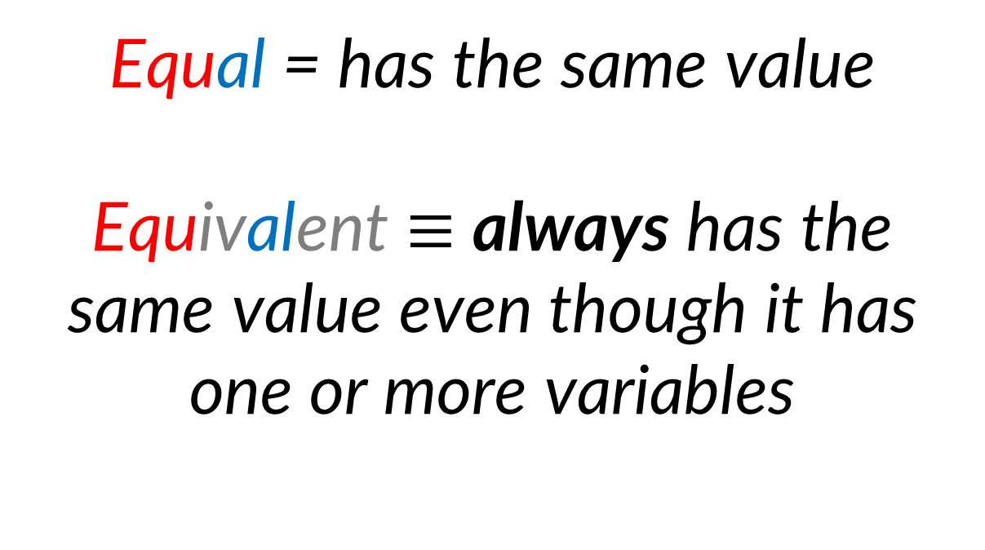
How are these words related?
Equal = has the same value
Equivalent $≡$ always has the same value even though it has one or more variables

Slide 3















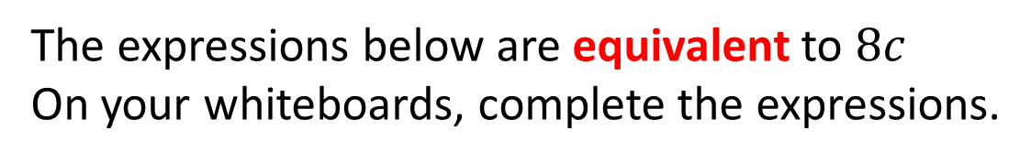


$8c$
$8c$
$8c$
$24c$
$c$
$12c$
$7c$
$2c$
$2c$
$2c$
$2c$
$5c$
$3c$
The expressions below are equivalent to $8c$
On your whiteboards, complete the expressions.
?
?
?
$$5c+3c$$
$$12c−4c$$
$$2c × 4$$
?
?
$$c+7c$$
$$24c÷3$$

Slide 4
On your whiteboard…
Write an expression that is equivalent to 12k
And another…
And another…
And another…

Slide 5
Is 3x + 4 the same as 4 + 3x?
Is 3x - 4 the same as 4 – 3x?

Slide 6
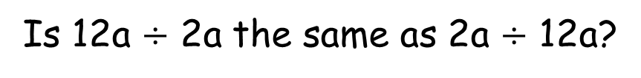
Is 2a x 3b the same as 3b x 2a?
Is 12a $÷$ 2a the same as 2a $÷$ 12a?

Slide 7
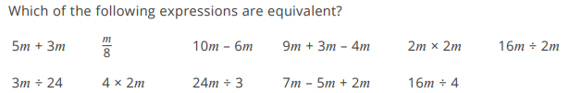

Slide 8
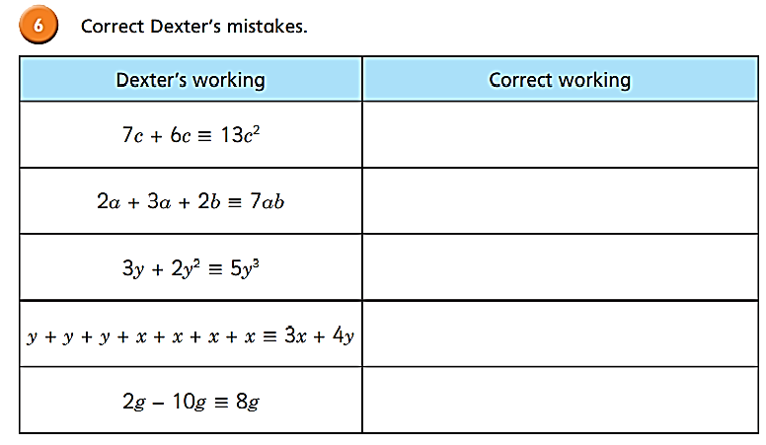
Judge the method!
Think, pair, share

Slide 9
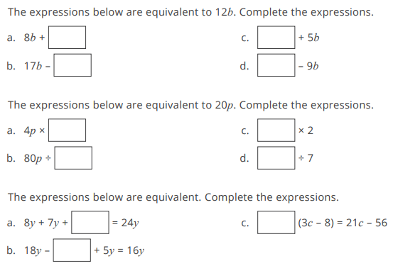

Slide 10
4b
7b
5b
21b
5
10p
4
140p
9y
7
7y

Slide 11
Yes or No
a + a + a + 5 + 2 3a + 7
s + s + t + s + t – 4 2t – 4 + 3s

Slide 12
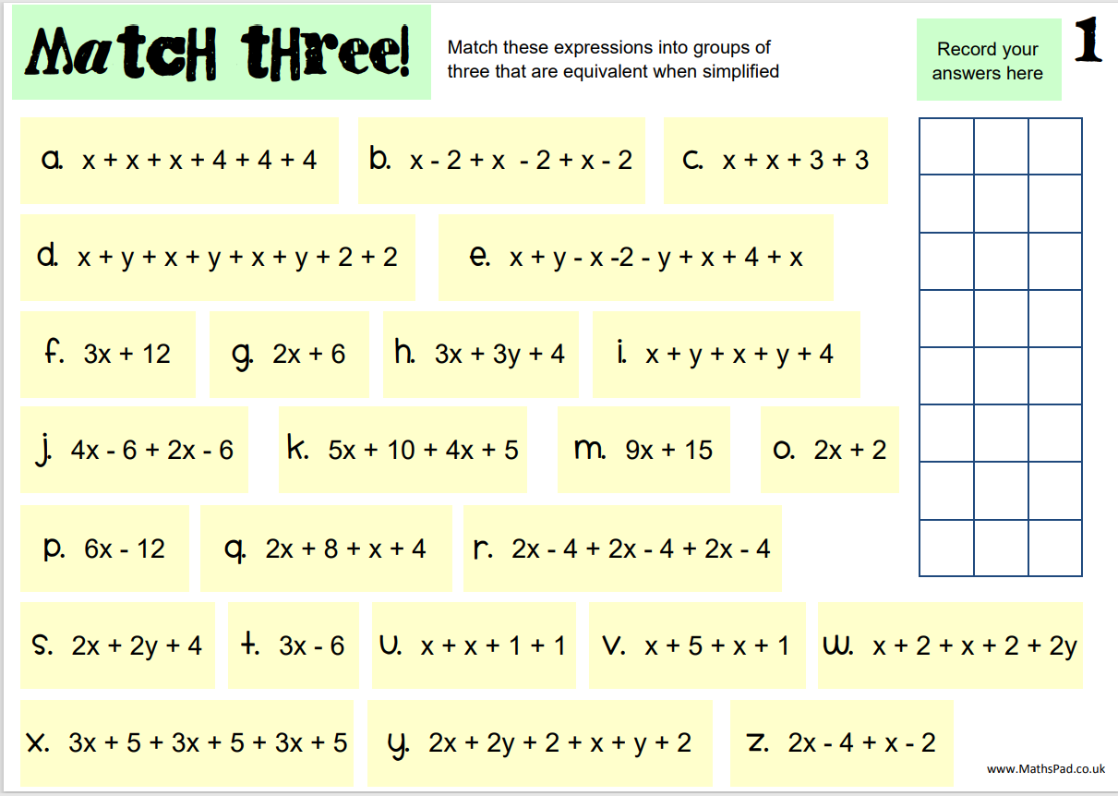

Slide 14
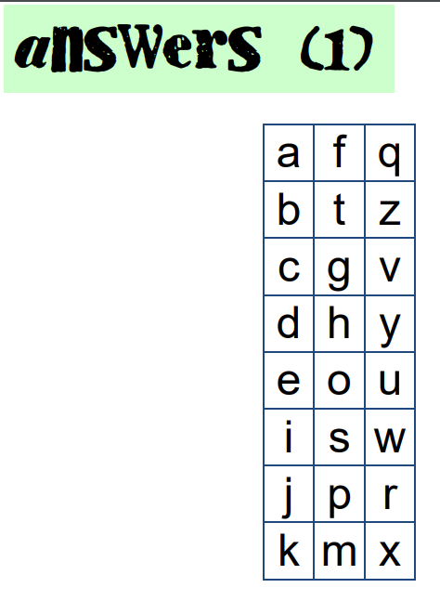
Answers

Slide 15
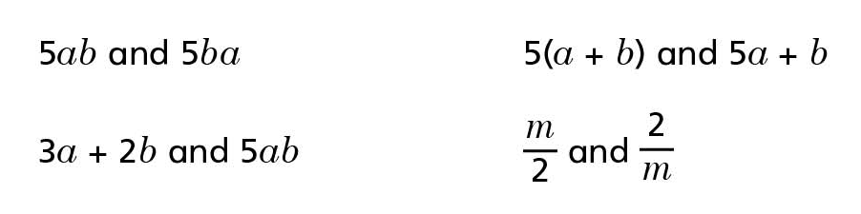
Discuss… Which of these pairs of expressions are equivalent to each other?
Find values of a and b that mean all of these pairs of expressions are equal to each other.

Slide 16
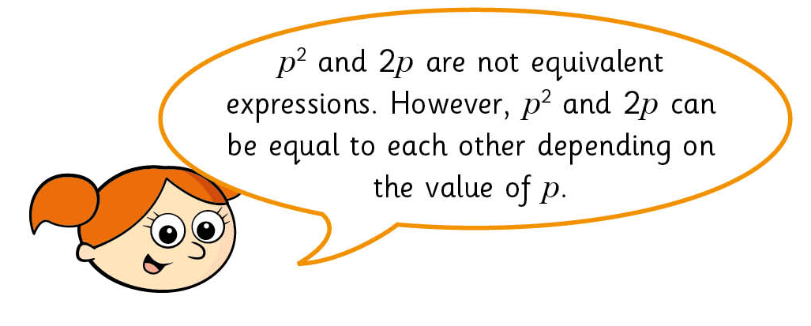
To finish…
Is Alex correct?
Can you prove it?

