Slide 1




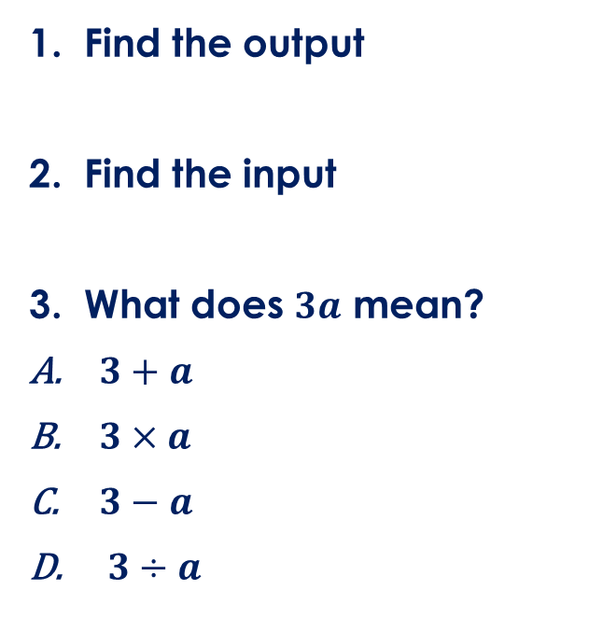



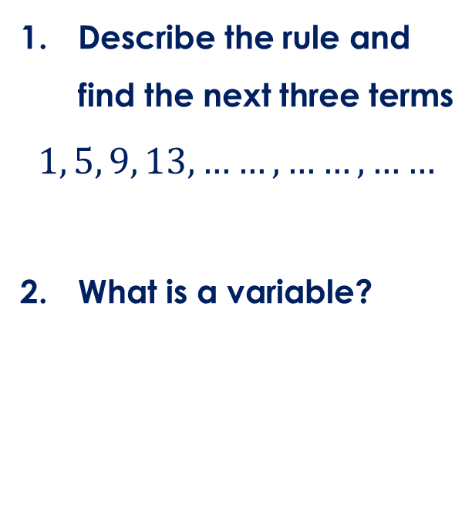

Friday, 14 February 2025
Substitution
Find the output
Find the input
What does $3a$ mean?
$3+a$
$3×a$
$3−a$
$3÷a$
Describe the rule and find the next three terms
$$1, 5, 9, 13, ……, ……, ……$$
What is a variable?
Calculate
$$20−3×2$$
Find 2/3 of 27
$$5$$
$$×3$$
$$−1$$
$$×3$$
$$−1$$
$$20$$

Slide 2






Key vocabulary:
Decode the word
Definition
.
Where have we heard/seen this word before?
What does it mean in Maths?
Substitution
Examples
Non-examples
What is substitution in Maths?
What is it NOT?

Slide 3

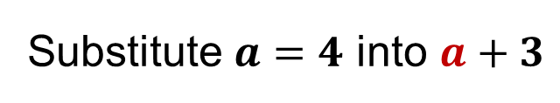


Key vocabulary:
Decode the word
Definition
.
Football, one person comes in to replace another player
A supply teacher comes in when another teacher is not in
Replacing a variable with a number
Substitution
Examples
Non-examples
Substitute $a=4$ into $a+3$
Substitute $a=4$ into $a+3$
$$4+3=7$$
$$8+3=11$$

Slide 4
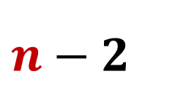
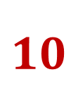

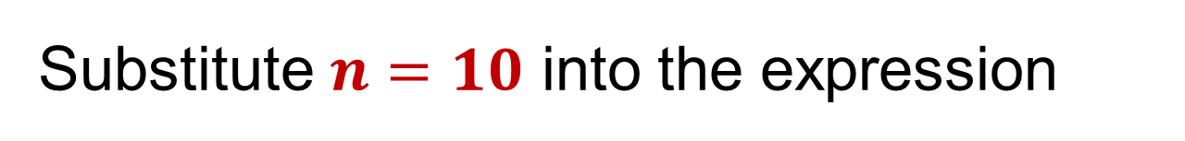
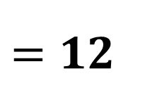

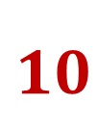

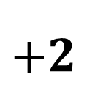
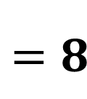

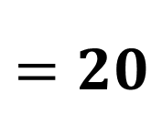
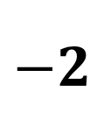
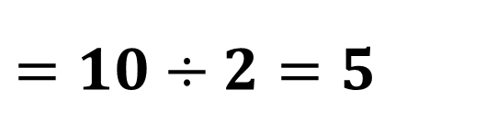


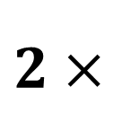
Example
Substitute $n=10$ into the expression
$$n+2$$
$$2n$$
$$10$$
$$+2$$
$$=12$$
$$2×$$
$$10$$
$$=20$$
$$n−2$$
$$\frac{n}{2}$$
$$10$$
$$\frac{ }{2}$$
$$=10÷2=5$$
$$10$$
$$−2$$
$$=8$$

Slide 5

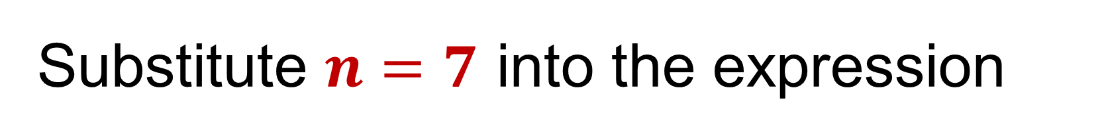
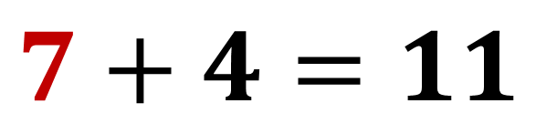
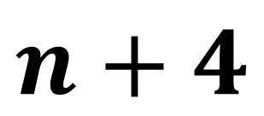
Mini White board
Substitute $n=7$ into the expression
$$n+4$$
$$7+4=11$$

Slide 6
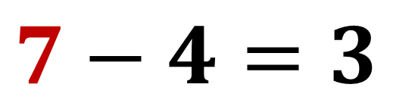
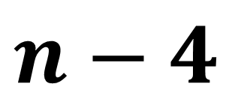
Mini White board
Substitute $n=7$ into the expression
$$n−4$$
$$7−4=3$$

Slide 7
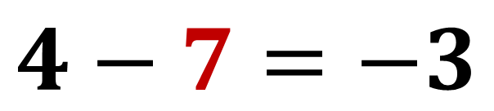
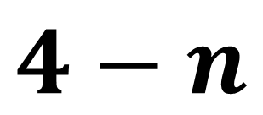
Mini White board
Substitute $n=7$ into the expression
$$4−n$$
$$4−7=−3$$

Slide 8
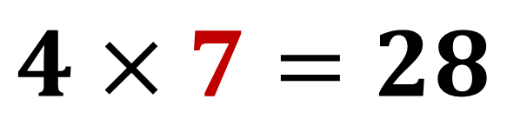
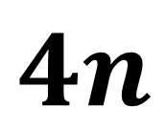
Mini White board
Substitute $n=7$ into the expression
$$4n$$
$$4×7=28$$

Slide 9
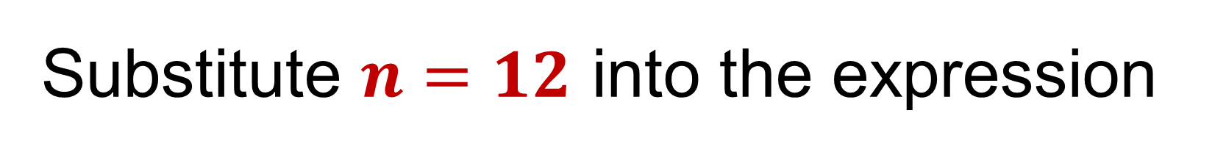
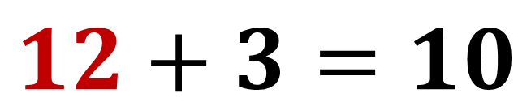
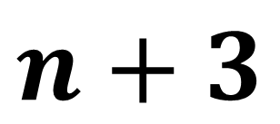
Mini White board
Substitute $n=12$ into the expression
$$n+3$$
$$12+3=10$$

Slide 10
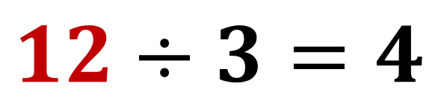
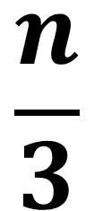
Mini White board
Substitute $n=12$ into the expression
$$\frac{n}{3}$$
$$12÷3=4$$

Slide 11
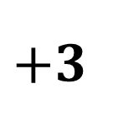
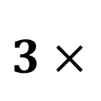
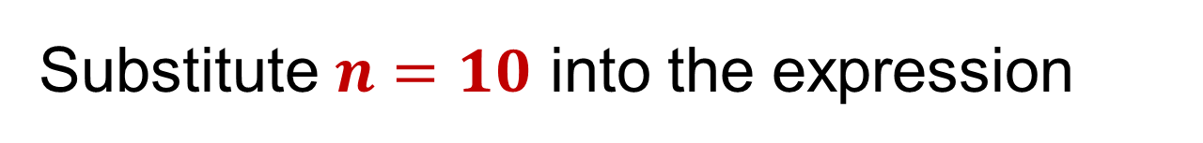
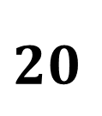

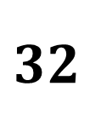
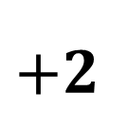
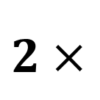
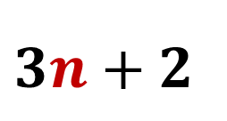

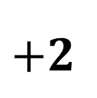
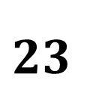

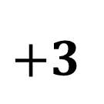
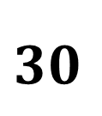
Example
Substitute $n=10$ into the expression
$$2n+3$$
$$3n+2$$
$$2×$$
$$10$$
$$+3$$
$$3×$$
$$10$$
$$+2$$
$$20$$
$$+3$$
$$30$$
$$+2$$
$$23$$
$$32$$

Slide 12
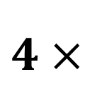
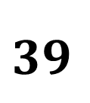
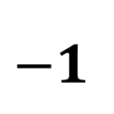
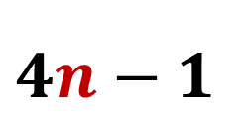


Your turn
Substitute $n=10$ into the expression
$$2n+3$$
$$4n−1$$
$$2×$$
$$10$$
$$+3$$
$$4×$$
$$10$$
$$−1$$
$$20$$
$$+3$$
$$40$$
$$−1$$
$$23$$
$$39$$

Slide 13













Spot the error
Substitute $n=2$into the expression $3n+5$
Substitute $n=2$into the expression $3n+5$
$$3n+5$$
$$3n+5$$
$$3$$
$$2$$
$$+5$$
$$3×$$
$$2$$
$$+5$$
$$37$$
$$3×7$$
$$21$$

Slide 14



Mini White board
Substitute $n=3$ into the expression
$$2n+1$$
$$2×3+1=7$$

Slide 15


Mini White board
Substitute $n=3$ into the expression
$$5n−2$$
$$5×3−2=13$$

Slide 16


Mini White board
Substitute $n=3$ into the expression
$$2n−5$$
$$2×3−5=1$$

Slide 17


Mini White board
Substitute $n=−3$ into the expression
$$2n−5$$
$$2×−3−5=−11$$

Slide 18



Mini White board
Substitute $n=8$ into the expression
$$\frac{n}{2}+3$$
$$8÷2+3=7$$

Slide 19



Mini White board
Substitute $n=15$ into the expression
$$\frac{n}{3}−1$$
$$\frac{15}{3}−1=4$$

Slide 20


Mini White board
Substitute $n=−15$ into the expression
$$\frac{n}{3}−1$$
$$\frac{−15}{3}−1=−6$$

Slide 21



Mini White board
Substitute $n=19$ into the expression
$$\frac{n−1}{3}$$
$$\frac{19−1}{3}=\frac{18}{3}=6$$

Slide 22


Mini White board
Substitute $n=19$ into the expression
$$\frac{n−1}{2}$$
$$\frac{19−1}{2}=\frac{18}{2}=9$$

Slide 23

Independent work
$$n$$ | $$n+5$$ | $$5n$$ | $$n/2$$ | $$3n−2$$ | $$2n−3$$ | $$\frac{n}{2}+3$$ | $$\frac{n+3}{2}$$ | $$n^{2}$$
6
10
14
7
11
-6
-10

Slide 24

Mark it
$$n$$ | $$n+5$$ | $$5n$$ | $$n/2$$ | $$3n−2$$ | $$2n−3$$ | $$\frac{n}{2}+3$$ | $$\frac{n+3}{2}$$ | $$n^{2}$$
6 | 11 | 30 | 3 | 14 | 9 | 6 | 4.5 | 36
10 | 15 | 50 | 15 | 28 | 17 | 8 | 6.5 | 100
14 | 19 | 70 | 7 | 40 | 25 | 10 | 8.5 | 196
7 | 12 | 35 | 3.5 | 19 | 11 | 6.5 | 5 | 49
11 | 16 | 55 | 5.5 | 31 | 19 | 8.5 | 7 | 121
-6 | -1 | -30 | -3 | -20 | -15 | 0 | -1.5 | 36
-10 | -5 | -50 | -5 | -32 | -23 | -2 | -6.5 | 100

