Slide 1















Dual coding symbols:
Practise
Explain
Organise
Big Question
Reflect
Present
Compare
Evaluate
Activate
Discuss
Predict
Connect
Summarise
Recall
Vocabulary

Slide 2


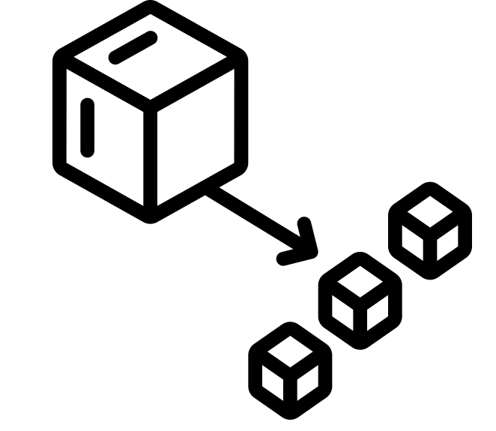





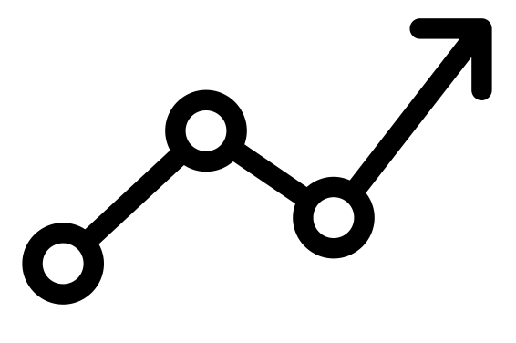

Editable reading ruler
Every child in an Archway school will become a fluent reader
 | RETRIEVE the words or phrases you need from the text | DECODE the words or phrase to address a breakdown | CONNECT with words or phrases you know from the text or your memory | VISUALISE the images in as much detail as possible | SUMMARISE the main ideas of the text in a few words | INFER meanings that might be within the text | PREDICT what might happen next using details from the text | EXAMINE how the writer uses words to construct meaning
 | ASK THOUGHTFUL QUESTIONS TO HELP YOU UNDERSTAND THE TEXT

Slide 3

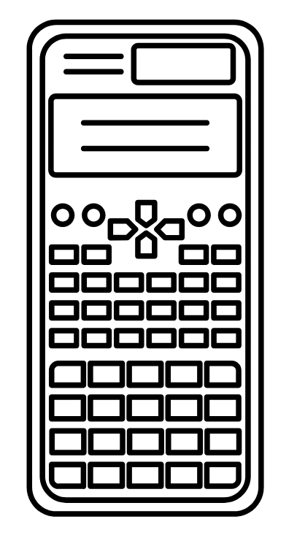



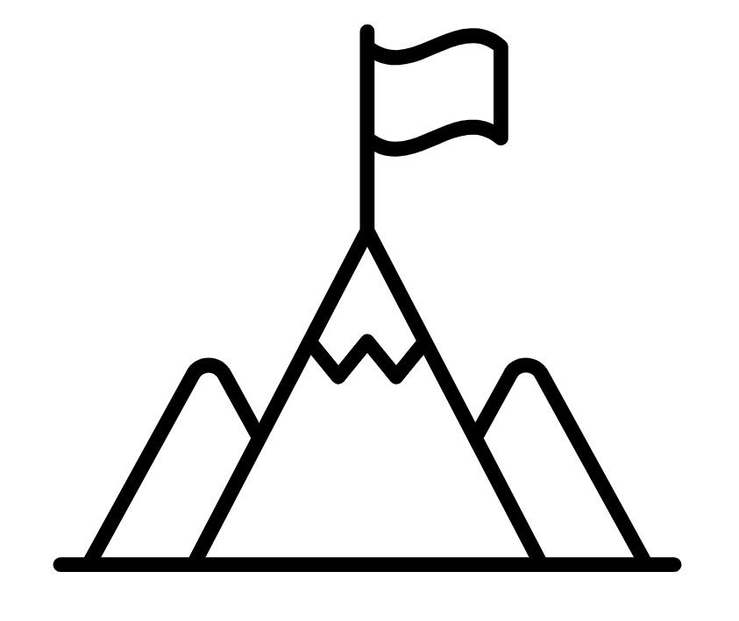
A
B

Slide 5
LESSON TITLE:

Slide 6
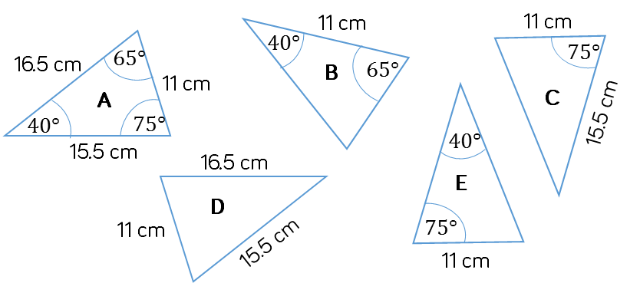


Which of the following triangles are congruent to triangle A? Justify your answers.
SAS
SSS
ASA
Notes:
https://whiterosemaths.com/resources/schemes-of-learning/secondary-sols/
Year 10 Autumn

Slide 7
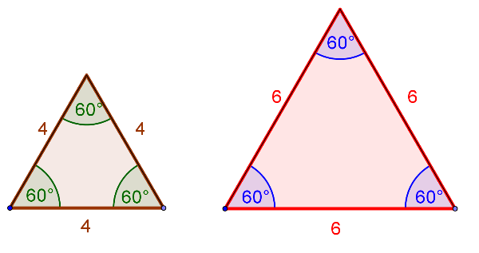
What about AAA?
Given three angles, is it possible to construct more than one triangle?
How do we describe the relationship between these shapes?

Slide 8
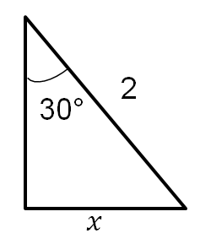
Thinking back to previous work…
θ°
1
How big is θ?
30°

Slide 9
Thinking back to previous work…
x
30°
1
2
How big is θ?
How big is x?
30°
4

Slide 10
Thinking back to previous work…
4
8
x
30°
1
2
y
4
How big is θ?
How big is θ?
How big is x?
How big is y?
30°
4
4
Discuss: What do you notice about these triangles?
What is the same, what is different?

Slide 11





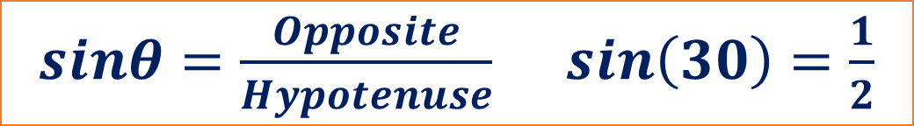








1.
2.
3.
4
$$x$$
$$x$$
$$x$$
$$4$$
$$1$$
30°
30°
30°
4.
5.
6.
$$2$$
$$x$$
$$6$$
60°
60°
60°
$$x$$
$$6$$
$$x$$
7.
What do you notice about these triangles?
What is the same, what is different?
$$6$$
30°
$sinθ=\frac{Opposite}{Hypotenuse}$ $\sin\left(30\right)=\frac{1}{2}$
$$x$$
Notes:
https://variationtheory.com/2019/04/01/trigonometry-exact-values-finding-sides/
@mathsmiles_k

Slide 12



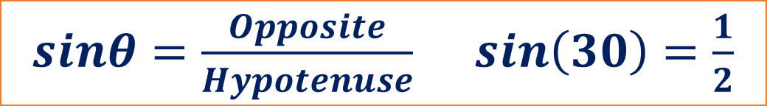




1.
2.
3.
$$x=2$$
$$x=8$$
4
$$x$$
$$x$$
$$x$$
$$4$$
$$1$$
$$x=2$$
30°
30°
30°
4.
5.
6.
$$x=12$$
$$2$$
$$x$$
$$6$$
60°
60°
60°
$$x$$
$$6$$
$$x$$
$$x=1$$
$$x=3$$
7.
What do you notice about these triangles?
What is the same, what is different?
$$6$$
30°
$sinθ=\frac{Opposite}{Hypotenuse}$ $\sin\left(30\right)=\frac{1}{2}$
$$x$$
$$x=3$$
Notes:
https://variationtheory.com/2019/04/01/trigonometry-exact-values-finding-sides/
@mathsmiles_k

Slide 13
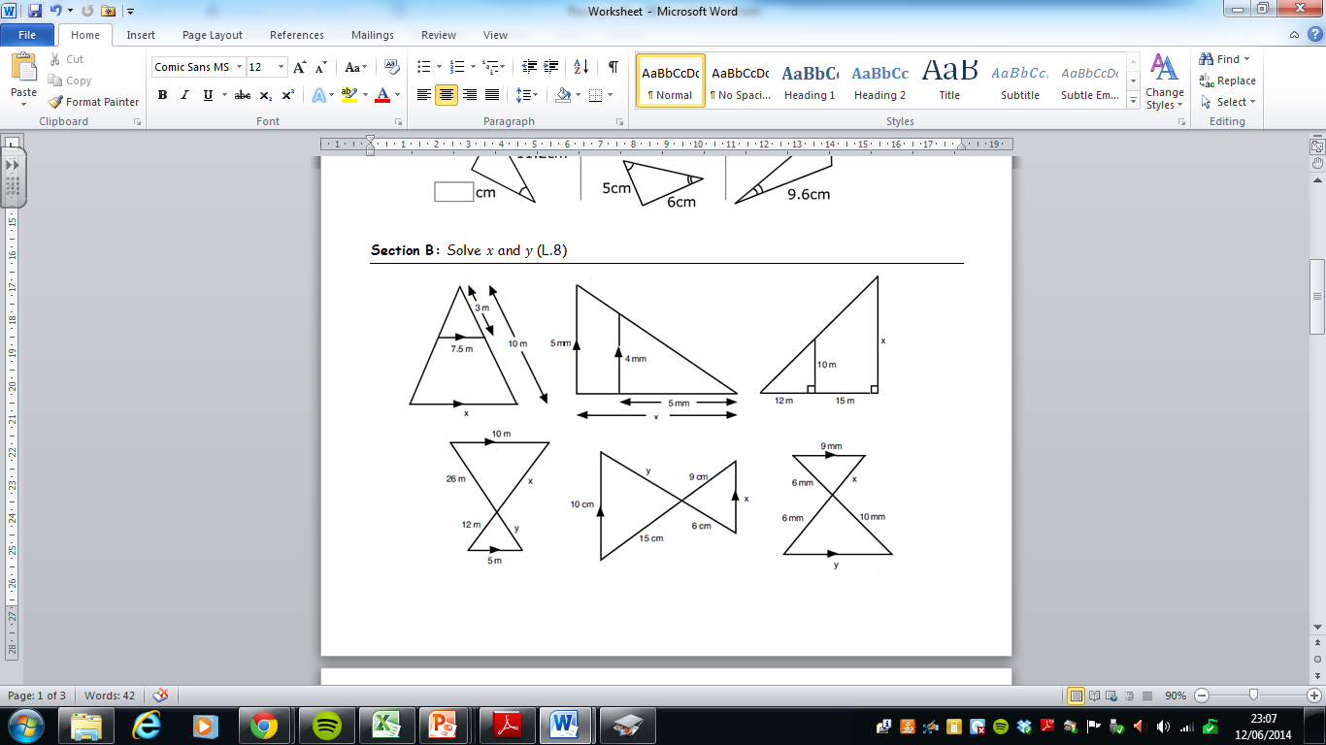
What is similarity?
The diagram shows two overlapping triangles.
What makes the two shapes similar?

Slide 14
What is similarity?
When two shapes are similar, their corresponding angles are equal.

Slide 15
How do you know the following overlapping triangles are similar?

Slide 16
How do you know the following overlapping triangles are similar?
C
C
A
D
B
B
A
E
A
E
D

Slide 17
How do you know the following overlapping triangles are similar?
A
B
C
D
E

Slide 18
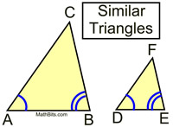
Construct two similar triangles
Draw two lines of different length (5cm & 10cm)
Construct the same angles at each vertex (40° & 80°)
Continue the lines until they
intersect.
How big is the third angle?
How long are the side lengths?
Label the triangles A and B
5cm
10cm

Slide 19
Compare the corresponding lengths
Length of side in triangle A | Length of corresponding side in triangle B
Can you spot a relationship between the sides?

Slide 20
Compare the corresponding lengths
Shown below is another example of two similar triangles
Length of side in triangle A | Length of corresponding side in triangle B
3 | 12
4 | 16
5 | 20
Can you spot a relationship between the sides?

Slide 21
Compare the corresponding lengths
Shown below is another example of two similar triangles
Length of side in triangle A | Length of corresponding side in triangle B
4.5 | 3
13.5 | 9
15 | 10
Can you spot a relationship between the sides?

Slide 22
What is similarity?
When two shapes are similar, their corresponding angles are equal
and the corresponding sides lengths have all enlarged by the same scale factor.

Slide 23
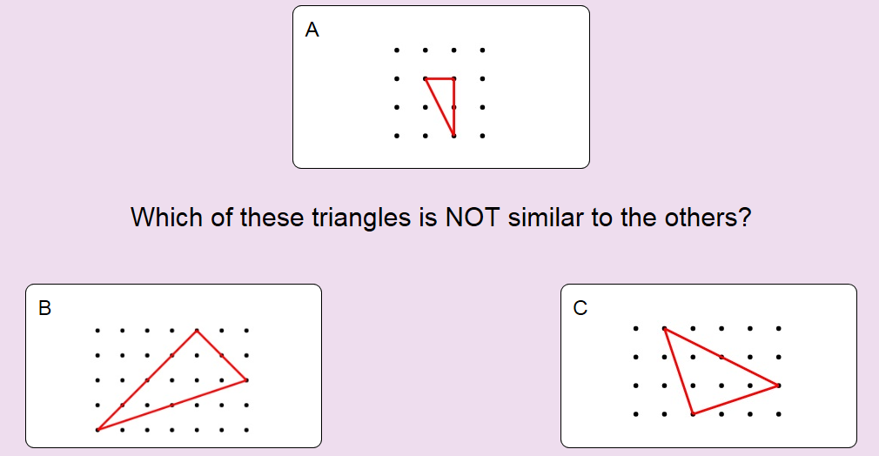
A and B are both right-angled scalene triangles, whilst C is isosceles. Look at the relationship between the side lengths.
Notes:
https://nonexamples.com/oddOneOut

Slide 24
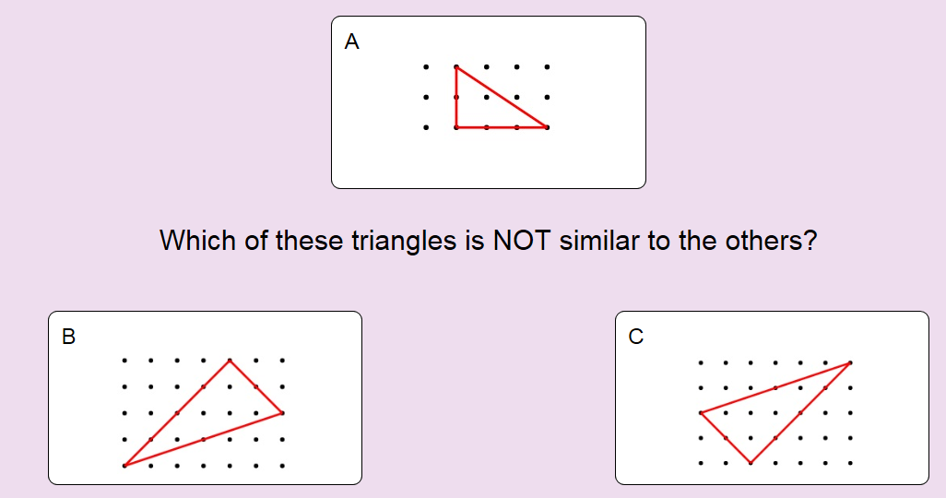
B and C are in fact congruent!
Notes:
https://nonexamples.com/oddOneOut

Slide 25
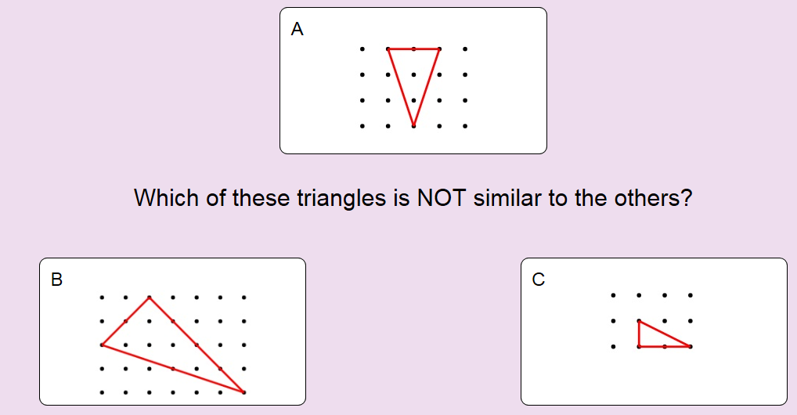
B and C are both right-angled triangles, whilst A is isosceles. Look at the relationship between the side lengths.
Notes:
https://nonexamples.com/oddOneOut

Slide 26
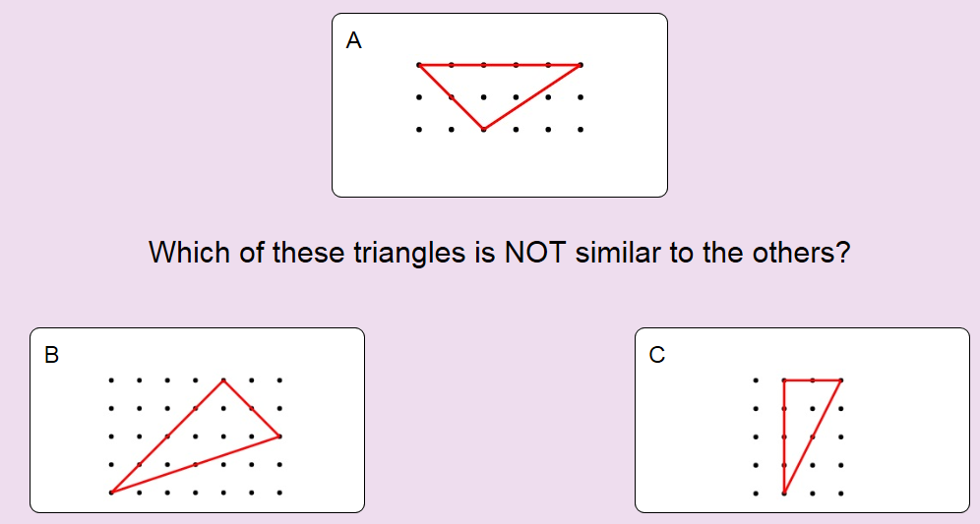
B and C are both right-angled triangles, whilst A is scalene. Look at the relationship between the side lengths.
Notes:
https://nonexamples.com/oddOneOut

