Slide 1















Dual coding symbols:
Practise
Explain
Organise
Big Question
Reflect
Present
Compare
Evaluate
Activate
Discuss
Predict
Connect
Summarise
Recall
Vocabulary

Slide 2








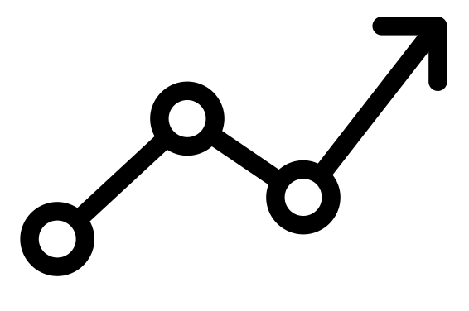

Editable reading ruler
Every child in an Archway school will become a fluent reader
 | RETRIEVE the words or phrases you need from the text | DECODE the words or phrase to address a breakdown | CONNECT with words or phrases you know from the text or your memory | VISUALISE the images in as much detail as possible | SUMMARISE the main ideas of the text in a few words | INFER meanings that might be within the text | PREDICT what might happen next using details from the text | EXAMINE how the writer uses words to construct meaning
 | ASK THOUGHTFUL QUESTIONS TO HELP YOU UNDERSTAND THE TEXT

Slide 3

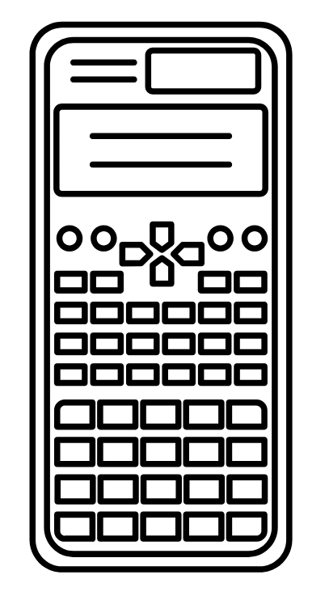



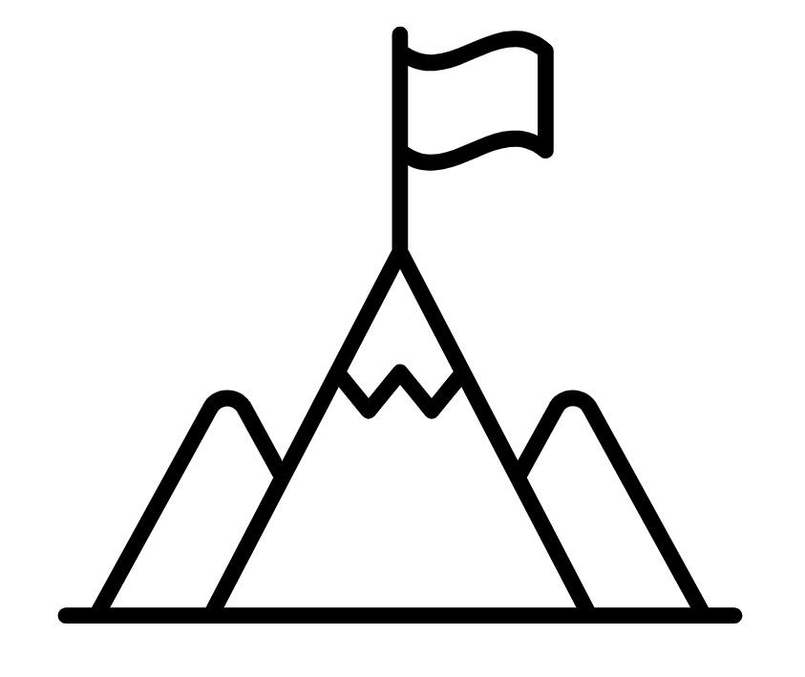
A
B

Slide 5
LESSON TITLE:

Slide 6
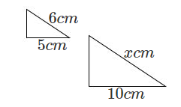
These two scalene triangles are similar – can you find the missing lengths?
Is there more than one way?

Slide 7








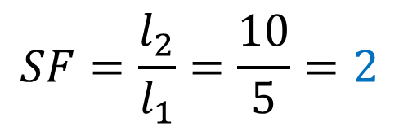


Using a scale factor
Using a common ratio
$$y$$
$$y$$
$$x$$
$$x$$
$$SF=\frac{l_{2}}{l_{1}}=\frac{10}{5}=2$$
$$y :5=4 :10$$
$$y=2cm$$
$$x=6×2=12cm$$
$$x :10=6 :5$$
$$y=4÷2=2cm$$
$$x=12cm$$

Slide 8
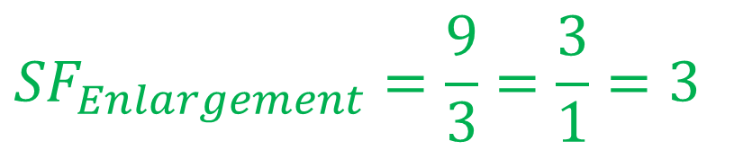
What is the scale factor of enlargement between the two similar shapes?
$${SF}_{Enlargement}=\frac{9}{3}=\frac{3}{1}=3$$
3cm
9cm

Slide 9
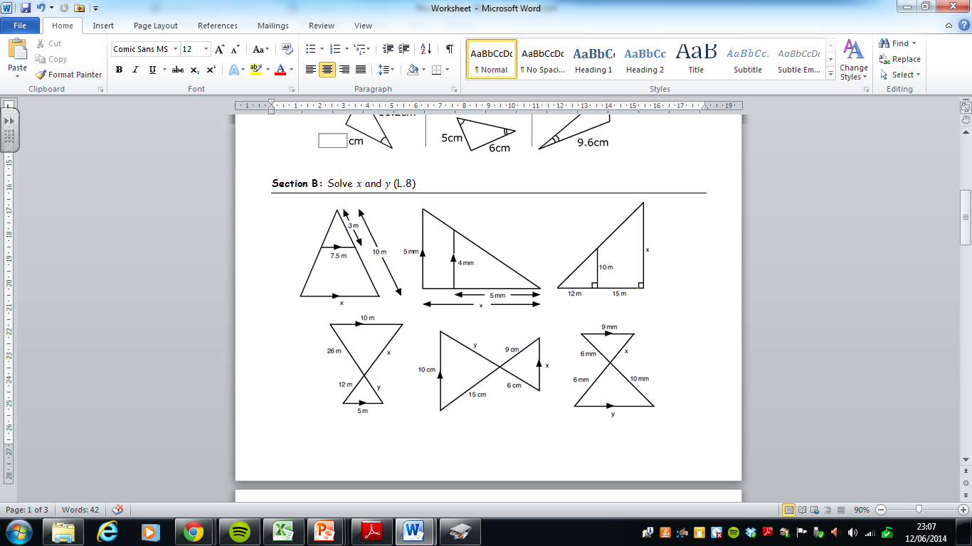
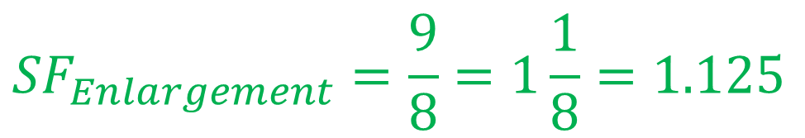
What is the scale factor of enlargement between the two similar shapes?
$${SF}_{Enlargement}=\frac{9}{8}=1\frac{1}{8}=1.125$$
9cm
8cm

Slide 10
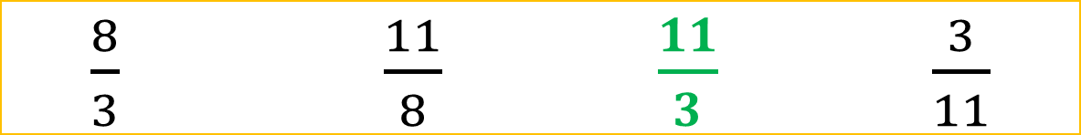
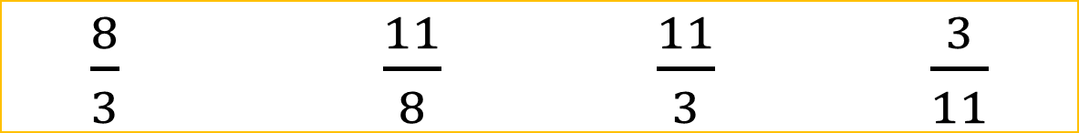
What is the scale factor of enlargement between the two similar shapes?
C
C
8cm
A
D
B
B
3cm
A
E
A
E
D
$\frac{8}{3}$ $\frac{11}{8}$ $\frac{11}{3}$ $\frac{3}{11}$
$\frac{8}{3}$ $\frac{11}{8}$ $\frac{11}{3}$ $\frac{3}{11}$

Slide 11



What is the scale factor between the two similar shapes?
Hint: which are the corresponding sides?
A
B
$√3$cm
$√6$cm
C
$2√3$cm
D
E

Slide 12
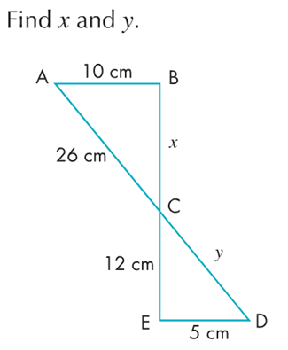
What are the missing lengths?
Hint: which are the corresponding sides?

Slide 13
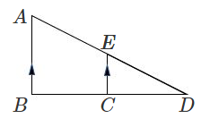
Find the size of ALL of the missing sides on these similar shapes.
Is there more than one way?
15
3
4
Notes:
AB=15 CE=3 CD=4

Slide 14
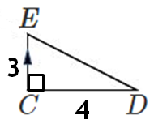
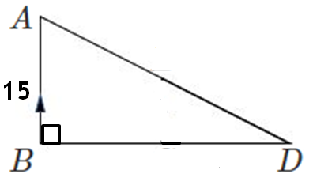



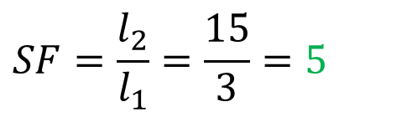









Using a scale factor
Using a common ratio
15
15
3
3
4
4
$$SF=\frac{l_{2}}{l_{1}}=\frac{15}{3}=5$$
$$BD :AB=CD :CE$$
$$BD :15=4 :3$$
$$BD=CD×5=4×5=20cm$$
$$BD=20cm$$
$$BC=BD−CD=20−4=16cm$$
$$BC=BD−CD=20−4=16cm$$
Using Pythagoras Theorem,
$$ED=5cm$$
Using Pythagoras Theorem,
$$ED=5cm$$
$$AD :AB=ED :EC$$
$$AD=ED×5=5×5=25cm$$
$$AD :15=5 :3$$
$$AD=25cm$$
$$AE=AD−ED=25−5=20cm$$
$$AE=AD−ED=25−5=20cm$$
Notes:
AB=15 CE=3 CD=4

Slide 15
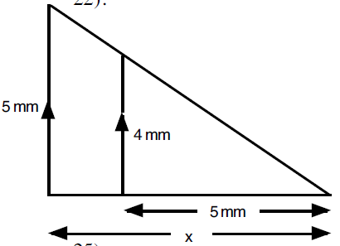
Intelligent Practice – Find the length of every missing side
Triangles not drawn to scale
1.
2.
12mm
x
20mm
3.
4.
6mm
6mm
x
x
6mm
10mm
12mm
Notes:
https://variationtheory.com/2019/05/04/similar-triangles-missing-sides-with-other-triangles/

Slide 16
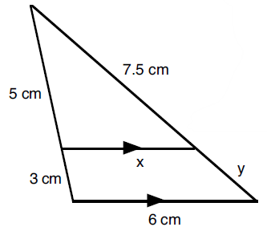
Intelligent Practice – Find the length of every missing side
Triangles not drawn to scale
5.
6.
8mm
6mm
6mm
x
3mm
6mm
12mm
Notes:
https://variationtheory.com/2019/05/04/similar-triangles-missing-sides-with-other-triangles/

Slide 17
Practice – Find the length of every missing side
Triangles not drawn to scale
1.
2.
SF = 3
SF = 4
4x4=16mm
12mm
x
5x3=15mm
20mm
3.
4.
SF = 3
6mm
SF = 2
6mm
x
x
6÷2=3mm
6÷3=2mm
6mm
10mm
12mm
Notes:
https://variationtheory.com/2019/05/04/similar-triangles-missing-sides-with-other-triangles/

Slide 18
Practice – Find the length of every missing side
Triangles not drawn to scale
5.
6.
SF = 1.5
SF = 1.5
8mm
6mm
6mm
x
8x1.5=12mm
6÷1.5=4mm
12-8 = 4mm
3mm
6÷1.5=4mm
6mm
12mm
Notes:
https://variationtheory.com/2019/05/04/similar-triangles-missing-sides-with-other-triangles/

Slide 19
Your Turn
Complete the exam-style questions in the booklet provided.
Notes:
AB=15 CE=3 CD=4

Slide 20
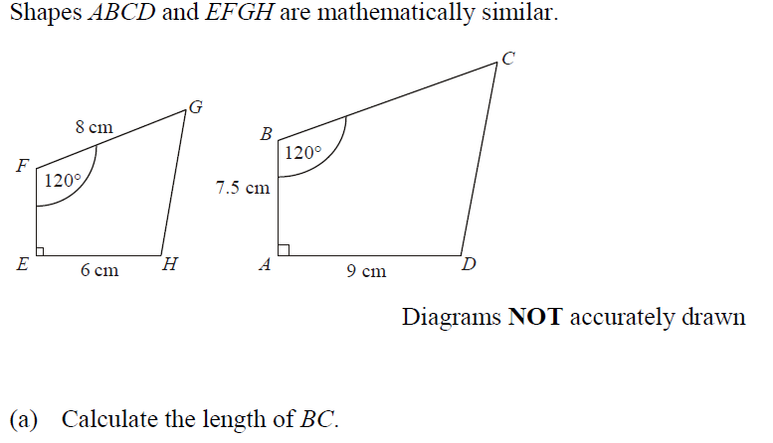



$$BC=12cm$$
$$EF=5cm$$

Slide 21
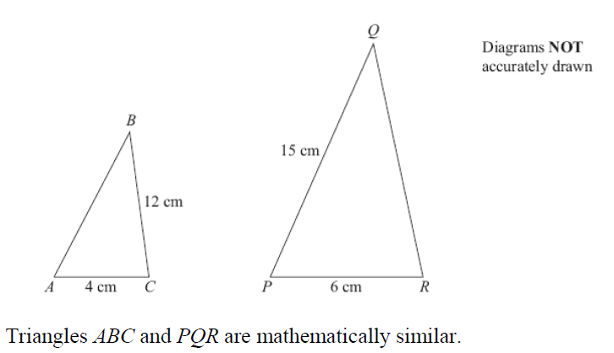




$$QR=18cm$$
$$AB=10cm$$

Slide 22
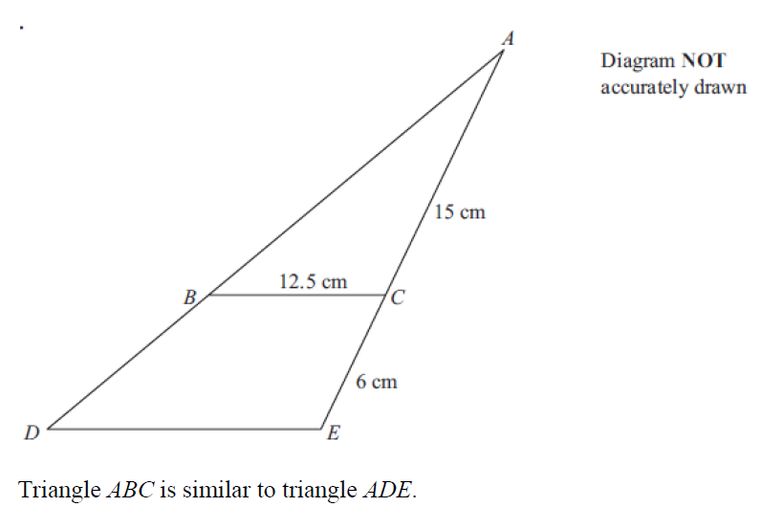


$$DE=17.5cm$$

Slide 23
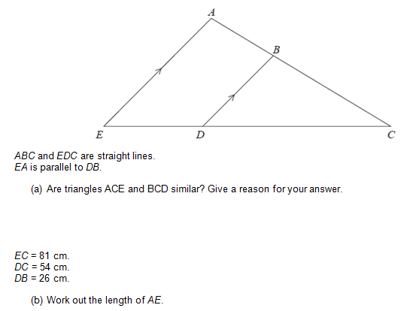

Yes
Angle EAC = Angle DBC (corresponding angles are equal)
Angle AEC = Angle BDC (corresponding angles are equal)
$$AE=39cm$$

Slide 24
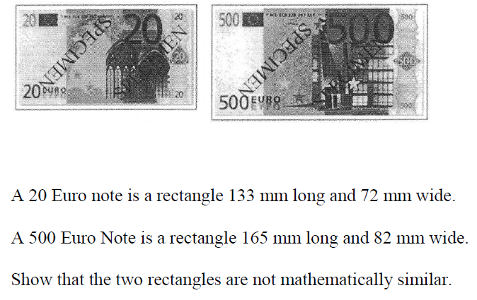
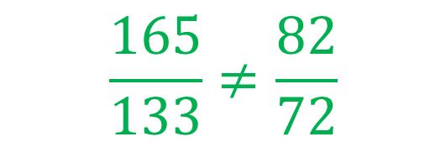
$$\frac{165}{133}≠\frac{82}{72}$$

Slide 25
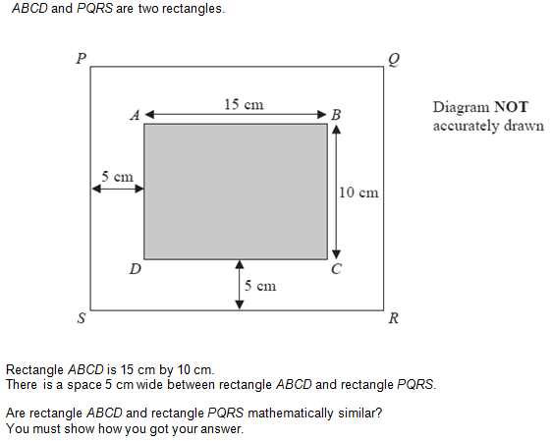
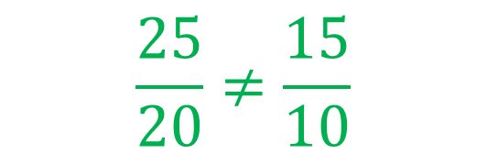
No
PQ = 25cm
QR = 20cm
$$\frac{25}{20}≠\frac{15}{10}$$

Slide 26
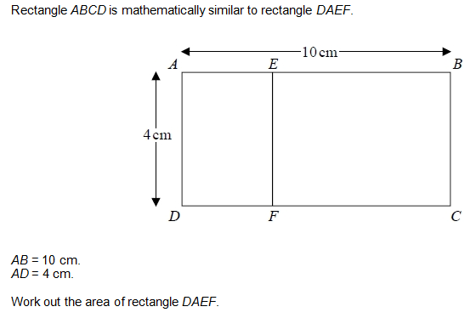

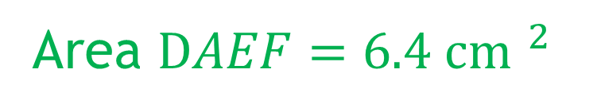
$$AE=1.6cm$$
Area $DAEF={6.4 cm }^{2}$

Slide 27
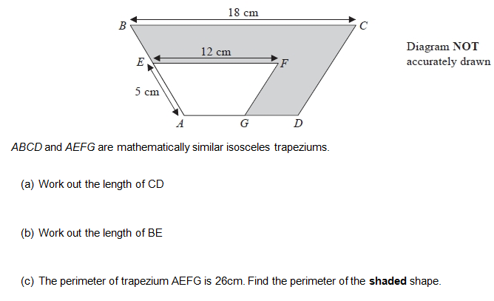






$$CD=7.5cm$$
$$BE=2.5cm$$
$$AG=4cm$$
$$AD=6cm$$
$$GD=2cm$$
Perimeter$=47cm$

