Slide 1

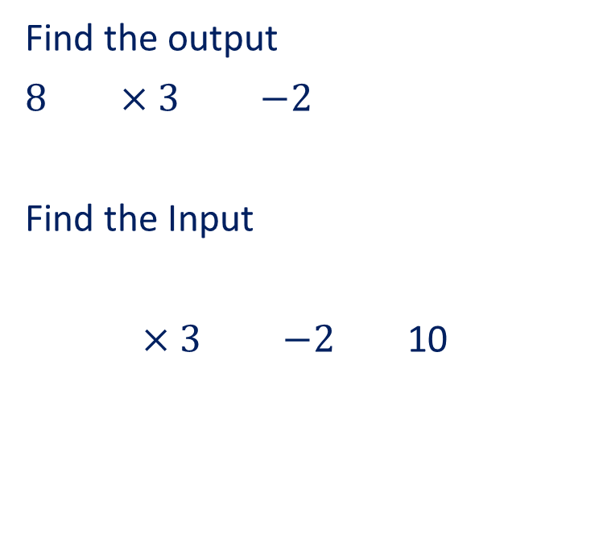


27/06/2025
Algebraic Conventions
Find the output
$8$ $×3$ $−2$
Find the Input
$×3$ $−2$ 10
Find 2/5 of 35
Convert 3100 into standard form
Find the missing angle
$$x$$
$$70°$$
$$50°$$

Slide 2
TITLE: Algebraic Conventions
27/06/2025
Spaced Retrieval

Slide 3

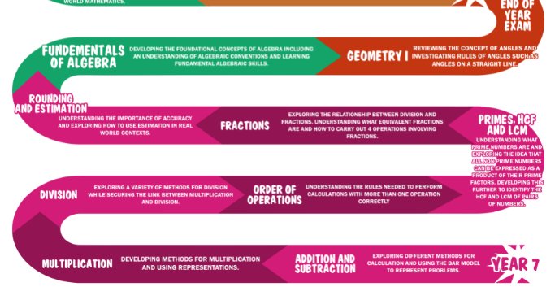

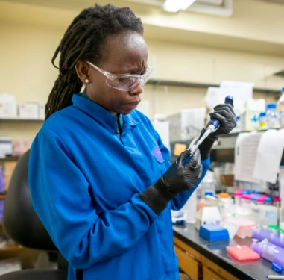
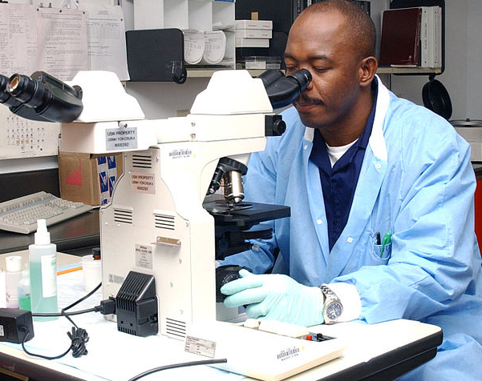

Meteorologist
Chemist
Forensic Pathologist
Electrician
Algebra- Why Bother?

Slide 4





TITLE: Algebraic Conventions
27/06/2025
From last lesson…
Input
Function
Output
$×$ 12
$+$ 8
$−$ 7.5
$+$ 10
3
11
3
70
13

Slide 5
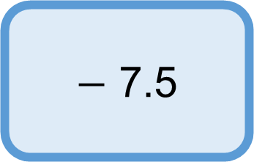






TITLE: Algebraic Conventions
What will the output be?
Input
Function
Output
$×$ 12
$+$ 8
$−$ 7.5
$+$ 10
$$8+a$$
$$a$$
70
$$a+8$$
13

Slide 6
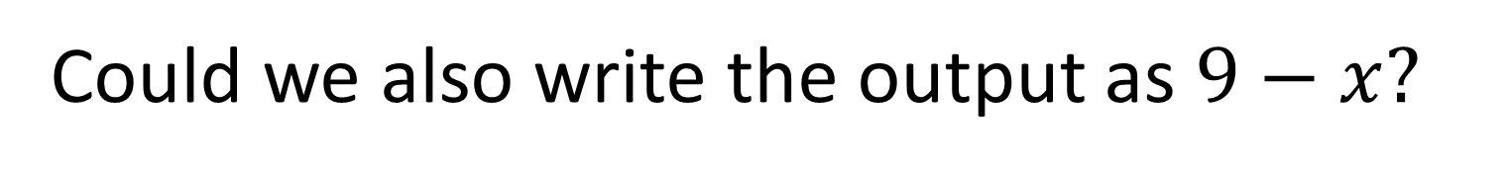






TITLE: Algebraic Conventions
What will the output be?
Input
Function
Output
$×$ 12
$−$ 9
$−$ 7.5
$+$ 10
$$x$$
70
$$x−9$$
13
Could we also write the output as $9−x?$

Slide 7






TITLE: Algebraic Conventions
What will the output be?
Input
Function
Output
$×$ 12
$$÷10$$
$−$ 7.5
$+$ 10
$$y$$
70
$$y÷10$$
13
How else could we write the output?

Slide 8

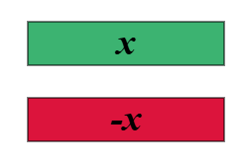
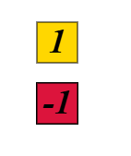


Remember our zero number pairs?
$$=0$$
$$=0$$

Slide 9







In algebra, letters are used to represent unknowns or variables.
Individual letters or numbers, or letters and numbers multiplied together are called terms.
Examples:
Non examples:
+
=

Slide 10
This algebra tile represents the number 1
What value have I represented below?
4
We can add 1s together and represent as a single number.
Instead of writing 1 + 1 + 1 + 1 we wrote 4
This is the same with variables.

Slide 11
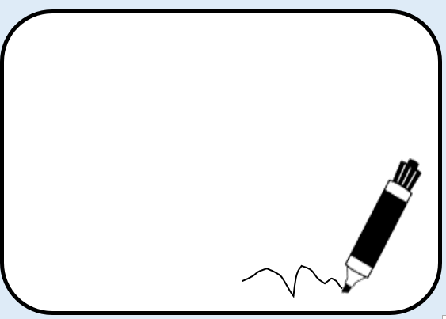


This algebra tile represents the variable
What value is shown below?
Instead of writing we can write

Slide 12


What value do these algebra tiles represent?
How would we show using algebra tiles?

Slide 13







When we have an expression made up of a single variable added to itself repeatedly, we can write that as a single term.
E.g can be written as
$$n$$
$$n$$
$$n$$
$$n$$
$$n$$
$$n$$

Slide 14
This works with subtraction as well
+
+
-

Slide 15

Subtracting a variable is the same as adding the negative of that variable.
This can be represented as:
+
+
+
Zero number pair

Slide 16


Which of the following expressions can be written as ?

Slide 17






Match the expression with the equivalent term.
a)
b)
c)
d)
e)

Slide 18
Match the expression with the equivalent term.
a)
b)
c)
d)
e)

Slide 19

2) Write each expression as a single term.
a)
b)
c)
d)
e)

Slide 20


2) Write each expression as a single term.
a)
b)
c)
d)
e)

Slide 21
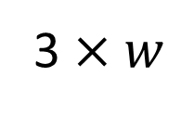
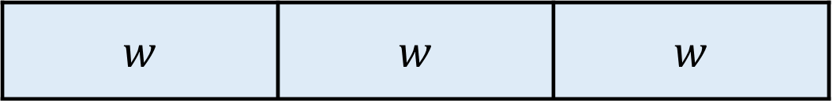

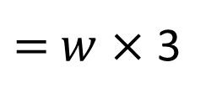
On your whiteboards…
What calculation does this bar model represent? Can you write it another way?
$w$ | $w$ | $w$
3 $×$ $w$
$=$ $w$ $×$ 3
How should we write this?
3$w$ OR $w$3

Slide 22
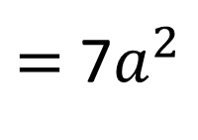

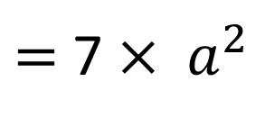
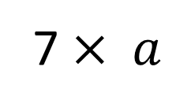

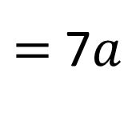
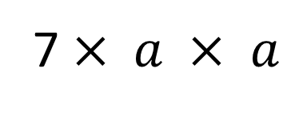
On your whiteboards…
How could we write the following expressions?
7 $× a$
$=$ 7$a$
$$a × a$$
$=$ $a^{2}$
7 $× a × a$
$=$ 7 $× a^{2}$
$=$ 7$a^{2}$

Slide 23
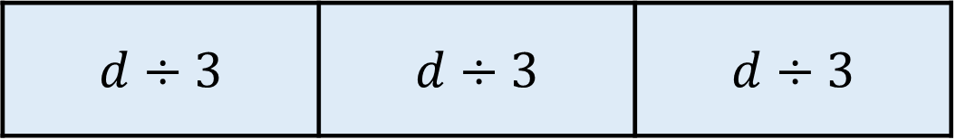

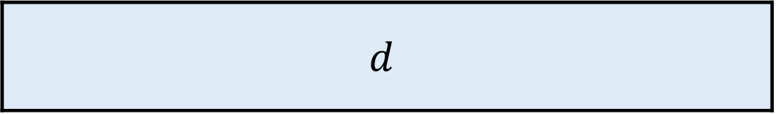
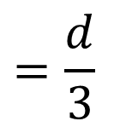

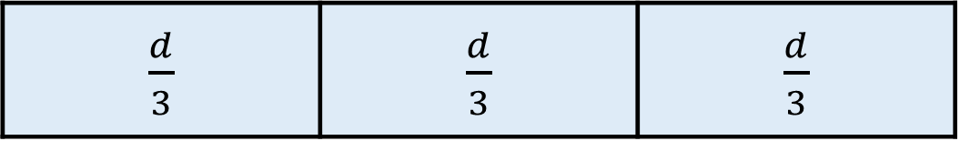
Think, Pair, Share
$$d$$
$$d$$
$d÷3$ | $d÷3$ | $d÷3$
$\frac{d}{3}$ | $\frac{d}{3}$ | $\frac{d}{3}$
What does this section represent?
$$=\frac{d}{3}$$
$$d÷3$$

Slide 24
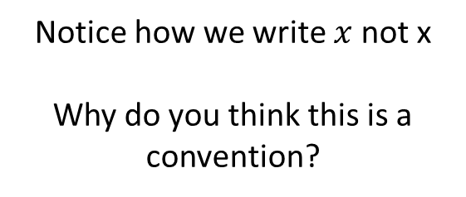

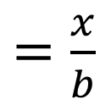

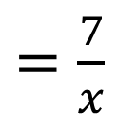
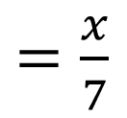

On your whiteboards…
How could we write the following expressions?
$$x÷7$$
$=$ $\frac{x}{7}$
Notice how we write $x$not x
Why do you think this is a convention?
$$7 ÷x$$
$=$ $\frac{7}{x}$
$$x÷b$$
$=$ $\frac{x}{b}$

Slide 25

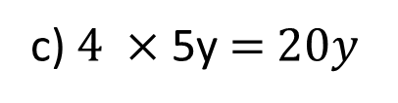
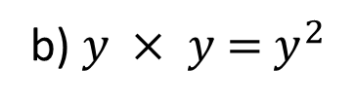

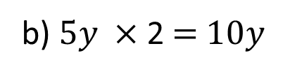
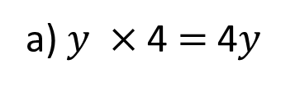
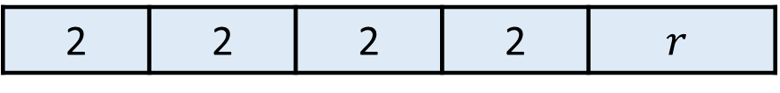
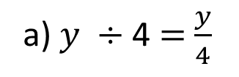
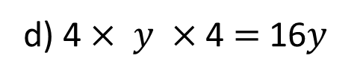

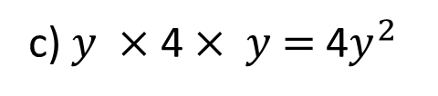

In your books: Algebraic Conventions
Copy and complete the expressions without using an operation.
Which expression represents the bar model below?
3) Copy and complete the expressions without an operation
a) $y ×$ 4 $=$ 4$y$
c) $y ×$ 4 $× y$ $=$ 4$y^{2}$
?
?
b) $y × y$ $=$ $y^{2}$
?
?
d) 4 $× y ×$ 4 $=$ 16$y$
2 | 2 | 2 | 2 | $$r$$
8$r$
2222$r$
8 $+ r$
16$r$
a) $y ÷$ 4 $=$ $\frac{y}{4}$
b) $5y ×$ 2 $=$ $10y$
c) $4 ×$ 5y $=$ $20y$
?
?
?

Slide 26
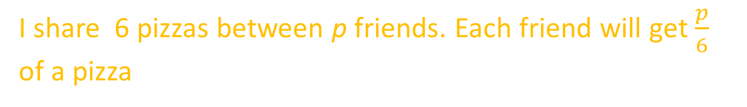
Can you spot what’s wrong with each of these statements?
t x r x 5 is written as tr5 in algebra.
I have four banknotes each worth y pounds, so all together I have y4 pounds.
a is the first letter of the alphabet so a = 1.
A class contains n students, then 3 students leave. Now there are 3 - n students in the class.
I share 6 pizzas between p friends. Each friend will get $\frac{p}{6}$ of a pizza
A packet of crisps costs £c and an apple costs £a. If I buy one of each, I will spend £a + £c
A rectangle has a width of b cm and a length of c cm, so it has an area of bc³m.

Slide 27
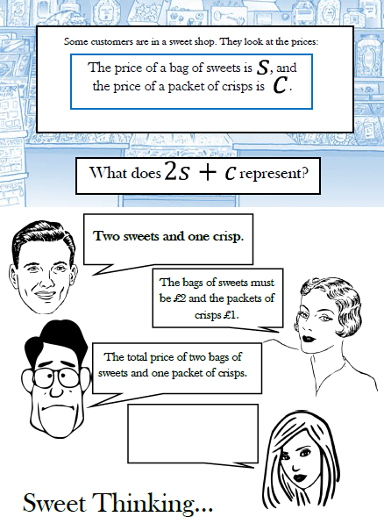
‘The price of a bag of sweets is S, and the price of a packet of crisps is C.’
What do you think?

Slide 28
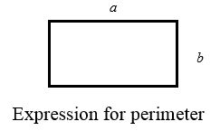
On your whiteboards…
What does perimeter mean?
How could we express it using the information given?

Slide 29
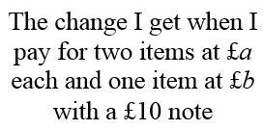

What did you write for this one?
The bar model could help with this one…

Slide 30


Slide 31
Challenge
Checkpoint 6: Stick differences
James has two sticks.
When he balances the sticks on top of each other, the total height is 150 cm.
When he stands them next to each other, the purple stick is 10 cm longer than the green stick.
How long is each stick?
Create your own stick problem. What information must you give to make sure it is solvable?

Slide 32
Challenge
Perimeter Expressions | NRICH

