Slide 1
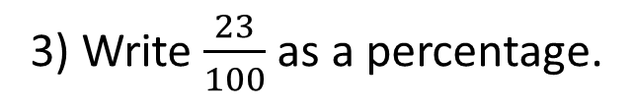

Spaced Retrieval
1) Complete the function machine.
input
output
6
$×$ 5
30
2) Write the next term in the sequence.
5, 9, 13, 17, ___
21
3) Write $\frac{23}{100}$ as a percentage.
23%
4) Work out 13$×$ 10
130

Slide 2
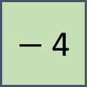
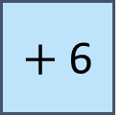
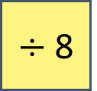
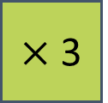
Find the output for the function machines.
input
output
input
output
a)
11
$+$ 6
17
c)
7
$×$ 3
21
input
output
input
output
b)
40
$−$ 4
36
d)
80
$÷$ 8
10

Slide 3
Spaced Retrieval

Slide 4
TITLE: one step function machines with algebra
27 June 2025

Slide 5



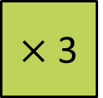
input
output
$×$ 3
What is the input to this function machine?
What will the output be?
3 packs of sweets

Slide 6


input
output
$×$ 3
What is the output of the function machine?

Slide 7
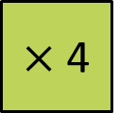
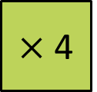


output
input
$×$ 4
We call letters in expressions variables.
input
output
2$a$
$×$ 4
8$a$
What’s the same? What is different?

Slide 8


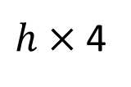
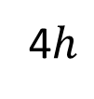



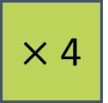
input
output
$$h$$
$×$ 4
4$h$
Which one is written correctly as a single term?
A
B
C
D
$h$4
$h$⁴
4$h$
$h×$ 4

Slide 9

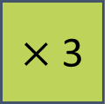

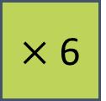





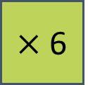
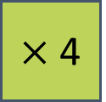

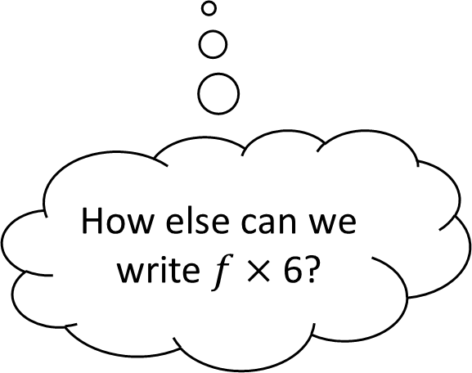
I do
You do
Complete the function machines.
Complete the function machines.
input
output
input
output
$$f$$
$×$ 6
6$f$
$$j$$
$×$ 3
3$j$
input
output
input
output
How else can we write $f×$ 6?
2$g$
$×$ 4
8$g$
5$k$
$×$ 6
30$k$

Slide 10
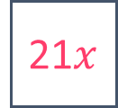
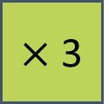


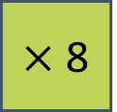

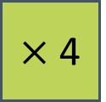
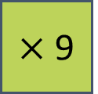




Complete the function machines.
input
output
$$v$$
$×$ 9
9$v$
input
output
2$w$
$×$ 4
8$w$
input
output
7$x$
$×$ 3
21$x$
input
output
3$y$
$×$ 8
24$y$

Slide 11
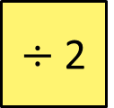



input
output
$÷$ 2
input
output
6$a$
$÷$ 2
3$a$
What’s the same? What is different?

Slide 12
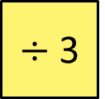
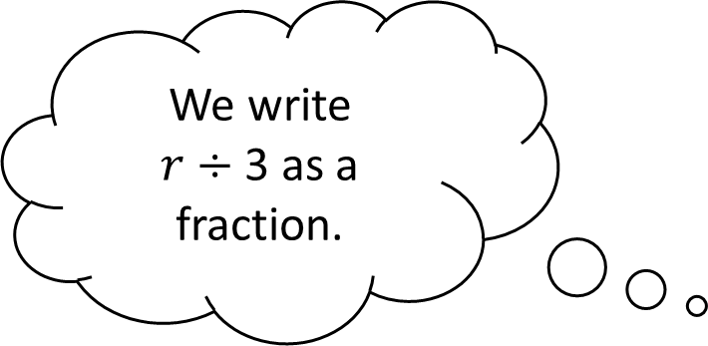


Complete the function machine.
input
output
$$r$$
$÷$ 3
$\frac{r}{3}$
We write
$r$ $÷$3 as a fraction.

Slide 13




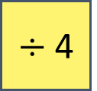
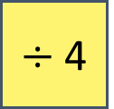


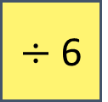





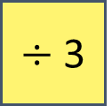

I do
You do
Complete the function machines.
Complete the function machines.
input
output
input
output
$$e$$
$÷$ 6
$\frac{e}{6}$
$$n$$
$÷$4
$\frac{n}{4}$
input
output
input
output
5$r$
÷ 7
$\frac{5r}{7}$
2$c$
$÷$ 3
$\frac{2c}{3}$
input
output
input
output
6$a$
÷ 2
3$a$
8$h$
$÷$ 4
2$h$

Slide 14




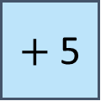
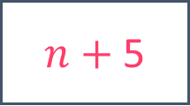

Think, pair, share
input
output
$$n$$
$×$ 5
5$n$
input
output
$$n$$
$+$ 5
$n+$ 5
What’s the same? What is different?

Slide 15
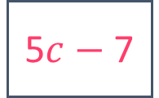

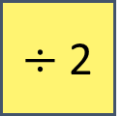
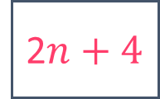

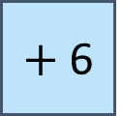



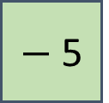


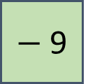


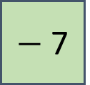
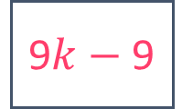
I do
You do
Complete the function machines.
Complete the function machines.
input
output
input
output
$$p$$
$−$ 5
$p−$ 5
$$q$$
$+$6
$q+$ 6
input
output
input
output
2$n$
+ 4
2$n+4$
5$c$
$−$ 7
5$c−$7
input
output
input
output
9$k$
$−$ 9
9$k−$ 9
6$j$
$÷$ 2
3$j$

Slide 16

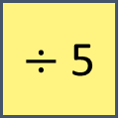









Complete the function machines.
input
output
$$h$$
$+$ 3
$h+$ 3
input
output
$$g$$
$×$ 4
4$g$
input
output
$$f$$
$−$ 2
$f−$ 2
input
output
$$e$$
$÷$ 5
$\frac{e}{5}$

Slide 17






Think, pair, share
input
output
3$y$
$+$ 2
I agree with _____, because…
The output is 3$y+$ 2
The output is 5$y$
Max
Dora
Who do you agree with?
Explain your answer.

Slide 18












I do
You do
Complete the function machines.
Complete the function machines.
input
output
input
output
$$t$$
$×$ 4
4$t$
$$w$$
$÷$ 6
$\frac{w}{6}$
What is the inverse of $×$ 4?
input
output
input
output
$$u$$
+ 6
$u+$ 6
$$x$$
$−$ 7
$x−$7

Slide 19










Mini White Board
input
output
$$u$$
$−$2
$u−$ 2
3$h$
3$h−$2
7$i$
7$i−$ 2
2$f+$ 3
2$f+$ 1

Slide 20












Mini White Board
input
output
$$n$$
$+$ 2
$n+$ 2
Which of the function machines have equal outputs?
input
output
$$n$$
$×$ 2
2$n$
input
output
$$n$$
$−$ 2
$n−$ 2
input
output
$$n$$
$+$ $n$
2$n$

Slide 21








Finding the function
input
output
a)
7$k$
$$k$$
input
output
b)
2$q$
10$pq$
input
output
c)
$$m$$
$m^{2}$
input
output
d)
2$r$
2$r+$3$s$

Slide 22








Finding the function
input
output
e)
$a+$7
$a+$12
input
output
f)
3$b$ $+$ 2
6$b+$ 4
input
output
g)
$c+$11
$c+$1
input
output
h)
15$b+$ 3
5$b+$ 1

Slide 23






Complete the function machine
input
output
5
25
3$a$
15$a$
$e−$ 1
$$h$$
2$j+$3

Slide 24


Challenge 2
Construct the function machine for these descriptions
Five more than n
Two less than n
Three times as much as n
Six less than 2n
Dan has got n sweets
Construct function machine to form expressions for: Kyle, Jake, Pete and Liam
Kyle has got three more than Dan
Dan has got three more than Jake
Pete has twice as many sweets as Dan
Liam has three more than Pete
$$n$$
$$n$$

Slide 25























Challenge
Construct the function machine for these descriptions
Five more than n
Two less than n
Three times as much as n
Six less than 2n
Dan has got n sweets
Construct function machine to form expressions for: Kyle, Jake, Pete and Liam
Kyle has got three more than Dan
Dan has got three more than Jake
Pete has twice as many sweets as Dan
Liam has three more than Pete
$$n$$
$$+5$$
$$n+5$$
$$n$$
$$+3$$
$$n+3$$
$$n$$
$$−2$$
$$n−2$$
$$n$$
$$−3$$
$$n−3$$
$$n$$
$$×3$$
$$3n$$
$$n$$
$$×2$$
$$2n$$
$$2n$$
$$2n−6$$
$$2n$$
$$+3$$
$$2n+3$$
$$−6$$

Slide 27


