Slide 1















Dual coding symbols:
Practise
Explain
Organise
Big Question
Reflect
Present
Compare
Evaluate
Activate
Discuss
Predict
Connect
Summarise
Recall
Vocabulary

Slide 2








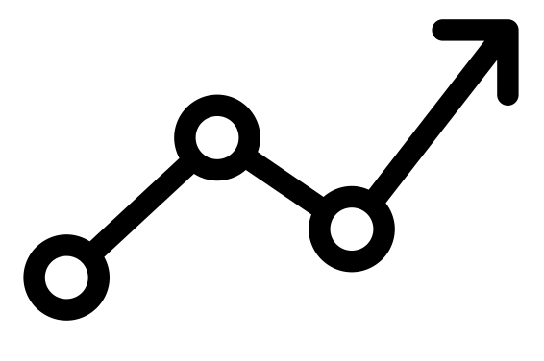

Editable reading ruler
Every child in an Archway school will become a fluent reader
 | RETRIEVE the words or phrases you need from the text | DECODE the words or phrase to address a breakdown | CONNECT with words or phrases you know from the text or your memory | VISUALISE the images in as much detail as possible | SUMMARISE the main ideas of the text in a few words | INFER meanings that might be within the text | PREDICT what might happen next using details from the text | EXAMINE how the writer uses words to construct meaning
 | ASK THOUGHTFUL QUESTIONS TO HELP YOU UNDERSTAND THE TEXT

Slide 3





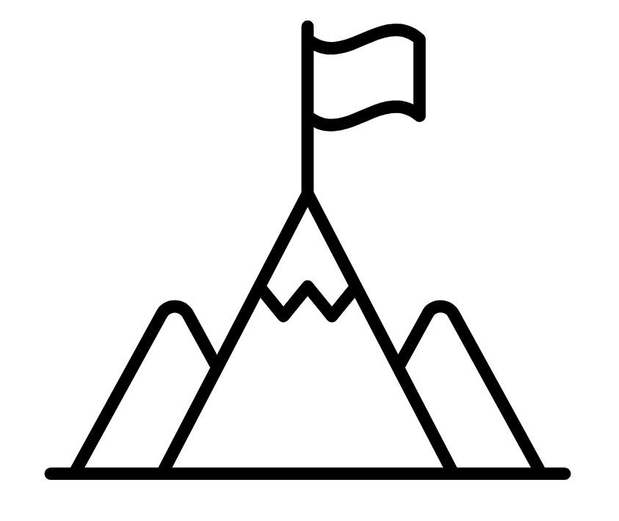
A
B

Slide 4
Collinear Points

Slide 5






Key vocabulary:
Decode the word
Definition
.
Collinear
Examples
Non-examples

Slide 6







How can we use vectors to show that these three points form a straight line?
To show that two vectors form a straight line we need to:
$$A$$
$$1$$
Show that the two vectors are parallel
$$B$$
$$2$$
Show that the two vectors have a common point
$$C$$
To show that three points are collinear we need to:
$$1$$
Show that two vectors joining any two of the points are parallel
When three or more points lie on a straight line they are called collinear.
$$2$$
Show that these two vectors have a common point
Notes:
The final phase of the lesson considers using parallel vectors to show points or vectors form a straight line. Define the word collinear and explain that it is not enough just to show the vectors that make up the line are parallel, you must also show they have a common point. You may also wish to point out that when there are three points, there are three possible vectors and they only need to show any two of them are parallel. Click to reveal.

Slide 7



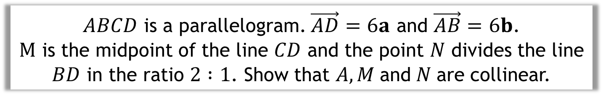









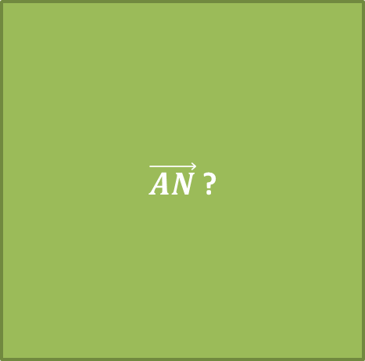


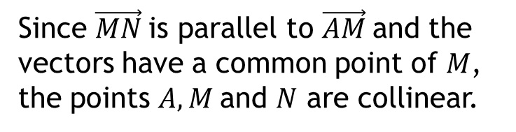






$ABCD$ is a parallelogram. $\vec{AD}=6a$ and $\vec{AB}=6b$.
$M$ is the midpoint of the line $CD$ and the point $N$ divides the line $BD$ in the ratio $2 :1$. Show that $A, M$and$N$are collinear.
$$C$$
Find $\vec{AN}$
$\vec{AM}$?
$\vec{AN}$?
Find $\vec{AM}$
$$\vec{AN}=\vec{AB}+\vec{BN}$$
$$\vec{AM}=\vec{AD}+\vec{DM}$$
$$B$$
$$M$$
$$N$$
$$\vec{AN}=\vec{AB}+\frac{2}{3}\vec{BD}$$
$$\vec{AM}=\vec{AD}+\frac{1}{2}\vec{DC}$$
$$D$$
$$\vec{MN}=6b+\frac{2}{3}(6a−6b)$$
$$\vec{AM}=6a+\frac{1}{2}(6b)$$
$$A$$
$$\vec{MN}=4a+2b$$
$$\vec{AM}=6a+3b$$
Compare $\vec{AN}$ and $\vec{AM}$
Compare vectors?
Since $\vec{MN}$is parallel to $\vec{AM}$and the vectors have a common point of $M$, the points $A, M$and $N$ are collinear.
Conclusion?
$$\vec{MN}=\frac{2}{3}\left(6a+3b\right)$$
$$\vec{MN}=\frac{2}{3}\vec{AM}$$

Slide 8
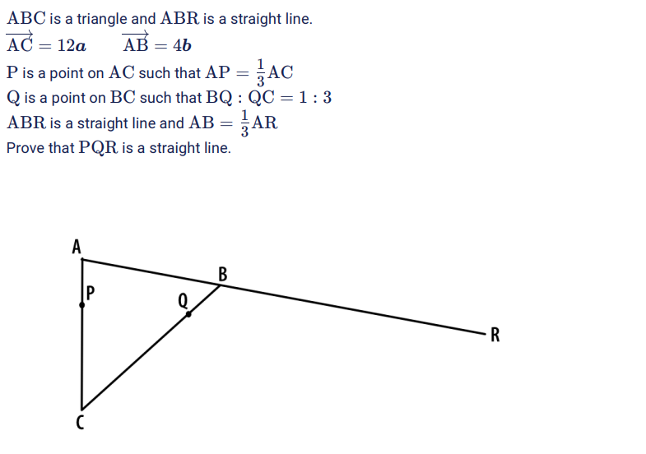


Slide 9
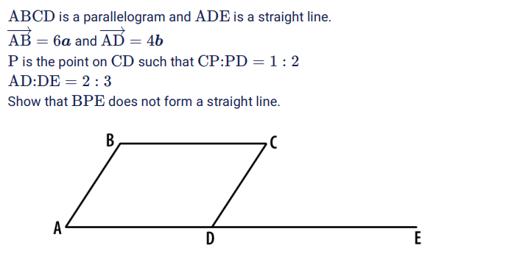
Notes:
Questions from here: Sparx Maths Curriculum - View the Curriculum

Slide 10
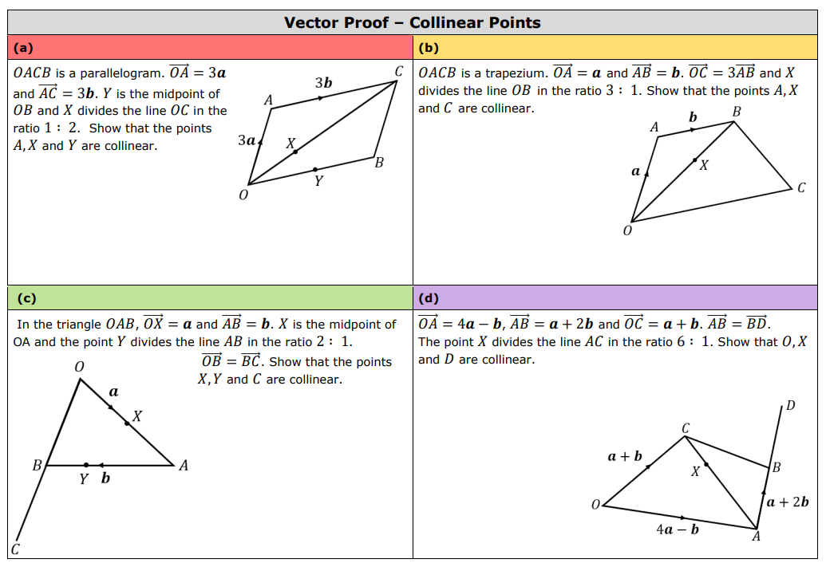
Notes:
7ac124_9c645bd3238e4f55bb192403dfbecac2.pdf

Slide 11
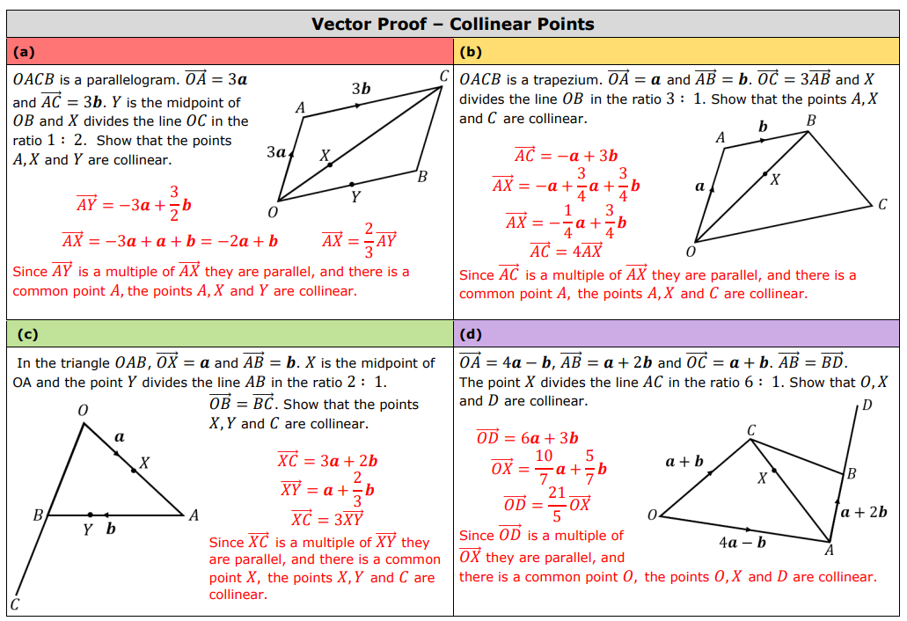

Slide 12
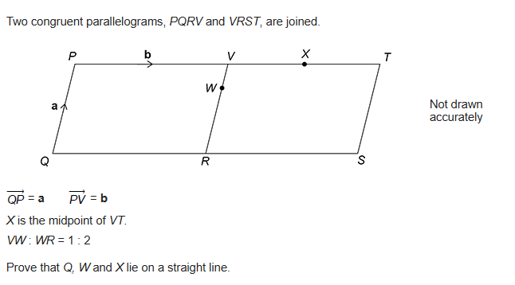
EXAM QUESTION 1

Slide 13
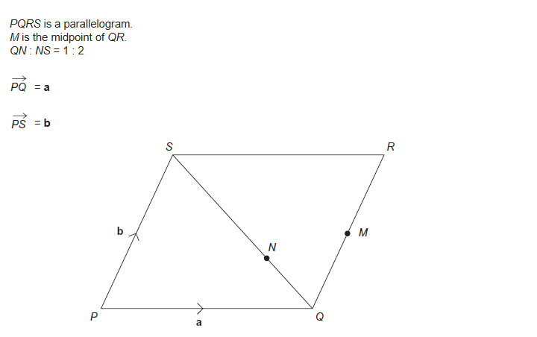
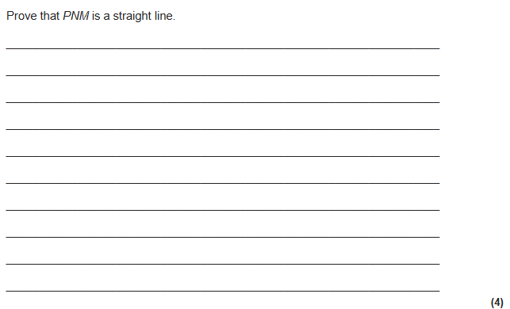
EXAM QUESTION 2

Slide 14
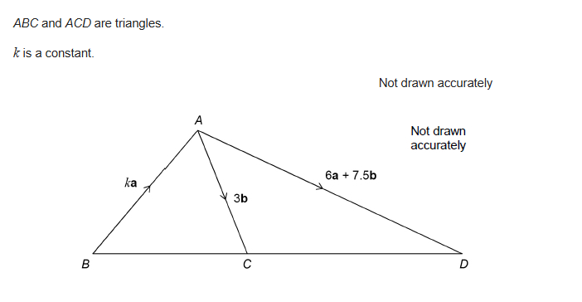
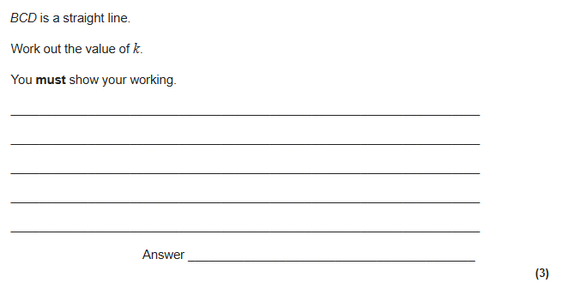
EXAM QUESTION 3

