Slide 1















Dual coding symbols:
Practise
Explain
Organise
Big Question
Reflect
Present
Compare
Evaluate
Activate
Discuss
Predict
Connect
Summarise
Recall
Vocabulary

Slide 2










Editable reading ruler
Every child in an Archway school will become a fluent reader
 | RETRIEVE the words or phrases you need from the text | DECODE the words or phrase to address a breakdown | CONNECT with words or phrases you know from the text or your memory | VISUALISE the images in as much detail as possible | SUMMARISE the main ideas of the text in a few words | INFER meanings that might be within the text | PREDICT what might happen next using details from the text | EXAMINE how the writer uses words to construct meaning
 | ASK THOUGHTFUL QUESTIONS TO HELP YOU UNDERSTAND THE TEXT

Slide 3






A
B

Slide 4
Further Vector Paths

Slide 5






Key vocabulary:
Decode the word
Definition
.
Parallel Vectors
Examples
Non-examples

Slide 6
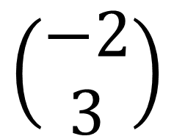
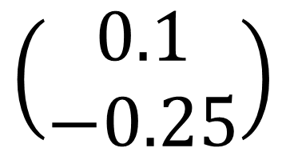
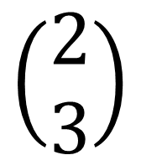
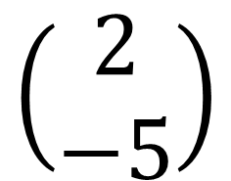
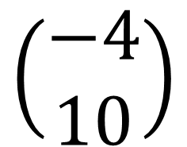
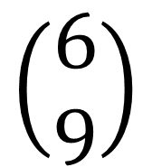
Which vectors are parallel?
How do you know?
$$\left(\begin{matrix}2 \\ 3\end{matrix}\right)$$
$$\left(\begin{matrix}−4 \\ 10\end{matrix}\right)$$
$$\left(\begin{matrix}−2 \\ 3\end{matrix}\right)$$
$$\left(\begin{matrix}0.1 \\ −0.25\end{matrix}\right)$$
$$\left(\begin{matrix}6 \\ 9\end{matrix}\right)$$
$$\left(\begin{matrix}2 \\ −5\end{matrix}\right)$$

Slide 7

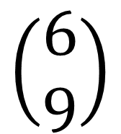
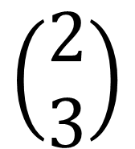
$$\left(\begin{matrix}2 \\ 3\end{matrix}\right)$$
$$\left(\begin{matrix}6 \\ 9\end{matrix}\right)$$
Notes:
Draw and show using grid

Slide 8
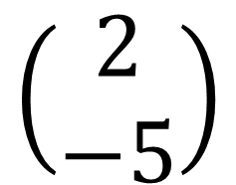
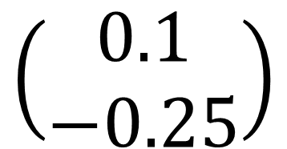
$$\left(\begin{matrix}2 \\ −5\end{matrix}\right)$$
$$\left(\begin{matrix}0.1 \\ −0.25\end{matrix}\right)$$

Slide 9
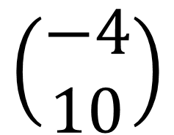
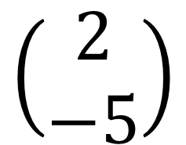
$$\left(\begin{matrix}2 \\ −5\end{matrix}\right)$$
$$\left(\begin{matrix}−4 \\ 10\end{matrix}\right)$$

Slide 10
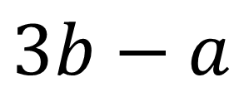


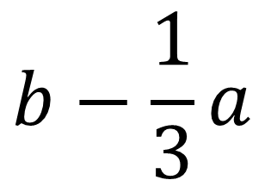
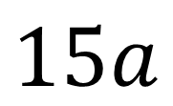
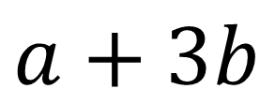
Which vectors are parallel?
How do you know?
$$5a$$
$$7a$$
$$3b−a$$
$$b−\frac{1}{3}a$$
$$15a$$
$$a+3b$$

Slide 11
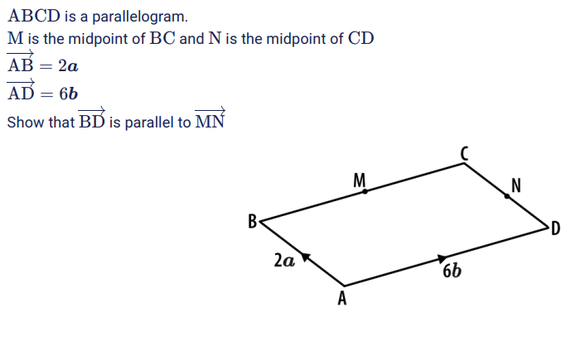

Notes:
Questions from here: Sparx Maths Curriculum - View the Curriculum

Slide 12
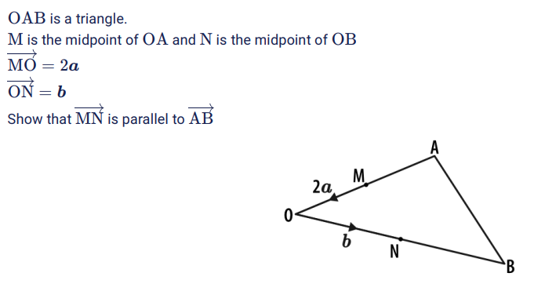

Slide 13
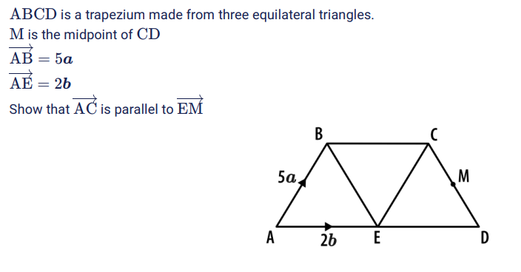

Slide 14
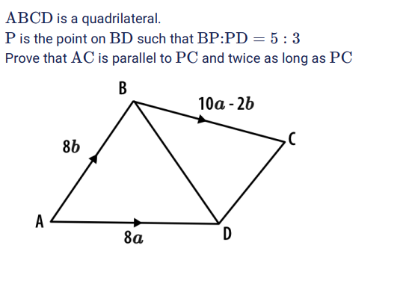

Slide 15
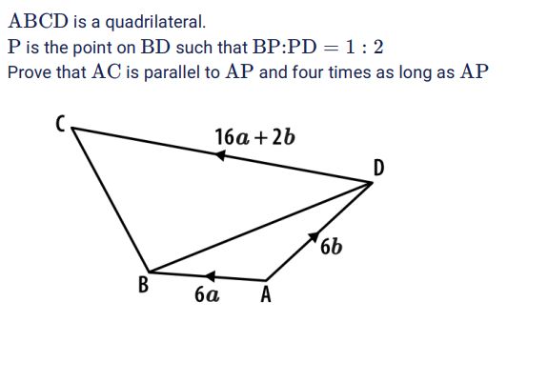

Slide 16
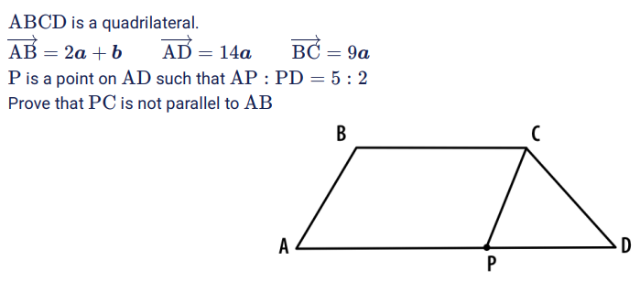

Slide 17
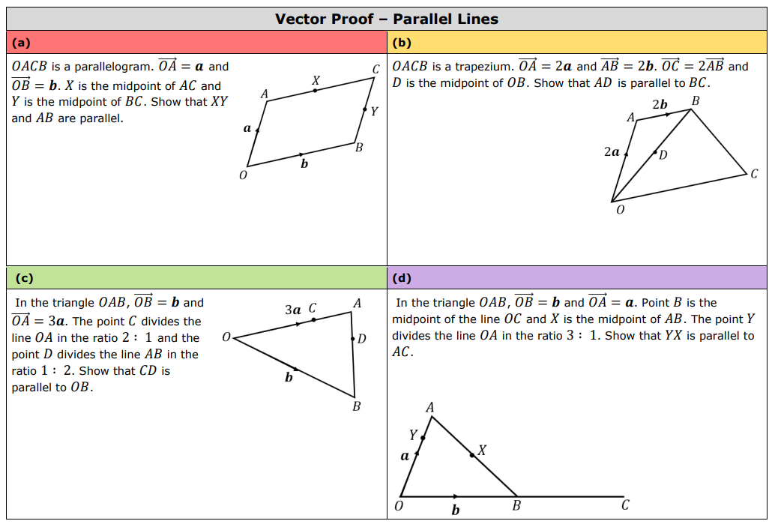

Slide 18
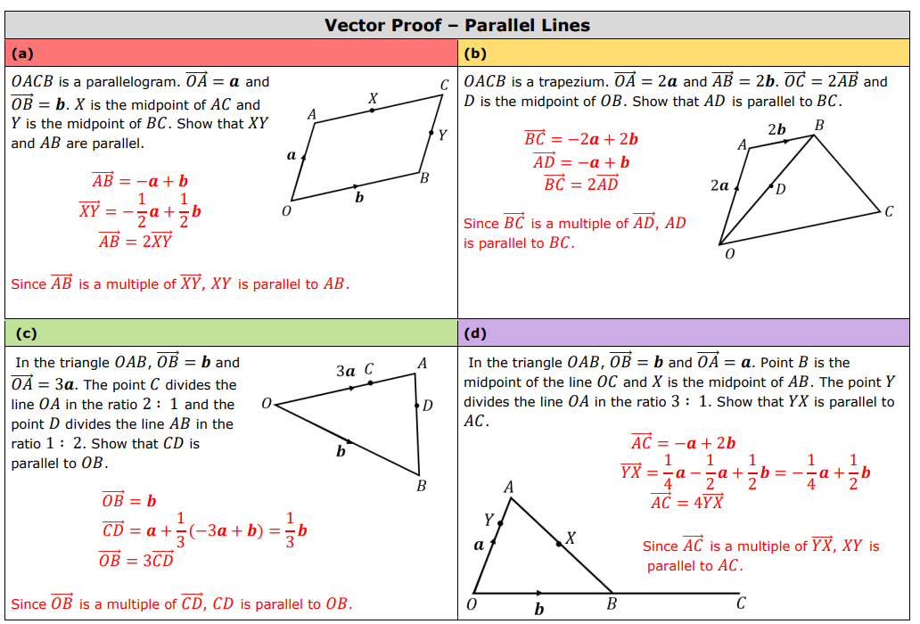
Notes:
7ac124_9c645bd3238e4f55bb192403dfbecac2.pdf

Slide 19
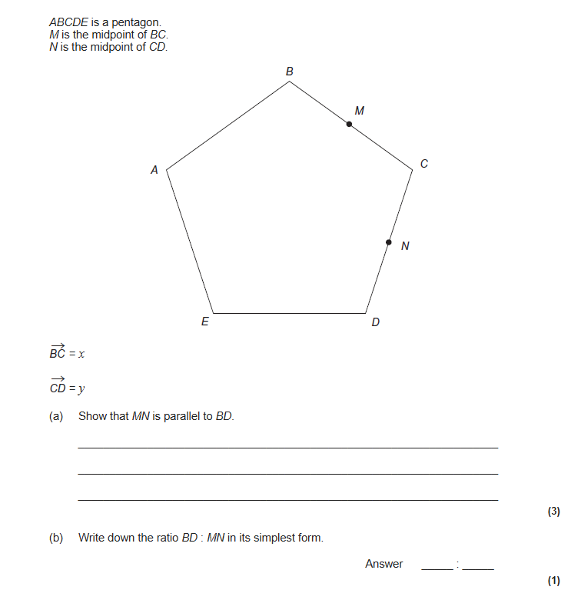
EXAM QUESTION 1

Slide 20
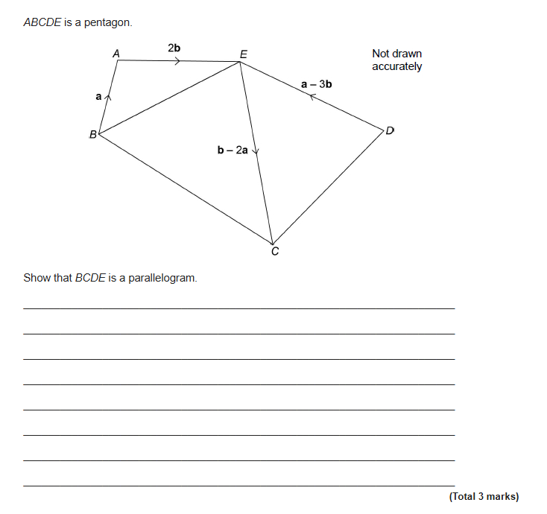
EXAM QUESTION 2

