Slide 1















Dual coding symbols:
Practise
Explain
Organise
Big Question
Reflect
Present
Compare
Evaluate
Activate
Discuss
Predict
Connect
Summarise
Recall
Vocabulary

Slide 2










Editable reading ruler
Every child in an Archway school will become a fluent reader
 | RETRIEVE the words or phrases you need from the text | DECODE the words or phrase to address a breakdown | CONNECT with words or phrases you know from the text or your memory | VISUALISE the images in as much detail as possible | SUMMARISE the main ideas of the text in a few words | INFER meanings that might be within the text | PREDICT what might happen next using details from the text | EXAMINE how the writer uses words to construct meaning
 | ASK THOUGHTFUL QUESTIONS TO HELP YOU UNDERSTAND THE TEXT

Slide 3





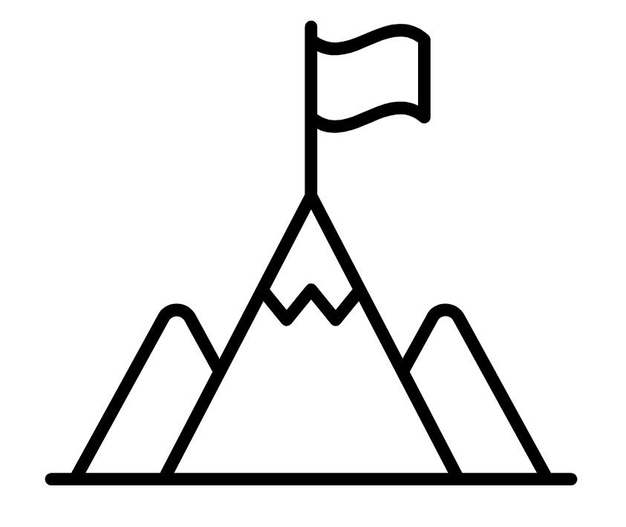
A
B

Slide 4
Multiplying & Dividing Algebraic Fractions

Slide 5
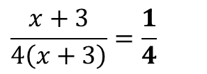
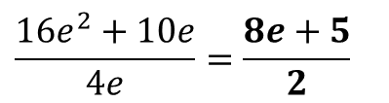


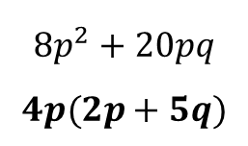


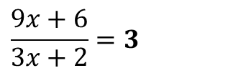


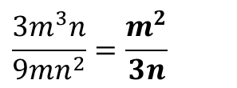

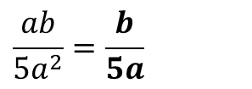
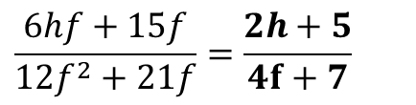
11z
?
?
?
?
$$\frac{1}{7}×\frac{1}{3}=\frac{1}{21}$$
$$\frac{4}{5}×\frac{3}{5}=\frac{12}{25}$$
$$\frac{8}{9}×\frac{5}{12}=\frac{40}{108}=\frac{10}{27}$$
$$\frac{4}{9}×\frac{3}{8}=\frac{12}{72}=\frac{1}{6}$$
a
b
c
d
12z
Factorise
a
$$9t−12$$
$$3(t−4)$$
b
$$8p^{2}+20pq$$
$$4p(2p+5q)$$
c
$$y^{3}−2y^{2}$$
$$y^{2}(y−2)$$
?
?
?
13z
Simplify
$$\frac{x+3}{4\left(x+3\right)}=\frac{1}{4}$$
$$\frac{ab}{5a^{2}}=\frac{b}{5a}$$
?
?
$$\frac{3m^{3}n}{9mn^{2}}=\frac{m^{2}}{3n}$$
?
a
b
c
$$\frac{9x+6}{3x+2}=3$$
$$\frac{16e^{2}+10e}{4e}=\frac{8e+5}{2}$$
$$\frac{6hf+15f}{12f^{2}+21f}=\frac{2h+5}{4f+7}$$
d
?
e
?
f
?
Notes:
Use the prerequisite knowledge check (on mini-whiteboards or in books) to assess whether students are sufficiently fluent in multiplying fractions and algebraic manipulation to continue with the lesson. Click boxes to reveal answers.

Slide 6







When we multiply fractions, we multiply the numerators and multiply the denominators.
$$=\frac{4×5}{7×3}$$
$$\frac{4}{7}×\frac{5}{3}$$
$$=\frac{20}{21}$$
We can use this same skill when we consider multiplying algebraic fractions.
$$\frac{a}{b}×\frac{c}{d}$$
$$=\frac{ac}{bd}$$
$$\frac{2e}{g}×\frac{3f}{g}$$
$$=\frac{6ef}{g^{2}}$$
Notes:
Introduction of multiplying algebraic fractions.
Click to reveal.
Test your understanding questions will appear to the right.

Slide 7

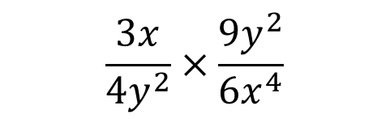


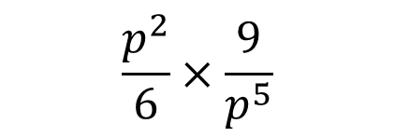


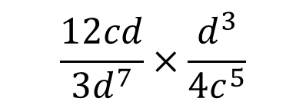
Simplify
a
$$\frac{p^{2}}{6}×\frac{9}{p^{5}}$$
b
$$\frac{5a^{7}}{4}×\frac{2b}{a^{5}}$$
?
$$=\frac{5a^{2}b}{2}$$
c
$$\frac{3x}{4y^{2}}×\frac{9y^{2}}{6x^{4}}$$
d
$$\frac{12cd}{{3d}^{7}}×\frac{d^{3}}{{4c}^{5}}$$
?
?
$$=\frac{1}{c^{4}d^{3}}$$
$$=\frac{9}{8x^{3}}$$
Notes:
Use quickfire questions (suitable for mini-whiteboards) to ensure students are confident cancelling and
multiplying algebraic fractions before progressing further. Click green boxes to reveal answers and next question.
Click green boxes to reveal answers and next question.

Slide 8
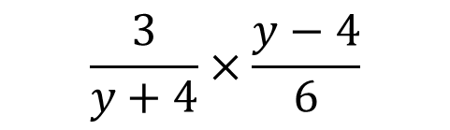

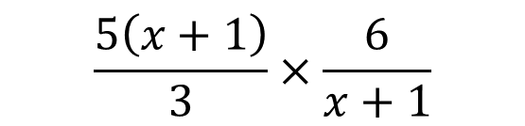
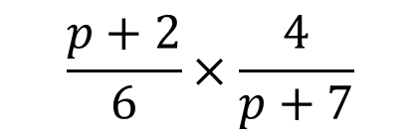


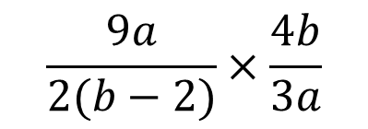
Simplify
a
$$\frac{p+2}{6}×\frac{4}{p+7}$$
b
$$\frac{3}{y+4}×\frac{y−4}{6}$$
?
$$=\frac{y−4}{2\left(y+4\right)}$$
c
$$\frac{5\left(x+1\right)}{3}×\frac{6}{x+1}$$
d
$$\frac{9a}{2(b−2)}×\frac{4b}{3a}$$
?
$$=\frac{6b}{b−2}$$
?
$$=10$$
Notes:
Use quickfire questions (suitable for mini-whiteboards) to ensure students are confident cancelling and
multiplying algebraic fractions with expressions before progressing further. Click green boxes to reveal answers and next question.
Click green boxes to reveal answers and next question.

Slide 9
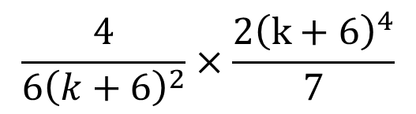

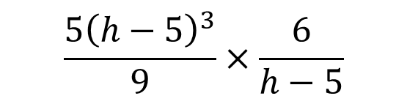
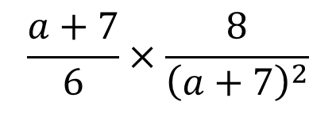

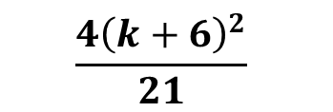
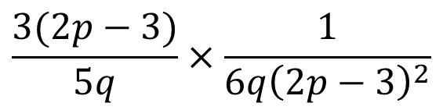
Simplify
a
$$\frac{a+7}{6}×\frac{8}{{\left(a+7\right)}^{2}}$$
$$\frac{5{\left(h−5\right)}^{3}}{9}×\frac{6}{h−5}$$
b
?
$$\frac{10{\left(h−5\right)}^{2}}{3}$$
c
$$\frac{4}{6{\left(k+6\right)}^{2}}×\frac{2{\left(k+6\right)}^{4}}{7}$$
d
$$\frac{3(2p−3)}{5q}×\frac{1}{6q{\left(2p−3\right)}^{2}}$$
?
?
$$\frac{1}{10q^{2}(2p−3)}$$
$$\frac{4{\left(k+6\right)}^{2}}{21}$$
Notes:
Use quickfire questions (suitable for mini-whiteboards) to ensure students are confident cancelling and
multiplying algebraic fractions before progressing further. Click green boxes to reveal answers and next question.
Click green boxes to reveal answers and next question.

Slide 10
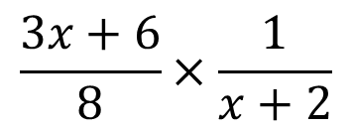

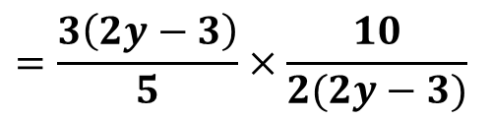

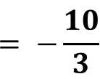
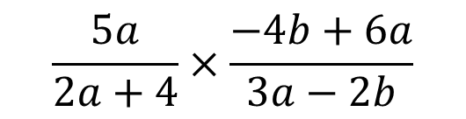
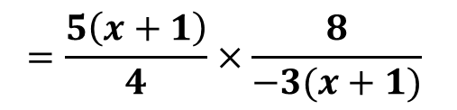
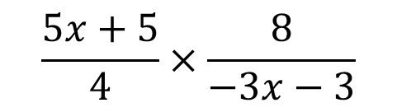

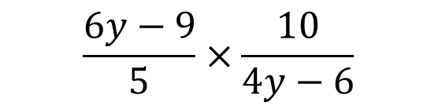
Simplify
$$\frac{3x+6}{8}×\frac{1}{x+2}$$
a
b
$$\frac{6y−9}{5}×\frac{10}{4y−6}$$
$$=\frac{3\left(2y−3\right)}{5}×\frac{10}{2(2y−3)}$$
? Factorisation
?
$$=3$$
c
$$\frac{5x+5}{4}×\frac{8}{−3x−3}$$
d
$$\frac{5a}{2a+4}×\frac{−4b+6a}{3a−2b}$$
$$=\frac{5\left(x+1\right)}{4}×\frac{8}{−3(x+1)}$$
$$=\frac{5a}{2\left(a+2\right)}×\frac{2(3a−2b)}{3a−2b}$$
? Factorisation
? Factorisation
$$= −\frac{10}{3}$$
$$=\frac{5a}{a+2}$$
?
?
Notes:
Use quickfire questions (suitable for mini-whiteboards) to ensure students are confident with factorising and multiplying algebraic fractions before progressing further.
Click green boxes to reveal answers and next question.
First green boxes shows factorised form for support/hint.
Click of second one reveals interim step and answer.

Slide 11

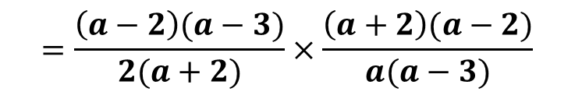
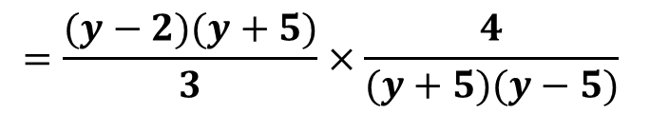
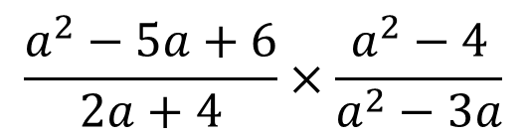

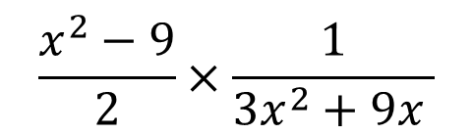
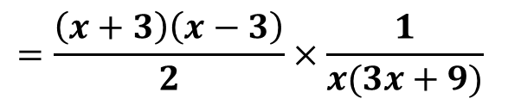



Simplify
$$\frac{x^{2}+4x+4}{2}×\frac{6}{2x+4 }$$
a
b
$$\frac{y^{2}+3x−10}{3}×\frac{4}{y^{2}−25}$$
? Factorisation
$$=\frac{(y−2)(y+5)}{3}×\frac{4}{(y+5)(y−5)}$$
$$=\frac{4(y−2)}{3(y−5)}$$
?
c
$$\frac{x^{2}−9}{2}×\frac{1}{3x^{2}+9x }$$
d
$$\frac{a^{2}−5a+6}{2a+4}×\frac{a^{2}−4}{a^{2}−3a}$$
? Factorisation
? Factorisation
$$=\frac{\left(x+3\right)\left(x−3\right)}{2}×\frac{1}{x(3x+9)}$$
$$=\frac{\left(a−2\right)(a−3)}{2(a+2)}×\frac{\left(a+2\right)(a−2)}{a(a−3)}$$
?
?
$$=\frac{x−3}{6x}$$
$$=\frac{{\left(a−2\right)}^{2}}{2a}$$
Notes:
Use quickfire questions (suitable for mini-whiteboards) to ensure students are confident with factorising and multiplying algebraic fractions before progressing further.
Click green boxes to reveal answers and next question.

Slide 12


When dividing fractions, we can still simplify before multiplying using common factors:
$$\frac{6}{9}÷\frac{3}{7}$$
We can apply this to algebraic fractions:
$$\frac{6}{x}÷\frac{3}{2x}$$
Notes:
Application of simplifying during the process of dividing fractions
Click to reveal

Slide 13







$$\frac{h−4}{6}÷\frac{1}{3(h−4)}$$
Simplify
a
b
$$\frac{m}{n+2}÷\frac{m^{2}}{3(n+2)}$$
?
$$=\frac{3}{m}$$
c
$$\frac{7p+2}{9p}÷\frac{4{\left(7p+2\right)}^{6}}{3}$$
d
$$\frac{6k{\left(j−2\right)}^{5}}{7k}÷\frac{{\left(j−2\right)}^{7}}{2}$$
?
$$=\frac{1}{12p{\left(7p+2\right)}^{5}}$$
?
$$=\frac{12}{7{\left(j−2\right)}^{2}}$$
Notes:
Use quickfire questions (suitable for mini-whiteboards) to ensure students are confident with expressions with higher powers and dividing algebraic fractions before progressing further.
Click green boxes to reveal answers and next question.

Slide 14







a
Simplify
$$\frac{1}{4n+8}÷\frac{m}{3n+6}$$
b
$$\frac{9−6b}{2b}÷\frac{12b−18}{3}$$
$$=\frac{−3(2b−3)}{2b}×\frac{3}{6(2b−3)}=−\frac{3}{4b}$$
?
?
c
$$\frac{4k^{2}+14k}{5k}÷\frac{10k+35}{10k}$$
d
$$\frac{6pq−2p}{1−3q}÷\frac{p}{3q}$$
?
$$=\frac{2k(2k+7)}{5k}×\frac{10k}{5(2k+7)}=\frac{4k}{5}$$
$$=\frac{2p(3q−1)}{−1(3q−1)}×\frac{3q}{p}=−6q$$
?
?
?
Notes:
Use quickfire questions (suitable for mini-whiteboards) to ensure students are confident with factorising and dividing algebraic fractions before progressing further. Click green boxes to reveal answers and next question.
Click green boxes to reveal answers and next question.

Slide 15



Slide 16



Slide 17

Exam Question 1

Slide 18

Exam Question 2
5 marks!

