Slide 1















Dual coding symbols:
Practise
Explain
Organise
Big Question
Reflect
Present
Compare
Evaluate
Activate
Discuss
Predict
Connect
Summarise
Recall
Vocabulary

Slide 2










Editable reading ruler
Every child in an Archway school will become a fluent reader
 | RETRIEVE the words or phrases you need from the text | DECODE the words or phrase to address a breakdown | CONNECT with words or phrases you know from the text or your memory | VISUALISE the images in as much detail as possible | SUMMARISE the main ideas of the text in a few words | INFER meanings that might be within the text | PREDICT what might happen next using details from the text | EXAMINE how the writer uses words to construct meaning
 | ASK THOUGHTFUL QUESTIONS TO HELP YOU UNDERSTAND THE TEXT

Slide 3





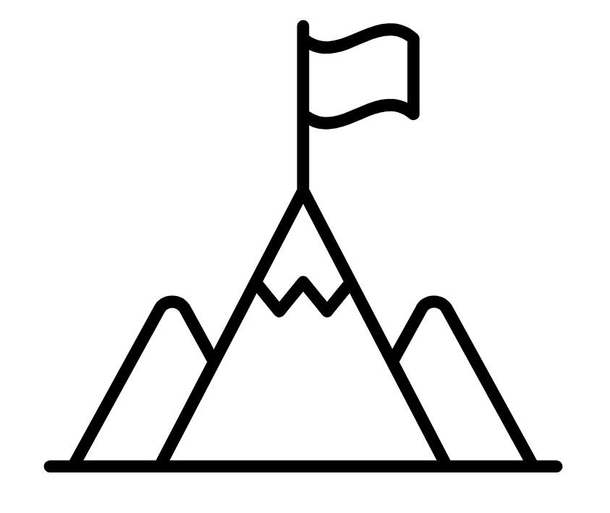
A
B

Slide 4

Simplifying Algebraic Fractions
Can you factorise…..?
$$6+9x$$
$$8x^{2}+6x$$
$$x^{2}+6x+8$$
$$x^{2}−4$$
$${2x}^{2}+17x+8$$

Slide 5
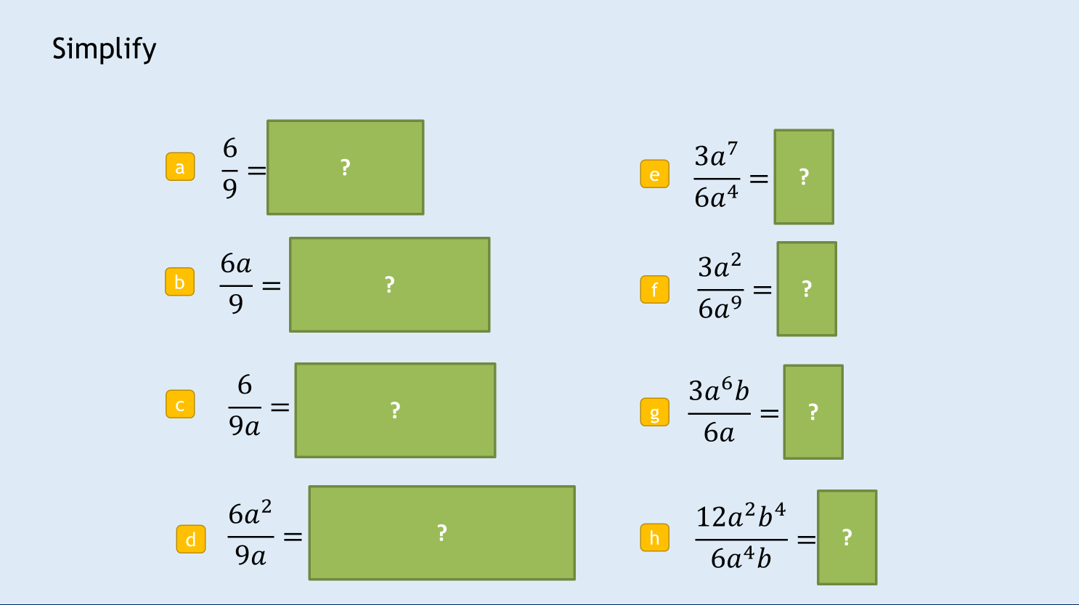
Simplifying Algebraic Fractions

Slide 6

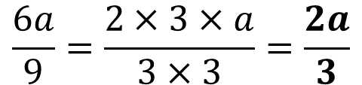
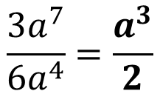

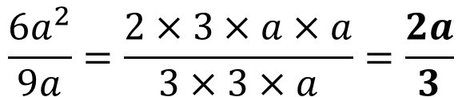

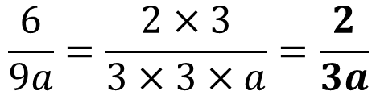
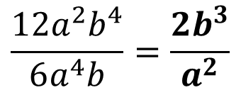
Simplify
?
?
$$\frac{6}{9}=\frac{2×3}{3×3}=\frac{2}{3}$$
$$\frac{3a^{7}}{6a^{4}}=\frac{a^{3}}{2}$$
a
e
?
?
$$\frac{6a}{9}=\frac{2×3×a}{3×3}=\frac{2a}{3}$$
$$\frac{3a^{2}}{6a^{9}}=\frac{1}{2a^{7}}$$
b
f
?
?
$$\frac{6}{9a}=\frac{2×3}{3×3×a}=\frac{2}{3a}$$
$$\frac{3a^{6}b}{6a}=\frac{a^{5}b}{2}$$
c
g
?
?
$$\frac{6a^{2}}{9a}=\frac{2×3×a×a}{3×3×a}=\frac{2a}{3}$$
$$\frac{12a^{2}b^{4}}{6a^{4}b}=\frac{{2b}^{3}}{a^{2}}$$
d
h
Notes:
Use quickfire questions (suitable for mini-whiteboards) to ensure students recall dividing with indices before progressing further. Click green boxes to reveal answers and next question.
Click green boxes to reveal answers and next question.

Slide 7










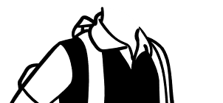





Have the students cancelled the fractions correctly?
(Click your answer)
Basma
Hannah
Nathan
$$\frac{y^{2}+x}{2+x}$$
$$\frac{s(4+z)}{s}$$
$$\frac{(a+2)}{5a}$$
Notes:
Use quickfire questions (suitable for mini-whiteboards) to ensure students understand when values can or cannot be cancelled, looks at elements outside of fractions.

Slide 8

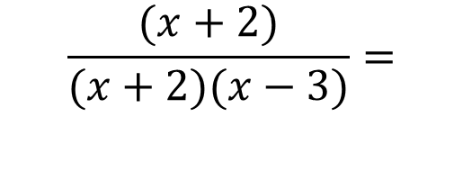
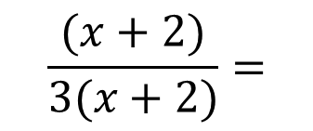
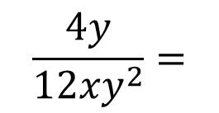
We could also start to simplify out more complex factors
$$\frac{4y}{12{xy}^{2}}=$$
$$\frac{(x+2)}{3(x+2)}=$$
$$\frac{(x+2)}{(x+2)(x−3)}=$$
Notes:
Introducing simplifying by cancelling out common factors. Starts numerically for familiarity.

Slide 9
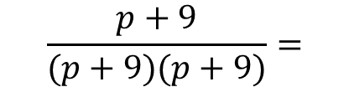


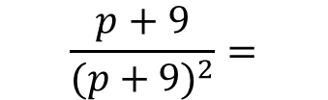




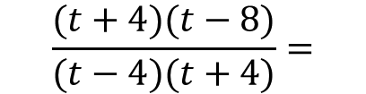
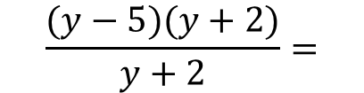

$$\frac{(y−5)(y+2)}{y+2}=$$
?
a
$$y−5$$
?
$$\frac{4(a+3)}{8(b+3)}=$$
$$\frac{a+3}{2(b+3)}$$
b
$$\frac{p+9}{{(p+9)}^{2}}=$$
?
?
c
$$\frac{p+9}{(p+9)(p+9)}=$$
$$\frac{1}{p+9}$$
?
$$\frac{x−1}{6}$$
$$\frac{x(x−1)}{6x}=$$
d
$$\frac{(t+4)(t−8)}{(t−4)(t+4)}=$$
?
$$\frac{t−8}{t−4}$$
e
Notes:
Use these examples to check students’ understanding of how to simplify with brackets
Click green boxes to reveal answers and next question.

Slide 10


Simplify $\frac{6y −9}{15}$
Simplify $\frac{24}{8p−4}$
Notes:
An example-problem pair which can be used as ‘I do/You do’ on mini-whiteboards. Click the reveal the example sequentially, then click the Test Your Understanding header to reveal the second example. Then click the green boxes to reveal the answer.

Slide 11


Simplify $\frac{10h+5}{4h+2}$
Simplify $\frac{3t+18}{7t+42}$
Notes:
An example-problem pair which can be used as ‘I do/You do’ on mini-whiteboards. Click the reveal the example sequentially, then click the Test Your Understanding header to reveal the second example. Then click the green boxes to reveal the answer.

Slide 12


Simplify $\frac{3ab+6b}{5a+10}$
Simplify $\frac{2g^{2}+4gh}{9g+18h}$
Notes:
An example-problem pair which can be used as ‘I do/You do’ on mini-whiteboards. Click the reveal the example sequentially, then click the Test Your Understanding header to reveal the second example. Then click the green boxes to reveal the answer.

Slide 13


Simplify $\frac{2x−4}{10−5x}$
Simplify $\frac{9p−6}{10−15p}$
Notes:
An example-problem pair which can be used as ‘I do/You do’ on mini-whiteboards. Click the reveal the example sequentially, then click the Test Your Understanding header to reveal the second example. Then click the green boxes to reveal the answer.

Slide 14
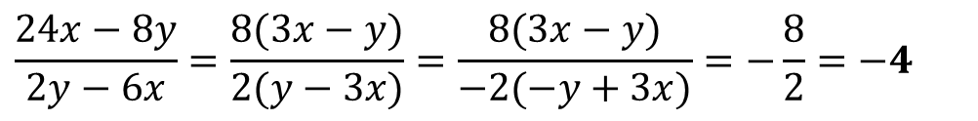
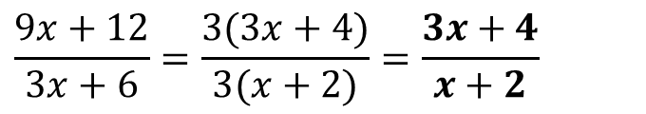
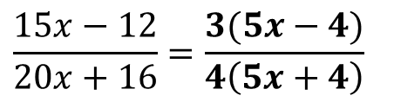

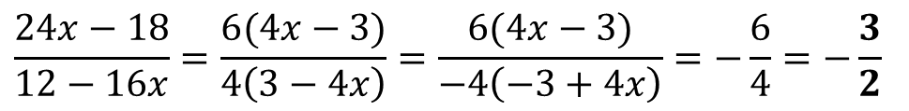
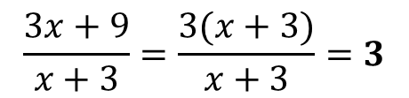
Simplify:
$$\frac{3x+9}{x+3}=\frac{3(x+3)}{x+3}=3$$
a
?
b
?
$$\frac{8x−4}{12}=\frac{4(2x−1)}{4×3}=\frac{2x−1}{3}$$
?
c
$$\frac{9x+12}{3x+6}=\frac{3(3x+4)}{3(x+2)}=\frac{3x+4}{x+2}$$
d
?
$$\frac{24x−18}{12−16x}=\frac{6(4x−3)}{4\left(3−4x\right)}=\frac{6(4x−3)}{−4\left(−3+4x\right)}=−\frac{6}{4}=−\frac{3}{2}$$
$$\frac{15x−12}{20x+16}=\frac{3(5x−4)}{4\left(5x+4\right)}$$
?
e
Does not simplify
?
$$\frac{24x−8y}{2y−6x}=\frac{8(3x−y)}{2(y−3x)}=\frac{8(3x−y)}{−2(−y+3x)}=−\frac{8}{2}=−4$$
e
Notes:
Use these examples to check students’ understanding of how to factorise and simplify
Click green boxes to reveal answers and next question.

Slide 15


Simplify $\frac{x^{2}+7x+10}{x+5}$
Simplify $\frac{x−3}{x^{2}+2x−15}$
Notes:
An example-problem pair which can be used as ‘I do/You do’ on mini-whiteboards. Click the reveal the example sequentially, then click the Test Your Understanding header to reveal the second example. Then click the green boxes to reveal the answer.

Slide 16


Simplify $\frac{x^{2}−5x+6}{5x−10}$
Simplify $\frac{2x+14}{x^{2}+12x+35}$
Notes:
An example-problem pair which can be used as ‘I do/You do’ on mini-whiteboards. Click the reveal the example sequentially, then click the Test Your Understanding header to reveal the second example. Then click the green boxes to reveal the answer.

Slide 17

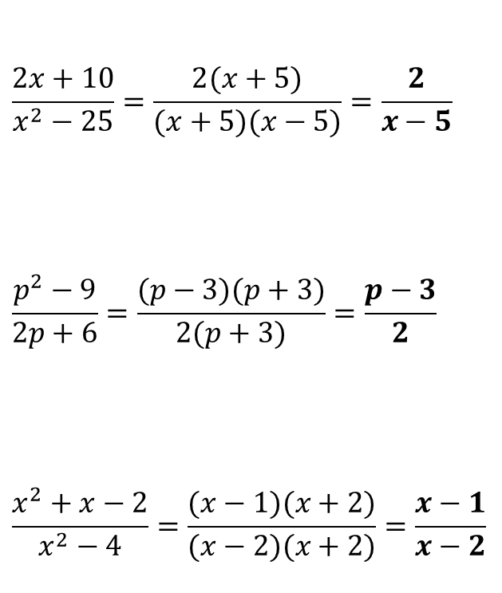


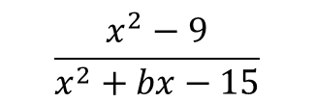

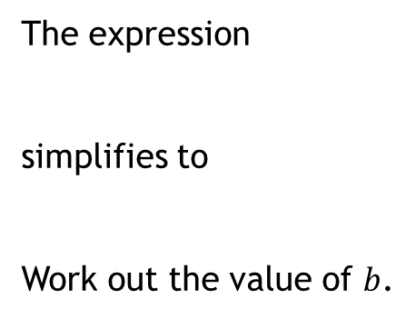



Simplify
N
[AQA GCSE June 2013 2H Q21]
$$\frac{2x+10}{x^{2}−25}=\frac{2(x+5)}{(x+5)(x−5)}=\frac{2}{x−5}$$
$$\frac{p^{2}−9}{2p+6}=\frac{(p−3)(p+3)}{2(p+3)}=\frac{p−3}{2}$$
$$\frac{x^{2}+x−2}{x^{2}−4}=\frac{(x−1)(x+2)}{(x−2)(x+2)}=\frac{x−1}{x−2}$$
The expression
simplifies to
Work out the value of $b$.
$$\frac{x^{2}−9}{x^{2}+bx−15}$$
a
?
$$\frac{x+3}{x+5}$$
b
?
?
$$x^{2}−9=(x+3)(x−3)$$
$\left(x−3\right)$ is the common factor
$$−15=−3×5$$
$$x^{2}+bx−15=(x−3)(x+5)$$
c
?
$$−3x+5x=2x$$
$$b=2$$

Slide 18
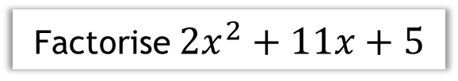
Factorise $2x^{2}+11x+5$
Notes:
Recap of factorising by splitting the middle term. Click to reveal each step of the method sequentially.

Slide 19
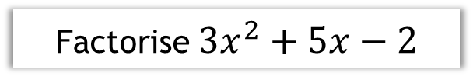
Factorise ${3x}^{2}+5x−2$
Notes:
Recap of factorising by inspection

Slide 20
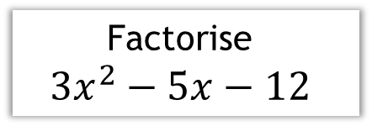

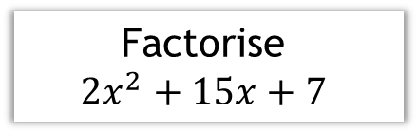


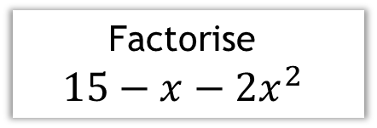

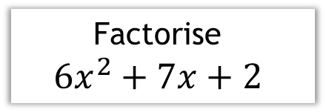
a
Factorise
$${2x}^{2}+15x+7$$
b
Factorise
$${3x}^{2}−5x−12$$
?
?
$$(2x+1)(x+7)$$
$$(x−3)(3x+4)$$
c
Factorise
$${6x}^{2}+7x+2$$
d
Factorise
$${15−x−2x}^{2}$$
?
?
$$(3x+2)(2x+1)$$
$$(5−2x)(x+3)$$
Notes:
Use these questions (suitable for mini-whiteboards) to give students opportunity to factorise quadratics where a>1 using their preferred method. Click green boxes to reveal answers and next question.

Slide 21
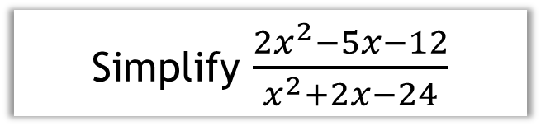
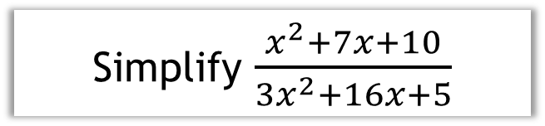
Simplify $\frac{{2x}^{2}−5x−12}{x^{2}+2x−24}$
Simplify $\frac{x^{2}+7x+10}{{3x}^{2}+16x+5}$
Notes:
An example-problem pair which can be used as ‘I do/You do’ on mini-whiteboards. Click the reveal the example sequentially. Then click the green boxes to reveal the answer.
Factorisation of the quadratic can also be done by splitting the middle term if preferred.

Slide 22
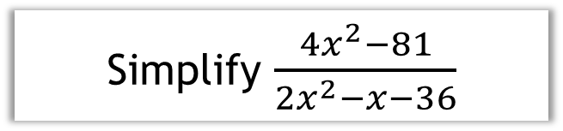
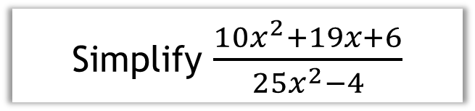
Simplify $\frac{{4x}^{2}−81}{2x^{2}−x−36}$
Simplify $\frac{{10x}^{2}+19x+6}{{25x}^{2}−4}$
Notes:
An example-problem pair which can be used as ‘I do/You do’ on mini-whiteboards. Click the reveal the example sequentially. Then click the green boxes to reveal the answer.
Factorisation of the quadratic can also be done by splitting the middle term if preferred.

Slide 23
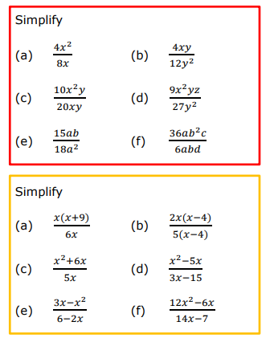
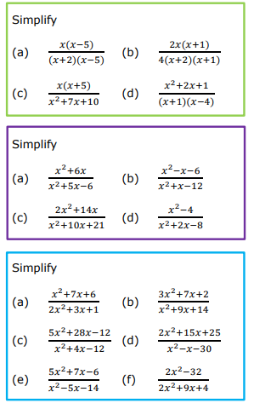

Slide 24
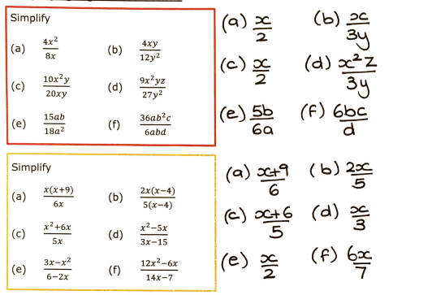
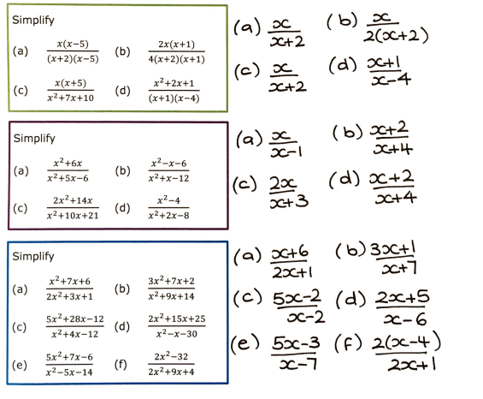

Slide 25
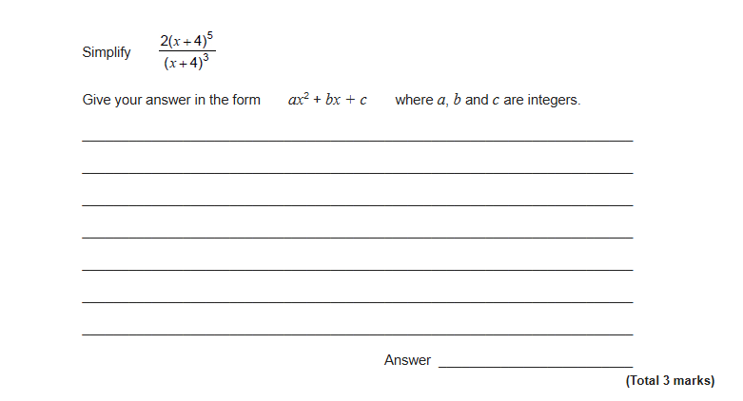
Exam Question 1

Slide 26
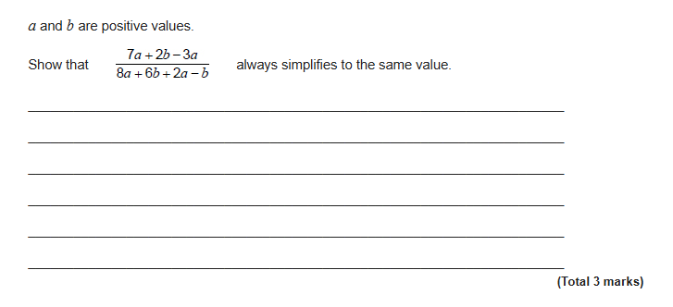
Exam Question 2

Slide 27
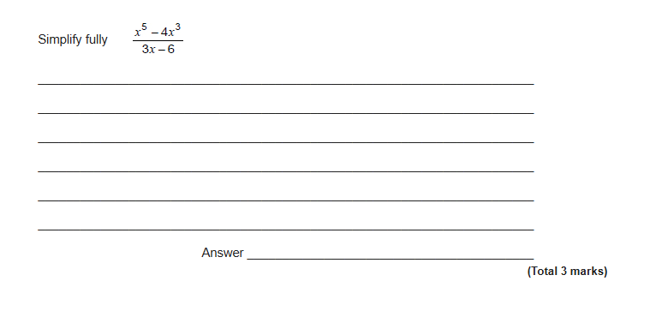
Exam Question 3

Slide 28
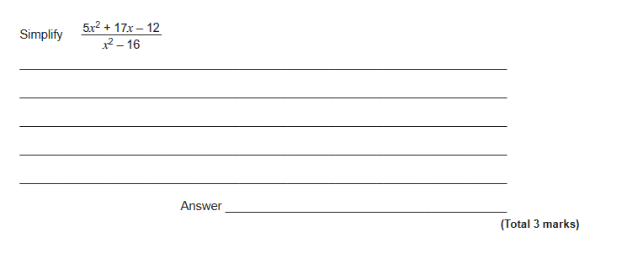
Exam Question 4

