Slide 1
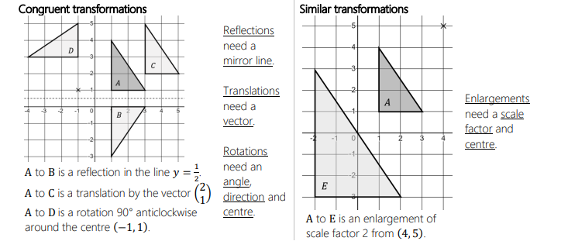

ARCHWAYMATHS
YEAR 11 HIGHER: Transforming Shapes
NAME:
TEACHER:

Slide 2

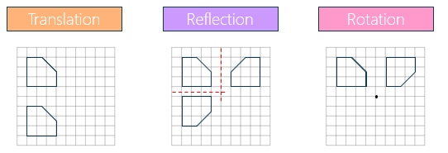
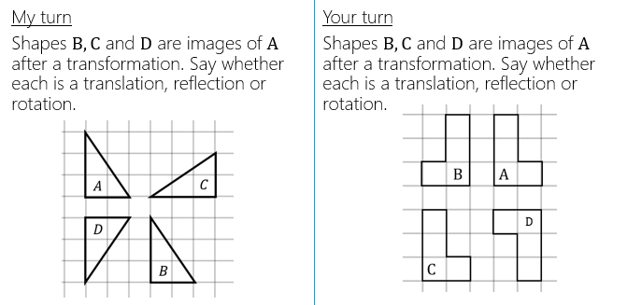
Transformations
When we transform a shape, we change something about it.
There are three congruent transformations we can do to shapes.
________________________________
________________________________
________________________________

Slide 3
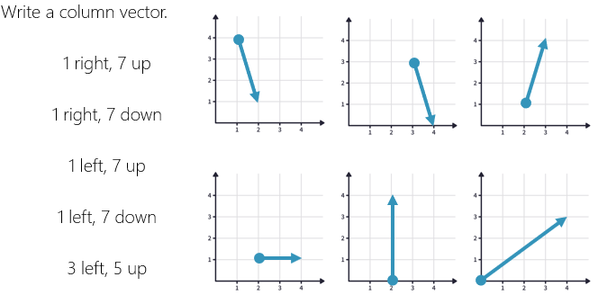
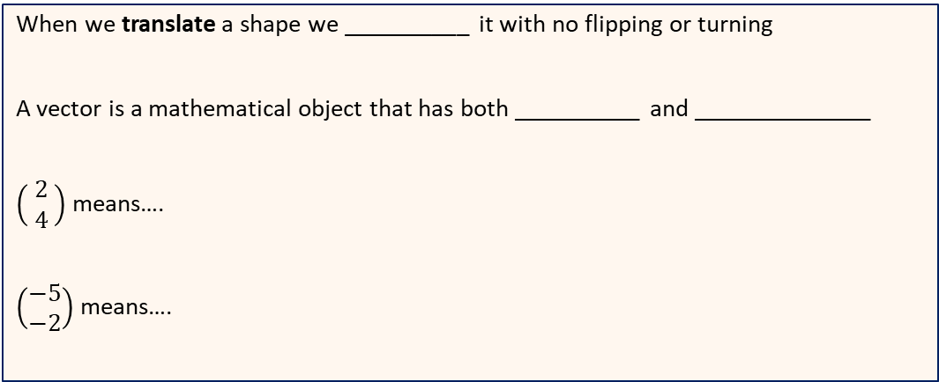
Translation
When we translate a shape we __________ it with no flipping or turning
A vector is a mathematical object that has both __________ and ______________
$\left(\begin{matrix} 2 \\ 4 \end{matrix}\right)$means….
$\left(\begin{matrix}−5 \\ −2\end{matrix}\right)$means….

Slide 4
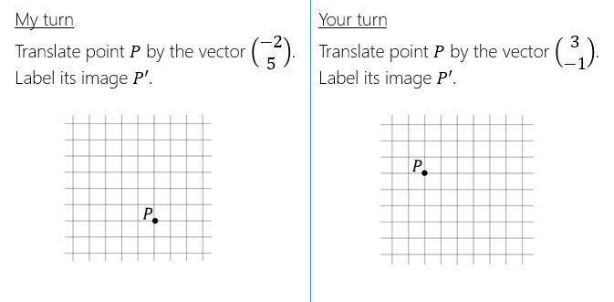
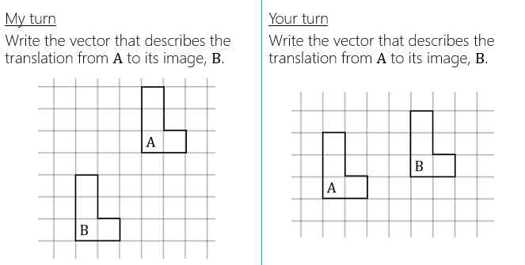
Translation

Slide 5
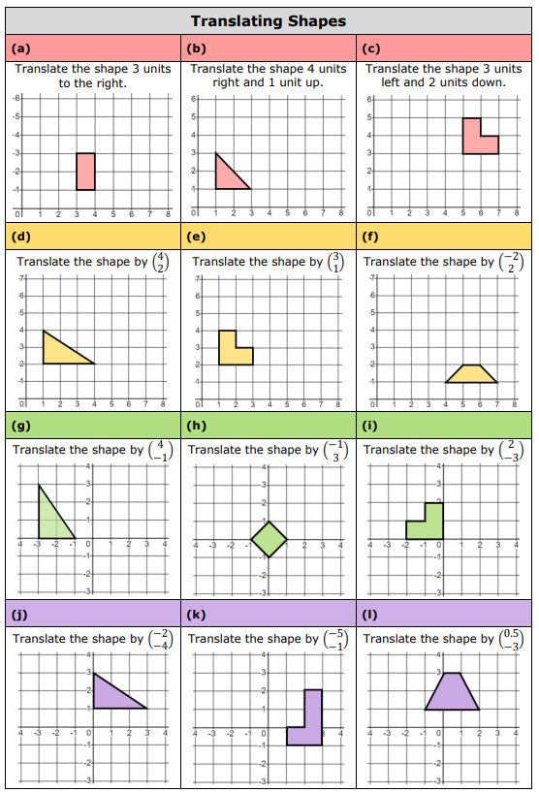

Slide 6
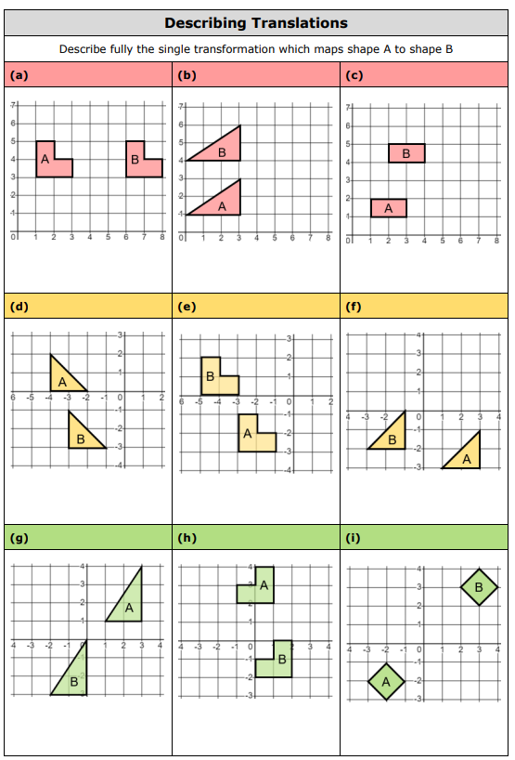

Slide 7
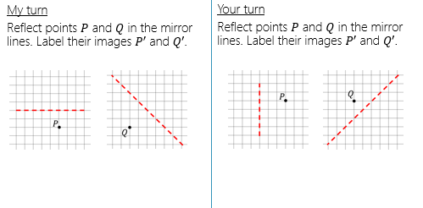
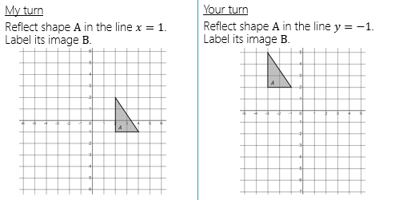
Reflecting Shapes
Reflection can be pictured as ‘flipping’ a shape over a mirror line.
To reflect a shape we need to know where the _____________________ is.

Slide 8
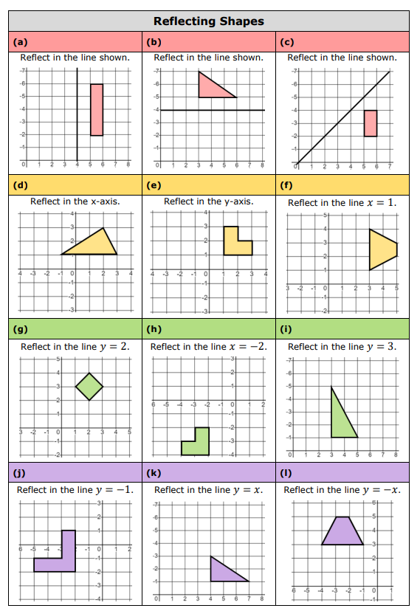

Slide 9
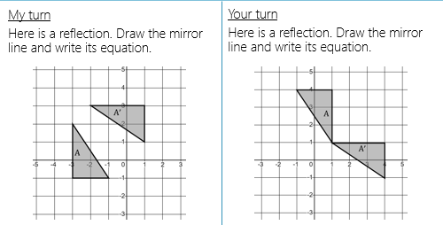
Reflecting Shapes
To describe a reflection we need to be able to state the ______________ of the mirror line .

Slide 10
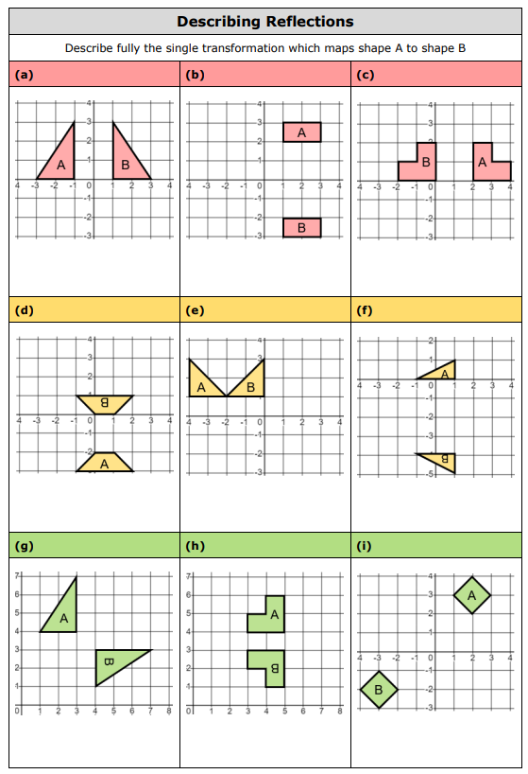

Slide 11
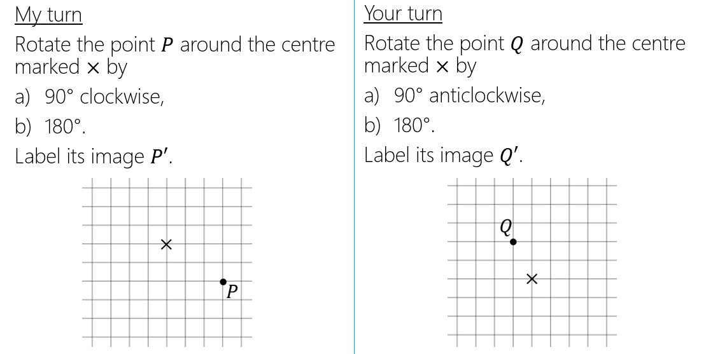
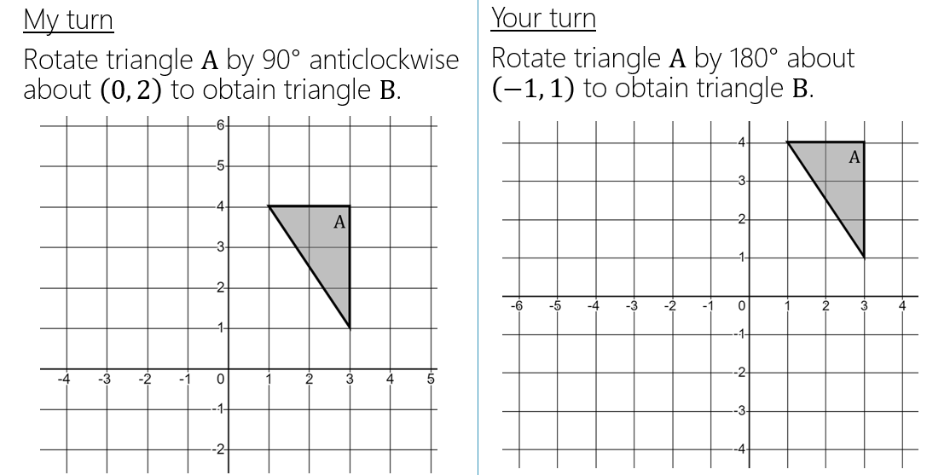
11
Rotation
Rotation can be pictured as moving in a circle around a fixed point
To rotate a shape we require the following information:
________________________________
________________________________
________________________________

Slide 12
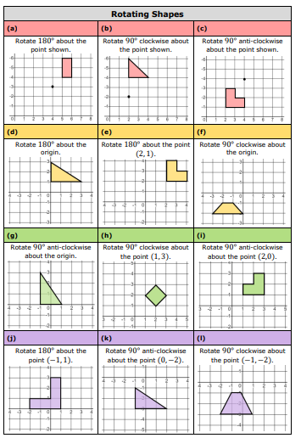
12

Slide 13
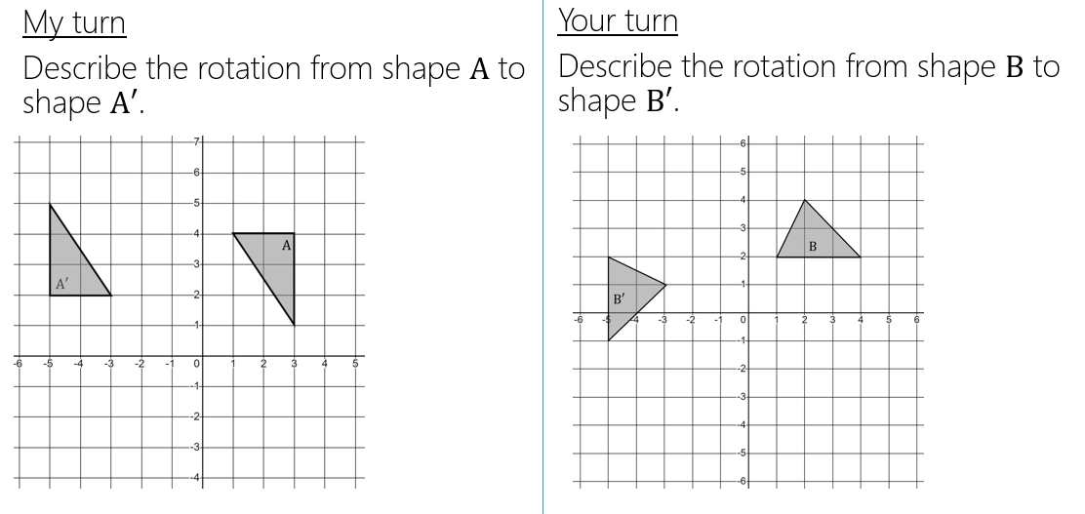
Rotation
To find the centre of rotation you can use tracing paper or construct perpendicular bisectors.

Slide 14
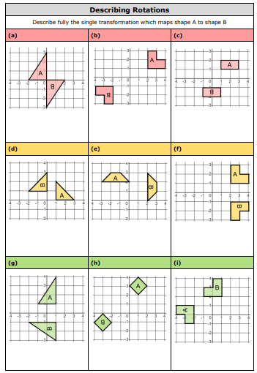

Slide 15
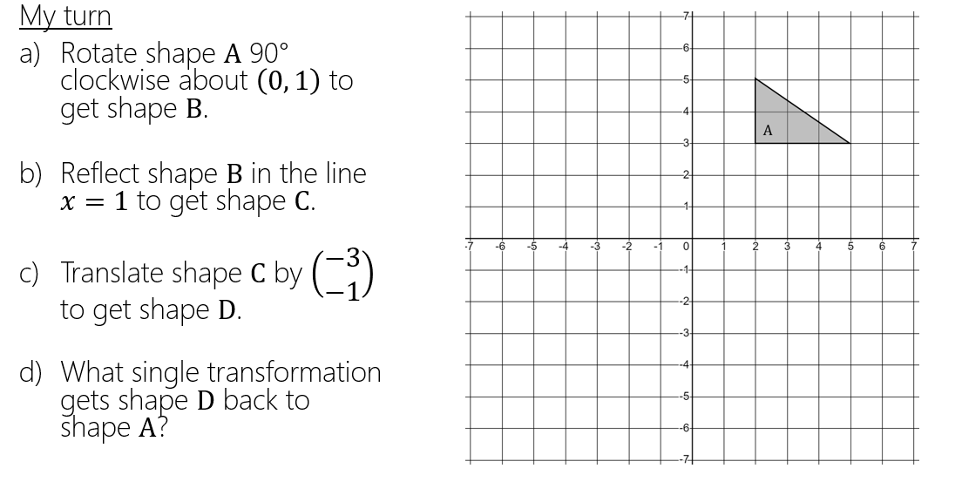
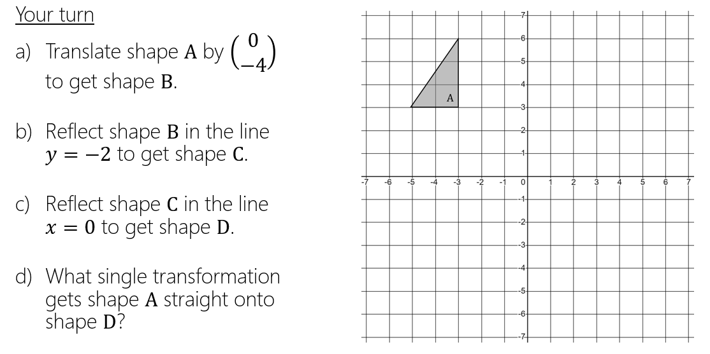
15
Mixed Congruent Transformations
When we transform a shape, we change something about it.
There are three congruent transformations we can do to shapes.
________________________________
________________________________
________________________________

Slide 16
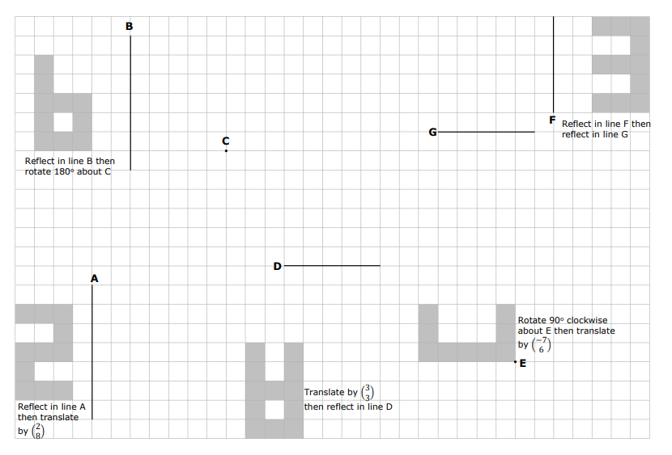

Slide 17
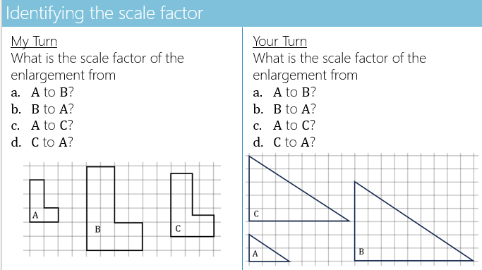
Enlargement
Enlargement is a type of transformation.
It is not a congruent transformation like translation, reflection and rotation.
It is a similar transformation, since object and image are similar.
To enlarge a shape we need:
_______________________________________
_______________________________________

Slide 18




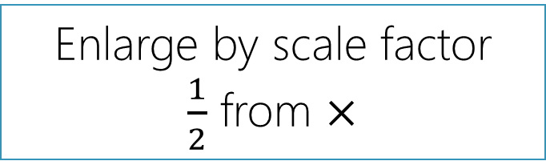
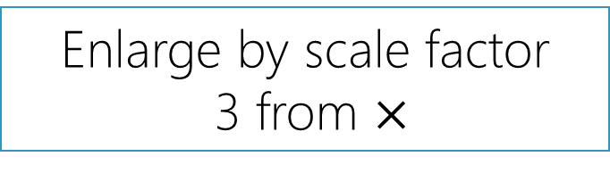

Centres of enlargement
Moving the centre of enlargement will change the position of the image.
Enlarge by scale factor
3 from $×$
Enlarge by scale factor
$\frac{1}{2}$ from $×$
$$×$$
$$×$$
$$A$$
$$B$$
18

Slide 19
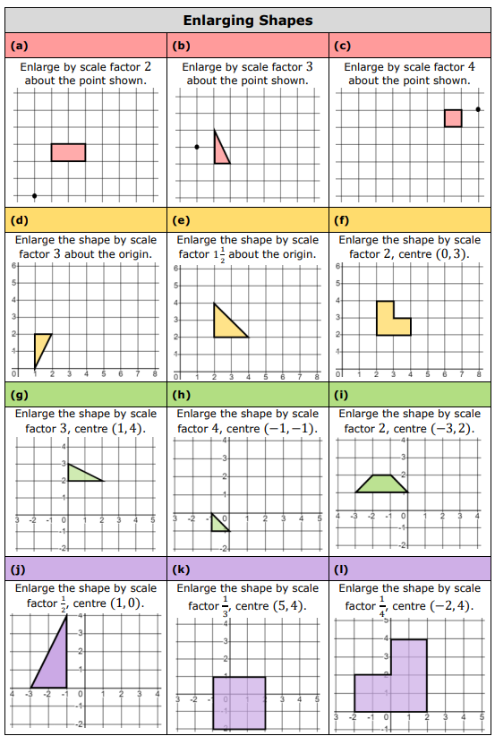
19

Slide 20
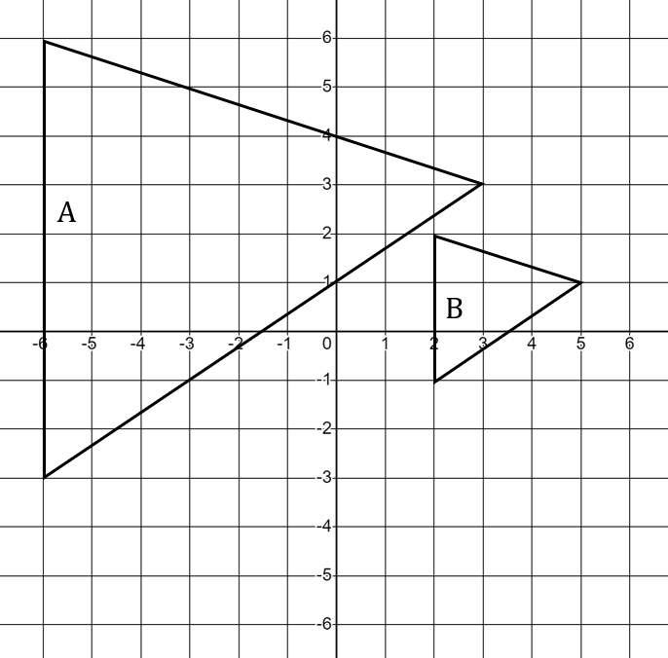
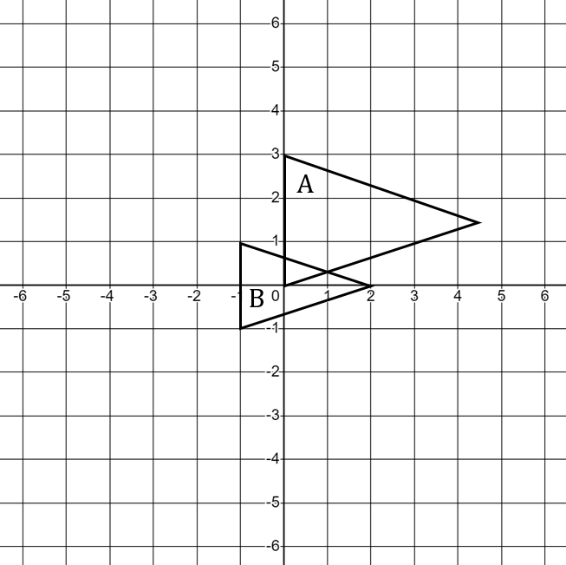
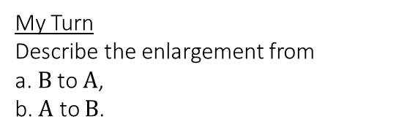
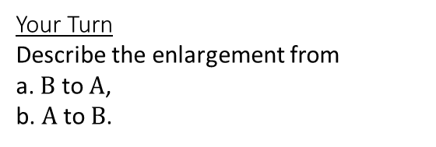
Describing an enlargement
My Turn
Describe the enlargement from
a. $B$ to $A$,
b. $A$ to $B$.
Your Turn
Describe the enlargement from
a. $B$ to $A$,
b. $A$ to $B$.

Slide 21
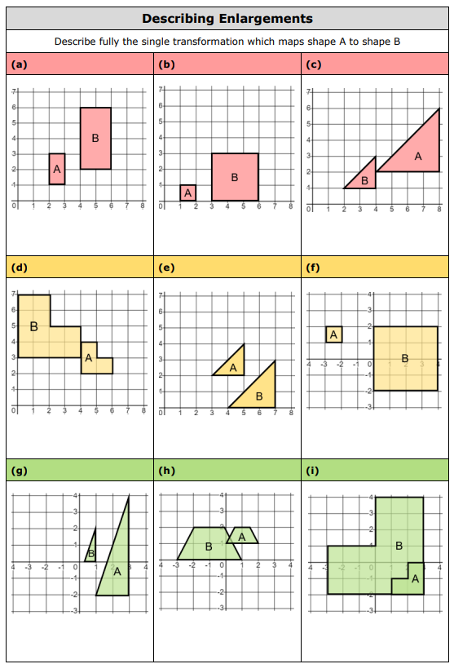

Slide 22
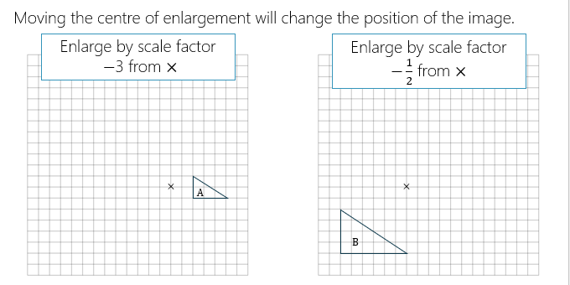
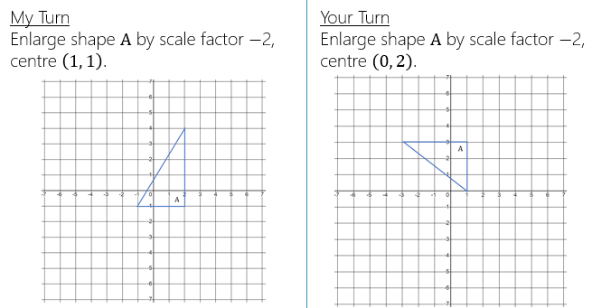
Negative Enlargement

Slide 23
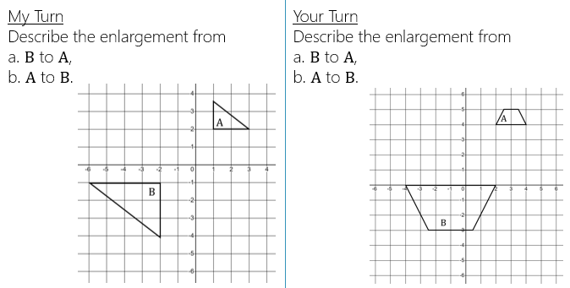
Negative Enlargement

Slide 24
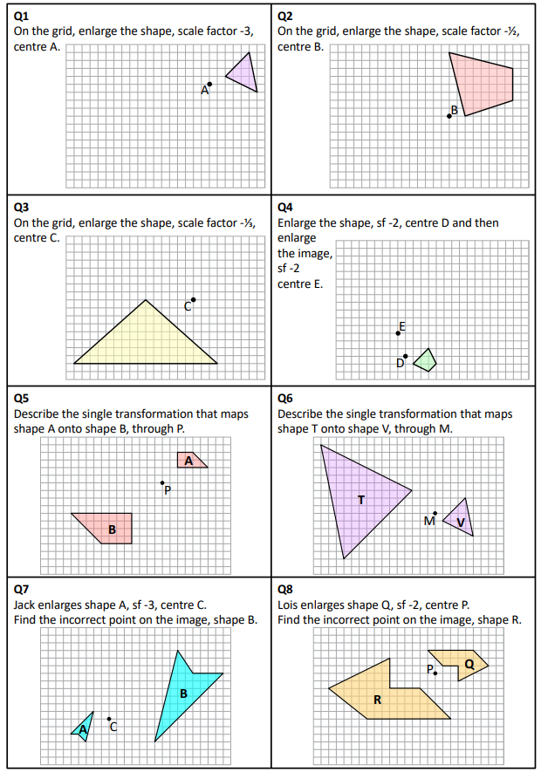

Slide 25
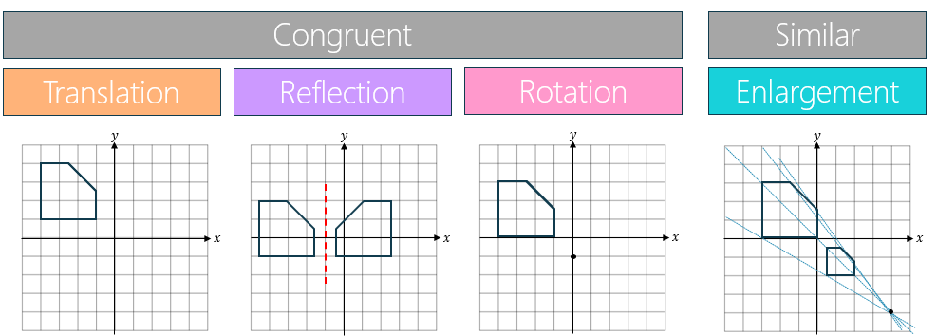
Combining Transformations
Transformations can be combined
Translations are described by ______________________________________________
Reflections are described by _______________________________________________
Rotations are described by _______________________________________________
Enlargements are described by _____________________________________________

Slide 26
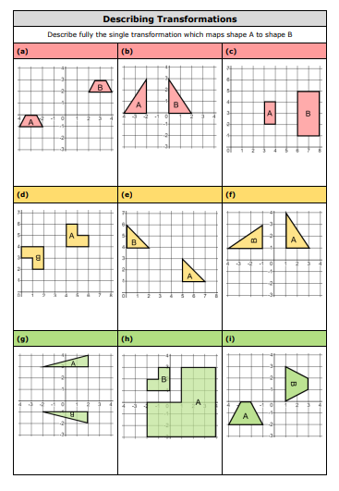
Notes:
Recap

Slide 27
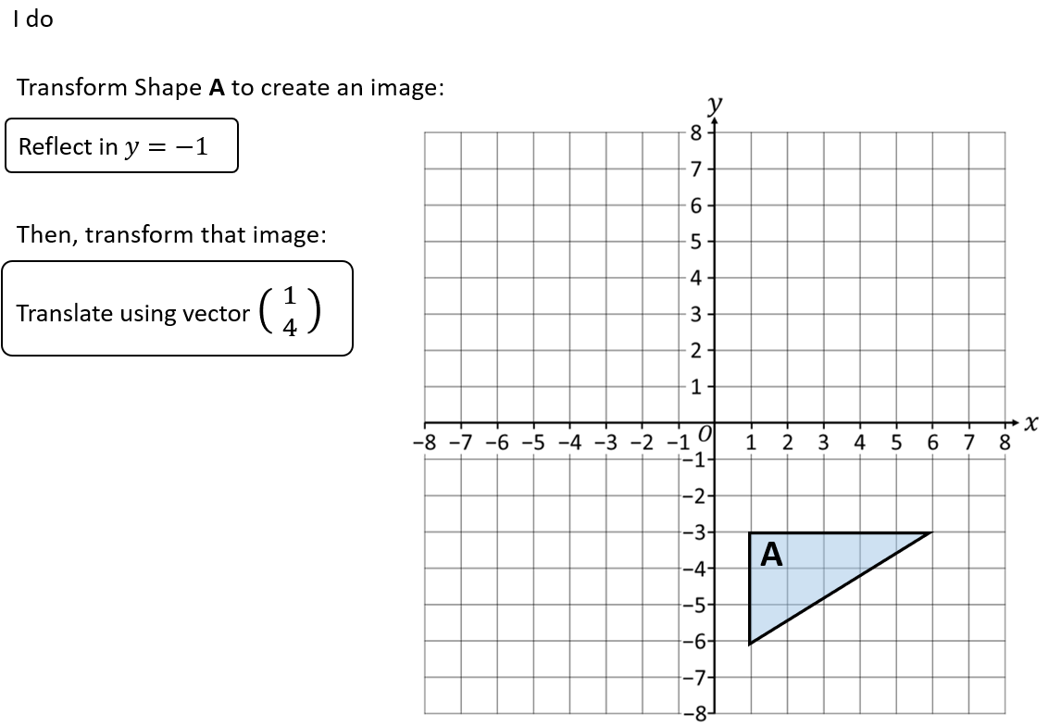
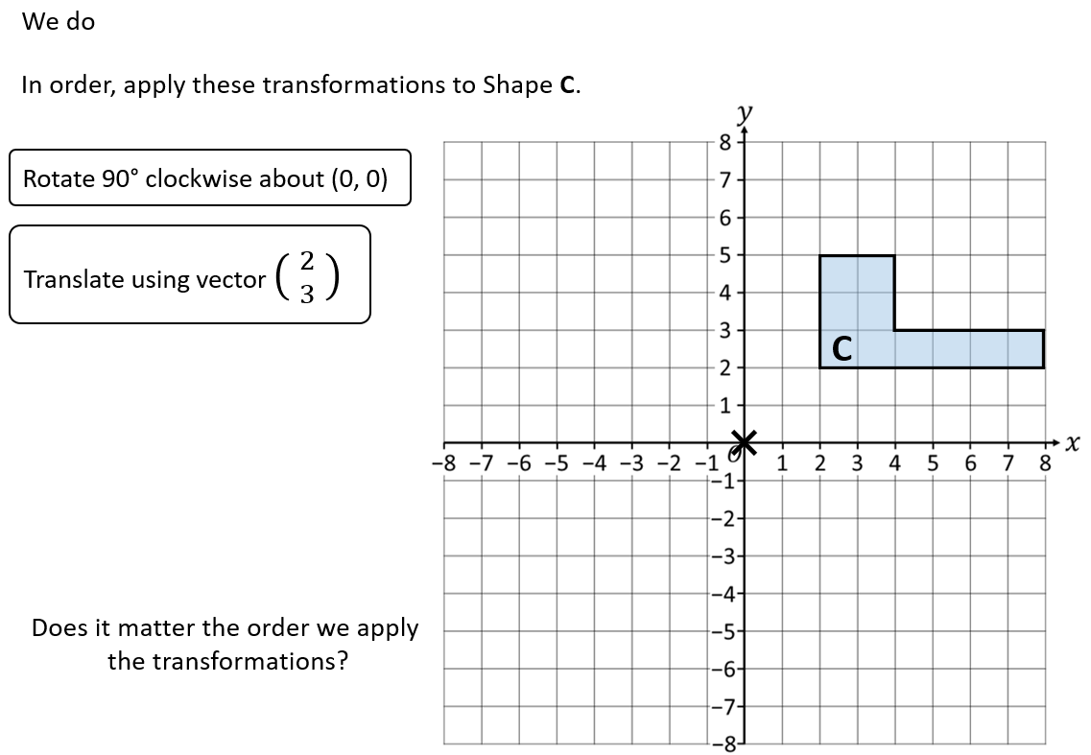
27
Combining Transformations

Slide 28
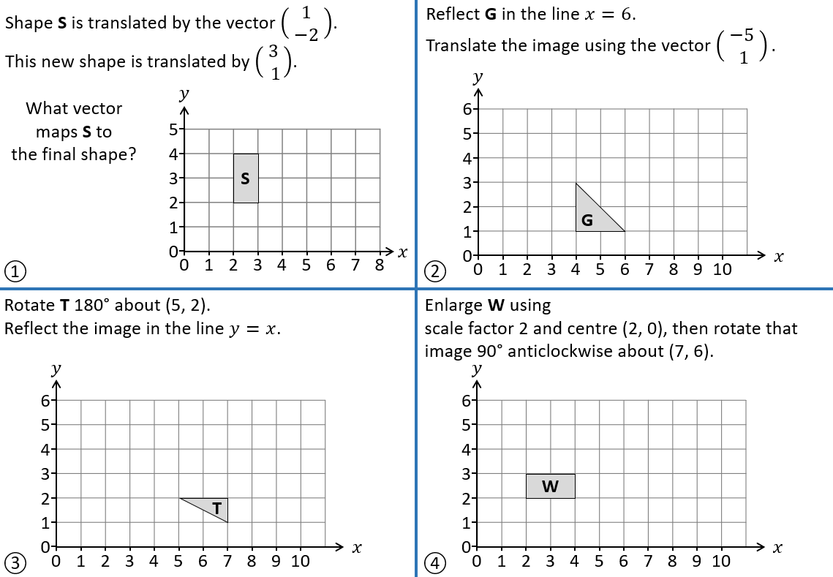
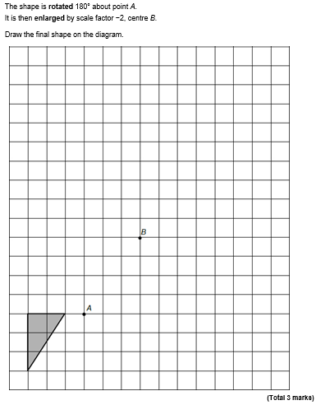
EXAM QUESTION
Notes:
Recap

Slide 29
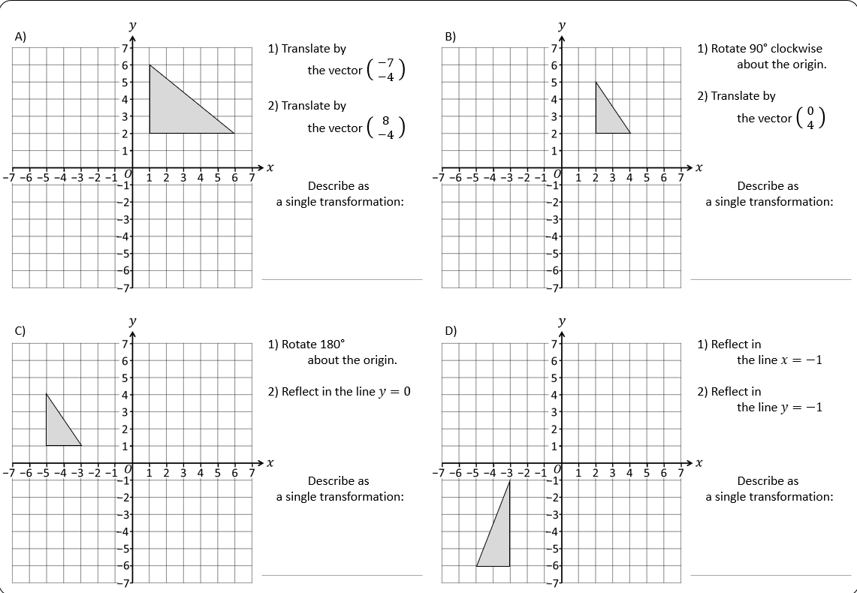
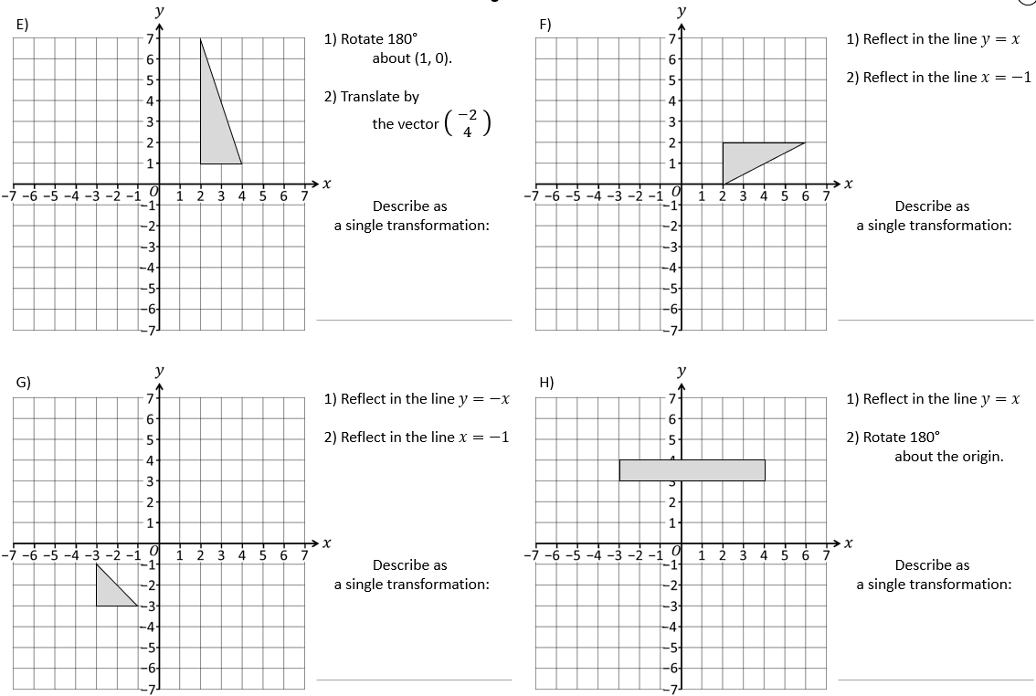
Notes:
Recap

Slide 30
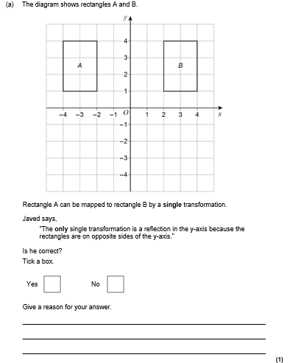

Slide 31
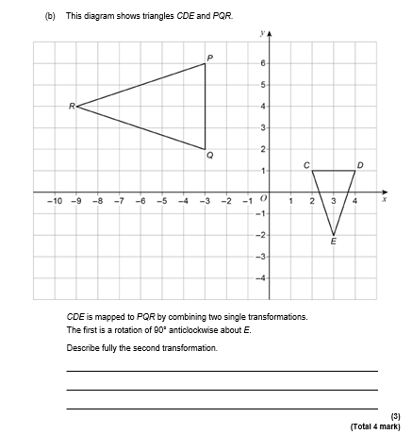

Slide 32
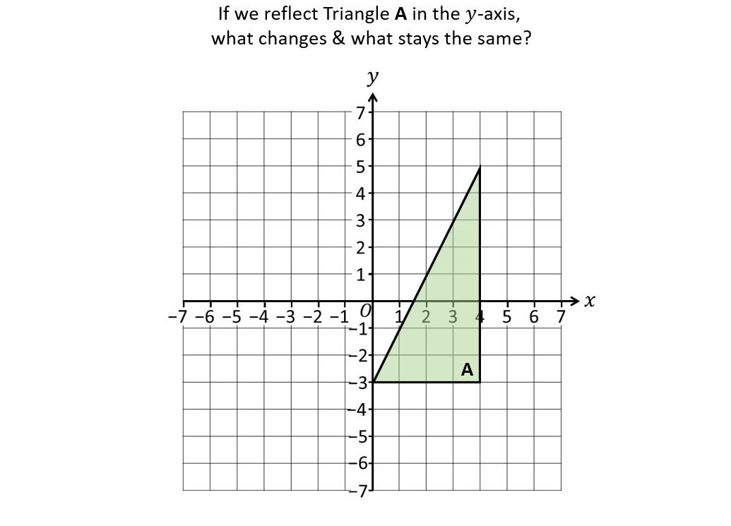
Invariant Points
What are invariant points?

Slide 33
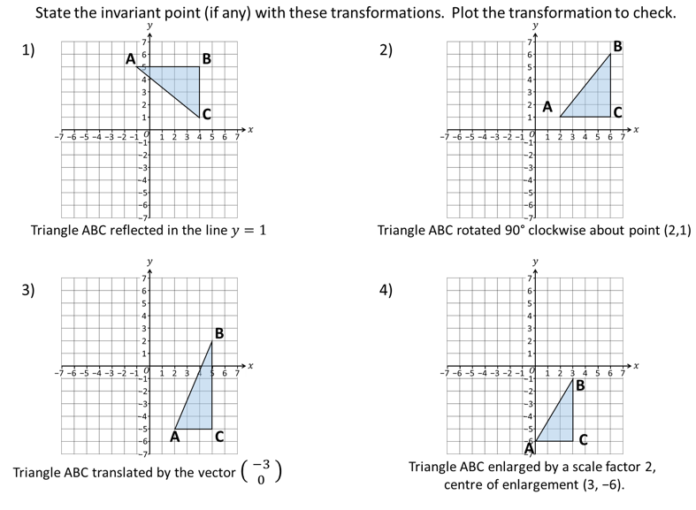
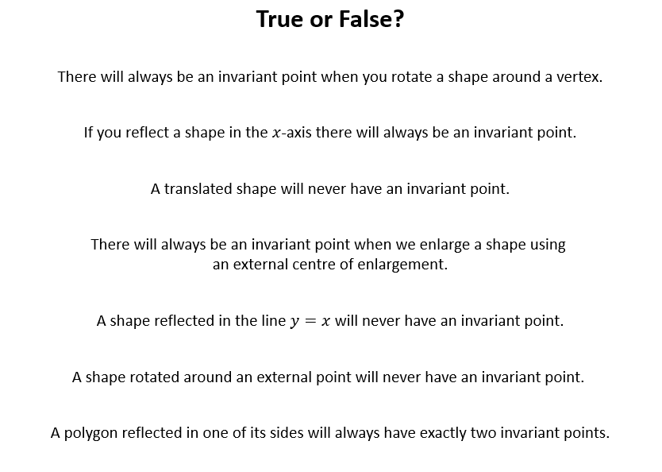
Invariant Points

Slide 34
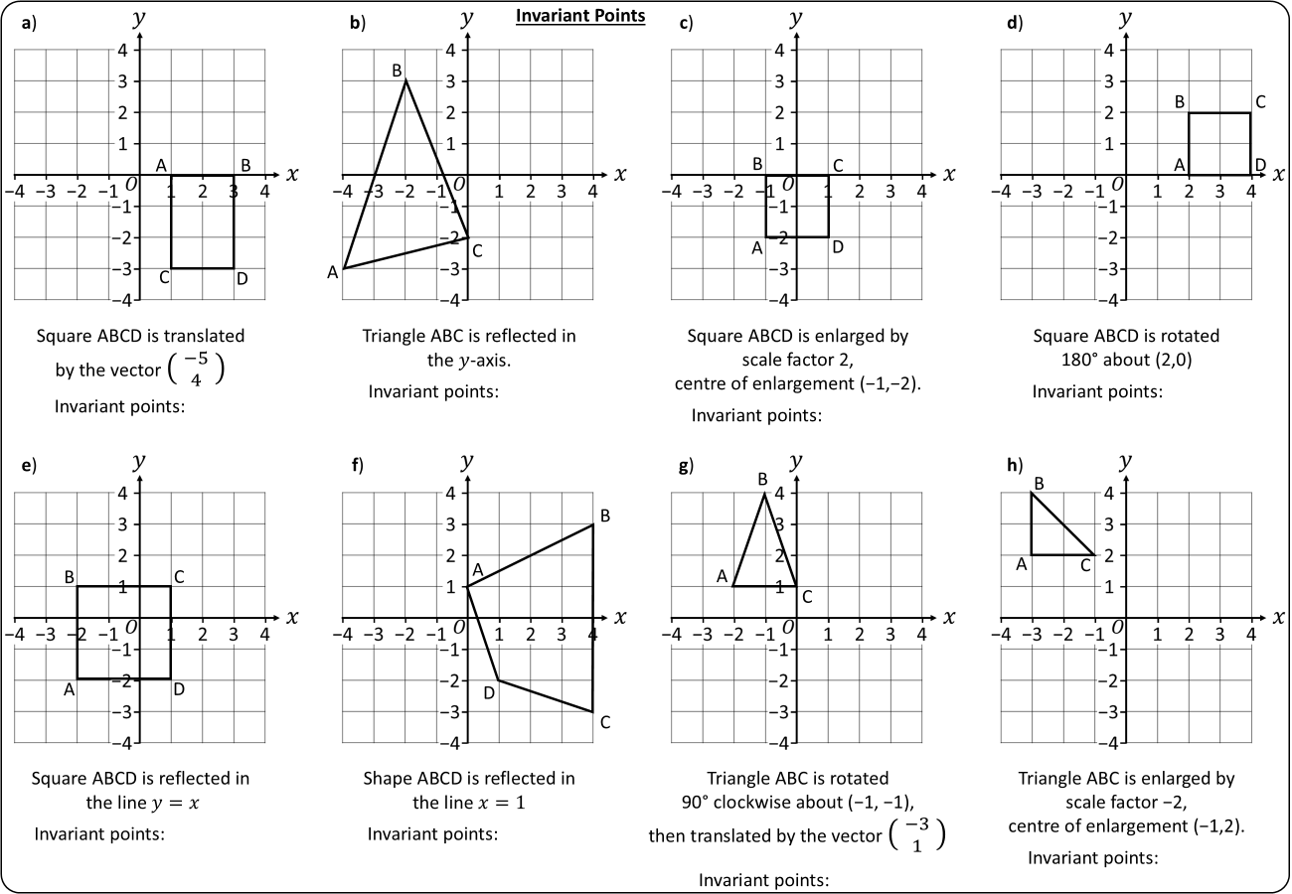

EXAM QUESTION
Notes:
Recap

