Slide 1















Dual coding symbols:
Practise
Explain
Organise
Big Question
Reflect
Present
Compare
Evaluate
Activate
Discuss
Predict
Connect
Summarise
Recall
Vocabulary

Slide 2








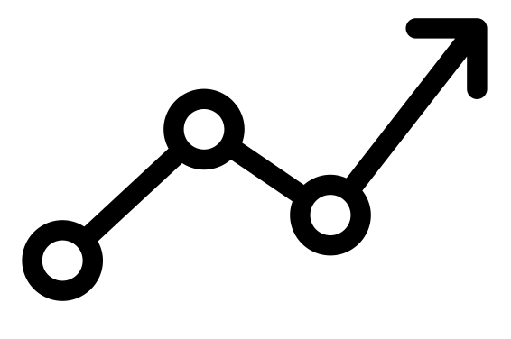

Editable reading ruler
Every child in an Archway school will become a fluent reader
 | RETRIEVE the words or phrases you need from the text | DECODE the words or phrase to address a breakdown | CONNECT with words or phrases you know from the text or your memory | VISUALISE the images in as much detail as possible | SUMMARISE the main ideas of the text in a few words | INFER meanings that might be within the text | PREDICT what might happen next using details from the text | EXAMINE how the writer uses words to construct meaning
 | ASK THOUGHTFUL QUESTIONS TO HELP YOU UNDERSTAND THE TEXT

Slide 3





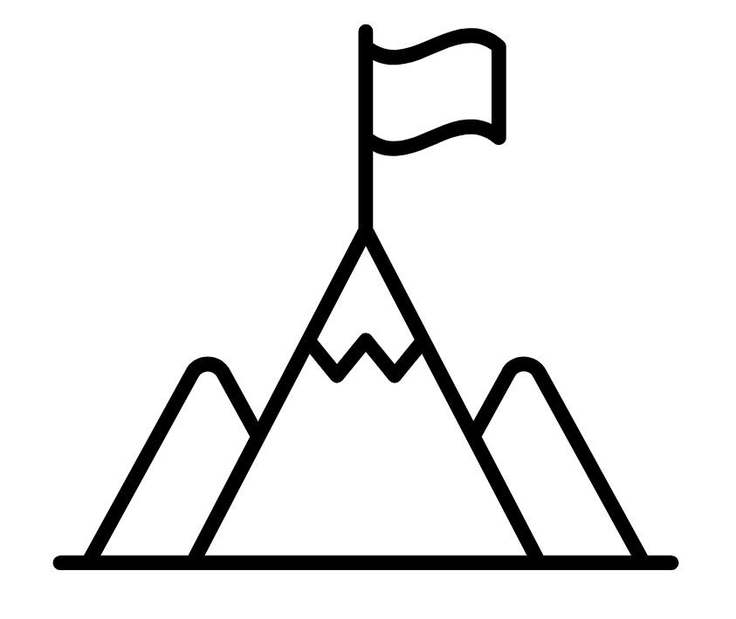
A
B

Slide 5
LESSON TITLE:

Slide 7
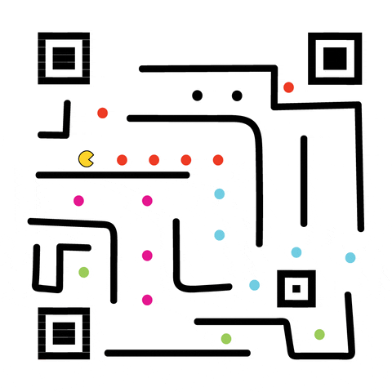
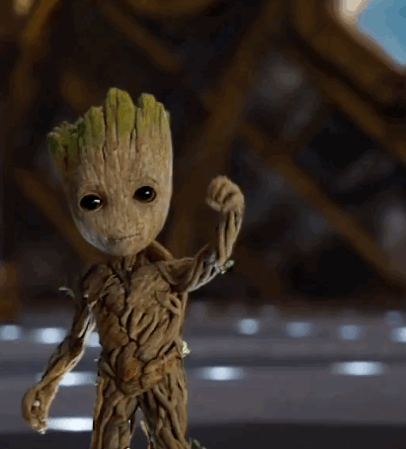
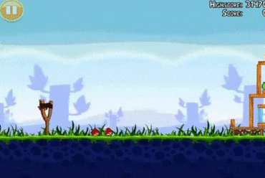
Transformations
In this unit we will learn about mathematical transformations.
These are used in game design and movie CGI to programme the movement of objects or characters.
Notes:
Explain that any computer-generated movement happens because the programmers use the mathematics they’re about to learn about. It underpins all the software that game designers or animators use.
From OAT resources
Pacman GIF from @samomo on giphy.com: https://giphy.com/gifs/qr-code-art-CODteyJZwSNEZI0pYO
Angry Birds GIF from Alinotka on giphy.com: https://giphy.com/gifs/angry-birds-12OUZridgOdMOI
Groot GIF from Guardians of the Galaxy Trailer on Youtube, found on giphy.com: https://giphy.com/gifs/marvel-guardians-of-the-galaxy-2-3o7budMRwZvNGJ3pyE

Slide 8

Congruent transformations
A transformation is a mathematical change.
When we transform a shape, we change something about it.
There are three congruent transformations we can do to shapes.
Translation
Reflection
Rotation
What do you notice about each transformation?
Notes:
This is the opportunity to explore the three transformations and how to recognise them. At this point, we’re not interested in the details (vectors/centre of rotation, equation of mirror line), just what the image looks like after each transformation and how to spot them.
A great way to explain the three is to get pupils moving a shape on desk: translate means no twisting/turning, only shifting L/R and U/D.
Use a set of mini mirrors to see reflections. If you don’t have them, talk about flipping the shape over to face the other way.
For rotations, we just turn the shape as it stays on the the desk.
Don’t rush this – we want pupils to be able to see all three.
You could then check for understanding by asking them to perform each transformation on their shape and watch what they do.

Slide 9

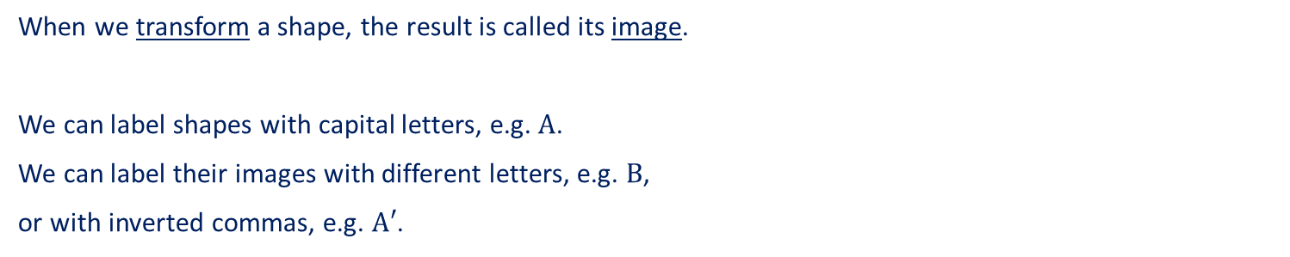





Congruent transformations
When we transform a shape, the result is called its image.
We can label shapes with capital letters, e.g. $A$.
We can label their images with different letters, e.g. $B$,
or with inverted commas, e.g. $A′$.
Translation
Reflection
Rotation
$$A$$
$$A$$
$$A′$$
$$A$$
$$A′$$
image
image
$$B$$
image
Notes:
This is the opportunity to explore the three transformations and how to recognise them. At this point, we’re not interested in the details (vectors/centre of rotation, equation of mirror line), just what the image looks like after each transformation and how to spot them.
A great way to explain the three is to get pupils moving a shape on desk: translate means no twisting/turning, only shifting L/R and U/D.
Use a set of mini mirrors to see reflections. If you don’t have them, talk about flipping the shape over to face the other way.
For rotations, we just turn the shape as it stays on the the desk.
Don’t rush this – we want pupils to be able to see all three.
You could then check for understanding by asking them to perform each transformation on their shape and watch what they do.

Slide 10
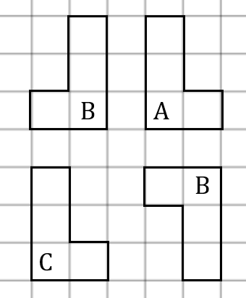
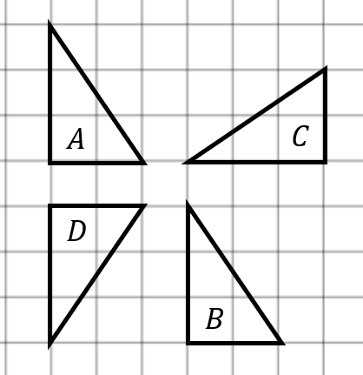



Congruent transformations
Page 2
My turn
Shapes $B, C$ and $D$ are images of $A$ after a transformation. Say whether each is a translation, reflection or rotation.
Your turn
Shapes $B, C$ and $D$ are images of $A$ after a transformation. Say whether each is a translation, reflection or rotation.
$$D$$
Notes:
At this point, use tracing paper wherever you can!
Talk through your thought process so pupils can emulate it.

Slide 11


Translation (Page 3)
We can describe a transformation by giving clear instructions for it.
Translation involves shifting a shape left/right and up/down, with no turning or flipping.
Translation involves moving a shape
$$A$$
5 right
$$B$$
3 down

Slide 12
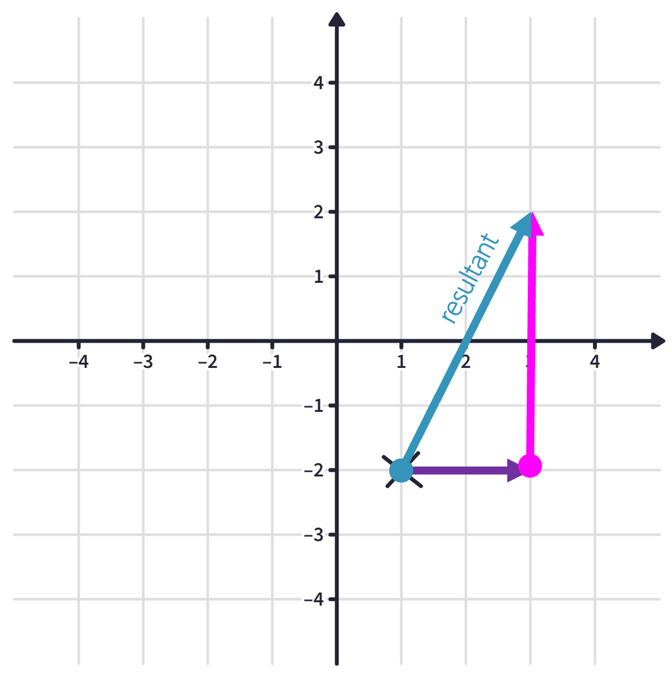

Vector notation
$$\left(\begin{matrix}2 \\ 4\end{matrix}\right)$$
Movement horizontally:
2 right
Movement vertically:
4 up
Notes:
Point out the notation – no fraction bar, in a column, brackets.

Slide 13
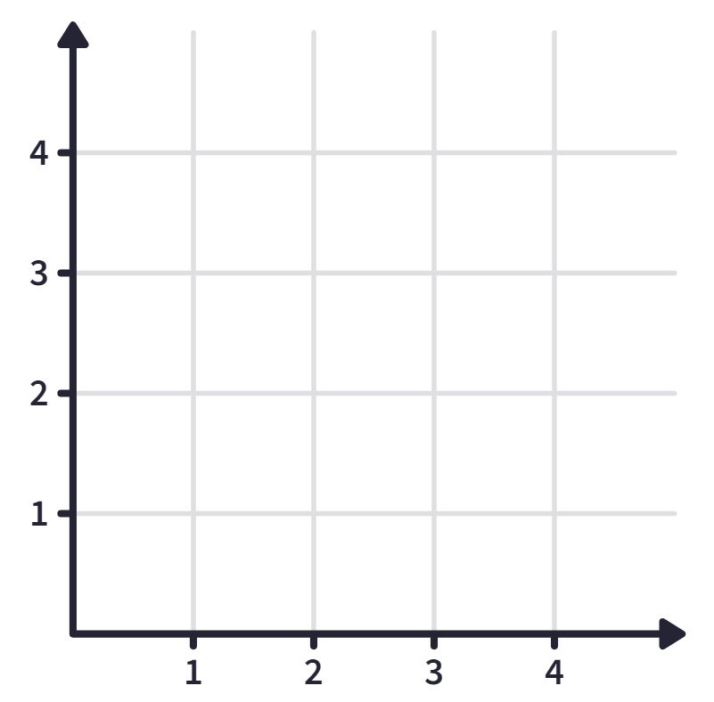
Quick fire!
Write as a column vector (Page 3)
Notes:
Pupils could answer these on mini whiteboards to allow you to check they are using column vectors correctly.

Slide 14
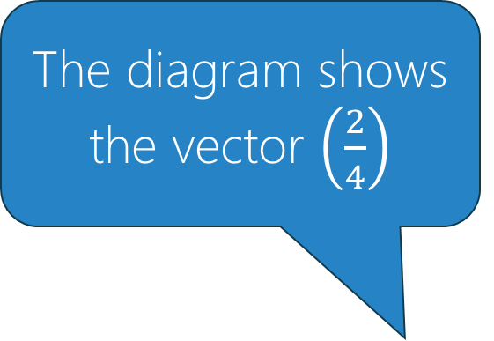
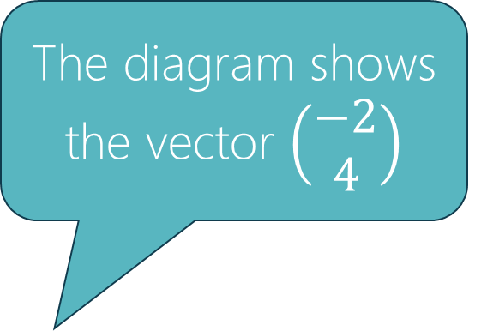
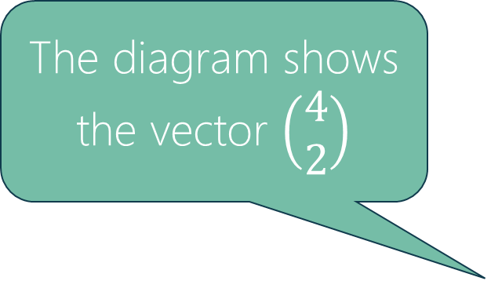
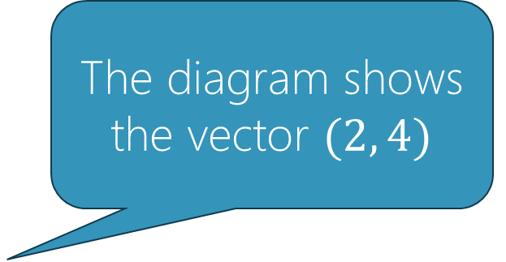
Each of these statements is incorrect. Can you explain why?
The diagram shows the vector $(2, 4)$
The diagram shows the vector $\left(\begin{matrix}4 \\ 2\end{matrix}\right)$
The diagram shows the vector $\left(\begin{matrix}−2 \\ 4\end{matrix}\right)$
The diagram shows the vector $\left(\frac{2}{4}\right)$
Notes:
Here we are addressing common mistakes with vectors:
Writing as coordinates – these describe a position rather than a movement
Writing $y$ before $x$
Errors over whether it is a positive or negative movement – this tends to be more common with the $x$ axis, remind pupils about movement along numberlines and which direction would be positive/negative
Including a vinculum – this can be more of a habit than a misconception, but needs attention drawn to it nonetheless

Slide 15

Vector
Now we know that a vector is a mathematical object that has both direction and magnitude.
(And the software used to make this movie uses vectors to make the characters move).
Notes:
If the embedded video doesn’t work, go to https://youtu.be/A05n32Bl0aY

Slide 16
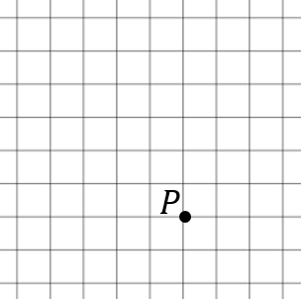
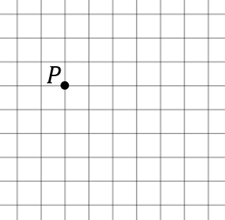


Translation (Page 4)
My turn
Translate point $P$ by the vector $\left(\begin{matrix}−2 \\ 5\end{matrix}\right)$. Label its image $P′$.
Your turn
Translate point $P$ by the vector $\left(\begin{matrix}3 \\ −1\end{matrix}\right)$. Label its image $P′$.
Notes:
At this point, use tracing paper wherever you can!
Talk through your thought process so pupils can emulate it.

Slide 17
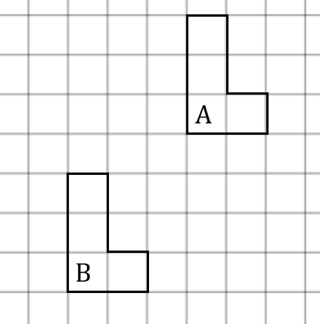
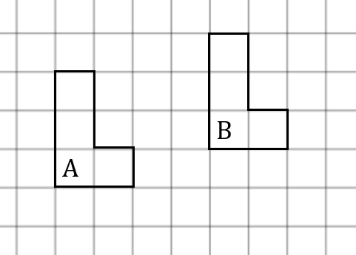


Translation (Page 4)
My turn
Write the vector that describes the translation from $A$ to its image, $B$.
Your turn
Write the vector that describes the translation from $A$ to its image, $B$.
Notes:
At this point, use tracing paper wherever you can!
Talk through your thought process so pupils can emulate it.

Slide 18
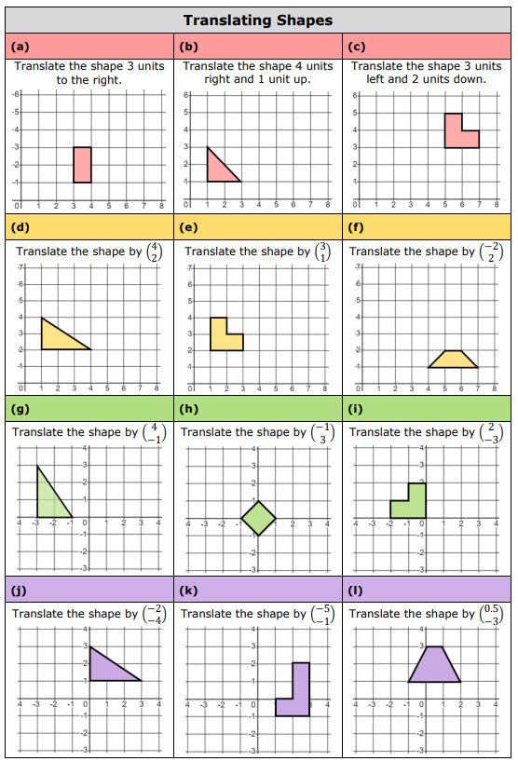
Translating Shapes (Page 5)
Notes:
Q9 Amanda Austin draustinmaths.com

Slide 19
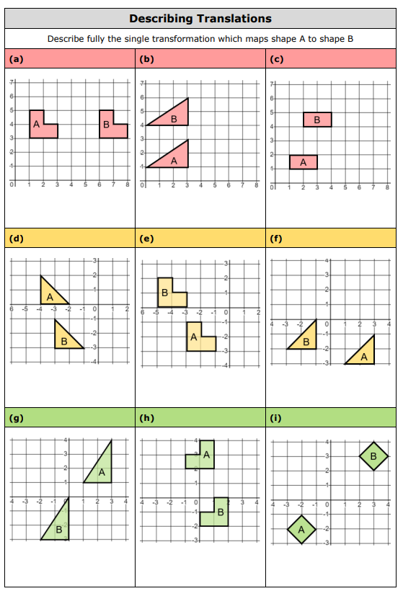
Describing Translations (Page 6)

Slide 20
Reflection
We can describe a transformation by giving clear instructions for it.
Reflection can be pictured as ‘flipping’ a shape over a mirror line.
Notes:
Ensure pupils are happy with equations of vertical and horizontal lines, $y=x$ and $y=−x$ before you start reflection.
The best way to model this is under a visualiser with tracing paper. Trace the shape and the line. Fold the paper along the line. Fold the shape up and over until it touches the page and you see the reflection.
The next few slides use automatic transition to mimic a reflection.

Slide 21
Reflection
We can describe a transformation by giving clear instructions for it.
Reflection can be pictured as ‘flipping’ a shape over a mirror line.
original shape
image after reflection
Notes:
The best way to model this is under a visualiser with tracing paper. Trace the shape and the line. Fold the paper along the line. Fold the shape up and over until it touches the page and you see the reflection.

Slide 22
Reflection
We can draw a reflection using perpendicular distances to the mirror line.
Notes:
Make it clear how the perpendicular distance from a point to the mirror line is the same for the corresponding point on the other side.

Slide 23
Reflection
We can draw a reflection using perpendicular distances to the mirror line.
The mirror line can be drawn anywhere.
Notes:
Make it clear how the perpendicular distance from a point to the mirror line is the same for the corresponding point on the other side.

Slide 24
Reflection
We can draw a reflection using perpendicular distances to the mirror line.
The mirror line can be drawn anywhere.
Notes:
Make it clear how the perpendicular distance from a point to the mirror line is the same for the corresponding point on the other side.

Slide 25
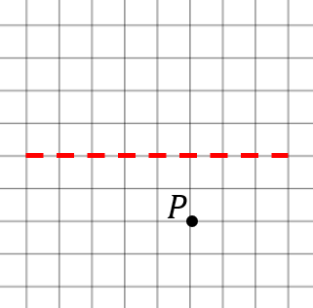
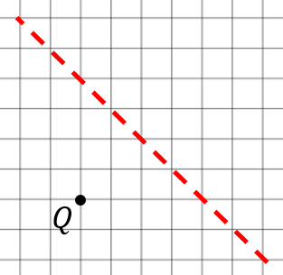
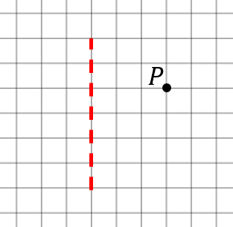
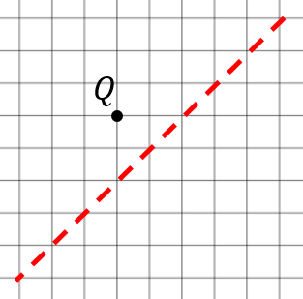


Reflection (Page 7)
My turn
Reflect points $P$ and $Q$ in the mirror lines. Label their images $P′$ and $Q′$.
Your turn
Reflect points $P$ and $Q$ in the mirror lines. Label their images $P′$ and $Q′$.
Notes:
Draw the perpendicular lines to the mirror and talk about going the same distance the other side by counting squares. With the diagonal line, make it clear how to use a ruler and the measurement lines on it to make a perpendicular, but count ‘diagonal squares’ as the distance – it’s much simpler than measuring actual distance in centimetres.

Slide 26
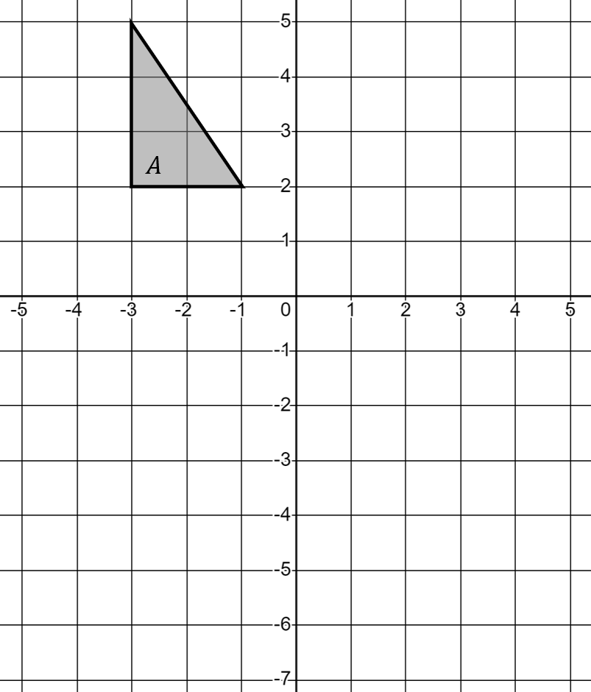
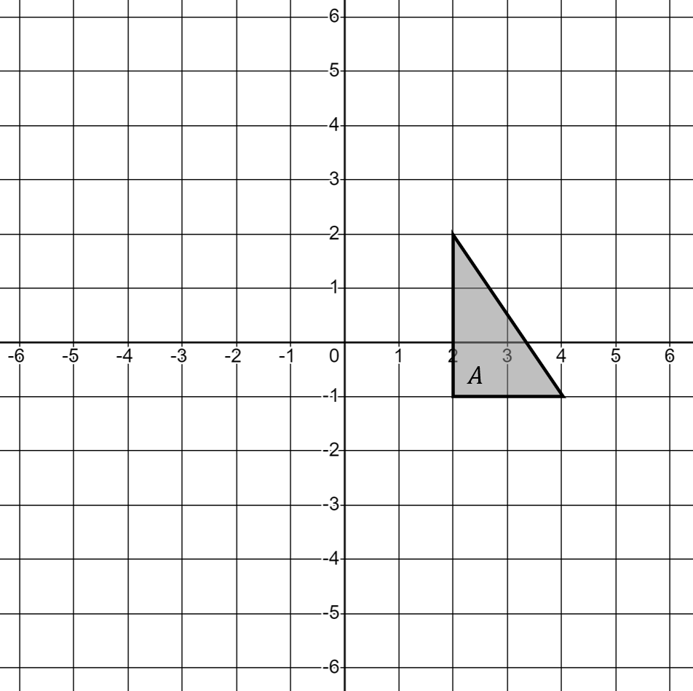


Reflection (Page 7)
Your turn
Reflect shape $A$ in the line $y=−1$. Label its image $B$.
My turn
Reflect shape $A$ in the line $x=1$. Label its image $B$.
Notes:
Now explain that we can just reflect all the vertices and join them.
If pupils struggle, use tracing paper and fold it over the mirror line.

Slide 27
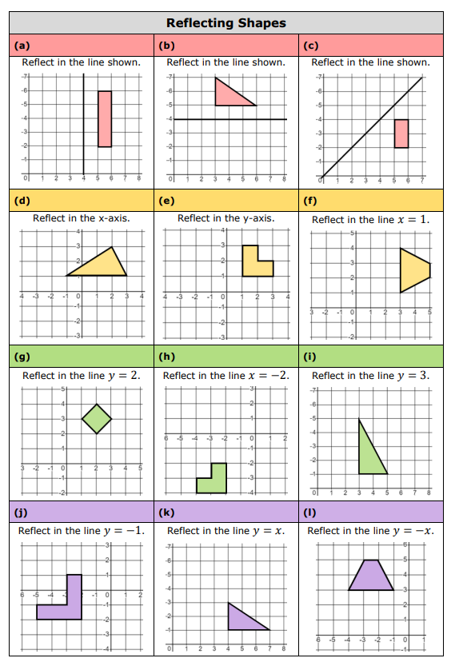
Reflecting Shapes (Page 8)

Slide 28
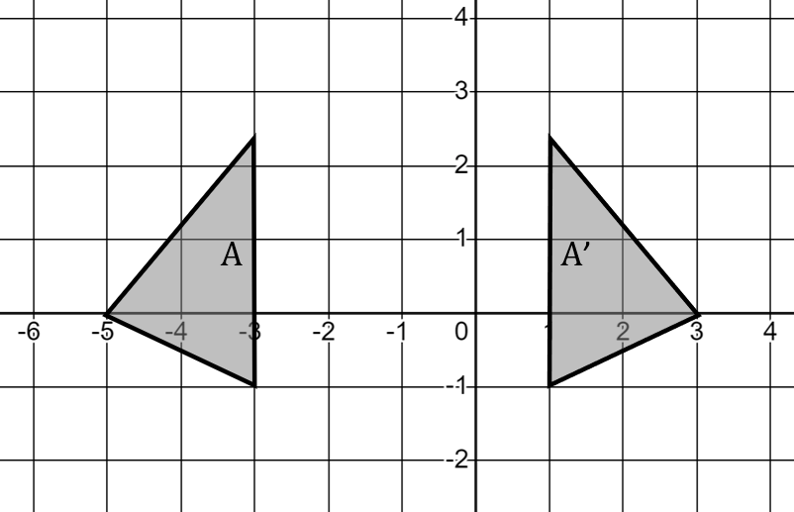




Finding the mirror line (Page 9)
If you see a reflection, you can find the mirror line by joining corresponding vertices and joining their midpoints.
$$x=−1$$
$$×$$
$$×$$
$$×$$
Notes:
‘Joining corresponding vertices’ is a standard technique to explain all transformations. We’ll keep using it in every section.

Slide 29
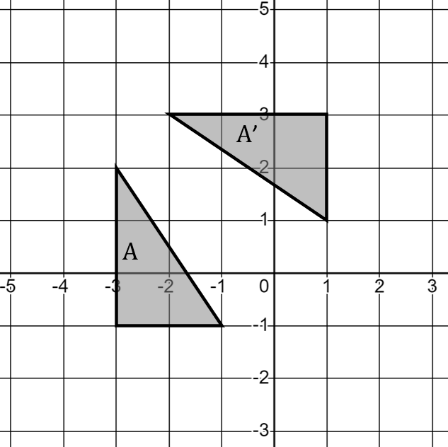
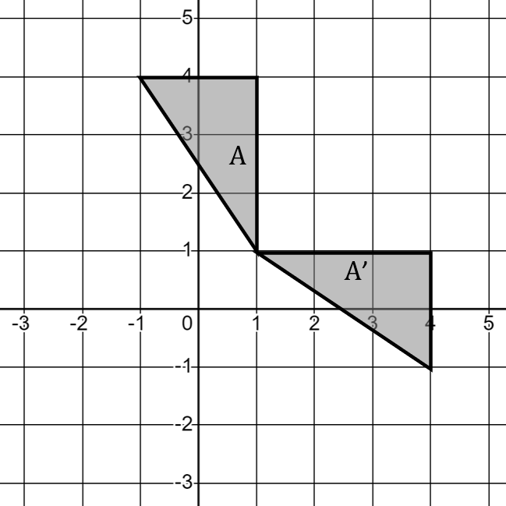
Reflection (Page 9)
Your turn
Here is a reflection. Draw the mirror line and write its equation.
My turn
Here is a reflection. Draw the mirror line and write its equation.
Notes:
Model the same way as the previous slide: join corresponding vertices and mark their midpoints, then join the midpoints.
Some pupils may not immediately know which vertices correspond – make it clear how to see this (e.g. the one at the right angle must join to the other one at the right angle, or, ‘If you folded this shape up and over, which vertices would touch on A and A’?’)

Slide 30
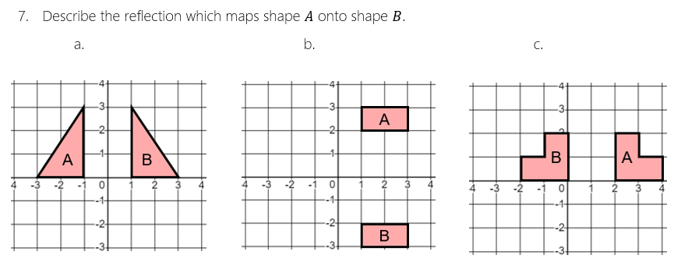
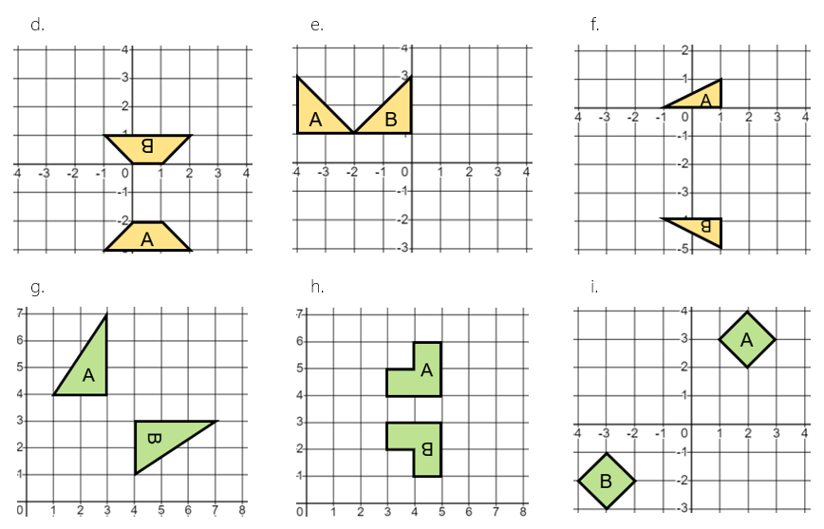
Reflection (Page 10)
Notes:
Q7 Amanda Austin (draustinmaths.com)

Slide 31

Rotation (Page 11)
We can describe a transformation by giving clear instructions for it.
Rotation can be pictured as moving in a circle around a fixed centre point.
$$×$$
Notes:
Ensure pupils are happy with equations of vertical and horizontal lines, $y=x$ and $y=−x$ before you start reflection.
The best way to model this is under a visualiser with tracing paper. Trace the shape and the line. Fold the paper along the line. Fold the shape up and over until it touches the page and you see the reflection.

Slide 32
Rotation can be pictured as moving in a circle around a fixed centre point.
$$×$$
Notes:
Ensure pupils are happy with equations of vertical and horizontal lines, $y=x$ and $y=−x$ before you start reflection.
The best way to model this is under a visualiser with tracing paper. Trace the shape and the line. Fold the paper along the line. Fold the shape up and over until it touches the page and you see the reflection.

Slide 33
Rotation can be pictured as moving in a circle around a fixed centre point.
$$×$$
Notes:
Ensure pupils are happy with equations of vertical and horizontal lines, $y=x$ and $y=−x$ before you start reflection.
The best way to model this is under a visualiser with tracing paper. Trace the shape and the line. Fold the paper along the line. Fold the shape up and over until it touches the page and you see the reflection.

Slide 34
Rotation can be pictured as moving in a circle around a fixed centre point.
$$×$$
Notes:
Ensure pupils are happy with equations of vertical and horizontal lines, $y=x$ and $y=−x$ before you start reflection.
The best way to model this is under a visualiser with tracing paper. Trace the shape and the line. Fold the paper along the line. Fold the shape up and over until it touches the page and you see the reflection.

Slide 35
To describe a rotation we require the following:
Angle of rotation
Direction of rotation
Centre of rotation

Slide 36
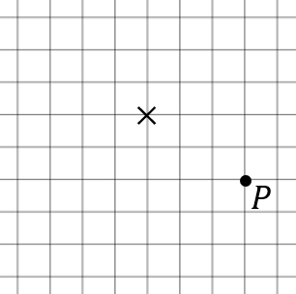
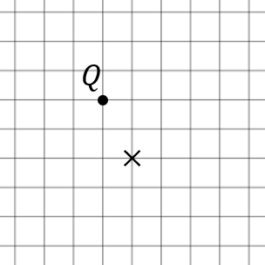


Rotation (Page 11)
Your turn
Rotate the point $Q$ around the centre marked $×$ by
90° anticlockwise,
180°.
Label its image $Q′$.
My turn
Rotate the point $P$ around the centre marked $×$ by
90° clockwise,
180°.
Label its image $P′$.
Notes:
Use lines to the centre point – draw them on the original and on the tracing paper. That way, when you rotate, you can see the angle you’re trying to make.

Slide 37
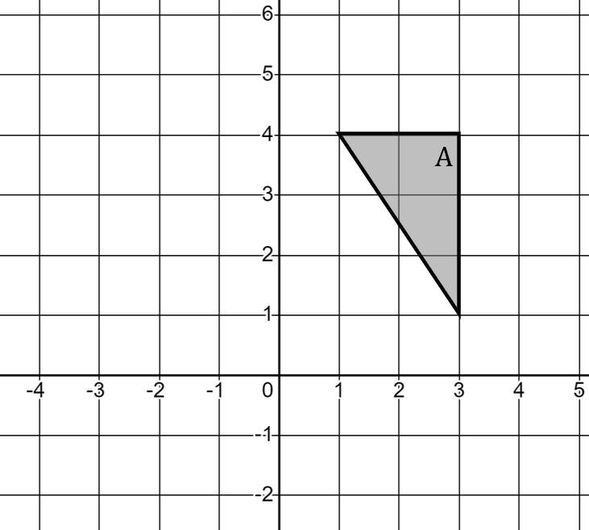
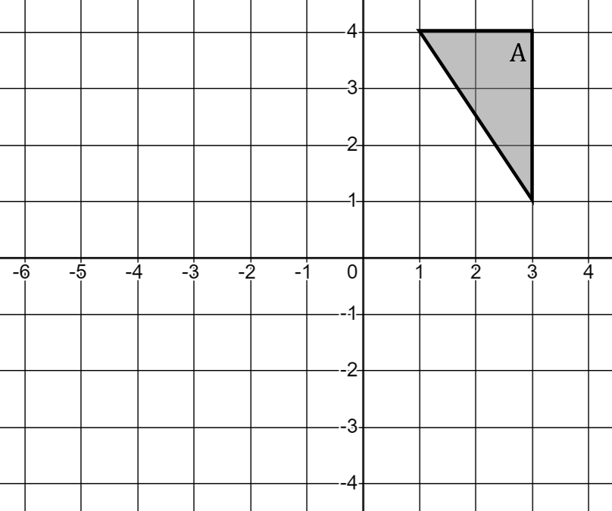


Rotation (Page 11)
My turn
Rotate triangle $A$ by 90° anticlockwise about $\left(0, 2\right)$ to obtain triangle $B$.
Your turn
Rotate triangle $A$ by 180° about $\left(−1, 1\right)$ to obtain triangle $B$.
Notes:
Use lines to the centre point – draw them on the original and on the tracing paper. That way, when you rotate, you can see the angle you’re trying to make.

Slide 38

Rotation (Page 12)

Slide 39

Discussion
What do you know about this rotation?
How do you know what you know?
Notes:
Give pupils 30s to decide what they know. They will probably come up with ‘rotation 90° anticlockwise’ but struggle to find the centre of enlargement, which leads us onto how to do that.

Slide 40

Finding the centre of rotation
If we use tracing paper, or imagine rotating $A$, we see it’s a rotation of 90° anticlockwise.
To find the centre of rotation, we have two options.
Trial and error with tracing paper.
 easy
✗ can take a while or be inaccurate
Using perpendicular bisectors
 accurate
✗ can take a while, harder to do
Notes:
We want pupils to see the ‘proper’ way to do it, but tracing paper is fine!

Slide 41

Finding the centre of rotation
To find a centre of rotation using perpendicular bisectors:
Join corresponding points and draw the perpendicular bisector of these lines.
Mark where the bisectors meet. This is the centre of rotation.
$$×$$
Notes:
Obviously, this could be quite cumbersome compared to tracing paper, so it’s absolutely fine to just pursue the tracing paper route! This is here for interest – pick carefully which classes to show it to!

Slide 42




Rotation (Page 13)
My turn
Describe the rotation from shape $A$ to shape $A′$.
Your turn
Describe the rotation from shape $B$ to shape $B′$.
Notes:
Use lines to the centre point – draw them on the original and on the tracing paper. That way, when you rotate, you can see the angle you’re trying to make.

Slide 43

Rotation (Page 14)

Slide 44
Congruent transformations (Page 15)
A transformation is a mathematical change.
When we transform a shape, we change something about it.
There are three congruent transformations we can do to shapes.
Translation
Reflection
Rotation
What do you notice about each transformation?

Slide 45


Congruent transformations (Page 15)
My turn
Rotate shape $A$ 90° clockwise about $\left(0, 1\right)$ to get shape $B$.
Reflect shape $B$ in the line $x=1$ to get shape $C$.
Translate shape $C$ by $\left(\begin{matrix}−3 \\ −1\end{matrix}\right)$ to get shape $D$.
What single transformation gets shape $D$ back to shape $A$?
Notes:
Reflection in line $y=−x$

Slide 46


Congruent transformations (Page 15)
Your turn
Translate shape $A$ by $\left(\begin{matrix}0 \\ −4\end{matrix}\right)$ to get shape $B$.
Reflect shape $B$ in the line $y=−2$ to get shape $C$.
Reflect shape $C$ in the line $x=0$ to get shape $D$.
What single transformation gets shape $A$ straight onto shape $D$?
Notes:
Rotation 180° about (0,0)

Slide 47

Congruent transformations (Page 16)
Notes:
Q2 Amanda Austin {draustinmaths.com}

Slide 48
Enlargement is a type of transformation.
It is not a congruent transformation like translation, reflection and rotation.
It is a similar transformation, since object and image are similar.
To enlarge a shape we need a SCALE FACTOR and a CENTRE of ENLARGEMENT.
Page 17

Slide 49




Identifying the scale factor (Page 17)
My Turn
What is the scale factor of the enlargement from
$A$ to $B$?
$B$ to $A$?
$A$ to $C$?
$C$ to $A$?
Your Turn
What is the scale factor of the enlargement from
$A$ to $B$?
$B$ to $A$?
$A$ to $C$?
$C$ to $A$?
Notes:
A fractional approach is consistently successful here:
A—B is $\frac{4}{2}=2$
B—A is $\frac{2}{4}=\frac{1}{2}$
A—C is $\frac{3}{2}$ ($=1.5$, but emphasise that fractions are good!)
C—A is $\frac{2}{3}$ ($=0.\dot{6}$, and a good example of why fractions are good!)
For the Your Turn we have 3, $\frac{1}{3}$, $\frac{5}{2}$ and $\frac{2}{5}$.

Slide 50







A scale factor controls the size of an enlarged image.
A centre of enlargement controls the position of an enlarged image.
3
6
Scale factor is 2, so we multiply all distances by 2.
$$×$$
$−$2
Let’s enlarge triangle $A$ by scale factor 2, from the centre marked $×$.
$−$4
$$A$$
$$\left(\begin{matrix}3 \\ −2\end{matrix}\right)×2=\left(\begin{matrix}6 \\ −4\end{matrix}\right)$$
Notes:
Bear in mind here that this demo tries to show the process clearly, but lots of pupils can do many of these steps in their head, so we don’t always need them to write everything out.

Slide 51





A scale factor controls the size of an enlarged image.
A centre of enlargement controls the position of an enlarged image.
3
6
Scale factor is 2, so we multiply all distances by 2.
$$×$$
Let’s enlarge triangle $A$ by scale factor 2, from the centre marked $×$.
$−$4
$−$8
$$A$$
$$\left(\begin{matrix}3 \\ −4\end{matrix}\right)×2=\left(\begin{matrix}6 \\ −8\end{matrix}\right)$$

Slide 52






A scale factor controls the size of an enlarged image.
A centre of enlargement controls the position of an enlarged image.
6
12
Scale factor is 2, so we multiply all distances by 2.
$$×$$
Let’s enlarge triangle $A$ by scale factor 2, from the centre marked $×$.
$−$4
$−$8
$$A$$
$$A′$$
$$\left(\begin{matrix}6 \\ −4\end{matrix}\right)×2=\left(\begin{matrix}12 \\ −8\end{matrix}\right)$$

Slide 53






Page 18
Enlarge by scale factor 3 from $×$
Enlarge by scale factor $\frac{1}{2}$ from $×$
$$×$$
$$B$$
$$×$$
$$A$$

Slide 54

Enlargement Page 19
Notes:
Q7 Amanda Austin (draustinmaths.com)
Q8/9/10 CIMT

Slide 55


Finding the centre of enlargement
To find the centre of an enlargement, draw rays that join corresponding vertices on a shape and its image. The rays meet at the centre.
Centre $\left(3, −5\right)$
Notes:
We revisit a central theme again – to describe any transformation, we can start by joining corresponding vertices.

Slide 56




Describing an enlargement (Page 20)
Your Turn
Describe the enlargement from
a. $B$ to $A$,
b. $A$ to $B$.
My Turn
Describe the enlargement from
a. $B$ to $A$,
b. $A$ to $B$.
Notes:
Emphasise that for parts (a) and (b), the centre doesn’t change, only the scale factor.

Slide 57

Enlargement (Page 21)
Notes:
(draustinmaths.com)

Slide 58
We have seen that
scale factors above 1 make image bigger than object
scale factors between 0 and 1 make image smaller than object.
What about negative scale factors?

Slide 59







A negative scale factor makes you enlarge in the opposite direction.
Scale factor is $−$2, so we multiply all distances by $−$2.
Let’s enlarge triangle $A$ by scale factor $−$2, from the centre marked $×$.
4
$−$6
$$×$$
3
$−$2
$$A$$
$$\left(\begin{matrix}3 \\ −2\end{matrix}\right)×−2=\left(\begin{matrix}−6 \\ 4\end{matrix}\right)$$

Slide 60





A negative scale factor makes you enlarge in the opposite direction.
Scale factor is $−$2, so we multiply all distances by $−$2.
Let’s enlarge triangle $A$ by scale factor $−$2, from the centre marked $×$.
8
$−$6
$$×$$
3
$−$4
$$A$$
$$\left(\begin{matrix}3 \\ −4\end{matrix}\right)×−2=\left(\begin{matrix}−6 \\ 8\end{matrix}\right)$$

Slide 61






A negative scale factor makes you enlarge in the opposite direction.
$A$’
Scale factor is $−$2, so we multiply all distances by $−$2.
Let’s enlarge triangle $A$ by scale factor $−$2, from the centre marked $×$.
8
$−$12
$$×$$
6
$−$4
$$A$$
$$\left(\begin{matrix}6 \\ −4\end{matrix}\right)×−2=\left(\begin{matrix}−12 \\ 8\end{matrix}\right)$$

Slide 62






Page 22
Enlarge by scale factor $−$3 from $×$
Enlarge by scale factor $−\frac{1}{2}$ from $×$
$$×$$
$$A$$
$$×$$
$$B$$

Slide 63




Negative scale factors (Page 22)
My Turn
Enlarge shape $A$ by scale factor $−$2, centre $\left(1, 1\right)$.
Your Turn
Enlarge shape $A$ by scale factor $−$2, centre $\left(0, 2\right)$.

Slide 64


Describing an enlargement (Page 23)
My Turn
Describe the enlargement from
a. $B$ to $A$,
b. $A$ to $B$.
Your Turn
Describe the enlargement from
a. $B$ to $A$,
b. $A$ to $B$.
Notes:
Emphasise that for parts (a) and (b), the centre doesn’t change, only the scale factor.
We’re still joining corresponding vertices, just be very clear which are corresponding.

Slide 65

Page 24

Slide 66







Page 25
Congruent
Similar
Translation
Reflection
Rotation
Enlargement
$$y$$
$$y$$
$$y$$
$$y$$
$$x$$
$$x$$
$$x$$
$$x$$
Described by:
Vector
$$\left(\begin{matrix}5 \\ −2\end{matrix}\right)$$
Equation of mirror line
$$x=−1$$
Angle and centre
90° clockwise about $\left(0, −1\right)$
Scale factor and centre
s.f. 2 about $\left(0, −1\right)$
Notes:
Explain that now we practise differentiating between all four.

Slide 67

Page 26

Slide 68



I do (Page 27)
Transform Shape A to create an image:
Reflect in $y=−1$
Then, transform that image:
Translate using vector $\left( {1 \atop 4} \right)$
A

Slide 69

Transform Shape A to create an image:
Reflect in $y=−1$
Then, transform that image:
Translate using vector $\left( {1 \atop 4} \right)$
$$y=−1$$
A

Slide 70

We do (Page 27)
In order, apply these transformations to Shape C.
Rotate 90° clockwise about (0, 0)
Translate using vector $\left( {2 \atop 3} \right)$
C
Does it matter the order we apply
the transformations?

Slide 71
In order, apply these transformations to Shape C.
Rotate 90° clockwise about (0, 0)
Translate using vector $\left( {2 \atop 3} \right)$
C
Does it matter the order we apply
the transformations?

Slide 72











Shape S is translated by the vector $\left(\begin{matrix}1 \\ −2 \end{matrix}\right)$.
This new shape is translated by $\left( \begin{matrix}3 \\ 1\end{matrix}\right)$.
Reflect G in the line $x=6$.
Translate the image using the vector $\left( \begin{matrix}−5 \\ 1\end{matrix}\right).$
Page 28
$$y$$
$$y$$
What vector
maps S to
the final shape?
6
5
5
4
4
3
S
3
2
2
1
G
1
0
$$x$$
0
$$x$$
①
0
1
2
3
4
5
6
7
8
②
0
1
2
3
4
5
6
7
8
9
10
Rotate T 180° about (5, 2).
Reflect the image in the line $y=x$.
Enlarge W using
scale factor 2 and centre (2, 0), then rotate that
image 90° anticlockwise about (7, 6).
$$y$$
$$y$$
6
6
5
5
4
4
3
3
W
2
T
2
1
1
0
$$x$$
0
$$x$$
③
0
1
2
3
4
5
6
7
8
9
10
④
0
1
2
3
4
5
6
7
8
9
10

Slide 73



Shape S is translated by the vector $\left(\begin{matrix}1 \\ −2 \end{matrix}\right)$.
This new shape is translated by $\left( \begin{matrix}3 \\ 1\end{matrix}\right)$.
On a copy of this grid, reflect G in the line $x=6$.
Translate the image using the vector $\left( \begin{matrix}−5 \\ 1\end{matrix}\right).$
$$y$$
$$y$$
What vector
maps S to
the final shape?
6
5
5
4
4
$$\left(\begin{matrix}4 \\ −1 \end{matrix}\right)$$
3
S
3
2
2
1
G
1
0
$$x$$
0
$$x$$
①
0
1
2
3
4
5
6
7
8
②
0
1
2
3
4
5
6
7
8
9
10
On a copy of this grid, rotate T 180° about (5, 2).
Reflect the image in the line $y=x$.
On a copy of this grid, enlarge W using
scale factor 2 and centre (2, 0), then rotate that
image 90° anticlockwise about (7, 6).
$$y$$
$$y$$
6
6
5
5
4
4
3
3
W
2
T
2
1
1
0
$$x$$
0
$$x$$
③
0
1
2
3
4
5
6
7
8
9
10
④
0
1
2
3
4
5
6
7
8
9
10

Slide 74

EXAM QUESTION (Page 28)

Slide 75





Page 29
A)
B)
1) Translate by
the vector $\left( {−7 \atop −4} \right)$
2) Translate by
the vector $\left( {8 \atop −4} \right)$
1) Rotate 90° clockwise
about the origin.
2) Translate by
the vector $\left( {0 \atop 4} \right)$
Describe as
a single transformation:
Describe as
a single transformation:
C)
D)
1) Rotate 180°
about the origin.
2) Reflect in the line $y=0$
1) Reflect in
the line $x=−1$
2) Reflect in
the line $y=−1$
Describe as
a single transformation:
Describe as
a single transformation:

Slide 76




Combining Transformations
②
Page 29
E)
F)
1) Rotate 180°
about (1, 0).
2) Translate by
the vector $\left( {−2 \atop 4} \right)$
1) Reflect in the line $y=x$
2) Reflect in the line $x=−1$
Describe as
a single transformation:
Describe as
a single transformation:
G)
H)
1) Reflect in the line $y=−x$
2) Reflect in the line $x=−1$
1) Reflect in the line $y=x$
2) Rotate 180°
about the origin.
Describe as
a single transformation:
Describe as
a single transformation:

Slide 77


Combining Transformations
①
A)
B)
1) Translate by
the vector $\left( {−7 \atop −4} \right)$
2) Translate by
the vector $\left( {8 \atop −4} \right)$
1) Rotate 90° clockwise
about the origin.
2) Translate by
the vector $\left( {0 \atop 4} \right)$
Describe as
a single transformation:
Describe as
a single transformation:
Translated by
the vector $\left( {1 \atop −8} \right)$
Rotated 90° clockwise
about (2, 2)
C)
D)
1) Rotate 180°
about the origin.
2) Reflect in the line $y=0$
1) Reflect in
the line $x=−1$
2) Reflect in
the line $y=−1$
Describe as
a single transformation:
Describe as
a single transformation:
Rotated 180°
about (−1, −1)
Reflected in the line $x=0$

Slide 78

Combining Transformations
②
A)
B)
1) Rotate 180°
about (1, 0).
2) Translate by
the vector $\left( {−2 \atop 4} \right)$
1) Reflect in the line $y=x$
2) Reflect in the line $x=−1$
Describe as
a single transformation:
Describe as
a single transformation:
Rotated 180°
about (0, 2)
Rotated 90° anticlockwise
about (−1, −1)
C)
D)
1) Reflect in the line $y=−x$
2) Reflect in the line $x=−1$
1) Reflect in the line $y=x$
2) Rotate 180°
about the origin.
Describe as
a single transformation:
Describe as
a single transformation:
Rotated 90° anticlockwise
about (−1, 1)
Reflected in the
line $y=−x$

Slide 79


EXAM QUESTION (Page 30 & 31)

Slide 80
If we rotate Triangle C 180° about point (−2, 1),
what changes & what stays the same?
This vertex does not change:
it is an invariant point.
C

Slide 81

If we translate Triangle D using the vector $\left( {6 \atop 7} \right)$,
what changes & what stays the same?
D
There are no invariant points with this transformation.

Slide 82

If we reflect Shape E in the line $x=2$,
are there any invariant points?
(2, 2) & (2, 3)
E
Invariant points do not need to be vertices. They can be on any side but are not within a shape.

Slide 83

If we reflect Shape F in the line $y=x$,
are there any invariant points?
F
(0, 0) & (3, 3)
Invariant points do not need to be vertices. They can be on any side but are not within a shape.

Slide 84

Page 32

Slide 85

If we reflect Triangle A in the $y$-axis,
what changes & what stays the same?
A
This vertex does not change:
it is an invariant point.

Slide 86



State the invariant point (if any) with these transformations. Plot the transformation to check.
Page 33
1)
2)
B
A
B
(2, 1)
C
A
C
(4, 1)
Triangle ABC reflected in the line $y=1$
Triangle ABC rotated 90° clockwise about point (2,1)
3)
4)
(3, −6)
B
B
A
C
C
A
Triangle ABC translated by the vector $\left( {−3 \atop 0} \right)$
Triangle ABC enlarged by a scale factor 2,
centre of enlargement (3, −6).

Slide 87
True or False?
Page 33
There will always be an invariant point when you rotate a shape around a vertex.
If you reflect a shape in the $x$-axis there will always be an invariant point.
A translated shape will never have an invariant point.
There will always be an invariant point when we enlarge a shape using
an external centre of enlargement.
A shape reflected in the line $y=x$ will never have an invariant point.
A shape rotated around an external point will never have an invariant point.
A polygon reflected in one of its sides will always have exactly two invariant points.

Slide 88


True or False?
Page 33
There will always be an invariant point when you rotate a shape around a vertex.
If you reflect a shape in the $x$-axis there will always be an invariant point.
A translated shape will never have an invariant point.
There will always be an invariant point when we enlarge a shape using
an external centre of enlargement.
A shape reflected in the line $y=x$ will never have an invariant point.
A shape rotated around an external point will never have an invariant point.
A polygon reflected in one of its sides will always have exactly two invariant points.
2 or more

Slide 89






a)
b)
Invariant Points
c)
d)
Page 34
B
B
C
A
B
B
C
A
D
C
A
D
C
D
A
Square ABCD is translated
by the vector $\left( {−5 \atop 4} \right)$
Invariant points: (4,5)
Triangle ABC is reflected in
the $y$-axis.
Invariant points: C (0, −2)
Square ABCD is enlarged by
scale factor 2,
centre of enlargement (−1,−2).
Invariant points: A (−1, −2)
Square ABCD is rotated
180° about (2,0)
Invariant points: A (2,0)
e)
f)
g)
B
h)
B
B
B
C
A
A
A
C
C
A
D
D
C
Square ABCD is reflected in
the line $y=x$
Invariant points: A & C (1,1), (−2,−2)
Shape ABCD is reflected in
the line $x=1$
Invariant points: D (1, −2)
Triangle ABC is rotated
90° clockwise about (−1, −1),
then translated by the vector $\left( {−3 \atop 1} \right)$
Invariant points: A (−2,1)
Triangle ABC is enlarged by
scale factor −2,
centre of enlargement (−1,2).
Invariant points: C (−1,2)

Slide 90





a)
b)
Invariant Points
c)
d)
Page 34
B
B
C
A
B
B
C
A
D
C
A
D
C
D
A
Square ABCD is translated
by the vector $\left( {−5 \atop 4} \right)$
Invariant points: None
Triangle ABC is reflected in
the $y$-axis.
Invariant points: C (0, −2)
Square ABCD is enlarged by
scale factor 2,
centre of enlargement (−1,−2).
Invariant points: A (−1, −2)
Square ABCD is rotated
180° about (2,0)
Invariant points: A (2,0)
e)
f)
g)
B
h)
B
B
B
C
A
A
A
C
C
A
D
D
C
Square ABCD is reflected in
the line $y=x$
Invariant points: A & C (1,1), (−2,−2)
Shape ABCD is reflected in
the line $x=1$
Invariant points: D (1, −2)
Triangle ABC is rotated
90° clockwise about (−1, −1),
then translated by the vector $\left( {−3 \atop 1} \right)$
Invariant points: A (−2,1)
Triangle ABC is enlarged by
scale factor −2,
centre of enlargement (−1,2).
Invariant points: C (−1,2)

Slide 91

EXAM QUESTION (Page 34)

