Slide 1















Dual coding symbols:
Practise
Explain
Organise
Big Question
Reflect
Present
Compare
Evaluate
Activate
Discuss
Predict
Connect
Summarise
Recall
Vocabulary

Slide 2








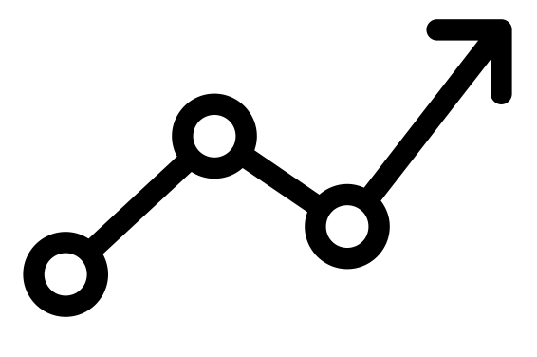

Editable reading ruler
Every child in an Archway school will become a fluent reader
 | RETRIEVE the words or phrases you need from the text | DECODE the words or phrase to address a breakdown | CONNECT with words or phrases you know from the text or your memory | VISUALISE the images in as much detail as possible | SUMMARISE the main ideas of the text in a few words | INFER meanings that might be within the text | PREDICT what might happen next using details from the text | EXAMINE how the writer uses words to construct meaning
 | ASK THOUGHTFUL QUESTIONS TO HELP YOU UNDERSTAND THE TEXT

Slide 3





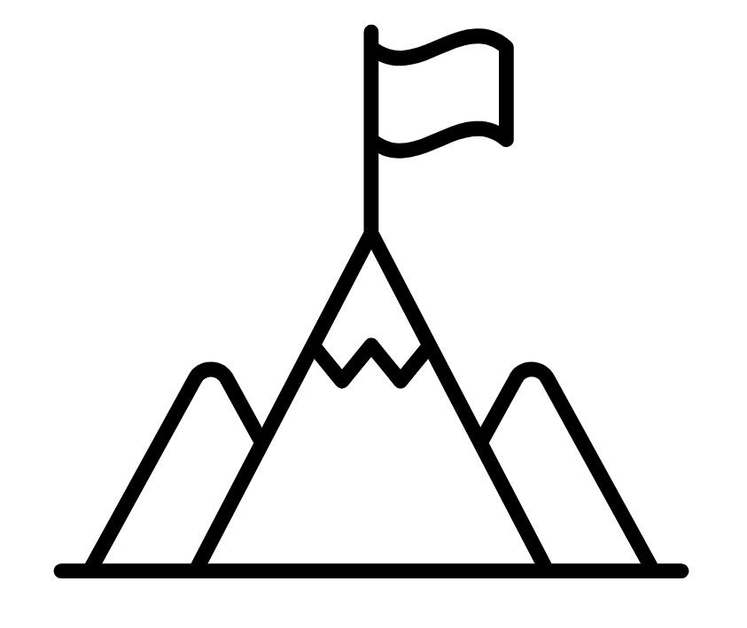
A
B

Slide 4
LESSON TITLE:

Slide 5

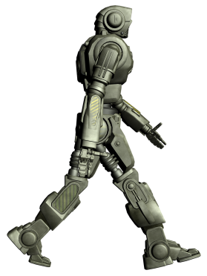
The robot moves along the lines.
It can only move two units
horizontally or vertically at a time.
How many moves to get to the portal?

Slide 6
The robot moves along the lines.
It can only move two units
horizontally or vertically at a time.
How many moves to get to the portal?
How can we describe the total movement?

Slide 7
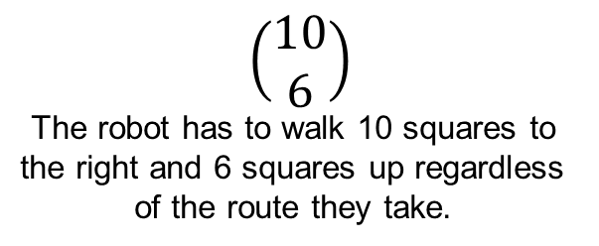
$$\left(\begin{matrix}10 \\ 6\end{matrix}\right)$$
The robot has to walk 10 squares to
the right and 6 squares up regardless
of the route they take.
How can we describe the total movement?

Slide 8
$$\left(\begin{matrix}10 \\ 6\end{matrix}\right)$$
The robot has to walk 10 squares to
the right and 6 squares up regardless
of the route they take.
6 Vertical + 10 Horizontal
How can we describe the total movement?

Slide 9






Key vocabulary:
Decode the word
Definition
.
Magnitude
Examples
Non-examples

Slide 10
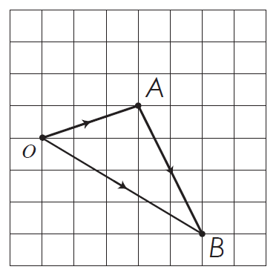




$$Vector Notation$$
$$a$$
What is $\vec{OA}?$
$$b$$
What is $\vec{OB}?$
Notes:
Example

Slide 11


$\vec{OA}=\left(\begin{matrix}3 \\ 1\end{matrix}\right)$ and $\vec{AB}=\left(\begin{matrix}2 \\ −4\end{matrix}\right)$
What is $\vec{OB}?$
Notes:
Example

Slide 12

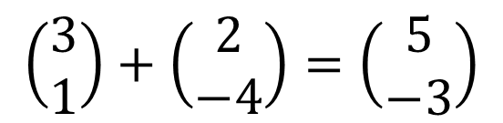
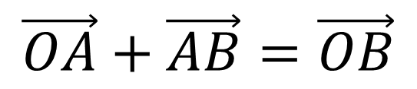
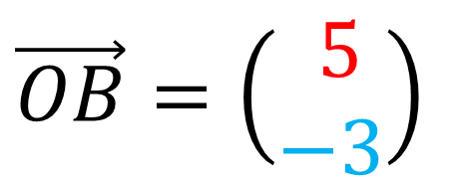
$\vec{OA}=\left(\begin{matrix}3 \\ 1\end{matrix}\right)$ and $\vec{AB}=\left(\begin{matrix}2 \\ −4\end{matrix}\right)$
$\vec{OB}=\left(\begin{matrix} 5 \\ −3\end{matrix}\right)$
$$\vec{OA}+\vec{AB}=\vec{OB}$$
$$\left(\begin{matrix}3 \\ 1\end{matrix}\right)+\left(\begin{matrix}2 \\ −4\end{matrix}\right)=\left(\begin{matrix}5 \\ −3\end{matrix}\right)$$

Slide 13



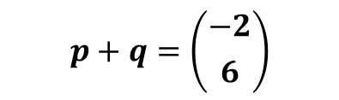


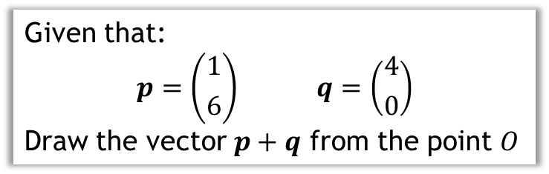
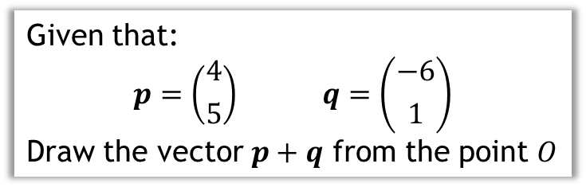
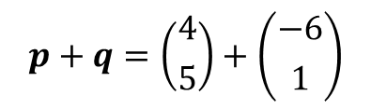

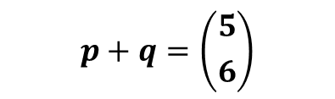


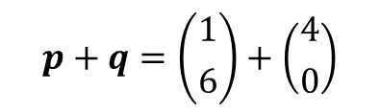
Given that:
$$p=\left({1 \atop 6}\right) q=\left({4 \atop 0}\right)$$
Draw the vector $p+q$ from the point $O$
Given that:
$$p=\left({4 \atop 5}\right) q=\left({−6 \atop 1}\right)$$
Draw the vector $p+q$ from the point $O$
$$q$$
$$q$$
$$p$$
$$p+q$$
$$p+q$$
$$p$$
Reveal
$$O$$
$$O$$
$$p+q=\left({1 \atop 6}\right)+\left({4 \atop 0}\right)$$
$$p+q=\left({4 \atop 5}\right)+\left({−6 \atop 1}\right)$$
$$p+q=\left({5 \atop 6}\right)$$
$$p+q=\left({−2 \atop 6}\right)$$

Slide 14



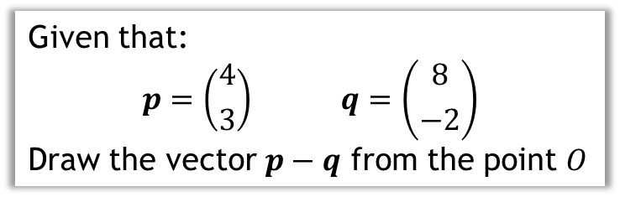
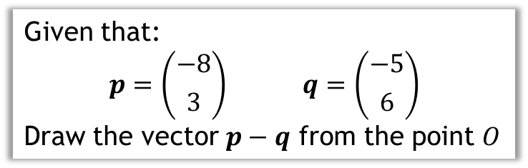

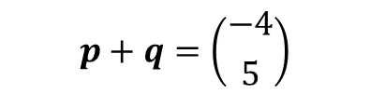

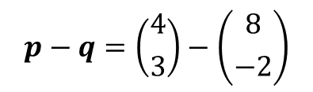
Given that:
$$p=\left({4 \atop 3}\right) q=\left({8 \atop −2}\right)$$
Draw the vector $p−q$ from the point $O$
Given that:
$$p=\left({−8 \atop 3}\right) q=\left({−5 \atop 6}\right)$$
Draw the vector $p−q$ from the point $O$
$$−q=\left({−8 \atop 2}\right)$$
$$−q$$
$$p−q$$
$$p$$
$$O$$
$$p−q=\left({4 \atop 3}\right)−\left({8 \atop −2}\right)$$
$$p+q=\left({−4 \atop 5}\right)$$

Slide 15
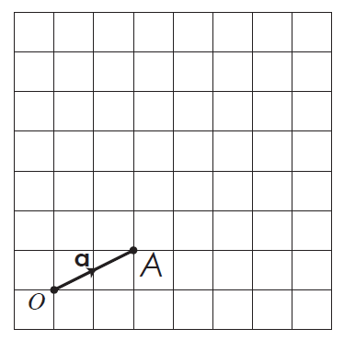


$$\vec{OA}=\left(\begin{matrix}2 \\ 1\end{matrix}\right)$$
What is $3\vec{OA}?$

Slide 16
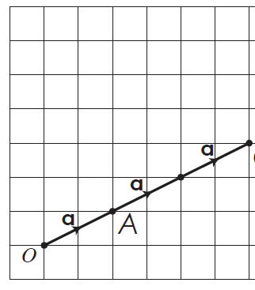

$$\vec{OA}=\left(\begin{matrix}2 \\ 1\end{matrix}\right)$$
$$3\vec{OA}=3\left(\begin{matrix}2 \\ 1\end{matrix}\right)=\left(\begin{matrix}6 \\ 3\end{matrix}\right)$$

Slide 17
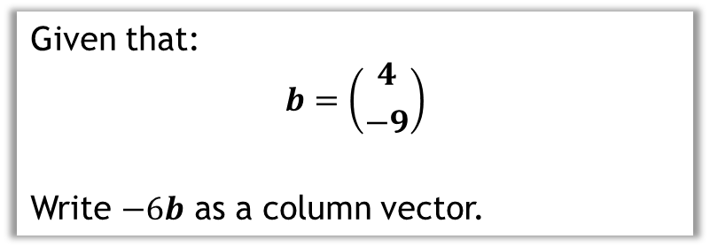
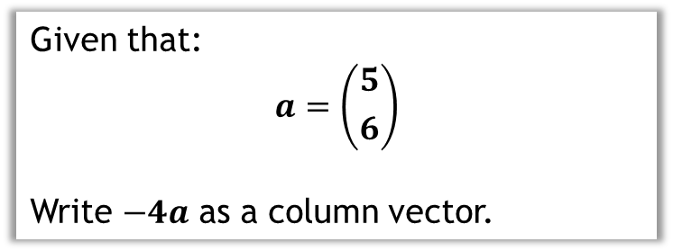
Given that:
$$a=\left({5 \atop 6}\right)$$
Write $−4a$ as a column vector.
Given that:
$$b=\left({4 \atop −9}\right)$$
Write $−6b$ as a column vector.

Slide 18


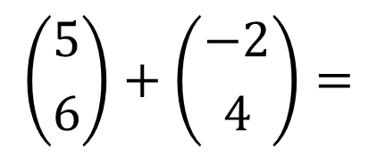

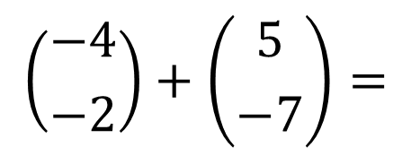
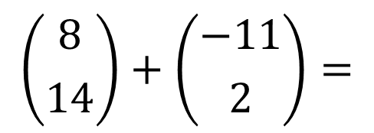

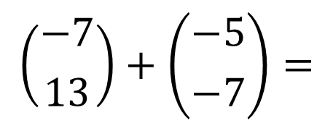

Add these column vectors together:
a
b
$$\left({5 \atop 6}\right)+\left({−2 \atop 4}\right)=$$
$$\left({3 \atop 10}\right)$$
$$\left({−7 \atop 13}\right)+\left({−5 \atop −7}\right)=$$
$$\left({−12 \atop 6}\right)$$
?
?
c
d
$$\left({8 \atop 14}\right)+\left({−11 \atop 2}\right)=$$
$$\left({−3 \atop 16}\right)$$
?
$$\left({−4 \atop −2}\right)+\left({5 \atop −7}\right)=$$
$$\left({1 \atop −9}\right)$$
?
Notes:
Quickfire questions to be completed on mini whiteboards or in exercise books

Slide 19

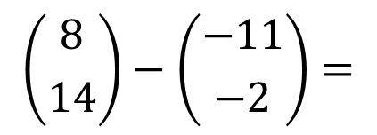

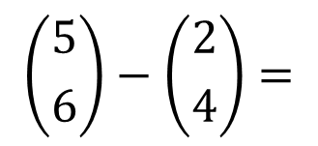

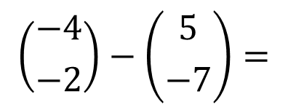
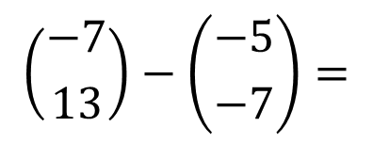

Subtracting column vectors is the same as subtracting the corresponding components.
Subtract these column vectors:
a
b
$$\left({5 \atop 6}\right)−\left({2 \atop 4}\right)=$$
$$\left({3 \atop 2}\right)$$
$$\left({8 \atop 14}\right)−\left({−11 \atop −2}\right)=$$
?
?
$$\left({19 \atop 16}\right)$$
c
d
$$\left({−7 \atop 13}\right)−\left({−5 \atop −7}\right)=$$
$$\left({−2 \atop 20}\right)$$
$$\left({−4 \atop −2}\right)−\left({5 \atop −7}\right)=$$
?
$$\left({−9 \atop 5}\right)$$
?

Slide 20
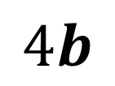

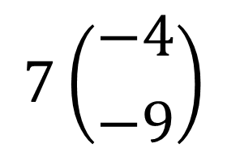

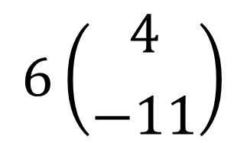


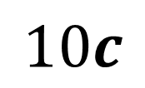
On your mini whiteboards, identify the scalar in each question below
a
b
$$6\left({4 \atop −11}\right)$$
$$7\left({−4 \atop −9}\right)$$
$6$ is the scalar
$7$ is the scalar
?
?
The scalar is the number in front of the column vector
c
d
$$4b$$
$$10c$$
$\text{4}$ is the scalar
$1\text{0}$ is the scalar
?
?

Slide 21
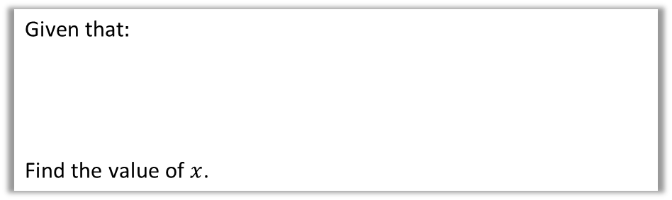
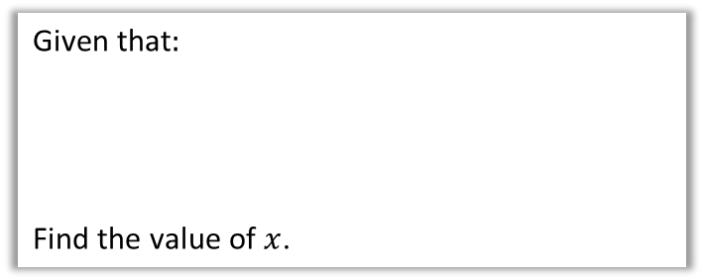
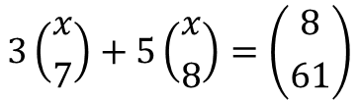
Given that$:$
Find the value of $x$.
Given that$:$
Find the value of $x$.
$$3\left({x \atop 7}\right)+5\left({x \atop 8}\right)=\left({8 \atop 61}\right)$$

Slide 22

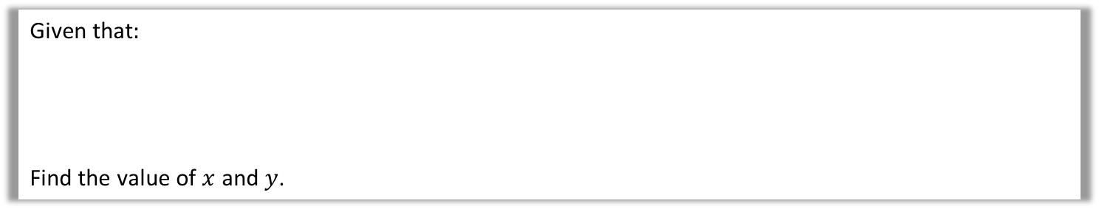

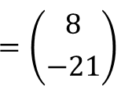

Given that$:$
Find the value of $x$ and $y$.
$$x\left({1 \atop −3}\right)$$
$$y\left({1 \atop −2}\right)$$
$$=\left({8 \atop −21}\right)$$
$$+$$

Slide 23





Given that$:$
Find the value of $y$.
$$y\left({−3 \atop −4}\right)$$
$$4\left({2 \atop 5}\right)$$
$$=\left({2 \atop 12}\right)$$
$$+$$

Slide 24






Given that$:$
Find the value of $y$.
Given that$:$
Find the value of $y$.
$$y\left({−3 \atop −4}\right)$$
$$4\left({2 \atop 5}\right)$$
$$=\left({2 \atop 12}\right)$$
$$3\left({−2 \atop y}\right)$$
$$2\left({y \atop 6}\right)$$
$$=\left({−16 \atop 3}\right)$$
$$+$$
$$−$$

Slide 25





Given that$:$
Find the value of $x$ and $y$.
$$x\left({−3 \atop 5}\right)$$
$$y\left({4 \atop −7}\right)$$
$$=\left({−25 \atop 43}\right)$$
$$+$$

Slide 26






































1
Given each of these vector equations, find the value of $x$.
$$2\left({x \atop 4}\right)$$
$$5\left({x \atop −1}\right)$$
$$=\left({−21 \atop 13}\right)$$
$$x\left({7 \atop −7}\right)$$
$$2\left({5 \atop 3}\right)$$
$$=\left({38 \atop −22}\right)$$
$$−$$
$$x=7$$
$$x=4$$
a
?
c
$$+$$
?
$$4\left({0 \atop x}\right)$$
$$3\left({x \atop −1}\right)$$
$$=\left({−9 \atop −15}\right)$$
$$x=−3$$
$$3\left({−3 \atop x}\right)$$
$$=\left({21 \atop −8}\right)$$
b
$$+$$
$$2\left({x \atop 5}\right)$$
$$x=6$$
?
d
$$−$$
?
2
Given each of these vector equations, find the value of $x$ and $y$.
$$2\left({5 \atop x}\right)$$
$$y\left({−1 \atop 2}\right)$$
$$=\left({6 \atop 2}\right)$$
$$x=−3$$
$$y=4$$
$$4\left({x \atop −2}\right)$$
$$2\left({y \atop x}\right)$$
$$+$$
?
$$=\left({12 \atop −16}\right)$$
$$x=4$$
$$y=2$$
a
c
$$−$$
?
$$4\left({x \atop y}\right)$$
$$2\left({3 \atop x}\right)$$
$$=\left({26 \atop −44}\right)$$
$$x=8$$
$$y=−7$$
$$x\left({−4 \atop 7}\right)$$
$$y\left({−7 \atop 6}\right)$$
$$=\left({−43 \atop 44}\right)$$
$$x=2$$
$$y=5$$
b
$$−$$
?
d
$$+$$
?

Slide 27



















3
[OCR GCSE (9-1) Nov 2018 6H Q20b]
$$m\left({4 \atop 1}\right)$$
$$n\left({5 \atop 2}\right)$$
$$=\left({12 \atop 6}\right)$$
$$+$$
Given that find the value of $m$ and the value of $n$.
$m=−2$, $n=4$
?
4
[OCR GCSE June 2012 3H Q16b]
$$p=\left({3 \atop −1}\right)$$
$$q=\left({−2 \atop 2}\right)$$
Vector and vector
The vector $r$ is shown on the grid.
Given that $r=jp+kq$, find the values of $j$ and $k$.
$j=3$, $k=2$
?
5
[OCR GCSE (9-1) June 2017 5H Q11c]
6
[OCR GCSE (9-1) Nov 2019 6H Q9a]
$$a=\left({2 \atop −1}\right)$$
$$b=\left({−2 \atop 1}\right)$$
$$c=\left({−12 \atop 0}\right)$$
$$a=\left({3 \atop −1}\right)$$
$$b=\left({1 \atop 3}\right)$$
Find the value of $k$ so that $k\left(a−b\right)=c$
Find the values of $k$ and $n$ so that
$$k\left(a+b\right)=\left({10 \atop n}\right)$$
$$k=−3$$
?
$k=2.5$, $n=5$
?

Slide 28

Challenge

